Slide 1
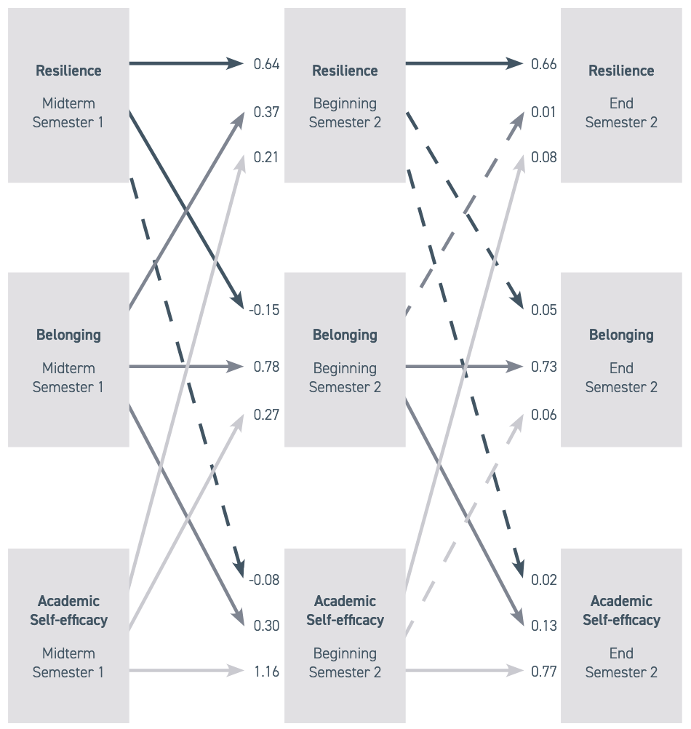
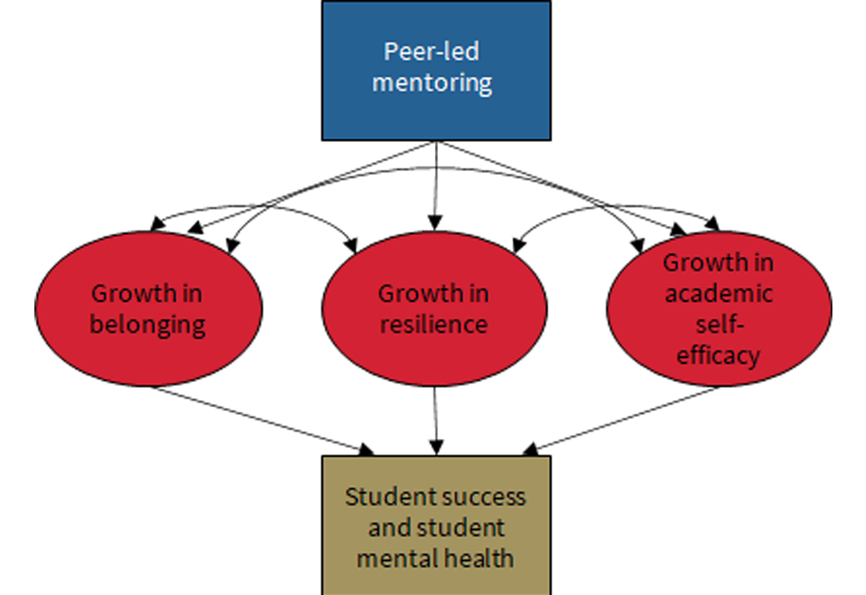
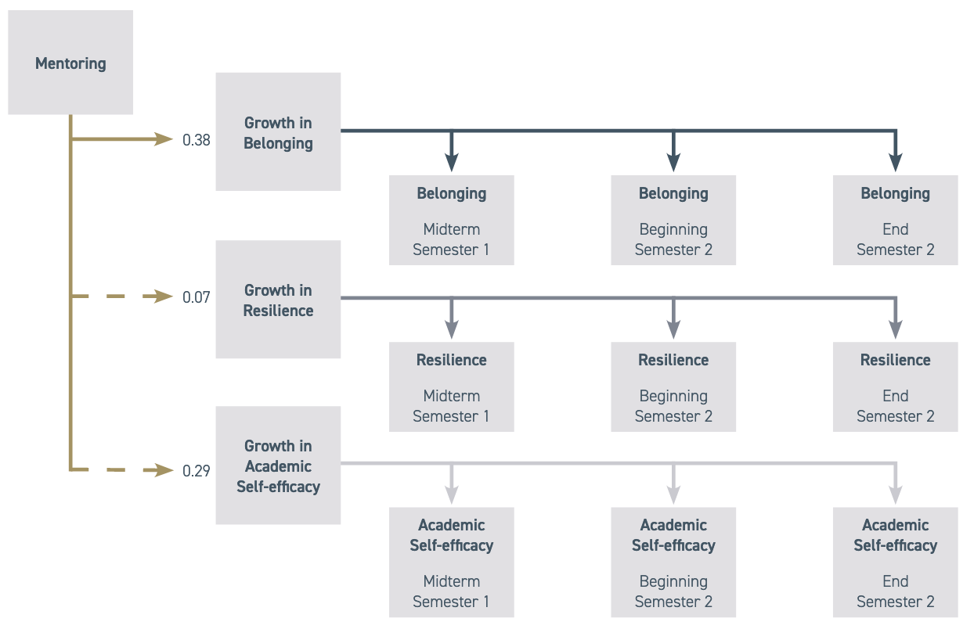



Peer-led Transition as a Catalyst for Student Mental Health and Wellbeing in 3rd Level Education
Background
Results
Recommendations
A strong standard of a scientific evidence (RCTs) shows that interventions involving peers can successfully increase belonging in students leading to improved health and academic performance with large effect sizes.
Other peer mentoring models such as SI PASS have focused on academic skills and adjustment while other interventions prioritise social networking.
No programme has yet attempted to intervene on belonging, academic self-efficacy, and wellbeing in a single model.
We already had a programme that attempted to address belonging through peer-led mentoring. We evaluated a new programme which added academic and emotional outcomes alongside the existing programme.
H1: our cross-lagged panel model found that increases in belonging, wellbeing, and academic self-efficacy are mutually associated over the transition – an increase in one causes a later increase in the other.
H2: overall, belonging decreased significantly across the transition period, but accessing mentoring had a statistically significant protective effect on belonging during the transition.
H3: the existing mentoring programme had a significant effect on belonging but no significant effect on academic self-efficacy or resilience. Among those who accessed the enhanced programme, there was no detriment in effects on belonging from the existing programme. In addition, there was a positive effect on resilience that was close to statistical significance [β=.44, std.err=.25, z=1.76, p=.08], and what appeared to be a very large positive effect on academic self-efficacy, but this did not reach statistical significance due to large standard errors, as sample size was low and variance was high in the enhanced treatment group [β=2.29, std.err=2.29, z=.97, p=.33].
Programmes to support students’ transition to higher education should address belonging, wellbeing, and academic self-efficacy.
Peer mentoring should be leveraged to support belonging, wellbeing, and academic self-efficacy for both new students and student volunteers.
Belonging, wellbeing, and academic self-efficacy are closely linked during the transition to higher education and so should be addressed together, and not in isolation.
References
Figure 1: cross-lagged panel model showing the mutual dependency of belonging, resilience, and academic self-efficacy during the student transition to higher education with standardized effects
Armstrong-Astley, R., Flynn, D., Dooley, B., Fox, T. (2022). HOW COUNSELLING AND PEER-LED SERVICES CAN OPTIMISE STUDENT SUCCESS: An integrated approach to student mental health and wellbeing in higher education. Trinity College Dublin.
Astin, A. W. (1984). Student Involvement: A Developmental Theory for Higher Education. Journal of College Student Development, 25(4), 297-308.
Brady, S. T., Cohen, G. L., Jarvis, S. N., & Walton, G. M. (2020). A brief social-belonging intervention in college improves adult outcomes for black Americans. Science advances, 6(18).
Carruthers Thomas, K. (2019). Rethinking student belonging in higher education: From Bordieu to borderlands. (1st ed.). Routledge Focus.
Kahu, E. R., & Nelson, K. (2018). Student engagement in the educational interface: understanding the mechanisms of student success., Higher Education Research & Development, 37(1), 58–71.
Kuh, G., Kinzie, J., Buckley, J. A., Bridges, B. K., & Hayek, J. C. (2006). What matters to student success: A review of the literature. National Postsecondary Education Cooperative.
Manning, K., Kinzie, J., & Schuh, J. H. (2014). One size does not fit all: Traditional and innovative models of student affairs practice. (2nd ed.). Routledge.
Murphy, M. C., Gopalan, M., Carter, E. R., Emerson, K. T., Bottoms, B. L., & Walton, G. M. (2020). A customized belonging intervention improves retention of socially disadvantaged students at a broad-access university. Science Advances, 6(29).
O’Keeffe P. (2013). A Sense of Belonging: Improving Student Retention. College Student Journal, Winter 47(4), 605–613.
Pittman, L., & Richmond, A. (2008). University Belonging, Friendship Quality, and Psychological Adjustment During the Transition to College. The Journal of Experimental Education, 76(4), 343-361.
Turetsky, K. M., Purdie-Greenaway, V., Cook, J. E., Curley, J. P., & Cohen, G. L. (2020). A psychological intervention strengthens students’ peer social networks and promotes persistence in STEM. Science advances, 6(45).
Walton, G. M., & Cohen, G. L. (2011). A brief social-belonging intervention improves academic and health outcomes of minority students. Science, 331(6023), 1447-1451.
Hypothesis
H1: wellbeing, belonging, and academic self-efficacy are strongly correlated during students’ transition to higher education.
H2: Our existing programme positively impacts belonging.
H3: Our enhanced programme positively impacts belonging, academic self-efficacy, and wellbeing for both first year students and student volunteers.
Theoretical Model
CONTACT US
Research queries to Ruairí Weiner: weinerr@tcd.ie
For information on the National Consortium for Peer-Led transition:
student2student@tcd.ie
Figure 2: growth in belonging as a function of mentoring with standardised effects

