Slide 1
Dublin City University’s Head Start Programme:
Supporting Mature Students in Re-engaging with Their Academic Career and Pathway
Alicia Menendez Tarrazo and Serge Shea
Student Learning Officers
Orla Stafford
Mature Students Officer

Slide 2
Overview
Programme objectives
Evolution 2015-2023
Key design elements
Structure, content and delivery
Student engagement and feedback
Next steps

Slide 3
Head Start Programme Objectives
Support incoming mature students in their transition to university life at DCU
Promote the development of personal and academic skills
Build community and a sense of belonging

Slide 4
Evolution of Head Start Programme
2015- 2019
2020-2021
2022-2023
In person
“Head Start Writing Week”
Focus on Motivation and Academic Writing
Fully online
Asynchronous pre-recorded video tutorials
Synchronous one-hour Zoom webinars: ‘highlights reel’ and Q&A
Hybrid
Enhanced programme
Asynchronous online interactive modules
Synchronous Writing Week: in person and online

Slide 5
Head Start Programme: Key Design Elements
Student centered
Self- directed learning
Strengths based approach
Balance between higher ed academic skills and university navigation skills
Building confidence and a sense of belonging
Blended approach
Collaborative development and design

Slide 6
Head Start Programme: Collaborative Development
Course | Subject Matter Experts
Student Learning & Academic Writing | Dr Alicia Menendez Tarrazo, Cillian Murphy, Hannah Millington and Conor Scully
Mature Student Transitions | Orla Stafford
Maths | Dr Eabhnat Ní Fhloinn, Dr Brien Nolan, Lucy Deacon and Aidan Fitzsimmons
Technology | Yvonne McGowan and DCU Teaching Enhancement Unit
Branding & Design | DCU Communications and Marketing
Video Editing | DCU Studio and DCU Communications and Marketing
Learning Technology | Yvonne McGowan and Catalyst IT Ireland Limited

Slide 7
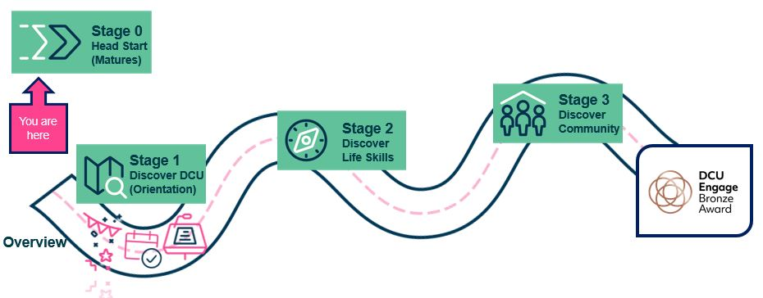
Online Modules
Available at offer stage
Delivered through our VLE (Moodle)
Part of a larger transition journey for incoming first-year students

Slide 8
Online Modules

Slide 9
Online Modules

Slide 10
Online Modules
Academic Writing

Slide 11
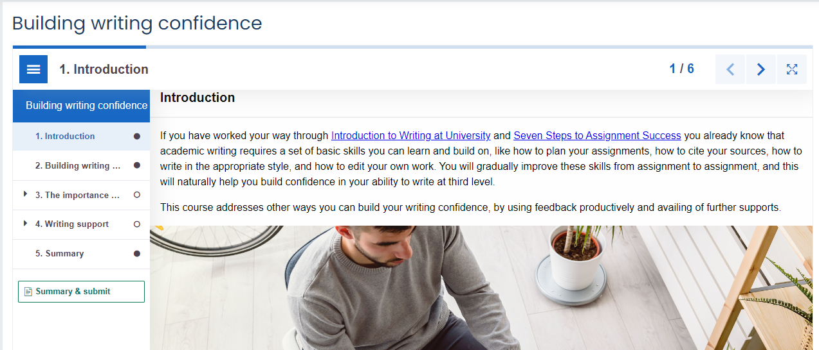
Online Modules
H5P interactive book format

Slide 12
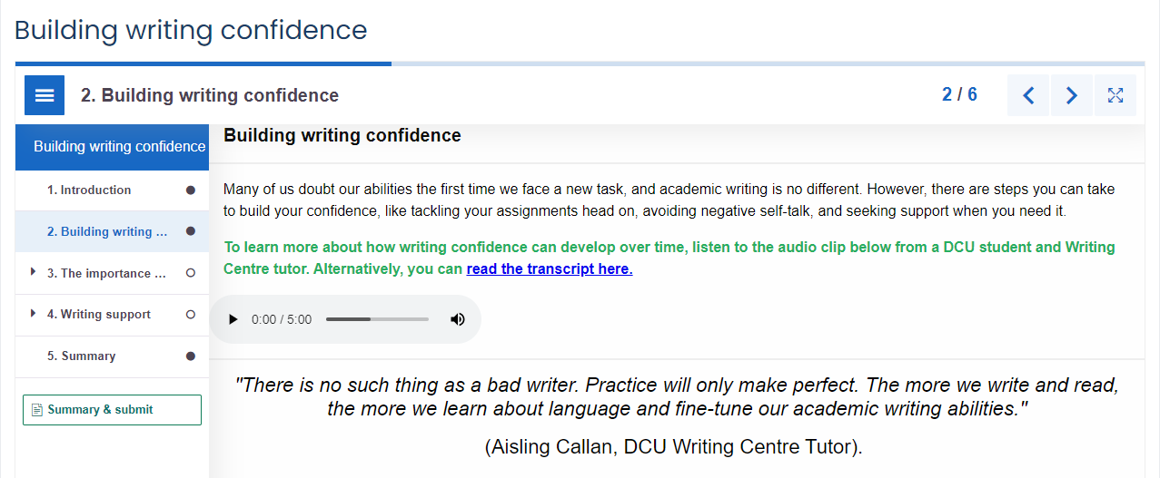
Online Modules
Multimedia resources

Slide 13
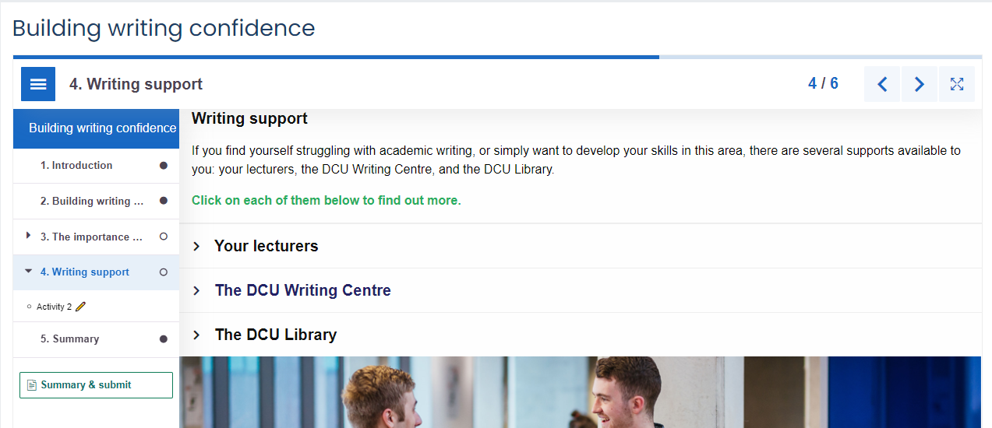
Online Modules
Signposting academic supports

Slide 14
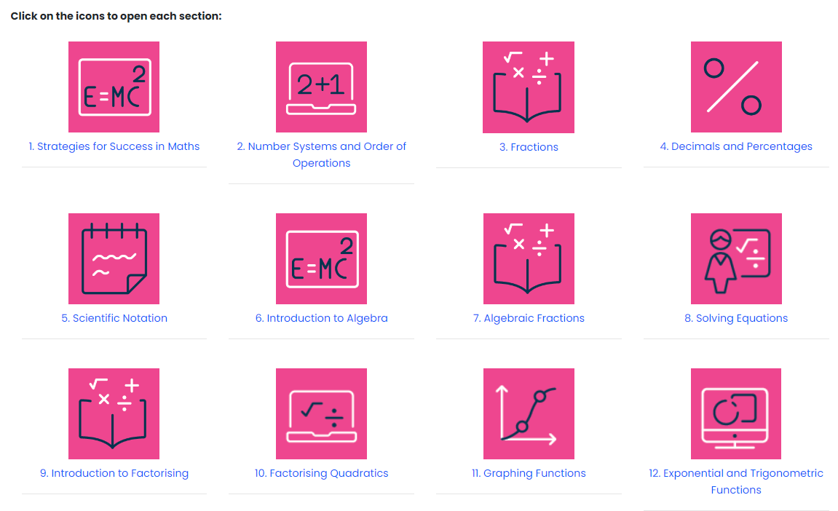
Online Modules
Maths Refresher
Developed by the Maths Learning Centre
Optional

Slide 15
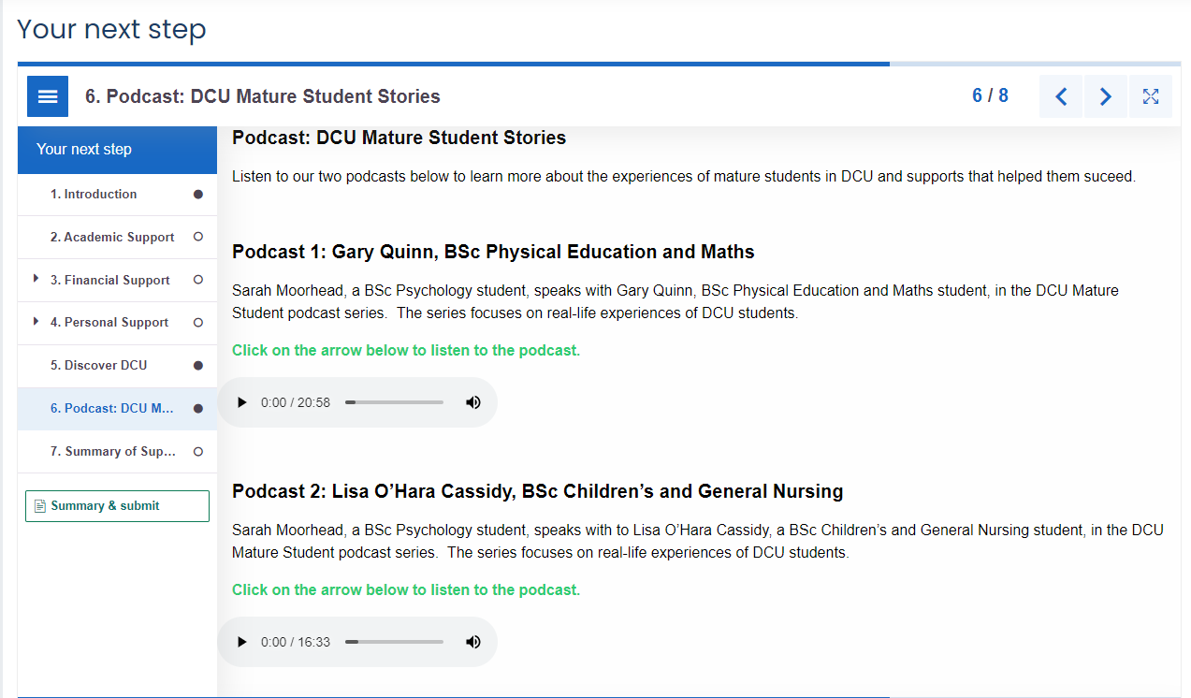
Online Modules
Summary of supports
Signpost to general orientation
Podcast: voices and experiences of fellow mature students

Slide 16
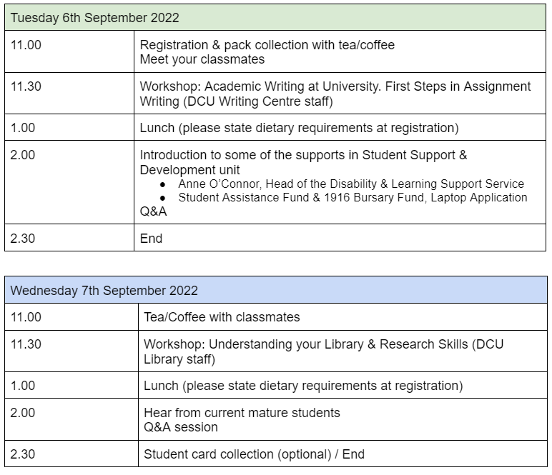
Live Event: Head Start Writing Week
Week before general orientation
Three-day programme
In person
First on-campus experience
Meet future classmates
Hear from current mature students (Ambassadors)
Meet support staff
Online
First online webinars
Exact same content as in-person
No opportunity to socialise and network

Slide 17
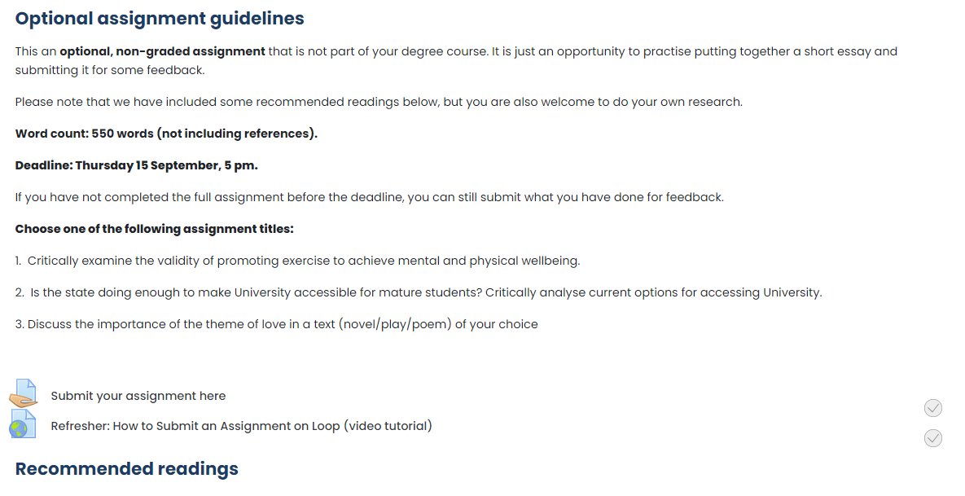
Optional Assignment

Slide 18
Student Engagement
Course | Sub-Course | Views | Unique Users | Completed
My Head Start | Remembering why you started | 679 | 141 | 102
 | You may already have the answers | 273 | 116 | 81
 | The value of mature students at DCU | 294 | 112 | 76
Learning at University | Time Management | 242 | 105 | 74
 | Research Skills | 228 | 93 | 71
 | Introduction to Critical Thinking | 221 | 100 | 70
Academic Writing | Introduction to Writing at University | 279 | 104 | 70
 | Seven steps to Assignment Success | 269 | 96 | 67
 | Building Writing Confidence | 228 | 85 | 66

Slide 19
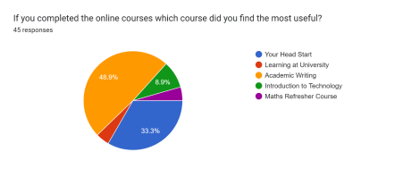
Student Feedback
Most useful online modules:
Academic Writing (49%)
Your Head Start (Motivation and Resilience) 33%

Slide 20
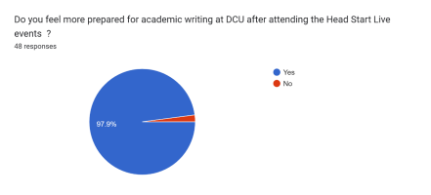
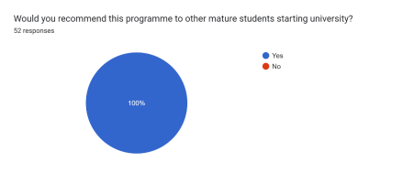
Student Feedback
98% feel more prepared for academic writing after attending the Writing Week
100% would recommend the programme to other mature students

Slide 21
Student Feedback
‘It made university seem accessible and really helped with my nerves as college was approaching, I felt very overwhelmed but head start really showed me there was help available for me every step of the way’.
‘Seeing that your thoughts/feelings were not individual and that other people experience the same stress or feelings of worry can be quite reassuring’.
‘The amount of material available for me to access and learn from was phenomenal. I used these essays to write my draft for the practice assessment and got brilliant feedback’.

Slide 22
Next Steps
Opened to incoming FET students in 23-24
Develop a bespoke self-assessment tool for students to complete before and after the online modules
Enhance online live event with opportunities to socialise and network
Outreach to community and adult learning: adapt programme to a shorter, in-person course (in progress)

Slide 23
Alicia Menendez Tarrazo
Student Learning Officer
Student Support and Development
Dublin City University
alicia.menendeztarrazo@dcu.ie
Serge Shea
Student Learning Officer
Student Support and Development
Dublin City University
serge.shea@dcu.ie
Orla Stafford
Mature Students Officer
Student Support and Development
Dublin City University
orla.stafford@dcu.ie

