Slide 1
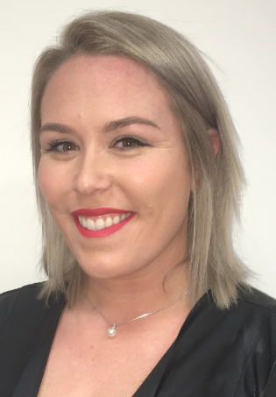
MTU Cork Campus Access Service Prison Lecture Series
Laura Coleman- Access Officer
Christine Nolan- Mature Student Officer

Slide 2
MTU Access Cork Prison Lecture Series
The Prison Lecture Series is a collaborative, innovative and responsive educational programme that is delivered annually and offers participants in Cork Prison the opportunity to engage in a series of lectures by volunteers across both academic and professional services staff in MTU in Cork, supported by the teachers in the Prison Education Unit.

Slide 3
Collaboration- Succeeding Together
The MTU Access Service Cork Prison Lecture Series is a unique, innovative and collaborative programme aimed at providing learning opportunities for prisoners whilst in custody.

Slide 4
Background
2017
Links developed in 2017
2018
Piloted Lecture Series in 2018
2018
Linked with Dillon's Cross Project in 2018
2020
Culinary Certificate ran in 2020, 2022, 2023
currently
The only one initiative of its kind in the Irish prison service.

Slide 5
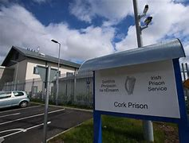
Target Cohort of participants
Cork Prison is a closed, medium security prison for male adult offenders who are 18 years or over. It is the committal prison for counties Cork, Kerry and Waterford and has a capacity for 280 prisoners ranging from short term sentences to life sentence prisoners.

Slide 6
Objective
The objective of the programme is to promote further educational opportunities and present positive learning pathways as alternatives for all participants and their families.

Slide 7
Rationale
The MTU Cork Campus Access Service is committed to widening participation, increasing access and supporting positive educational outcomes for underrepresented groups.
The lecture series creates an opportunity for participants to directly engage and interact with the university. It creates awareness around the opportunities that can come with engaging in higher education and identifies current feasible pathways for all learners, allowing for a meaningful learning impact for participants and their families.
This student cohort has been identified as an official target group in the recent National Access Plan 2022 to 2028.

Slide 8
Programme determined by the participants
Built around the needs and interests of the participants
The prisoners have autonomy in terms of deciding what the lecture series will consist of as they choose the lectures that most interest them. This has a significant impact on the success of this programme.
By offering choice to the participants, the lecture series is responsive, and participants are motivated to attend, engage and learn.

Slide 9
Some participants may have previously experienced trauma in educational environments and the lecture series presents an opportunity to reframe and reimagine education and the potential for opportunities to access education.

Slide 13
Topics delivered in 2023
HEAR Information Session
Recognition of Prior Learning
CAO and Pathways to Higher Education
Science for Life Workshop
Starting your own Business
Networking & Employment Opportunities
Societal and cultural influences on lifelong learning
Artificial Intelligence
Active Listening
World of Logistics
Money Management Workshop
Health and Hygiene
Guiding & supporting children’s behaviour
Ocean Energy
Bugs and our Bodies
Selling, a career, a curse or a bit of both
Apprenticeship Options
Leadership in Sports
Staff from MTU involved in MTU Access Service Prison Lecture Series with President of MTU Professor Maggie Cusack at the certificate presentation in 2023

Slide 14
Feedback from MTU Staff
“The Lecture Series is one of the most rewarding things I’ve done. It’s such a fantastic initiative!” Dept. of Management & Enterprise
"Such a rewarding experience, great participation & engagement and a great reminder of why I love to teach"
Dept. Of Accounting & Info Systems
It was great to see such active engagement from the participants and to see all of the fantastic rehabilitation, upskilling and lifelong learning opportunities being offered within the prison. It was a brilliant experience and I hope to go back again soon!”
MTU Funds Academy
"Getting involved in this initiative reignited my passion for teaching"
Dept. of Management & Enterprise

Slide 15
Statistics
224 participants over the last 4 years
Number of lectures have increased from an offering of 4 in 2018 to 19 in 2023.
21 staff expressions of interest in 2023- highest to date
18 graduates of the Culinary Skills Certificate over 3 years

Slide 16
2023 in numbers
56 participants
Delivered over 6 weeks
19 lectures
19 MTU staff volunteers from 14 services/departments
6 graduates from Culinary Skills Cert

Slide 17
Associated Developments from the MTU Access Service Prison Lecture Series

Slide 18
Culinary Skills- Single Subject Certificate
Evaluation in 2018 – highlighted strong interest from prisoners in Culinary Skills
This offers a very realistic pathway to further education and employment for many participants' post-release.
In 2019-2020, a 5 credit Single Subject Certificate in Culinary Skills was offered to prisoners.
Participants earned a Level 2 Primary Food Hygiene Award - a compulsory award which is required to work full-time in a commercial kitchen and considered a bonus credential by future employers.

Slide 19
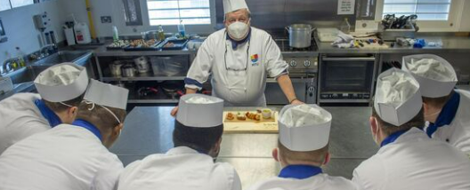
Culinary Skills- Single Subject Certificate
In 2023, the Culinary Skills certificate was delivered for a third time.
Six prisoners took part in the programme and a Pop-Up Restaurant was created within the Prison for prisoners on the programme to demonstrate their culinary skills to employers in the Tourism and Hospitality sector.

Slide 21
Participant Feedback

Slide 22
Graduate Feedback
“After completing the programme in 2022 it opened the door for so any new opportunities. The learning, training, support and accreditation I received allowed me to secure my first ever offer of employment. The last 12 months have been life changing for me and my family with a new job, home and career with a great employer in the community.”
William O’Brien- Class of 2022

Slide 23
Statistics on 2022 Graduates
All six graduates were offered work
Of the six, four are currently in full-time employment.

Slide 24
Next Steps
We are currently looking at the feasibility of delivering Single Subject Certificates in;
Music
Accounting
Business Studies

Slide 25
Awards/ Recognition of Programme

Slide 26
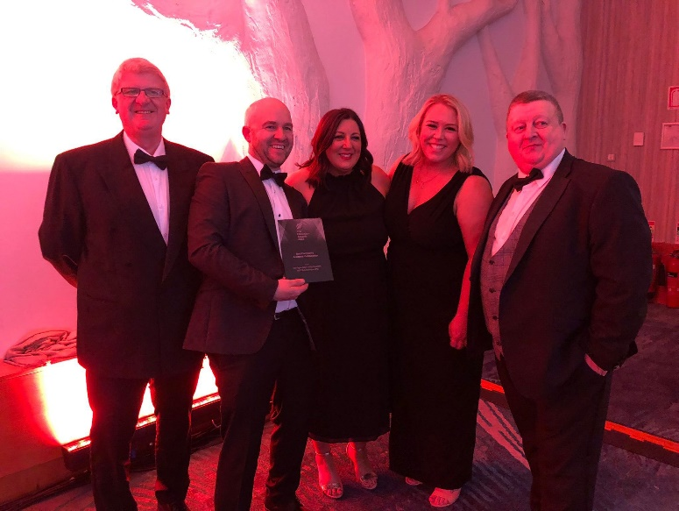
Cork Prison Lecture Series
Education Award Finalist- Education Outreach Award, March 2020
The Open-Door Pop-Up Restaurant
Education Award Winner- Best Community Academic Collaboration, April 2023
European Finalist- EDI Community Engagement Initiative of the Year- Triple E Awards, due to be held in late June 2023

Slide 27
Thank You!
accesscork@mtu.ie
Facebook: /MTUCork_Access
Instagram: @MTUCork_Access
Twitter: @MTUCork_Access

