Slide 1


N-TUTORR: A collaborative approach to transforming the learner experience
N-TUTORR University Lead ATU, Dr. Carina Ginty
N-TUTORR University Lead DKIT, Dr. Moira Maguire
N-TUTORR Student Empowerment Co-Ordinator, ATU, Jessica Duffy
N-TUTORR Student Empowerment Co-Ordinator, SETU, Caitriona McGrattan
N-TUTORR Learner Empowerment Lead, TU Dublin, Roisin Murray

Slide 3

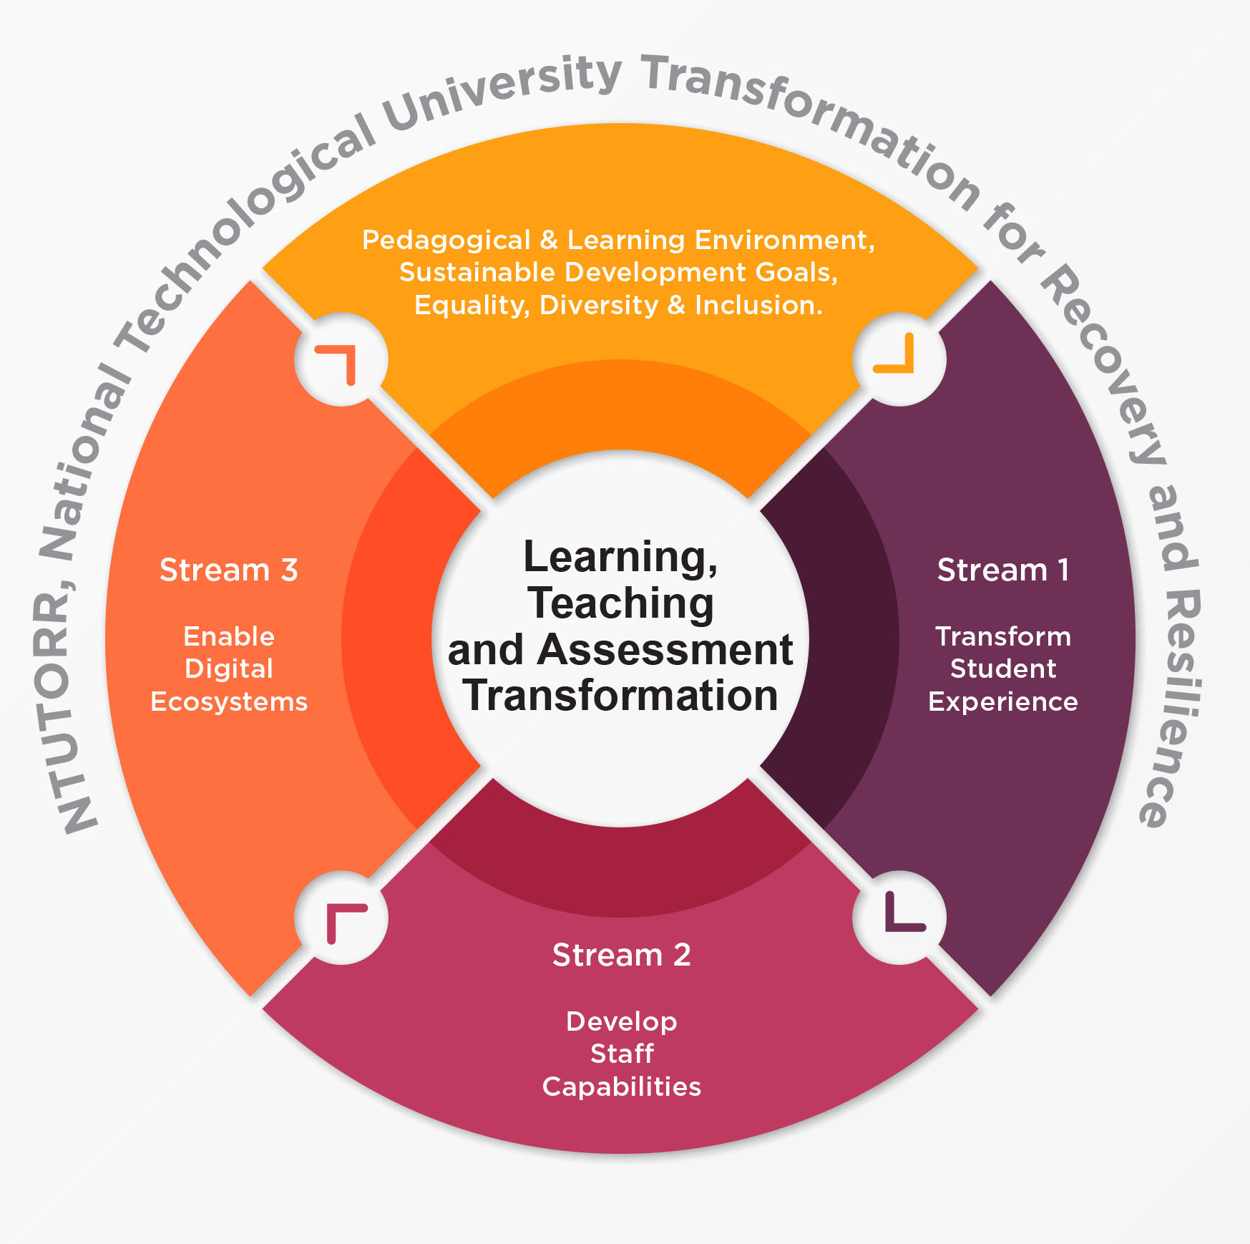
National Technological University Transformation for Recovery & Resilience
STREAMS
Transform the Student Experience through learner empowerment
Transform Learning, Teaching and Assessment by Developing Staff Capabilities
Enable Digital Ecosystems to transform Learning, Teaching and Assessment

Slide 4

N-TUTORR Development Themes:
Digital Transformation in Teaching and Learning
Equality Diversity and Inclusion (EDI)
Education for Sustainability
Universal Design for Learning (UDL)
Academic Integrity

Slide 5
N-TUTORR STREAMS
Stream 1 TU Sector Leads for N-TUTORR:
Dr Carina Ginty (ATU) + Dr Moira Maguire (DKIT)
Transform the Student Experience through learner empowerment
Stream 2 TU Sector Leads for N-TUTORR:
Prof. Jacqueline McCormack (ATU) + Ken McCarthy (SETU)
Transform Learning, Teaching and Assessment by Developing Staff Capabilities
Stream 3 TU Sector Leads for N-TUTORR:
Frances O’Connell (TUS), Mike Ahern (TU Dublin), Dr Gearoid O Suilleabhain (MTU)
Enable Digital Ecosystems to transform Learning, Teaching and Assessment
WP 3.1 Sustainable Learning & Pedagogical Environment: Digitally Enabled Assessment embedding Academic Integrity
Digitally enabled assessment / examination, proctored assessment system, research ethics mgt system, digitally enabled academic integrity, repository & training programmes
WP 3.2 Digital Campus
Hybrid & on-campus digital enhancement, media delivery spaces, future media production hub, badging / microcredentials, open education platform
WP 3.3 Improve flexibility and accessibility of learning resources
Sectoral coordination team, IReL, CRM for learner recruitment, flexible learner pathways
WP 1.1 Sustainable pathways to higher education
  HyFlex Access HE Foundation Programme
  Micro-credentials (to meet regional needs)
  HyFlex Student Support Pilot
WP 1.2 Empower students to become change agents
  Partners in Innovation & Change Fellowship Programme
  Digital Literacy & Citizenship Student Competency Framework
WP 1.3 Academy for education for sustainability, leadership and employability
  National TU Student Digital Backpack
  Student Digital & Sustainable Futures Champions Network
WP 2.1 Develop staff capabilities using a sustainable higher education framework
  Sectoral Sustainable HE Framework CoP, Sustainable HE Champions, Toolkit, Digital Badging
WP 2.2 Develop a curriculum framework for digital transformation, resilience and sustainability in higher education
  Staff workshops, Curriculum Framework, integration of Curric. Framework, graduate attributes, and UDL principles
WP 2.3 Develop capabilities of all staff to support digital transformation, resilience and sustainability in higher education
  Needs analysis, staff CPD plan, staff development portal, recognition of CPD

Slide 6







N-TUTORR Project Teams
Institutional Leads
Student/Learner Empowerment Co-ordinators
Teaching & Learning Co-ordinators
Academic Developers
Instructional Designers
Digital Campus Lead
Sustainability Education and Engagement Lead
Staff Development Co-ordinators
Senior Technical Officers
Data Analysts
Researchers
Academic Champions
Student Champions
Fellows

Slide 7


Stream 1
Transforming the Student Experience Through Learner Empowerment

Slide 8
Partners in Innovation & Change Fellowship Programme
(Student/Staff projects)
Student Digital & Sustainable Futures Champions Network
(100 in the TU sector)
TU Student Digital Backpack
Micro-credentials
(incl. regional needs)
HyFlex/Hybrid Access HE Foundation Programme
Work packages underway in Stream 1

Slide 9
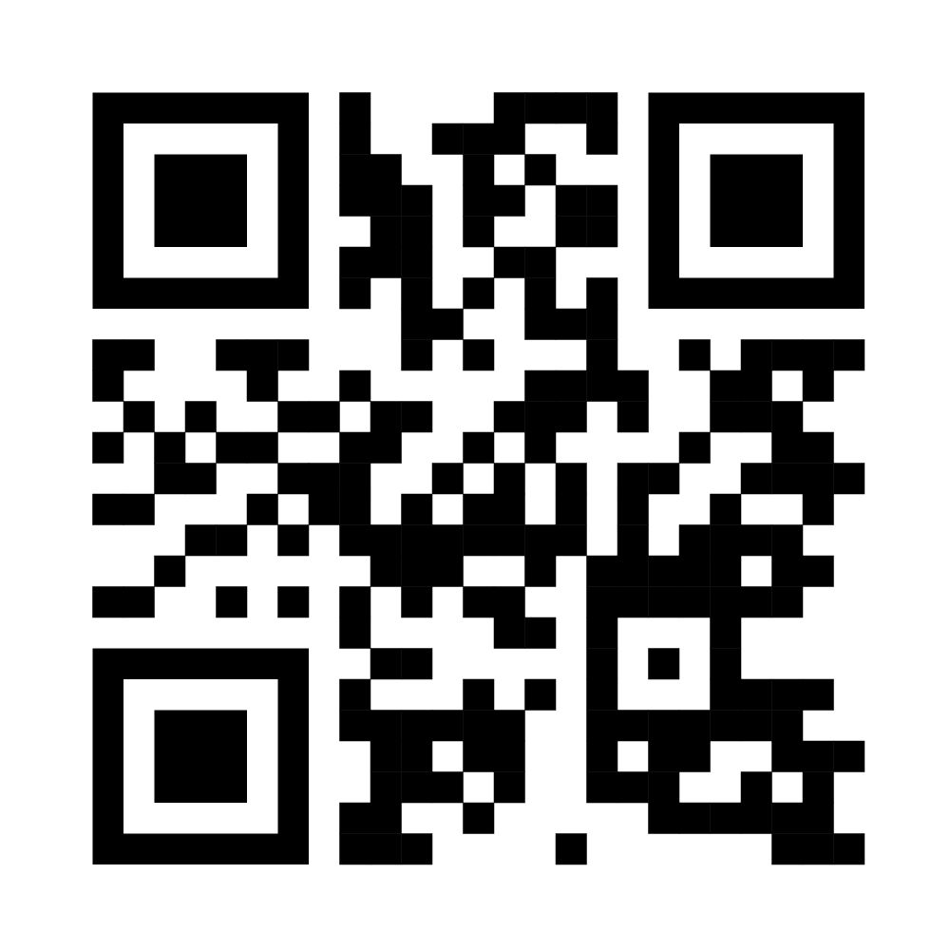
N-TUTORR Fellowship Project Awards
131 Awards
https://www.thea.ie/transforminglearning

Slide 10

N-TUTORR
Student
Champions

Slide 11
N-TUTORR Student Champions
Engagement initiatives (June 2023 – May 2024)
TU Student Digital Backpack
Testing & Pilot
Design Sprint for Sustainability
Introduction to UDL & contribute to the design of UDL badge for students
Mentoring & Coaching
Artificial Intelligence & Assessment Workshops
Academic Integrity Projects
Join TU Committees developing Policies & Strategies
Insights Showcase

Slide 12


TU Student Digital Backpack
Piloting in TU sector from October
Self-directed micro-courses (non-accredited) with a digital badge. Piloting from June with 100 Student Champions:
Discover Digital Capabilities
Academic Integrity
Introduction to Sustainable Dev. Goals
White Ribbon (EDI)
Civic Engagement
Public Speaking
20 + more to review from audit and curate thematic learning pathways from the Autumn

Slide 13


Slide 14
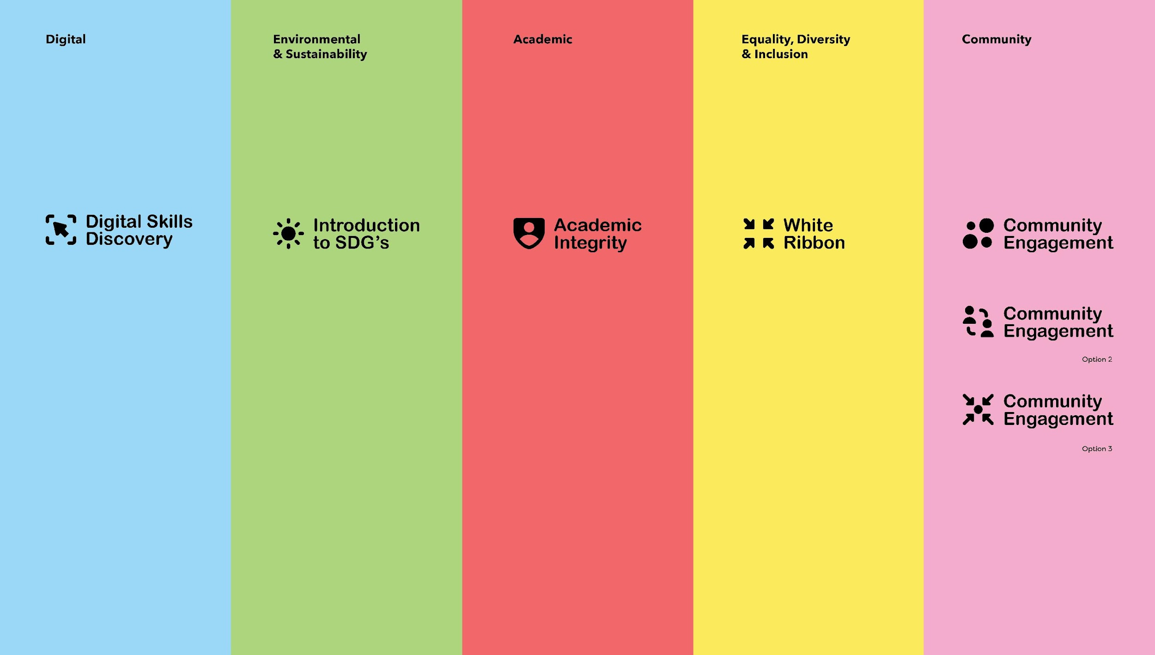

Slide 15
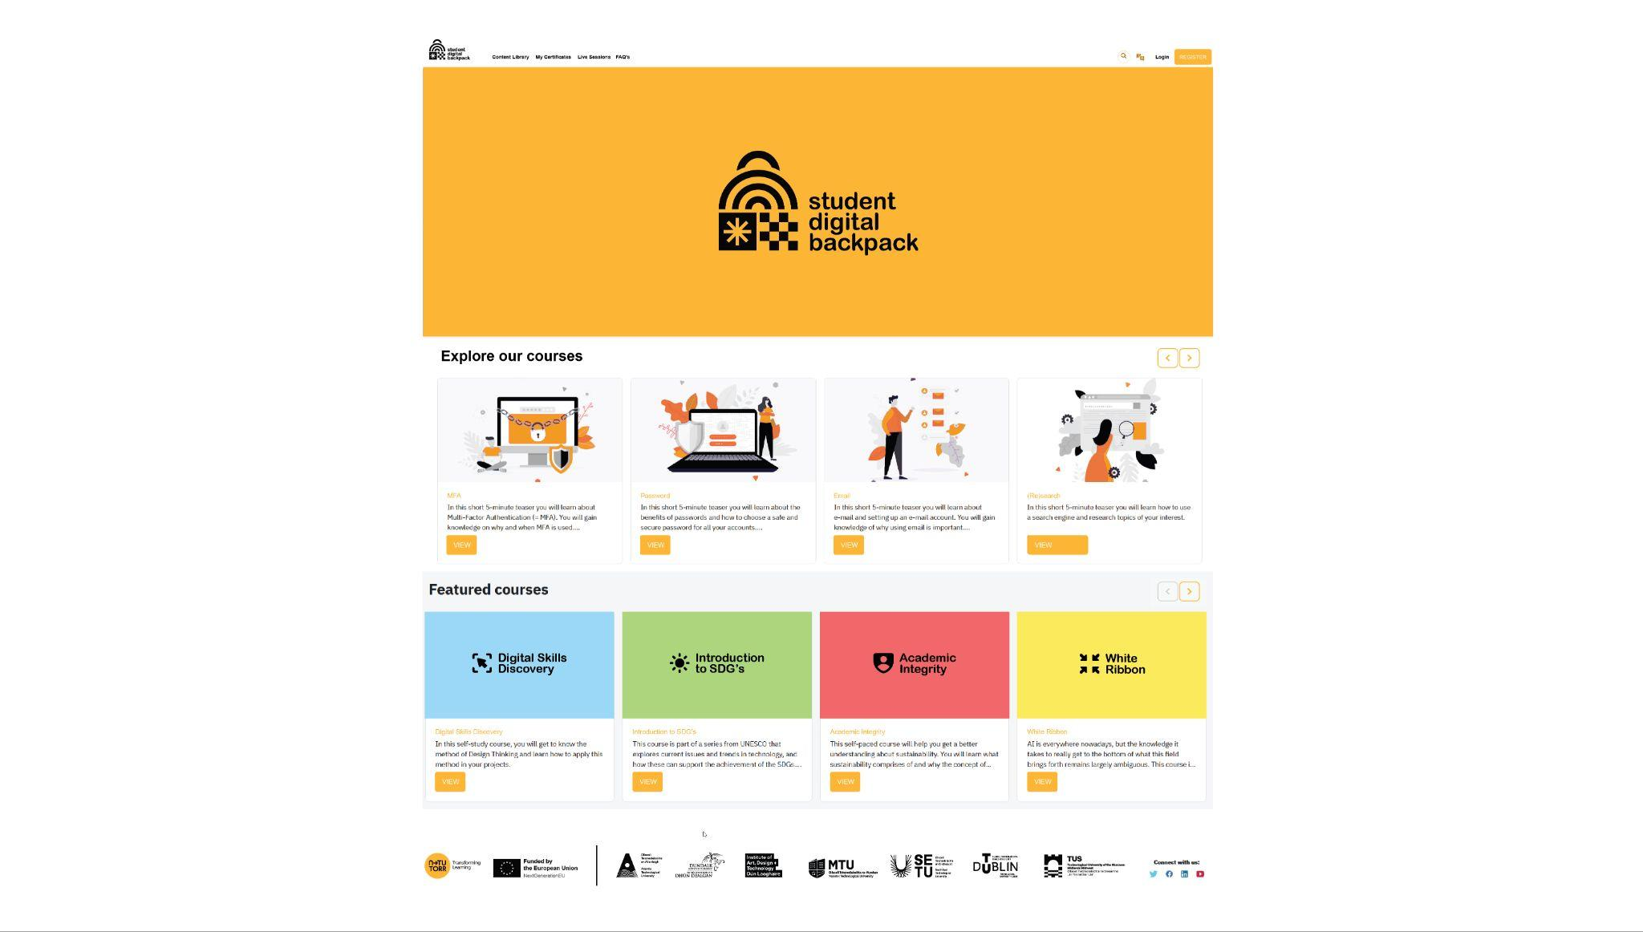

Slide 16

Stream 2
Transforming learning, teaching and assessment by developing staff capabilities

Slide 17
Develop a sustainable futures higher education curriculum framework:
Audit of Sectoral Sustainable HE Framework Resources
Academic Champions recruited
Develop staff capabilities using a sustainable higher education framework:
Sectoral Sustainable HE Framework Community of Practice (CoP)
Audit Resources for an LTA Toolkit
Exploring Digital Badging recognition for ALL staff
Develop capabilities of all staff to support digital transformation, resilience and sustainability in higher education:
Needs analysis planning underway
Staff CPD plan in place by end of June
ATU Staff Training Hub in design stage
Exploring CORE capabilities.
Work packages and activities underway in Stream 2

Slide 18

Academic Champions

Slide 19

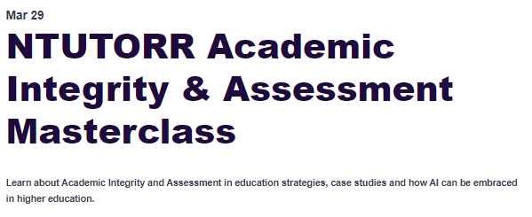
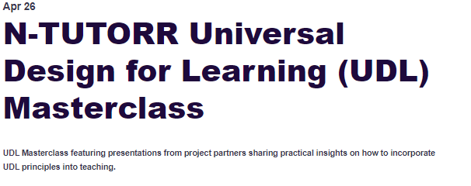
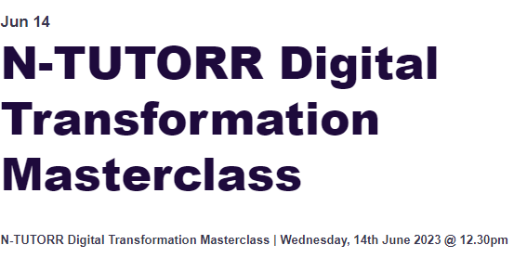
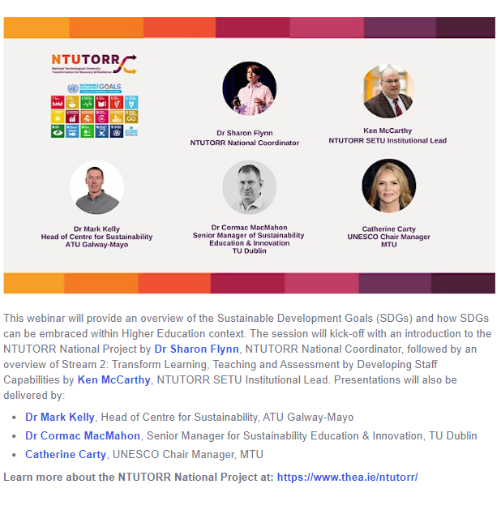

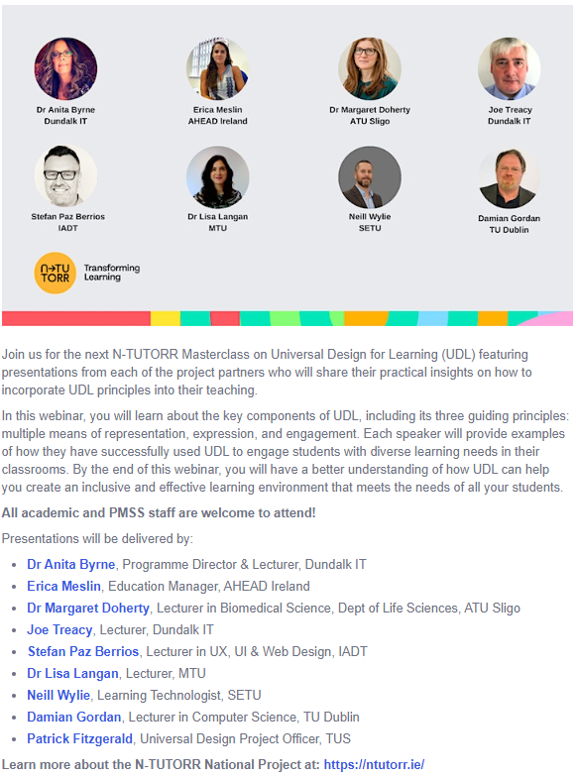

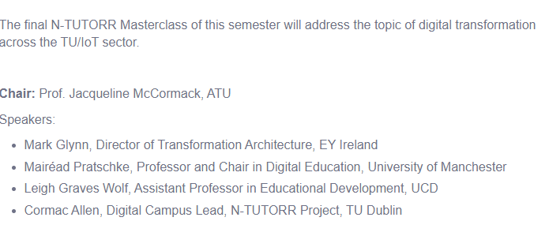
Still time to register
Masterclass Series

Slide 20

Stream 3
Digital Ecosystem to Transform Learning, Teaching and Assessment

Slide 21
Digital Ecosystem Stream
Stream 3: Digital Ecosystem to Transform Learning, Teaching and Assessment
WP 3.1 A Sustainable Learning and Pedagogical Environment
A digitally enabled assessment/examination management system & repository
  A proctored e-assessment/e-examination management system
  Digitally enabled research ethics application management system, and digitally enabled academic integrity software solutions & toolkits for students and staff
WP 3.2 Digital Campus:a range of hybrid and on-campus digital enhancement solutions
bespoke media/delivery spaces with the creation of media-rich asynchronous learning content.
future media production ideas focussed on the creation and curation of reusable “here and now” & media-rich digital learning content with immersive technology and virtual production capacity to meet the future needs of learners.
badging/micro-credential issuing platform that integrates with existing digital & academic infrastructure and systems
and helps share and cohere emerging practice in the area.

Slide 22
Digital Ecosystem Stream
Stream 3: Digital Ecosystem to Transform Learning, Teaching and Assessment
WP 3.3 Improving flexibility & accessibility
  Adoption and deployment of IReL
  Deploy integrated CRM system
  VLE Integration consultation, scoping and planning
  Digital innovation and transformation investment initiatives

Slide 23
Key Take Aways
N-TUTORR for Student Affairs and Student Services Professionals
  Masterclass series
  Student & Staff Fellowships leading to change and improved student experience
  Staff training and capacity building
  Student Digital Backpack – sector wide pilot from October
  Sector-wide approach to developing digital systems

Slide 24
Follow N-TUTORR developments at:
www.ntutorr.ie

