Slide 1
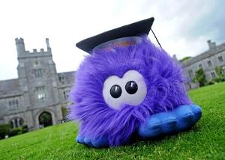
Professor Fluffy Early Intervention Outreach
Paul Geeleher
Maeve Minihane
Maria Flavin

Slide 2
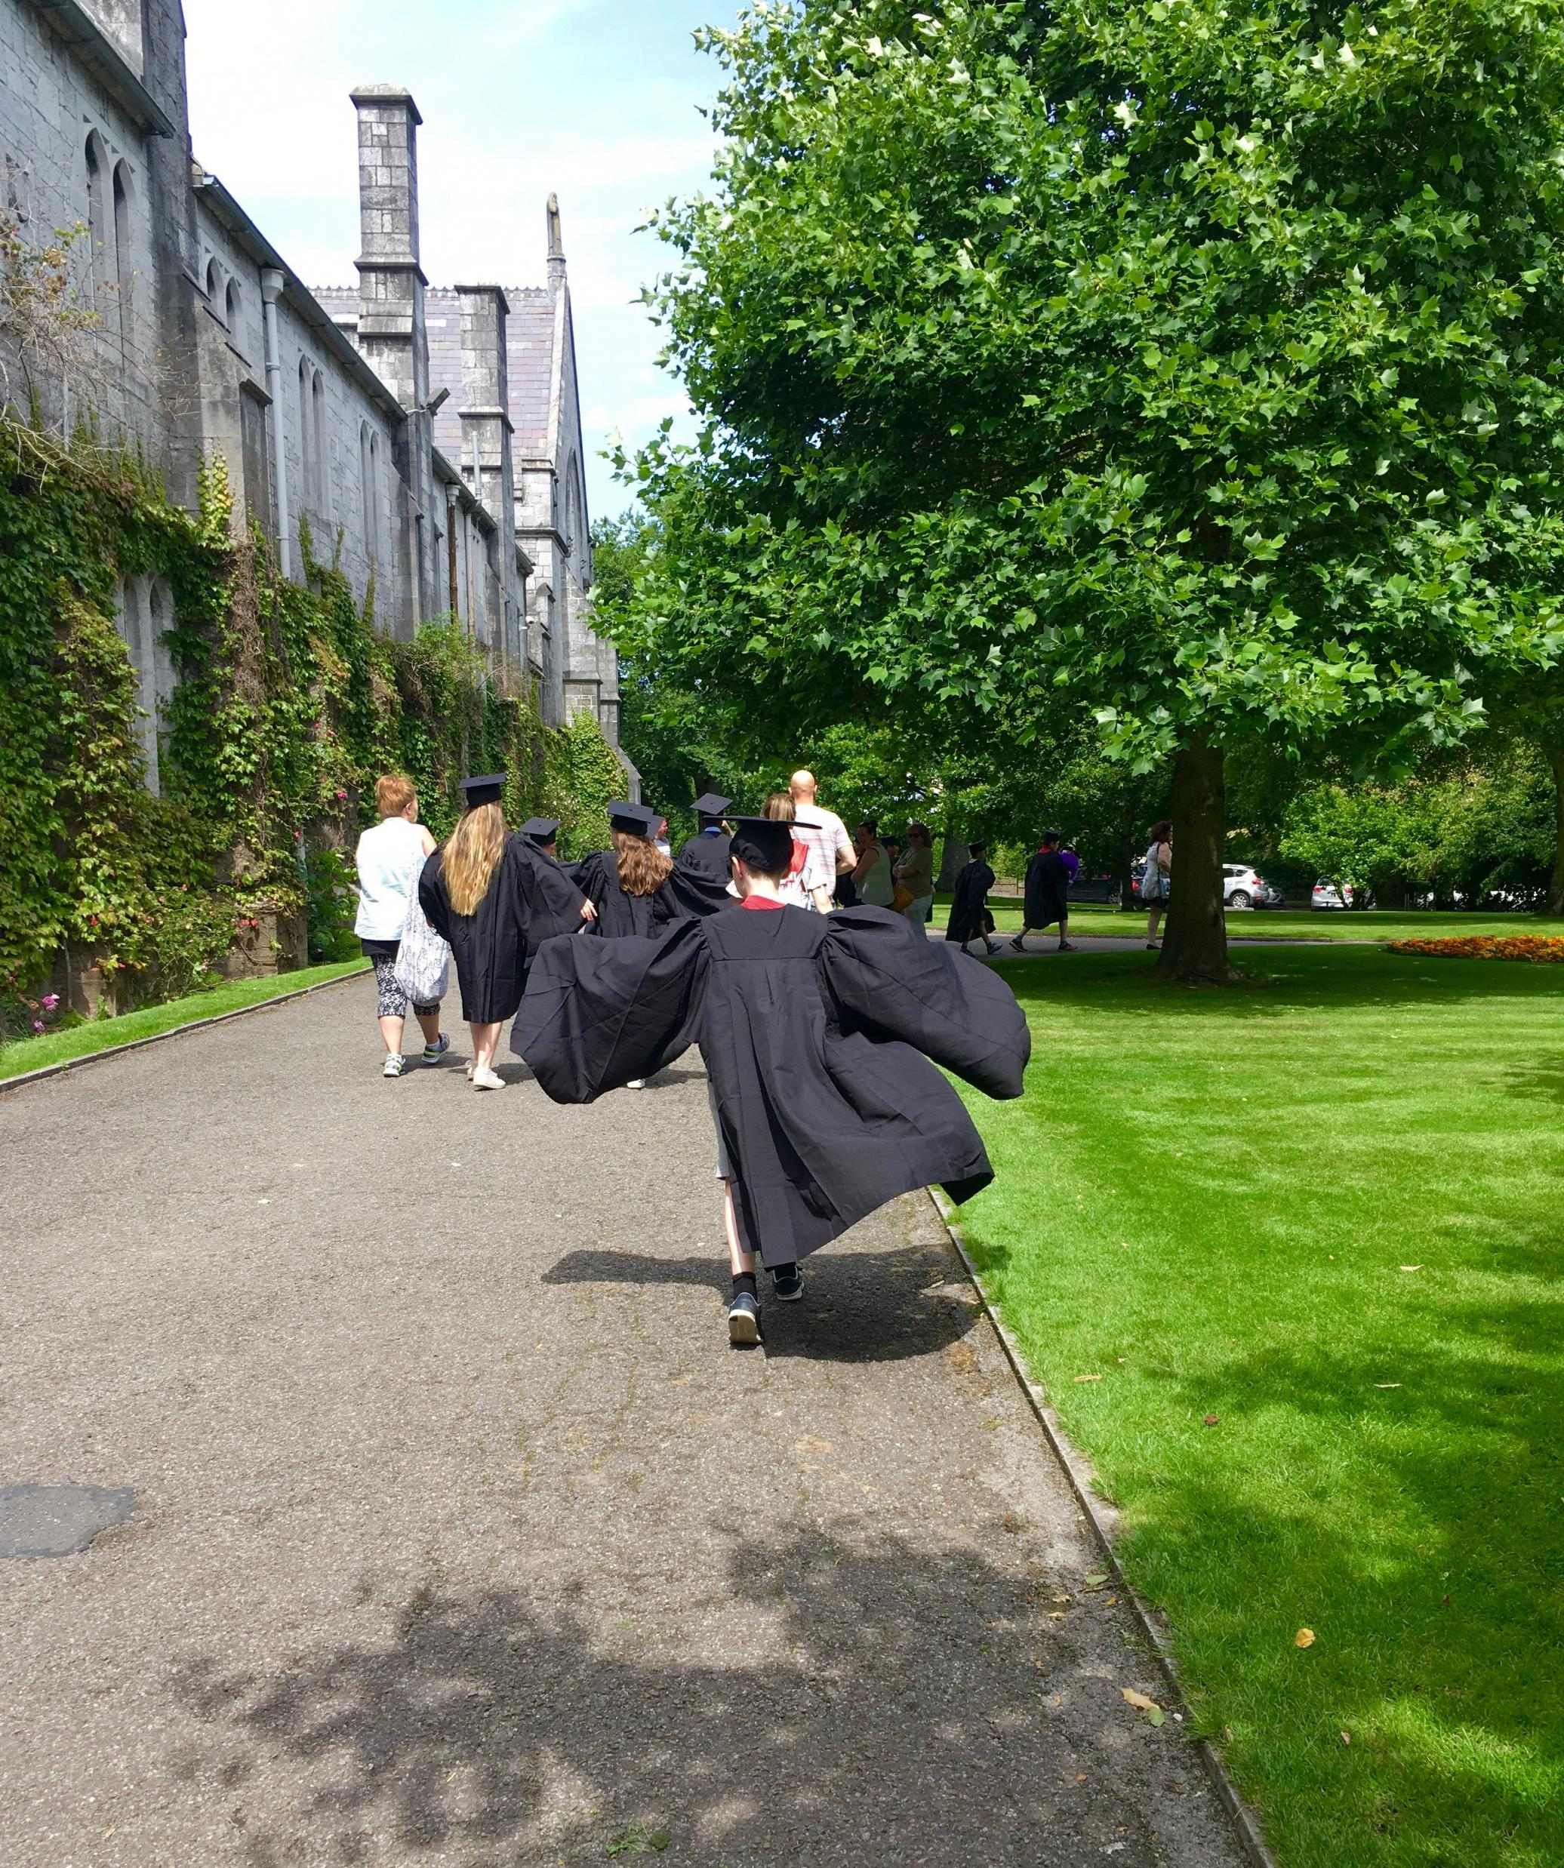
Background & Overview
Primary school outreach Programme
5 lesson programme - Early intervention
Professor of Engineering
University of Liverpool
University College Cork
DEIS (Delivering Equality of Opportunity in Schools) Cork City Primary Schools

Slide 3
Aims of the programme
Raise awareness of FE & HE to children in primary schools in areas of low participation; - College is an option.
Link students with College Students as role models;
Introduce vocabulary of Higher Education (e.g. “campus”, “degree”, “lecture”, “graduation”, etc.); and
Raising awareness that education improves career and life chances understanding the concept of choice.

Slide 4
Delivery of the programme
Teacher training
Introduction to College – Language, student friends, careers, student life
Materials – Workbook , graduation gowns
University Experience’ – students, parents, teachers come to UCC to meet Access staff & UCC Students.
Bookmark competition
5 lesson programme - delivered in school and in University College Cork

Slide 5
Adaptation to Covid
2020
‘Home-school Pack’
2021
Professor Fluffy Virtual Programme – ‘Interview a College Student’
2022
6th Class visit to UCC ‘Cork Lifelong Learning Festival

Slide 6
Impact & Success
Increase in school participation from 5 – 15
14 schools, 300 students, 150 parents (figures 2022)
Shortlisted for Education Awards 2022-23
Receipt of funding from Irish American Partnership
Feedback from Parents, teachers & students, (include quotes &/or numbers)
Future Goals to expand to more DEIS schools

Slide 7
Parent Survey May 2023 Sample size 20

Slide 8
Parent Quotes
She would have not wanted to go to college till she came to campus.
The Professor fluffy program is a fabulous way to introduce the idea of college to children. It makes kids realise college is an option for them and accessible to everybody. It's great to see that this has changed over the years. I would be delighted to see my daughter attend UCC in the future.
It is a great way for them to see how life would be like for them if they go.
It gave both children and parents a great insight into college life and a comfort around the campus.
For a parent of a child that has always liked UCC and aspired to one day attend, this program has given her a great insight into college and campus.
Opens their eyes to what they can achieve giving them a great insight.
she would have not wanted to go to college till she came to campus.

Slide 9
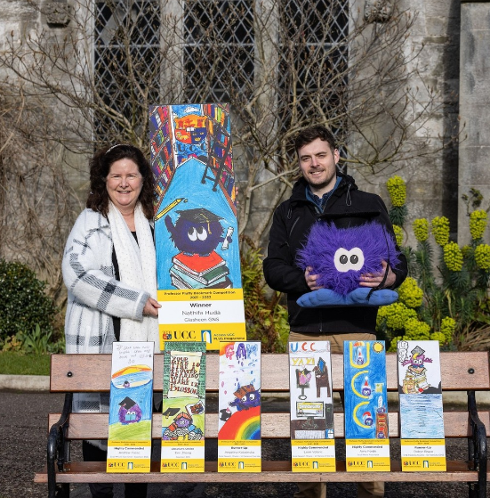
Thank You

