Slide 1
Supporting Underrepresented University Students During and After a Pandemic -
Access Service, Munster Technological University, Cork Campus
Louise O'Callaghan
Elaine Dennehy
13 June 2023

Slide 2
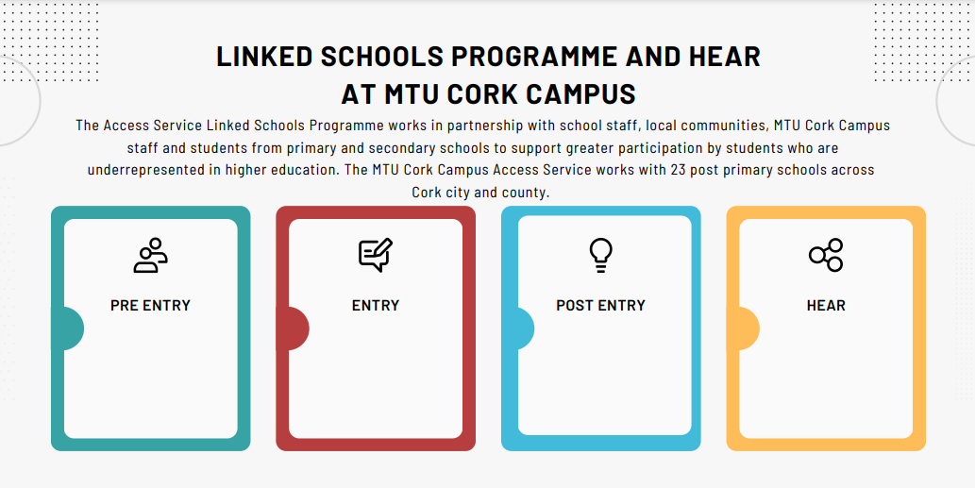
Notes:
The MTU Cork Campus Linked Schools Programme offers students who attend linked schools in Cork City and County a pre-entry programme of events including workshops, information sessions for students and parents, information on additional entry routes, study skills workshops, revision courses, drama and art programmes, campus and school visits, scholarships, StudyClix and study skills sessions, collaborative initiatives with our colleagues in UCC Plus, attending school awards evenings, open days, parent/teacher meetings and careers fair, etc….. Just a sample!! We have links with Cork Migrant Centre, Cork Life Centre, Cork Prison, TUSLA, School Completion Programme, North Cork Education Board, Johnson and Johnson Bridget to Employment, DPS etc…..
At entry level, we are directly involved in the HEAR admission process and we oversee the HEAR offers process in conjunction with the Access Officer, the admissions office and the DSS. The HEAR team also link with the DARE team at the time of the offers to ensure priority candidates, who are both HEAR and DARE eligible, are prioritised as per the scheme guidelines. The process begins prior to round 1 of the CAO offers and concludes following round 5 and takes place over a number of weeks.
Both HEAR merit and reduced offers are made during this process; decisions are made around reduced points offers in line with procedures; available to view at www.cit.ie/hear
Additionally, at post-entry level, registered MTU Cork Campus students are offered additional college supports, through the Higher Education Access Route (HEAR) scheme, to help them navigate third level successfully including financial, academic, personal and social supports. Due to the pandemic many events remained online for semester 1 and 2 at both pre and post entry level. We also provide support to students who have engaged with TUSLA. For this presentation we focus on the academic year 2021/22.
NOTE: This AY we have four years on HEAR intake students, figures/stats being collated currently.

Slide 3
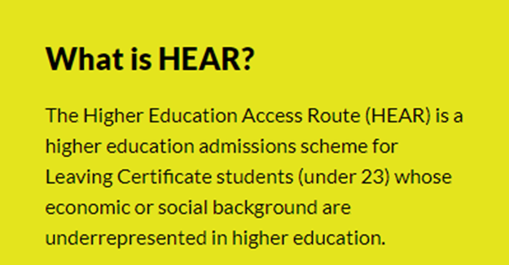

Slide 4
Meet the Team
Elaine Dennehy
Louise O’Callaghan
Kirstie Higgins
All queries to: HearCork@mtu.ie or
Tel: 021 433 5138
Notes:
This is us!
Three of us work on all three aspects of programme.

Slide 5
Notes:
The HEAR post entry support programme was completely redesigned and moved online during the COVID-19 pandemic. This required significant upskilling on the part of the HEAR team in addition to a key collaboration with the Department of Technology Enhanced Learning (TEL) at MTU. Key features of this programme re-design include the creation of an online support module using the Canvas platform, which is not its primary use (academic learning tool) the use of MS Teams and Zoom for one to one support, in addition to outreach activities. Key features of this design have been retained due to the high levels of student engagement and will be discussed later in this presentation. [99 words]

Slide 6
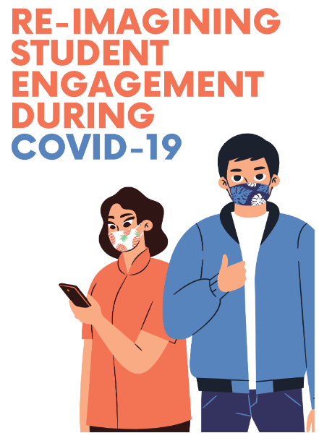
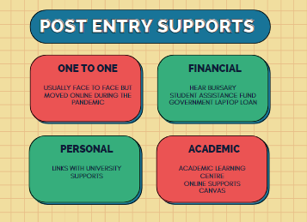
Notes:
Our response to effects of the campus lockdown was COLLABORATE AND CREATE: to engage with our students online, but we knew we had to collaborate with experts in the IT field and we needed to be creative. Students are very familiar with Canvas already, most of them have downloaded the app on their smart phones and engage with academic staff in the departments in this way, its primary use is an academic online tool.
We decided to be creative with technology platforms the students were already comfortable using and were available to us (with additional training!!). We had no idea how to create a module so linked in with IT services and the Dept. of Technology Enhanced Learning (TEL) to develop a be-spoke module for our HEAR students. Module enrollment was by invitation only and allowed us to create a one stop shop for all post entry support needs of our students. The module was created to allow to engage individually, by year group, by HEAR category or to engage with the entire HEAR enrolment at the University. It was very effective.
The instructions on how to avail of the post entry support programme were emailed to students and also delivered during online information sessions to all students. This information session was mandatory was all first- and second-year students and third year students could attend by choice. We also delivered specific live MS Teams and Zoom information sessions for parents. It was a live broadcast…. RTE better watch out!!
To avail of the post entry support programme students were required to:
Submit Terms of Engagement Forms (modified for online meetings) – available on Canvas. NO PAPER.
Accept the Online Meeting Agreement (modified) – Available on Canvas.
Book an online meeting (using a booking link created in conjunction with IT services at the University)
Complete a HEAR bursary form to receive HEAR bursary – Available on Canvas.
Attend an online one to one meeting using MS Teams (later zoom and also telephone call was available)
All forms were available for download on Canvas app and then emailed to HEAR email
Students could contact us either by email, text, Canvas or telephone, MS Teams.
Semester 2: as above.
THE BOX in TOE forms: found students were filling out the box with information they weren’t forthcoming with in the one to one meetings; this often created another meeting where issues/challenges were discussed further.
FASTRACK: government laptop loan scheme and SAF on sharepoint – continued to assess and award payments online.
Canvas also allowed us to develop a blueprint for other services within the Access Service whereby generic information could be shared with all.

Slide 7
HEAR CANVAS Module
How to Register for post entry supports
You will receive an email from HearCork@mtu.ie with a link to enroll in the HEAR Canvas Module
Enrol in the Canvas Module using self-enrol
Read the introductory information about the HEAR post entry supports at MTU Cork Campus
Complete the ‘Terms of Engagement’ form and HEAR Bursary Form
Attend a one to one meeting with your coordinator (bookings – instructions for downloading this are in your canvas module)

Slide 8
Canvas Screen Log in
Use your Student ID and Password to Log In
Email HearCork@mtu.ie for self enroll link if you haven’t already received it

Slide 9
Home Page of HEAR Canvas looks like this
‘Pages’ contain all the information you need to know about registering for post entry supports and receiving your HEAR Bursary Payment.

Slide 10
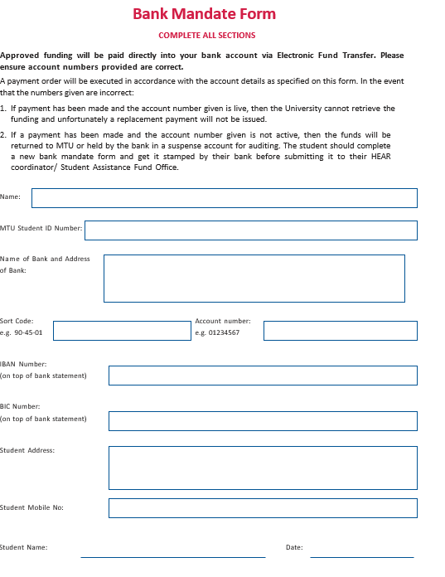
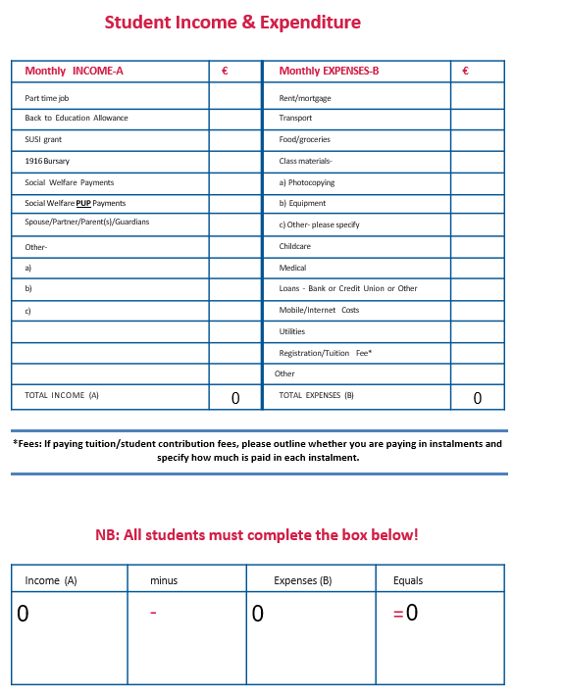
Samples
Documentation available on the Canvas Module
Notes:
The new systems and processes embedded in the programme have allowed for more efficiencies across the entire post entry programme. We have retained most elements of the HEAR post entry support programme however students now have a choice of either in person or online meetings.

Slide 11
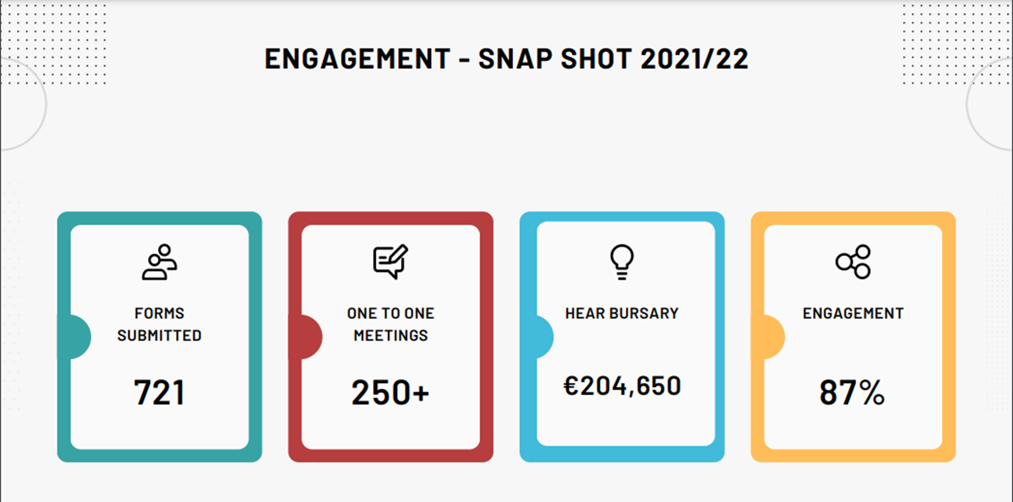
Notes:
Year on year our HEAR payments are increasing, our student intake has now reached full enrolment so figures are being collated for this AY.
Above shows a snap shot of the engagement during that AY 21/22 – collaborate and create plan have proven effective in engaging with students during lockdown.

Slide 12
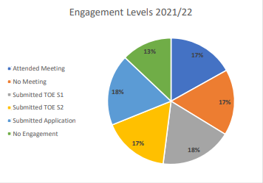
STUDENT NUMBERS 2021/22
Year 1 | Year 2 | Year 3 | Total
162 | 168 | 118 | 448
Notes:
Engagement figure reflects those students who fully engaged with the post entry programme and received their HEAR bursary as a result. 87% of all HEAR students engaged at some level in AY 2021/22 which may have included attending at least one support meeting, submitting documentation but not meeting all mandatory requirements to receive the HEAR bursary. 13% of HEAR eligible students did not receive their bursary, due to a number of reasons including: did not attend meetings, did not submit all necessary documents or did not engage. This figure reflects the same level of engagement in the previous academic year showing that we effectively engaged with our students despite a complete campus shut down.

Slide 13
Access Service Survey of Student Experience During the pandemic
Notes:
The Access Service surveyed students to ascertain what challenges they were experiencing and what could be put in place to further support their learning. The infographic shows some of the challenges of our HEAR students, which reflect the results of a university wide survey (TEL) and national findings.
Anecdotal evidence from one to one meetings and THE BOX suggests that mental health was a challenge among students. Studying from home, with little or no access to the campus and few opportunities to connect with their peers brought about many challenges for our HEAR students, and, this was very evident in the one to one meetings.
The following infographic depicts HEAR student’s experiences of learning from home; results from an online Access Survey carried out in April 2021

Slide 14
Thank You!
For more information, please email HearCork@mtu.ie

