Slide 1
What does student success mean to Indian postgraduate students in Irish HEIs?
Caroline Forsyth, Doctoral student, School of Education, Trinity College Dublin
Dr Michelle Share, Supervisor, School of Education, Trinity College Dublin

Slide 2
Overview
Rationale
Background
Defining student success
Preliminary findings
Questions to consider

Slide 3
Rationale for research
Personal experience
Colleagues in other student services
Increase in South Asian students in Trinity
Recognition of the short timeframe of one-year masters programmes Government’s System Performance Framework 2018-2020

Slide 4
What does student success mean to Indian international one-year postgraduate students enrolled in higher education institutions in Ireland?
Sub research Questions
SRQ1 – Who are Indian international students in Ireland?
SRQ2 - Who/what defines student success?
SRQ3 - How do Indian postgraduate international students in Ireland define student success?
SRQ4 – What helps or hinders Indian postgraduate international students to be successful in Ireland?

Slide 5
Background
Investing in Global Relations:
Irish Government 2010-2015 International Education Strategy
Ireland to be “internationally recognised and ranked as a world leader in the delivery of high-quality international education by providing a unique experience and long-term value to students” (DES, 2010, p12).

Slide 6
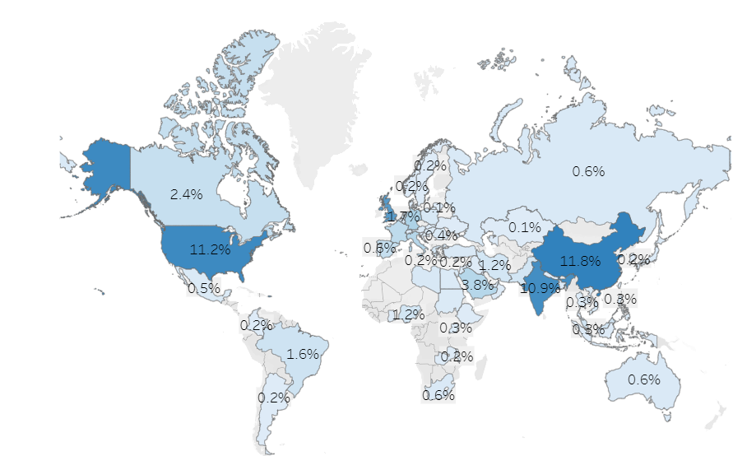
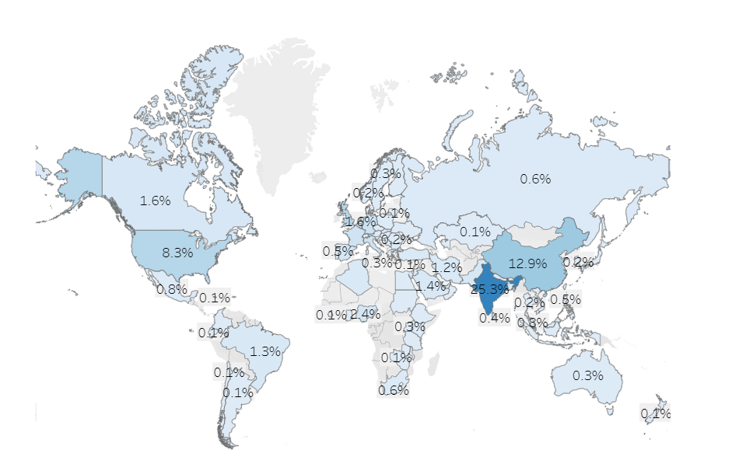
Background 50% increase in International PG students 2015/16-2021/22
Indian postgraduate students increased from
751 in 2015/16 to 3,415 in 2021/22
455% or 4.5 times increase
2015-16 – 6,890 International PG Students
2021-22 – 13,500 International PG Students
https://hea.ie/statistics/data-for-download-and-visualisations/key-facts-figures/

Slide 7
Defining Student Success
No agreed definition
Variously defined
retention figures which focus on enrolled students as they progress to graduation
engagement with their studies
satisfaction with college experience
academic achievement
student involvement, engagement and integration often conflated

Slide 8
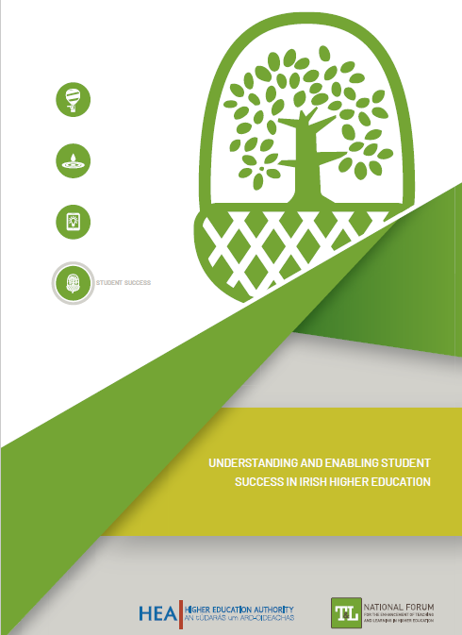
Defining Student Success

Slide 9
Methodology
Qualitative research design
Students contacted through HEI schools, Facebook groups, Indian student societies
Students self-selected then snowballing used
7 HEIs
45 students
23 female, 22 male
Semi-structured interviews on Zoom
Initial short interview for background/demographic information
Longer second interview re experiences, expectations, views of success
Student journey from India, through transition, towards postgraduation

Slide 10
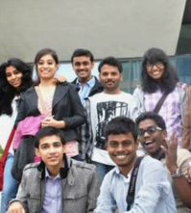
Preliminary findings
Attaining degree
Rewarding career
Personal development
Independent learning
Independent living
Questioning beliefs
Intercultural competence
Confidence
This Photo by Unknown Author is licensed under CC BY

Slide 11
Success
This Photo by Unknown Author is licensed under CC BY-SA
P2 (M)‘And also for me personally, the success would be earning enough, getting a good job where in a positive environment where I meet like-minded people from which I'm also learning I'm learning as in the human experience, my own experience, not about just technology. I'm learning about culture and I'm good to travel around the world and I'm very much independent person. So that will be a success for me.’

Slide 12
Personal Development – transition to independence
P21 (F) “it was the first time living apart from my family. So I've just lived my whole life with my family and in the same house…So I've never really lived on my own. So it was a really new experience for me and also a lot of learning experience, just making all of my own decisions, what to buy, what to wear, what to do every day. So it was lots of responsibility also for me.”
This Photo by Unknown Author is licensed under CC BY

Slide 13
Personal Development – freedom and agency
P3 (F)“I think I have already succeeded at as a student because I'm definitely getting a degree in next couple of months. But the way the I talk, the way I live, the way I am right now, none of this would have been possible if I did not came to come to Ireland.”

Slide 14
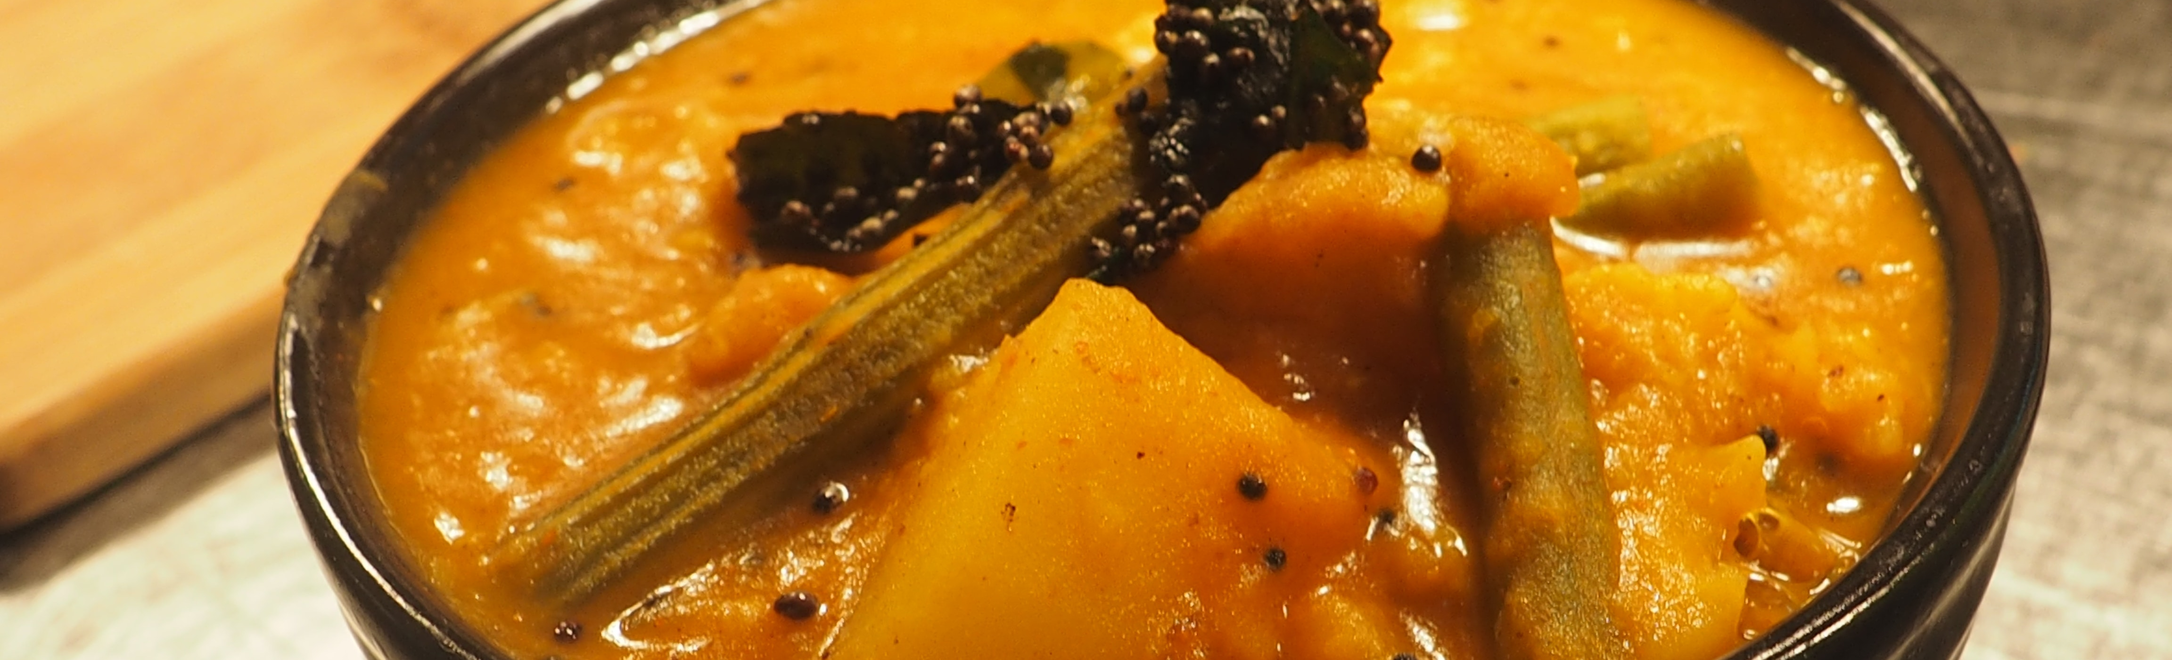
Personal development – independence and questioning beliefs
P4 (M)“My mom was really, really proud…if you're coming abroad as an international student, cooking is the preliminary skill you need to have... And to this, I want to add that when I was back in India, I had this thing that… I used to see my mom cook. So I had this gender bias, only women cook. But when I moved out, I like my gender bias broke and my perspective horizon. And I was like that this is a mandatory life skill you need to have…So now I really enjoy cooking really. And now I teach my mom.”

Slide 15
Independent learning
P29 (F)“education system here, at least my coursework, how they have the assigned assessments and the feedback, they do make you academically independent. They allow you to explore your thoughts and dimensions if you want to do something more or not…I really like that feeling of being academically independent. I still don't know how to write a thesis, how to do research. My academic writing is super messed up, but I like that feeling of making mistakes and growing.”
This Photo by Unknown Author is licensed under CC BY-ND

Slide 16
Intercultural competence
P36 (F) “I'm extremely happy because there is nothing different. What I said, if I haven't met these people, I would've always thought it's a huge difference. People are very different and there is something mysterious there…But now I understand that they are just us. They are human beings. They are normal people. We can talk to them... I don't see them as different people. I just see them as my own people. So it’s …Really nice, actually.”
This Photo by Unknown Author is licensed under CC BY-NC-ND

Slide 17
Confidence
P3 (F)“I feel like every week I have been doing something different. That was very intimidating for people back in India. How come this tiny girl does so much and everything on her expenses? That was a big thing for me. That definitely built my confidence, but I did it.”

Slide 18
Success – Indian Students’ perspectives
Initial focus on academic degree/rewarding career
Views changed over their journey
Personal development
Indian students - large cohort of students in Ireland
Views of students need to be taken into account in strategy development

Slide 19
To consider:
Thriving in a Challenging Higher Education Landscape
What is your view of student success for international students?
How could a broader, more holistic view of student success for international, marginalised and under-represented students enable institutions to develop policies and services that could help students to be successful?

Slide 20
References:
Deardorff, D. (2015). A 21st Century Imperative: integrating intercultural competence in Tuning. Tuning Journal for Higher Education, 3(1), 137-147.
Department of Education and Skills (2010). Investing in global relationships: Ireland’s international education strategy 2010–15, Dublin: Department of Education and Skills. Accessed at https://www.education.ie/en/Publications/Policy-Reports/Ireland-s-International-Education-Strategy-2010-2015-Investing-in-Global-Relationships.pdf
Department of Education and Skills (2016). Irish educated, globally connected: An international education strategy for Ireland, 2016–2020, Dublin: Department of Education and Skills. Accessed at https://www.education.ie/en/The-Education-System/International/Strategy-2016-2020.html
Fass-Holmes. B. (2106). International Undergraduates’ Retention, Graduation, and Time to Degree. Journal of International Students. 6(4), 933-955.
Korobova, N., & Starobin, S.S. (2015). A Comparative Study of Student Engagement, Satisfaction, and Academic Success among International and American Students. Journal of International Students 5(1), 72-85.
Groarke, S. & Dunst, C (2019). Economic and Social Research Institute. Attracting and Retaining International Higher Education Students: Ireland
Higher Education Authority. (2018). Higher Education System Performance Framework 2018-2020. Accessed at https://hea.ie/assets/uploads/2018/01/higher-education-system-performance-framework-2018-2020.pdf
Higher Education Authority, 2021. Higher Education Authority Statistics, Available at https://hea.ie/statistics/
Manyaga, F., Sithole, A., & Hanson, S.M. (2017). Comparison of Student Retention Models in Undergraduate Education From the Past Eight Decades. Journal of Applied Learning in Higher Education, 7, 29-41.
O’Farrell, L. (2019). National Forum for the Enhancement of Teaching and Learning. Understanding and Enabling Student Success in Irish Higher Education
O'Shea, S., & Delahunty, J. (2018). Getting through the day and still having a smile on my face! How do students define success in the university, learning environment?. Higher Education Research & Development, 37(5), 1062-1075. https://doi.org/10.1080/07294360.2018.1463973
Wolf-Wendel, L., Ward, K. & Kinzie J. (2009). A Tangled Web of Terms: The Overlap and Unique Contribution of Involvement, Engagement, and Integration to Understanding College Student Success. Journal of College Student Development, 50(4).
Tight, M. (2020). Student retention and engagement in higher education. Journal of Further and Higher Education, 44(5), 689-704. https://doi.org/10.1080/0309877X.2019.1576860
Zepke, N., & Leach, L. (2010). Improving Student Engagement: Ten Proposals for Action. Active Learning in Higher Education, 11(3), 167–177.

