Slide 1
EDI Training in HEIs or, “What are we up to at all, at all?”
1st research report by Student Affairs Ireland’s EDI special interest group
Presented by Simon Gray (UCD)
Prepared by Simon Gray, Anne-Marie Curtin (UCC), Catherine Tormey (UCD), Gill K’Eogh (Maynooth University / TUD)
Martha Henchion (UCC), Niamh Nestor (UCD), Vicky O’Sullivan (MTU)

Slide 2
SAI EDI Special Interest Group
Theory:
What is EDI?
EDI in Irish Higher Education Institutions
The SAI EDI SIG
What’s a SIG?
Who we are

Slide 3
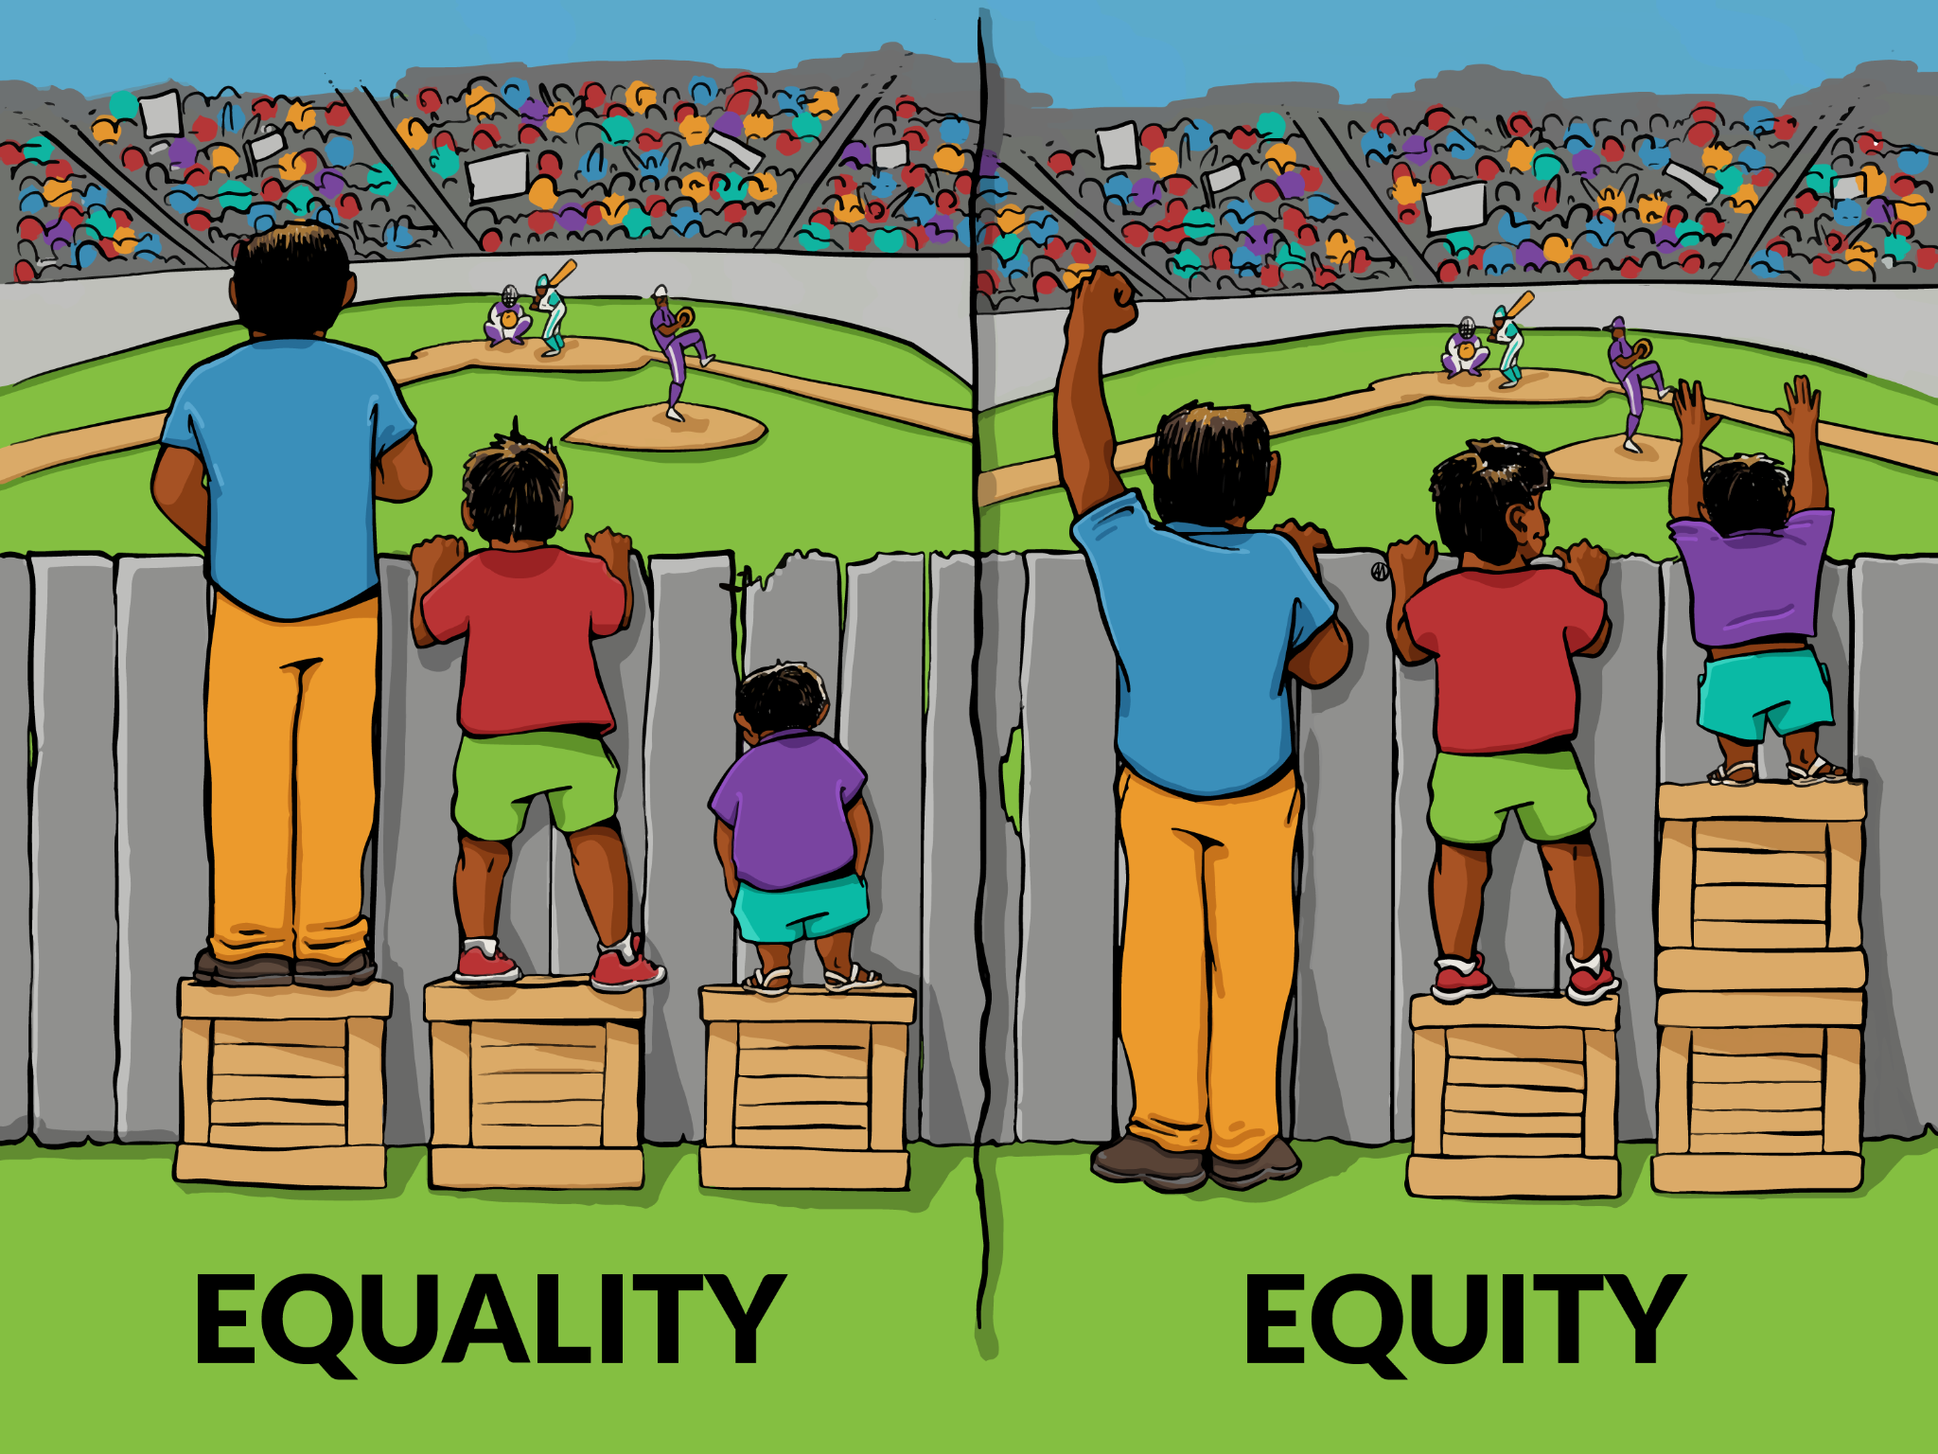
What is EDI?
Equality: the absence of discrimination
on the basis of specific grounds: gender, age, race, socio-economic status, sexual orientation, civil status, family status, disability, religion, membership of the Traveller community (Equal Status Acts, 2000-2018)
equality versus equity (incl. positive differences)
Diversity:
understanding and respecting difference among members
Inclusion:
‘an individual’s sense of identification or positioning in relation to … the community, which may yield an affective response’ (Strayhorn, 2022)
(Belonging: a priori or empirical?)

Slide 4
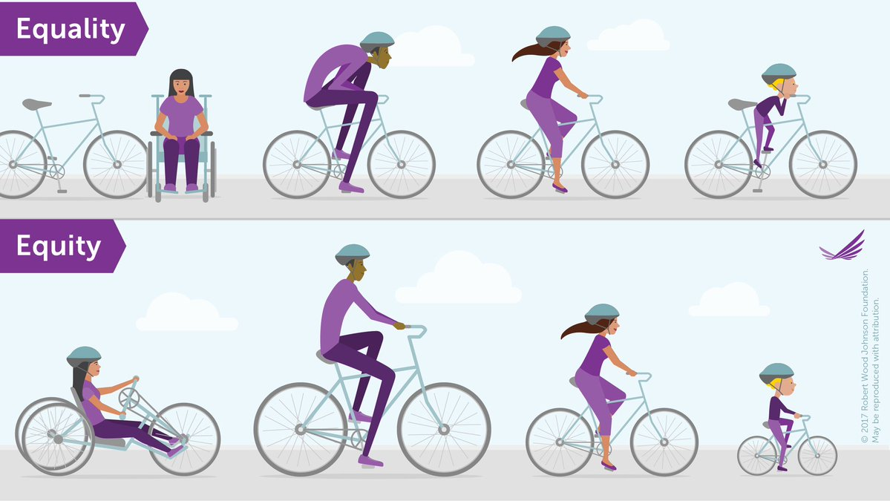
EDI in Higher Education Institutions
EDI training in an HEI should…
create/strengthen a sense of belonging (EDI⇒B)
“yield an affective response”
"If students feel like they belong [academically], they excel, thrive, and persist through college". (York & Fernandez, 2018)
Increase engagement & involvement (incl. in EDI conversations & initiatives; Strayhorn, 2022)
EDI in practice – 2 aspects + 1 consideration:
How staff engage with the world
How staff act in daily life
No one size fits all – staff can and must adapt to their own environment’s needs
Notes:
How staff engage with the world: training gives tools & information about possibly unfamiliar areas, like Trans terminology, the effects of ASD on time management. How staff act in daily life: incorporating training into work practices (e.g. including non-binary options on surveys; implementing universal design & consistent messaging) No one size fits all: If your end aim is for everyone to cycle (to school/work), it’s not enough to just give them a bike. You need to look at and meet their individual needs.

Slide 5
What is an SIG?
Special Interest Groups further the aims of SAI’s mission + strategic plans by …
…providing a forum to share information, address common issues, develop best practice policies;
…acting as a mutual support forum for student issues
…conducting research and advocacy
Notes:
PURPOSE: The purpose of the Equality, Diversity and Inclusion (EDI) SIG is to provide a space for Student Affairs Professionals working in higher education (HE) in Ireland to explore how their work can support students from diverse backgrounds and improve outcomes for all. The SIG provides a platform for discussion and collaboration on EDI-related matters. It provides a space to share best good practice and to collaborate on EDI-related projects and initiatives. It also provides a space to find and offer peer support and to work collaboratively on research and projects.

Slide 6
HEIs Represented in EDI SIG
(so far)

Slide 7
What is an SIG?
EDI Special Interest Group:
Purpose: “... explore how our work can support students … share good practice & collaborate … offer peer support”
Supporting UN Sustainable Development Goals
no.4 (quality education),
no.1 (end poverty),
no.5 (achieving gender equality & empower women+girls),
no.10 (reduce inequalities)
Since autumn 2023, narrow focus (hoping to expand)
Notes:
PURPOSE: The purpose of the Equality, Diversity and Inclusion (EDI) SIG is to provide a space for Student Affairs Professionals working in higher education (HE) in Ireland to explore how their work can support students from diverse backgrounds and improve outcomes for all. The SIG provides a platform for discussion and collaboration on EDI-related matters. It provides a space to share best good practice and to collaborate on EDI-related projects and initiatives. It also provides a space to find and offer peer support and to work collaboratively on research and projects. Since autumn 2023…The group has focused on collating data on the state of EDI training in HEIs around the country – particularly in the HEIs represented in our group – and discussing questions which arose from this task.

Slide 8
Training surveyed

Slide 9
Training/Upskilling Opportunities
Common to (almost) all HEIs surveyed
Equality, Diversity & Inclusion in Higher Education (offered in 8 of 11 HEIs)
Race Equality in Higher Education via Irish Universities’ Association (8/11)
Unconscious Bias (8/11)
Gender Identity and Expression (7/11)
Women in Leadership, incl. Aurora* (7/11)
Inclusive Classroom (7/11)
Bystander Intervention (4/11)
Unique but effective
University Design Beyond the Classroom digital badge
Continental European practices
What else?
Notes:
Universal Design URL: https://opencourses.ie/opencourse/universal-design-beyond-the-classroom/ What else? = a prompt to ask the audience

Slide 10
Comments on Findings
PROBLEM: HEIs differ in access to / variety of training courses (e.g. a large university vs a small HEI)
SUGGESTION: SAI facilitate training solutions to its members SAI EDI passport / award
PROBLEM: EDI training is “bitty” (“known unknowns”, “unknown unknowns”)
SUGGESTION: An easily and regularly maintained database of EDI training; promotion (to line managers) of EDI training
PROBLEM: Siloed data indicating uptake of EDI training
SUGGESTION: To what extent should we monitor training and to what extent, if at all, should we share these data between HEIs? Should training be mandatory?
Notes:
PROBLEMS will appear one by one; each SOLUTION is just a suggestion, and will prompt the speaker to pause for a brief open-floor discussion

Slide 11
What next?
or, More! More! More! (How do you like it? How do you like it?)
More members More HEI representation More research & discussion More ideas
More HEI collaboration More data More recommendations & rewards
More Belonging More equity More diversity More inclusion
Notes:
PROBLEMS will appear one by one; each SOLUTION is just a suggestion, and will prompt the speaker to pause for a brief open-floor discussion

Slide 12
References
French AE & Price-Williams SR (2022), “Economic Stratification in Higher Education”, in Bentrim EM & Henning GW (eds.) The Impact of a Sense of Belonging in College. Virginia : Stylus
Hallet R, Kezar A, Kitchen J, Perez R (2022), “Facilitating a Sense of Belonging for Students with Multiple Identities”, in Bentrim EM & Henning GW (eds.) The Impact of a Sense of Belonging in College. Virginia : Stylus
Irish Human Rights & Equality Commission (n.d.), Equal Status Acts. Available at https://www.ihrec.ie/guides-and-tools/human-rights-and-equality-in-the-provision-of-good-and-services/what-does-the-law-say/equal-status-acts/ (Accessed 31 May 2024)
Strayhorn TL (2022), “Unravelling the Relationship among Engagement, Involvement and Sense of Belonging”, in Bentrim EM & Henning GW (eds.) The Impact of a Sense of Belonging in College. Virginia : Stylus
Tovar E & Simon MA (2010), “Factorial Structure and Invariance Analysis of the Sense of Belonging Scales”, in Measurement and Evaluation in Counseling and Development, 43(3), pp.199–217 Available at https://www.tandfonline.com/doi/epdf/10.1177/0748175610384811?needAccess=true (Accessed 28 May 2024)
UCD (2018), Equality, Dignity & Inclusion Policy. Available at https://www.ucd.ie/equality/information/policies/ (Accessed 28 May 2024)
Vaccaro A & Newman B (2022), “Theoretical Foundations for Sense of Belonging in College”, in Bentrim EM & Henning GW (eds.) The Impact of a Sense of Belonging in College. Virginia : Stylus

