Slide 1


The 3Set Model for Innovation in Student Mental Health and Wellbeing
A Peer-led Transition Example

Slide 2

Today’s Presentation
Brief overview of the 3Set Project
The 3Set Model for Innovation in Student Mental Health & Wellbeing
Defining student success
The 6 Influences
The 10 mechanisms, using the S2S mentoring programme as an example
Summary

Slide 3

3 Work Packages – One Mission:
Innovation & Transformation
Meaningful Data
National standards for the collection of data in SCSs
Memorandum of understanding with PCHEI
Establish a Practice-Research Network
Database for the collection of SCS data nationally
Outcome measures for routine evaluation
SynthSCS
Assist HEA with National Student Mental health and Suicide Prevention Framework
Partnerships/ collaborative networks
Resource repository of tools for SCSs
Dissemination of key tools and resources nationally, including:
  CAMS training
  50808
Peer-led Transition
Integrated model for peer-led social, emotional and academic transition
Measure benefit of participation (first-years and volunteers)
Best practice guidelines for peer-led transition programmes
Volunteer management data system
National consortium for peer-led transition

Slide 4
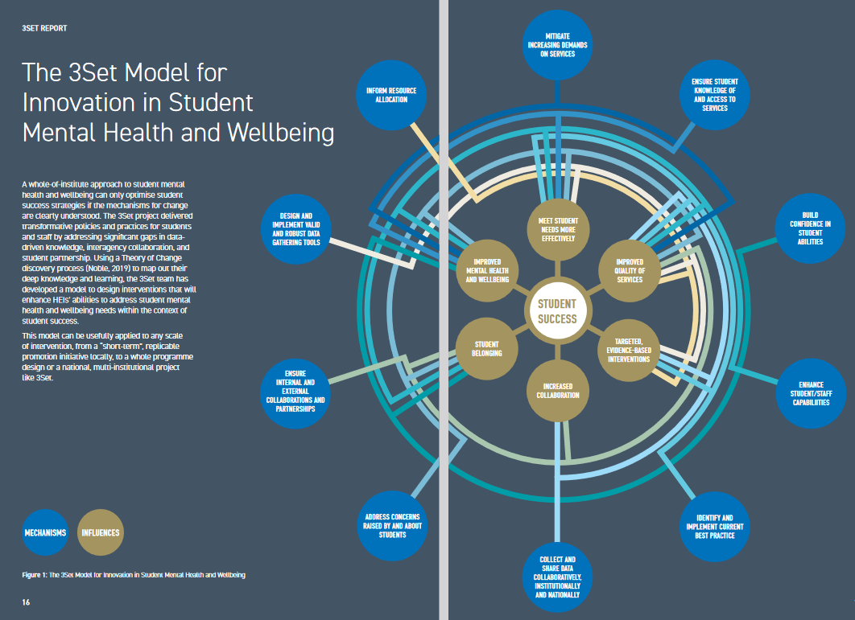

Notes:
Emma Carroll (DkIT) at recent Healthy Campus Conference: “Every single action on campus has the potential to act for student mental health

Slide 5
Notes:
Braxton, J. M. (2006). Faculty professional choices in
teaching that foster student success. National Postsecondary
Education Cooperative.
Kuh, G., Kinzie, J., Buckley, J. A., Bridges, B. K., & Hayek, J.
C. (2006). What matters to student success: A review of the
literature. National Postsecondary Education Cooperative.
O’Farrell, L. (2019). Understanding and enabling student success
in Irish higher education. National Forum for the Enhancement of
Teaching and Learning.
NFTL Forum Insight Sept 2019: Towards a National Understanding of Student Success

Slide 6


Slide 7
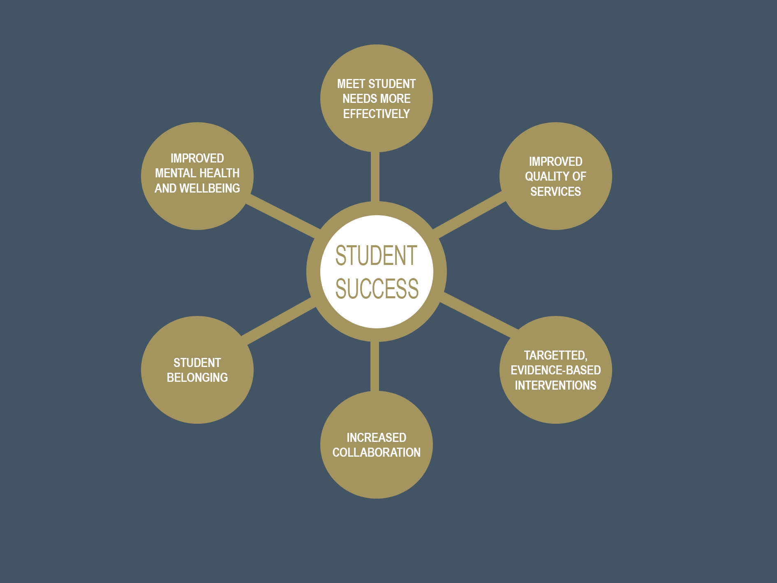
INFLUENCES
Notes:
Note how they are not separate elements – belonging informs mental health, collaboration (especially with student partners or co-creators) enhances belonging and so on…

Slide 8
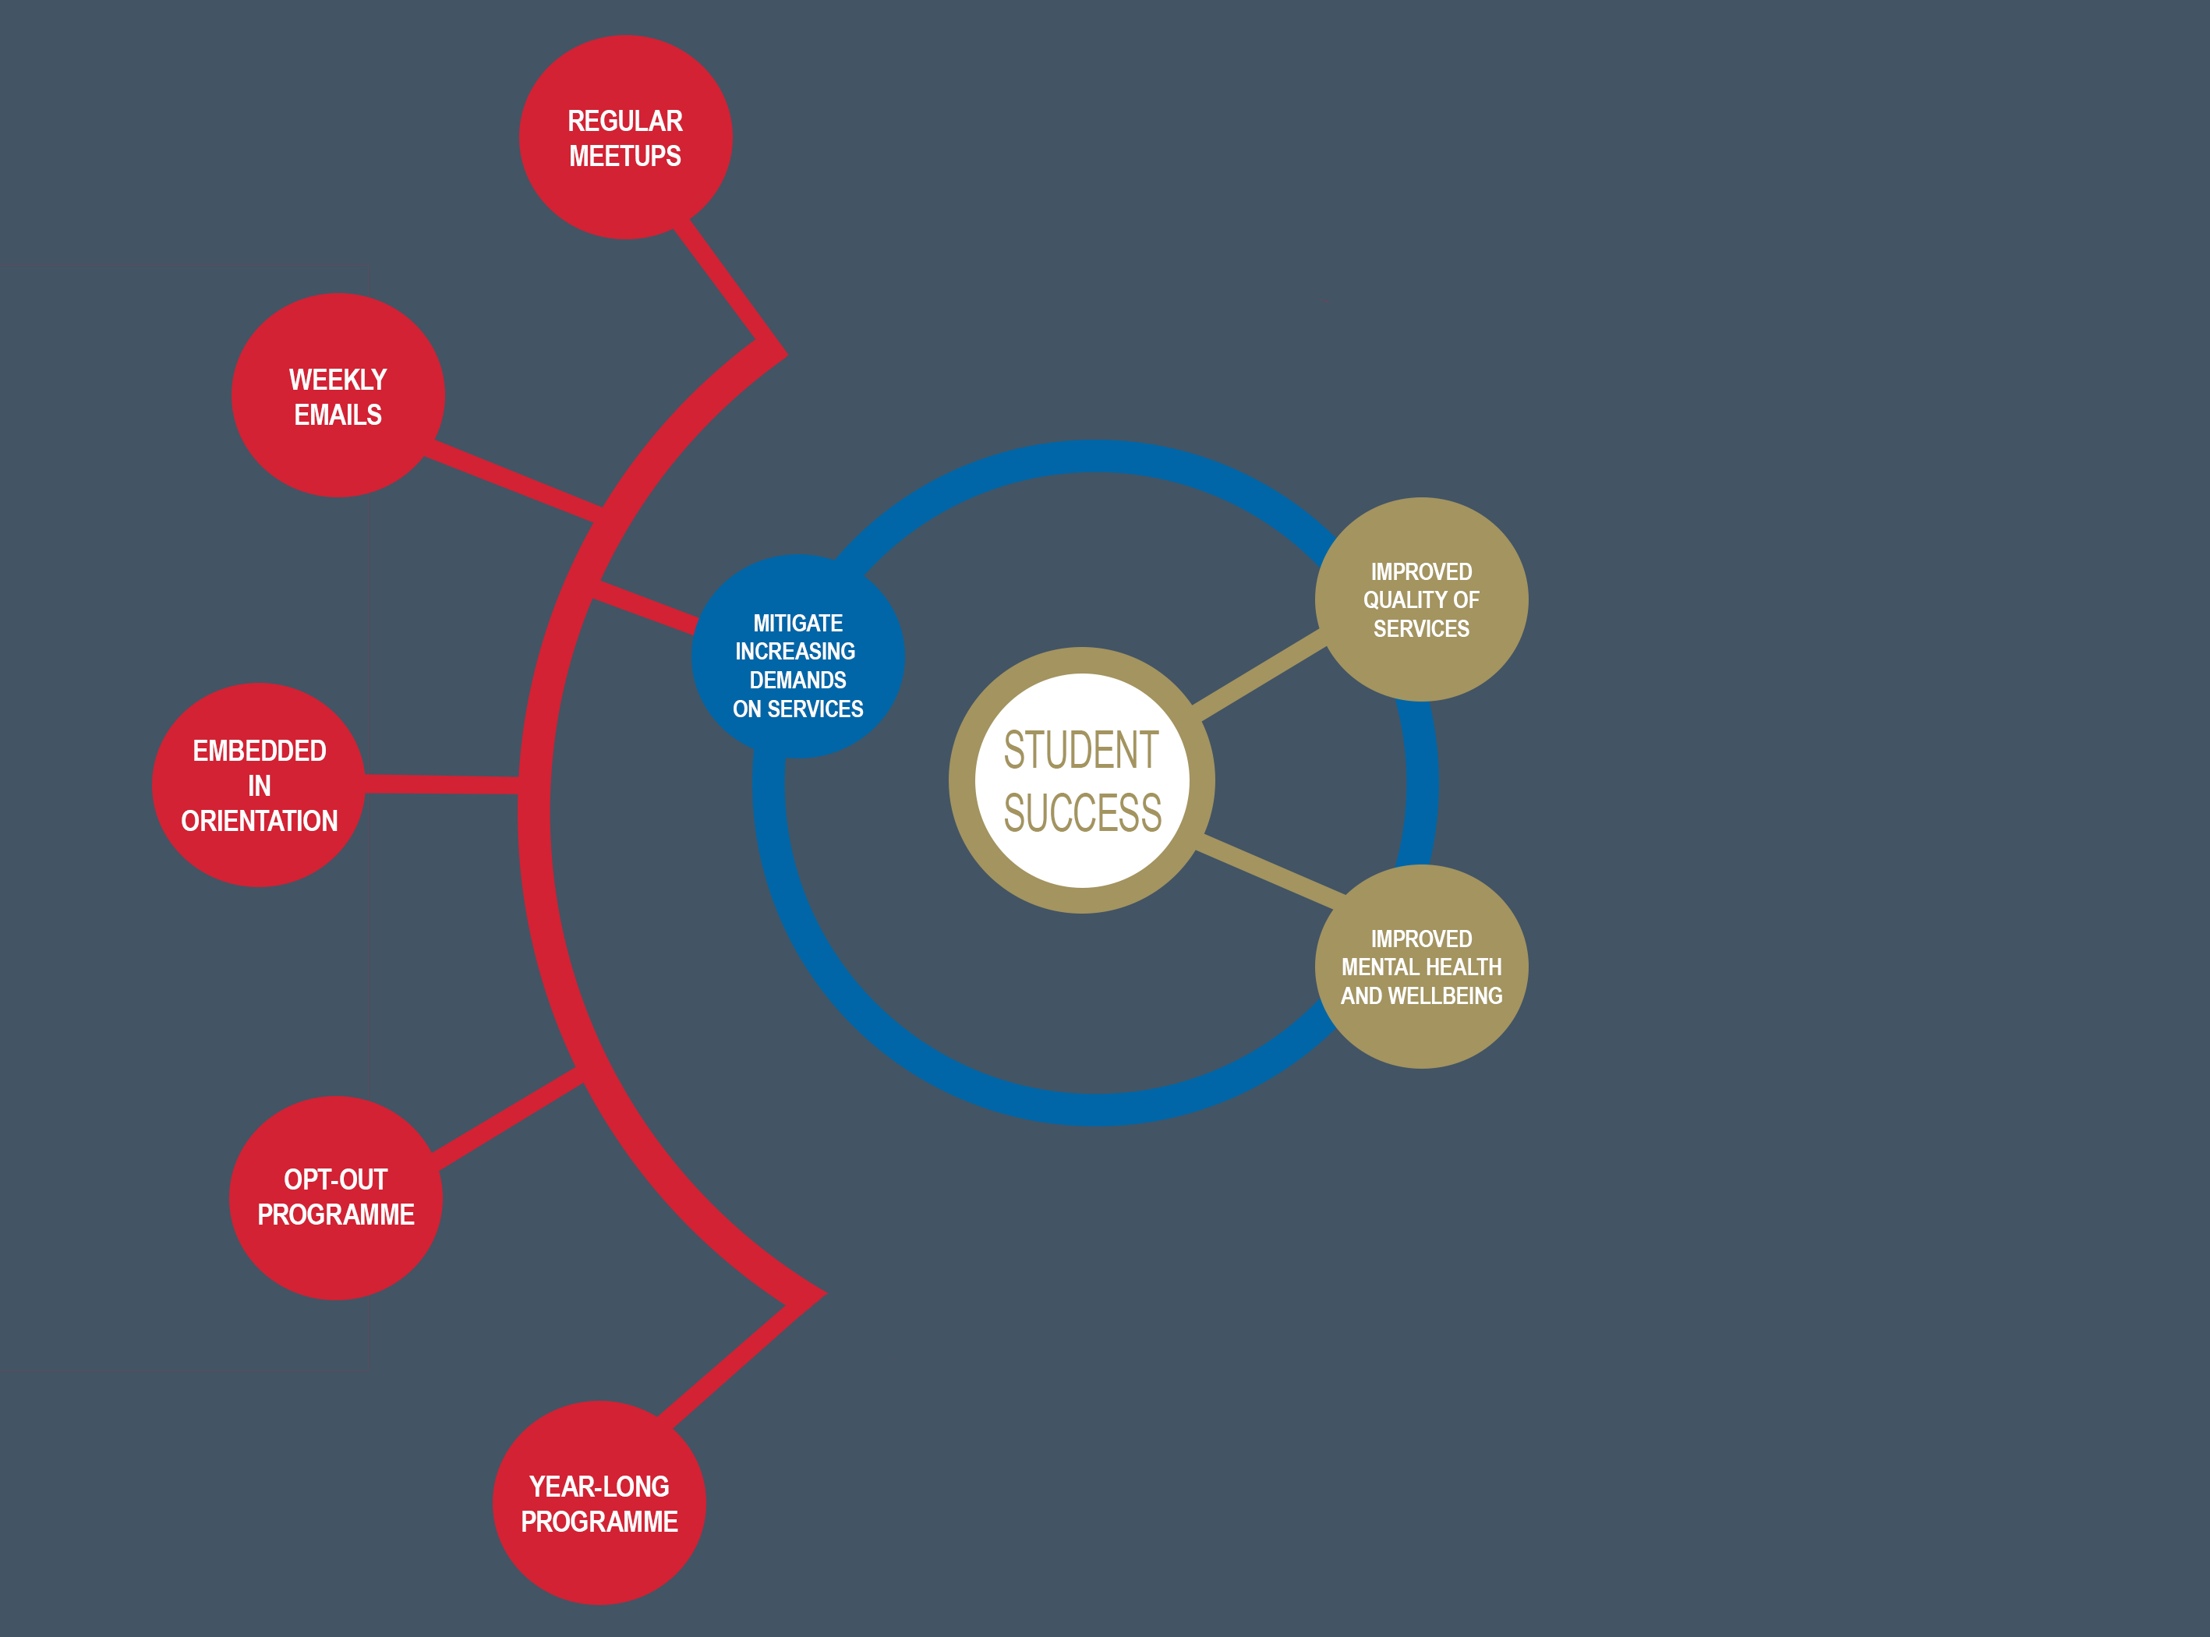
WORK PIECES
MECHANISMS
INFLUENCES
Notes:
Mentors ease immediate transition to university by providing campus tours and Q&A session. Throughout the year sending weekly emails and organising events where they are accessible to student who have any queries. First point of contact for any immediate course and college life queries. Emphasise importance of opt-out (so no one gets left behind) and year-long.

Slide 9
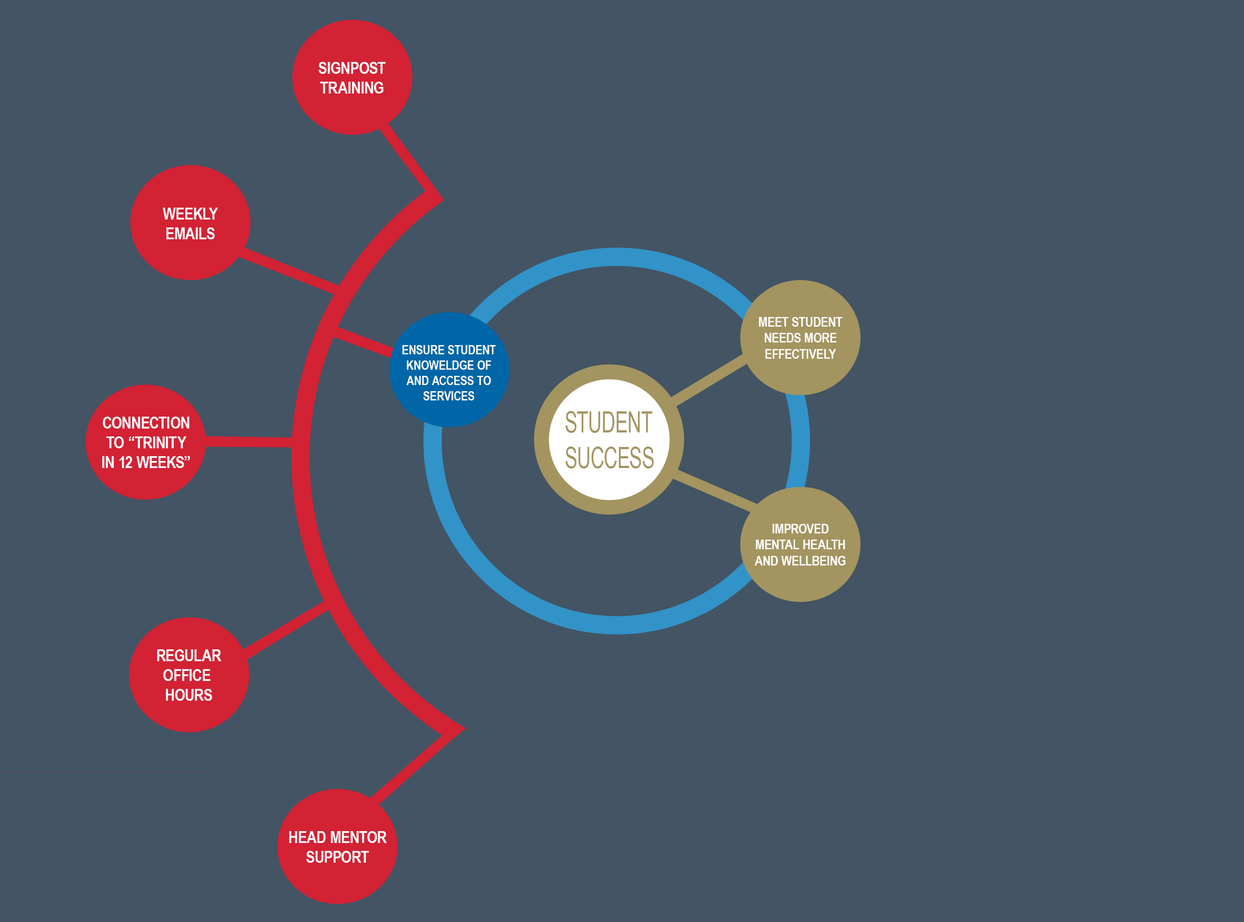
WORK PIECES
MECHANISMS
INFLUENCES
Notes:
Mentors are trained in signposting and referral, and encouraged not to believe they have to know everything – they can always come and ask. Office hours and Head Mentors as more approachable resource.
Weekly emails sent to drip feed information to students which include information about the SU, course information, academic supports, health and wellbeing information, beginning with Trinity in 12 weeks (Eimear Rouine)

Slide 10
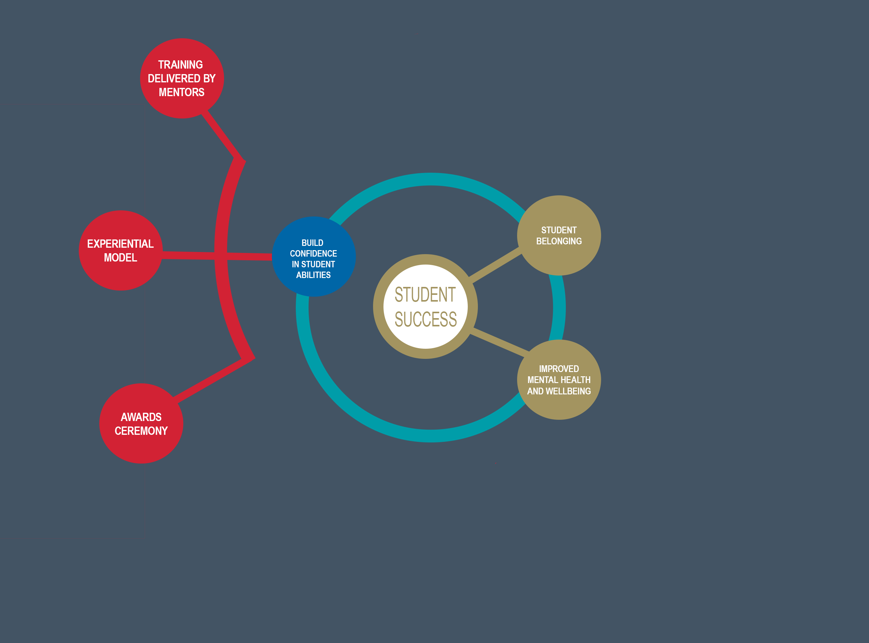
WORK PIECES
MECHANISMS
INFLUENCES
Notes:
Mentors/ Head Mentors are trained and supported to deliver 4hour mentor trainings in pairs to over 500 students throughout March-May. Imparts confidence that this is a student-delivered programme, and that the students are the authority.
The experiential model means students are encouraged to see their own experience as relevant and valuable.
End of year award ceremony, hosted by the TCD Provost, celebrating volunteer contributions along with highlighting outstanding contributions, special awards for involvement and crystal awards for specific individuals. The Awards Ceremony is a very public way of sharing volunteer initiatives and achievements with the wider College body – builds trust and esteem.

Slide 11
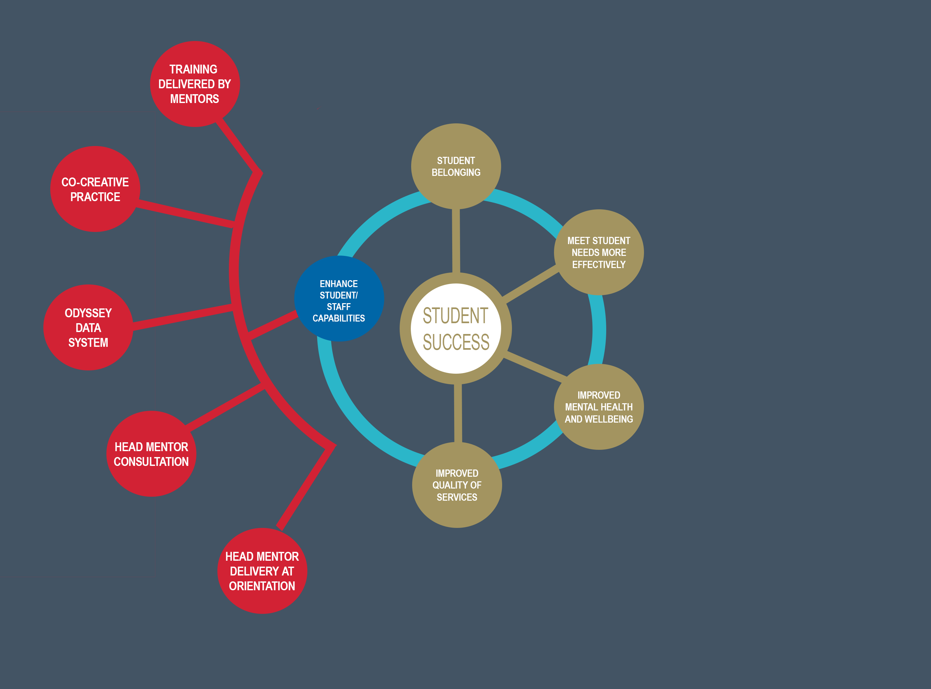
WORK PIECES
MECHANISMS
INFLUENCES
Notes:
Head Mentors provide on the ground information specific to their Head Mentor area at monthly meetings, allowing staff to remain up to date with the wider programme. With orientation sessions happening in the evening, Head Mentors manage smaller orientation sessions, allowing staff to manage the larger sessions so that all sessions can be completed in the one week.
Specific purpose data management system where all applications, training dates, group information and logged hours are stored and processed lessening the administrative load, and allowing for quality assurance.

Slide 12
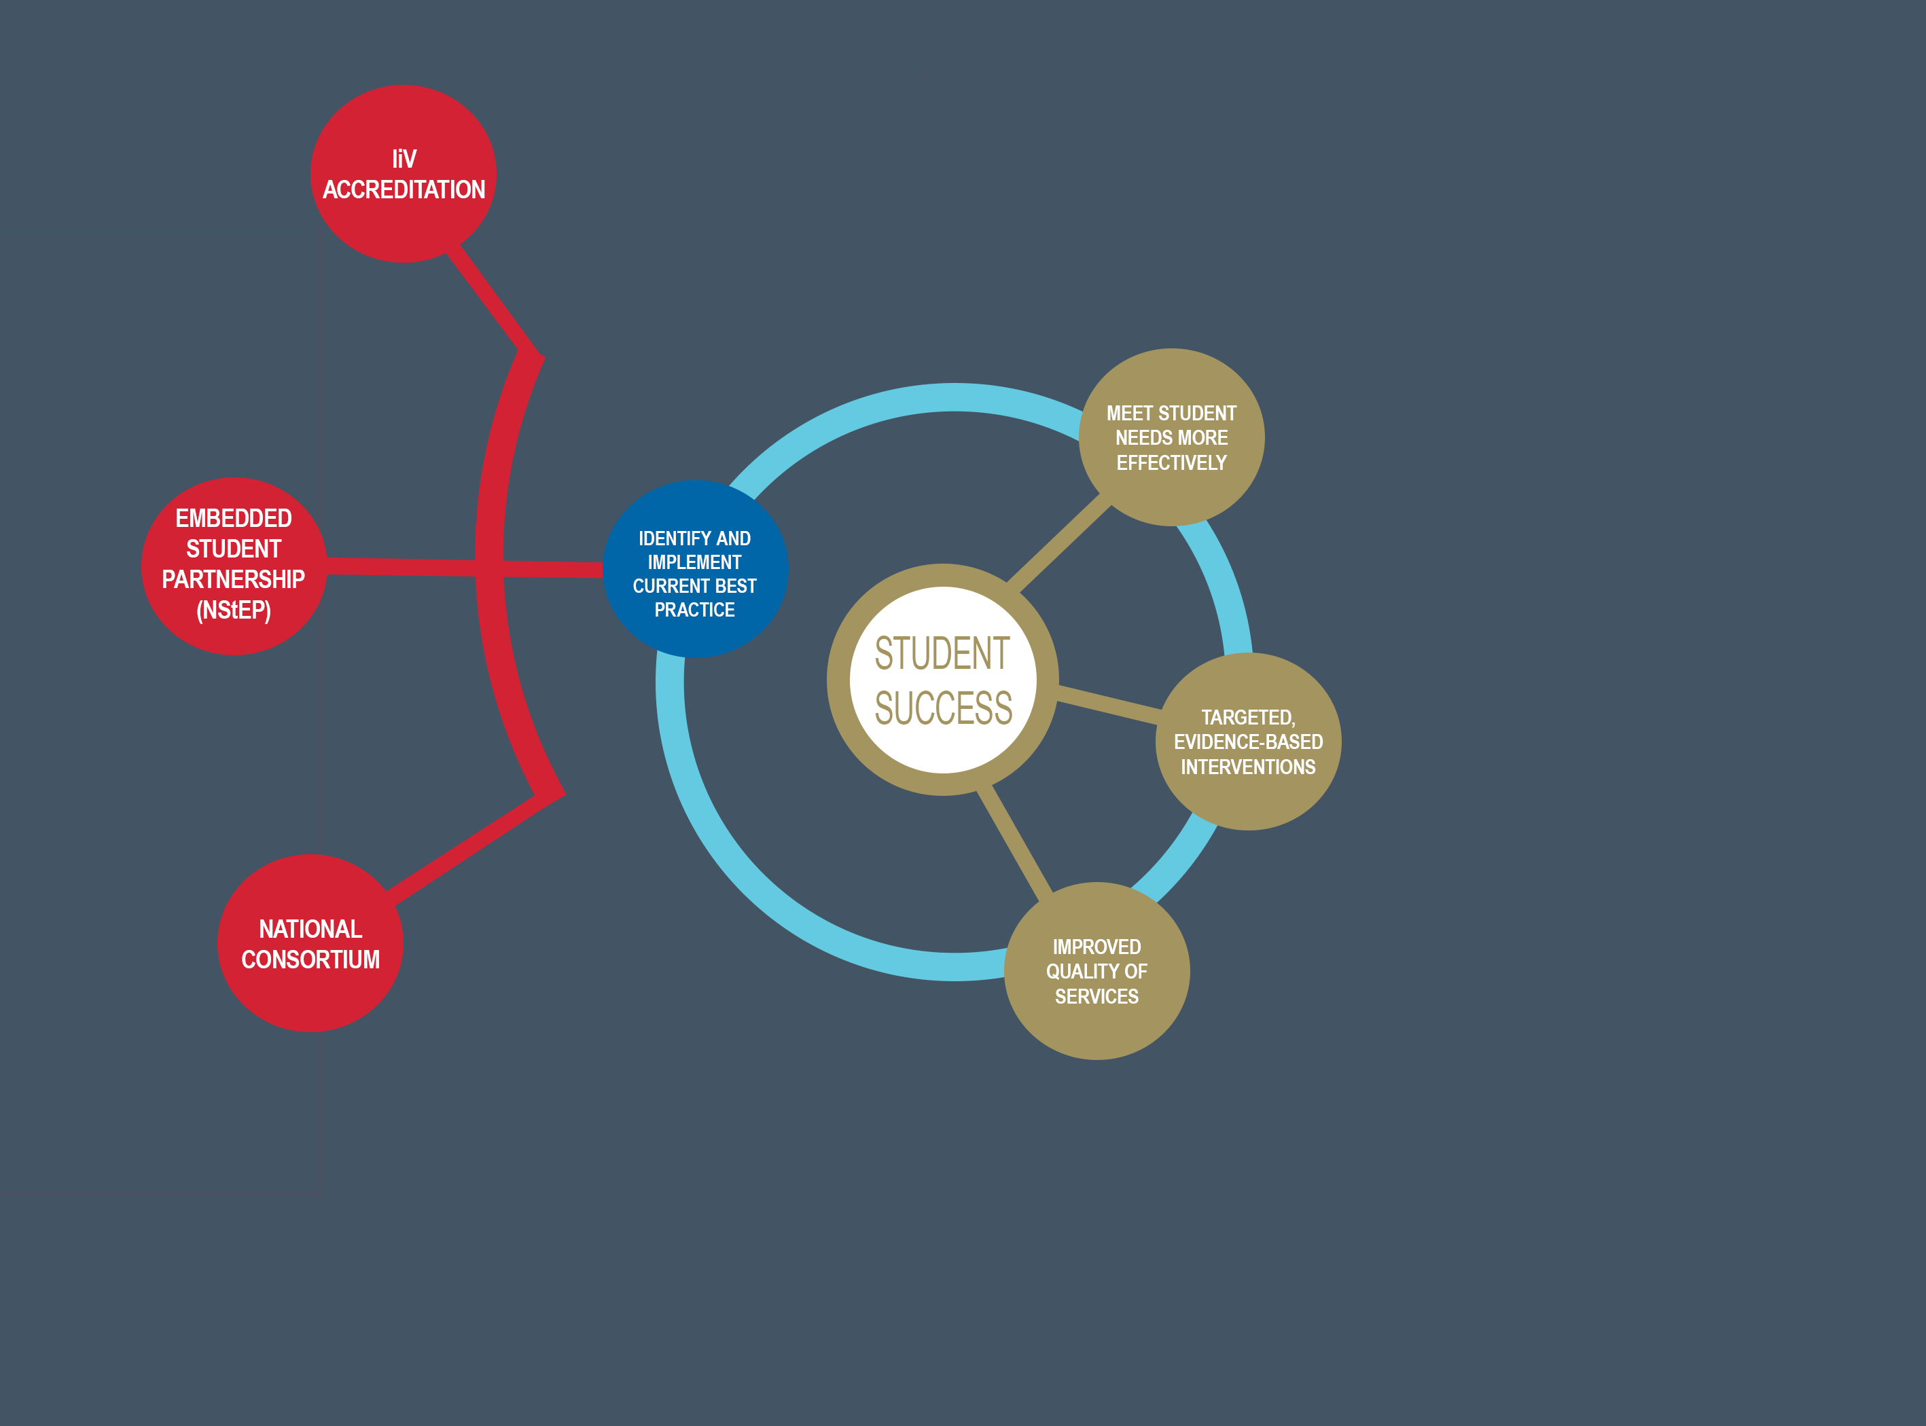
WORK PIECES
MECHANISMS
INFLUENCES
Notes:
In 2021, S2S achieved the accreditation for best practice when managing a volunteer programme ensuring appropriate polices are in place, support structures, recruitment processes, volunteer inclusion and volunteer celebration. Accreditation process ensured best practice standards are being met.
Worked with NStEP during the 3Set project and adopted student partnership practices, including training staff to increase their confidence in student abilities, and students to hold confidence in their voice with staff-led groups.
National Consortium designed to share best practice between peer-led transition programmes.

Slide 13
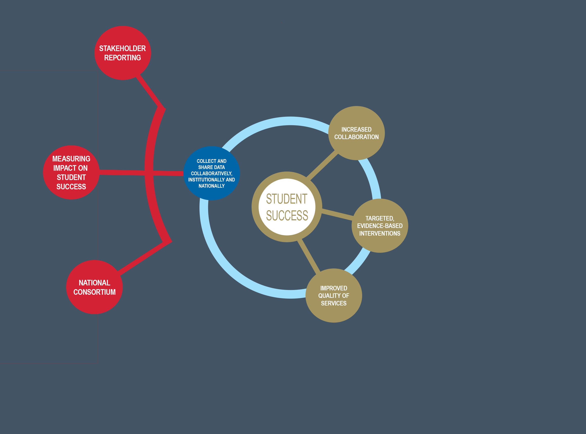
WORK PIECES
MECHANISMS
INFLUENCES
Notes:
National Consortium - Monthly meeting of representatives from HEI's sharing information about Peer Led transition, areas for learning and issues that are presenting. New programmes have the benefit to hear from established programmes, while other programmes can share the difficulties and potentially hear how other programmes have addressed that issue.
Measuring Student Success - Development and implementation of a national measure tracking the impact of programmes on resilience, sense of belonging and academic self-efficacy that can be adopted by other programmes, creating a national data set.
Reporting annually through SCS annual report, and with top-level figures in infographics for funders, academic departments and student services colleagues.

Slide 14
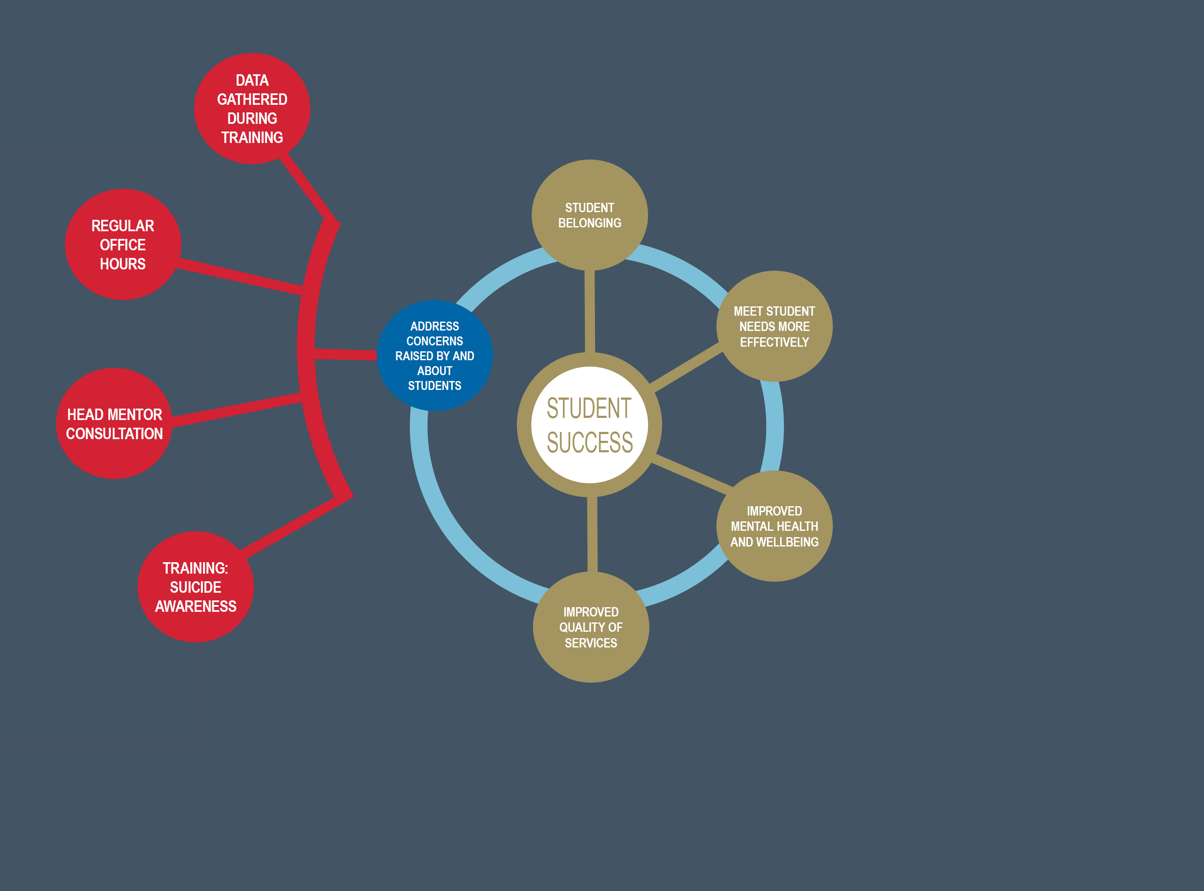
WORK PIECES
MECHANISMS
INFLUENCES
Notes:
Collecting data during training about what students remember to be the most pressing issues/concerns they had.
Regular office hours for volunteers to bring any issues/concerns to us directly.
Head Mentors meet monthly to update Staff on their Head Mentor area bringing any concerns or challenges being experienced, support needs of both students, mentors and head mentors. Head Mentors have opportunity to hear how other groups are doing and similar challenges or solutions they may have.
All volunteers trained in basic suicide awareness, referral and self-care.

Slide 15
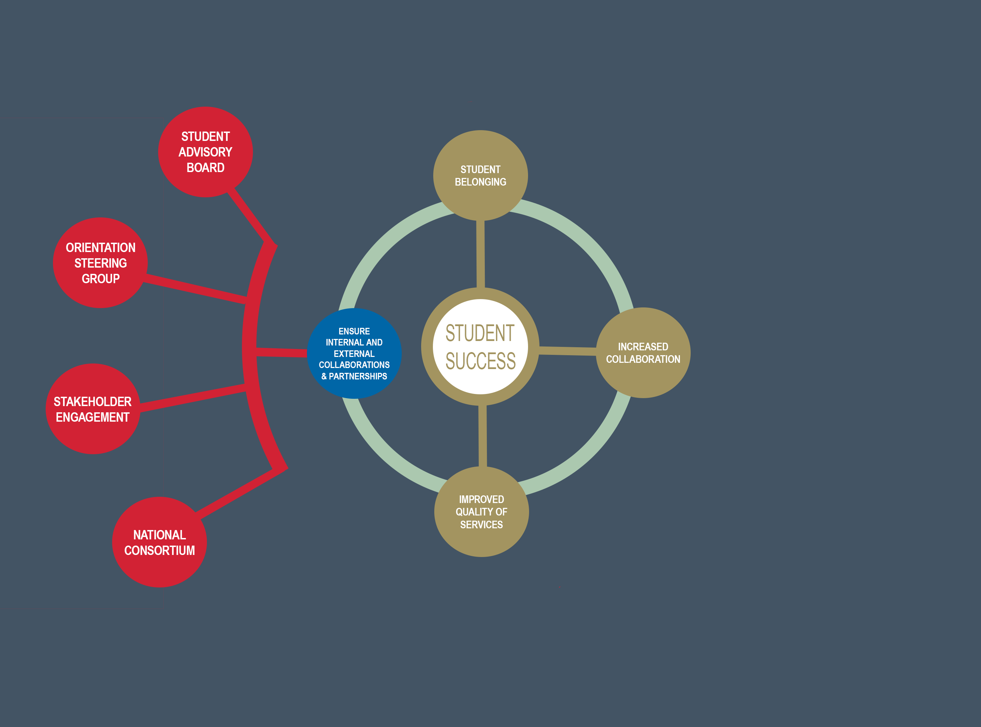
WORK PIECES
MECHANISMS
INFLUENCES
Notes:
Recruitment for student advisory board is done on a yearly basis from current cohort of students inviting new students to join, along with involvement from partners within counselling service, S2S, SLD and the Students Union. All members are collectively trained in student partnership.
Monthly meetings to prepare for 1st Year Orientation, working closely with transition office, enquires and the library to organise rooms and tours. Attending bi-weekly outreach meetings with the counselling service, student advisory board and Students Union.
During monthly National Consortium meetings there is the opportunity to share knowledge and learnings across different programmes. The need for a national measure is supported by the research and action to develop this measure came from the national consortium

Slide 16
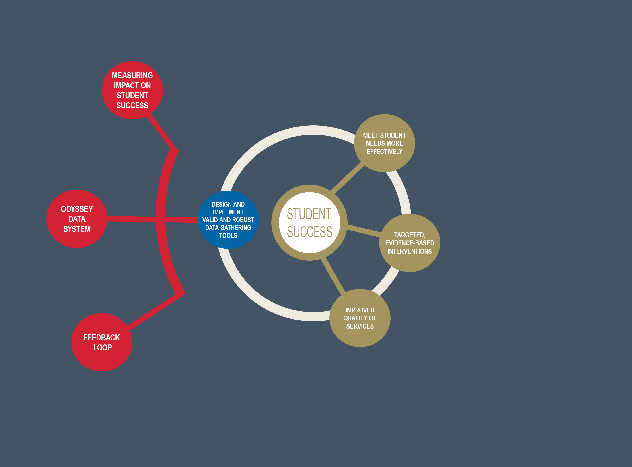
WORK PIECES
MECHANISMS
INFLUENCES
Notes:
Designed, established validity and began the implementation of a measure for student success delivered through anonymous survey that is distributed to both 1st year students and volunteers. The same measures can be used nationally across multiple programmes using the same rubrics yearly
Volunteer data collected and held securely in Odyssey data system, which also allows for reporting on volunteer activity (including minimum wage equivalence for volunteer contributions), as well as references etc.
Experiential activities within training module that asks students directly questions they had coming into university, concerns they might have had and what they would have liked to know about library resources.
Volunteers are also invited to reflect on their training and experience in the programme, and to suggest improvements annually

Slide 17
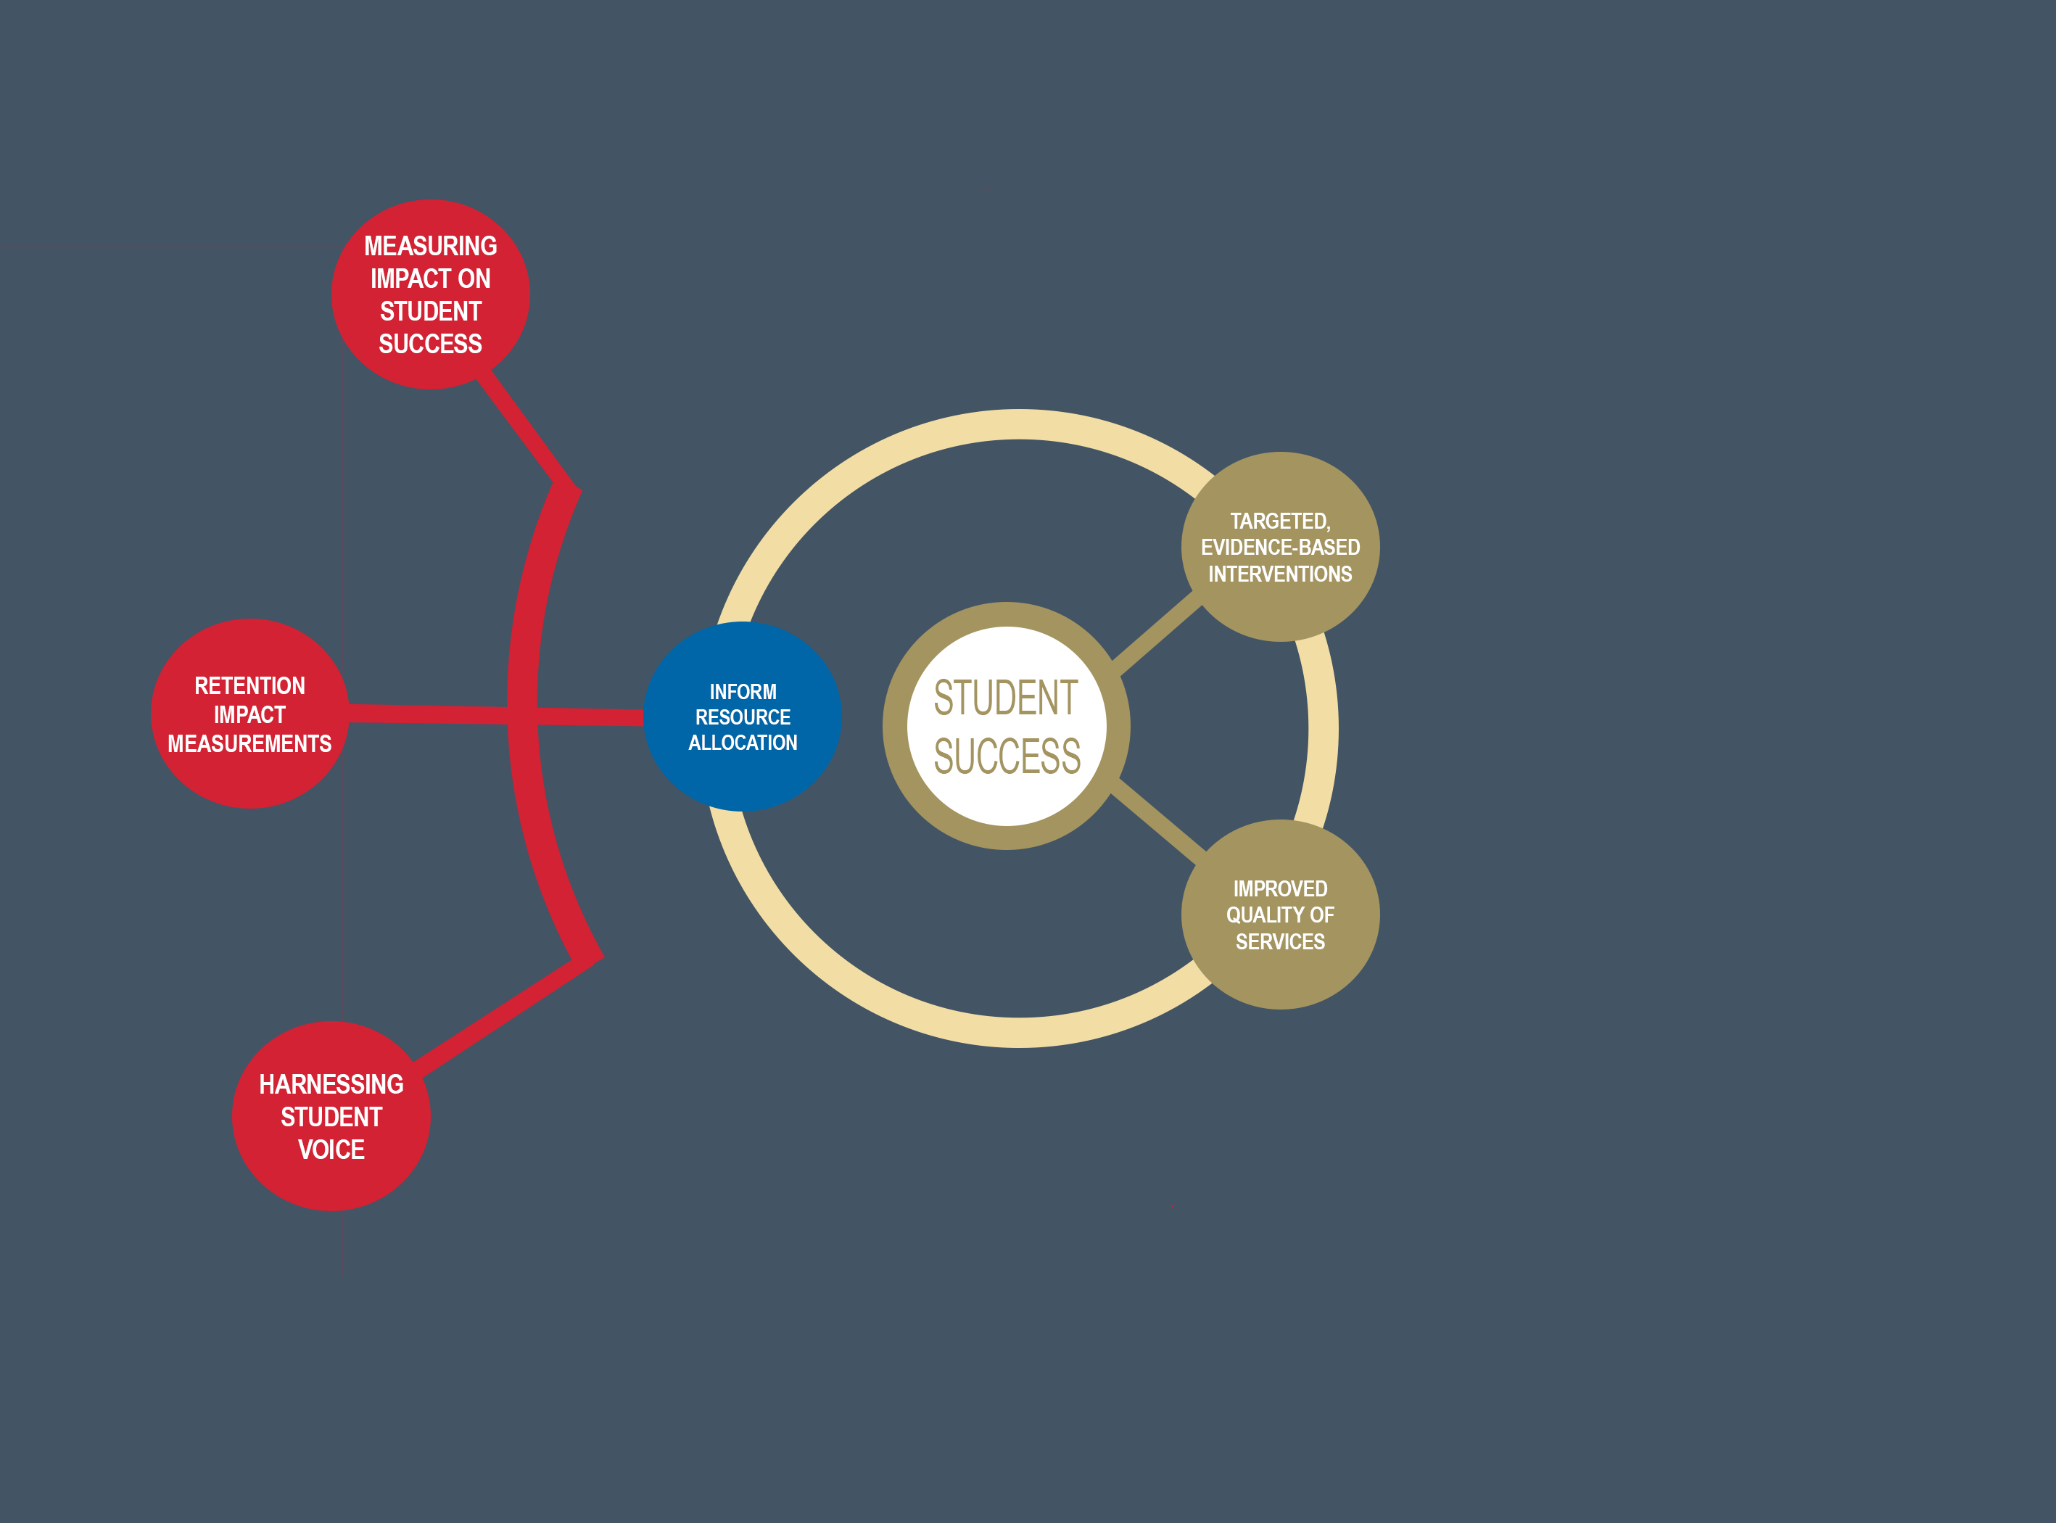
WORK PIECES
MECHANISMS
INFLUENCES
Notes:
Already mentioned salary equivalence report for volunteer hours logged.
Previously have calculated savings to the College based on the number of students who indicated the Mentor programme was strongly or very strongly an influence in their decision to stay in College past first year.
Most effective arguments for funding do not come from staff, but from the student body and the feedback they give as first years and as volunteers, including former volunteers who take roles in the SU and advocate strongly for more supports

Slide 18
STUDENT PARTNERSHIP
Meaningfully engaged students are a significant source of relevant and insightful contributions (evidence of theoretical convergence),
Partnership accentuates sense of sense of belonging, self-efficacy and a belief that the HEI cares - so is an intervention in its own right,
Should be campus wide – not just organised student bodies.
“A culture of partnership supports a developmental model of citizenship, that motivates partners to engage in activities that enhance their own learning journey, as well as collective experiences.” ¹
¹ NStEP, Steps to Partnership, https://studentengagement.ie/wp-content/uploads/2021/05/NStEP-Steps-to-Partnership-WEB-VERSION.pdf

Slide 19
In Summary
Academic, social and emotional experiences are not distinct pillars of student success – they are uniquely intertwined,
Robust, systematic data collection has an important role in development and evaluation of student sucess strategies,
No student success strategy is complete without integrating mental health & wellbeing,
Mental health and wellbeing initiatives in higher education are incomplete without student success strategies,
Peer support, peer-led initiatives and student partnerships are invaluable change catalysts.

