Slide 1
Reflect & Connect: ​
A 360° Approach to Work Placement Learning
Theme: Supporting Student Engagement
Susan Lyons, Amy McMullan, Aileen Waterman Ruth McConaill, Jillian O’Mahony & Yvonne Harding
Student Work Placement Team
SAI Conference​
Technology University of Shannon
18th June 2024

Slide 2
UCC Strategic Plan 2023-2028
Goal Two: Student Success
To Provide:
A student-centred, inclusive and digitally enhanced learning environment
A Connected Curriculum and an outstanding student experience
To prepare UCC graduates to make a positive impact

Slide 3
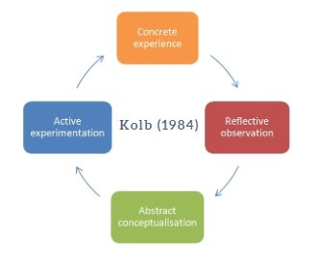
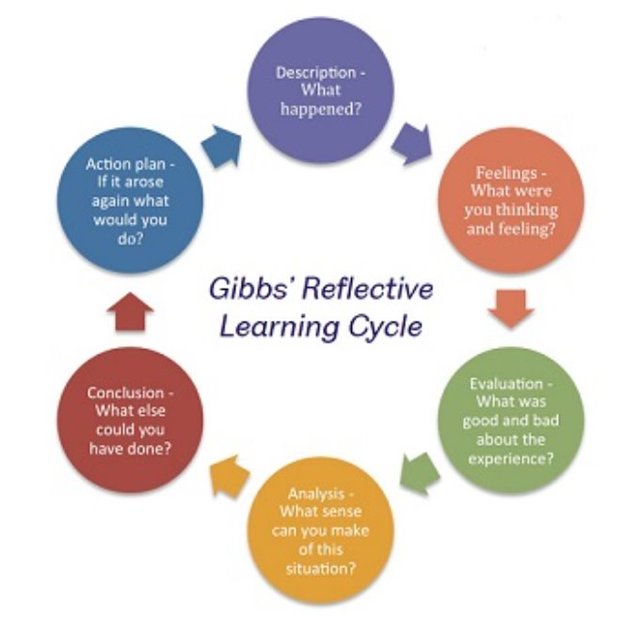
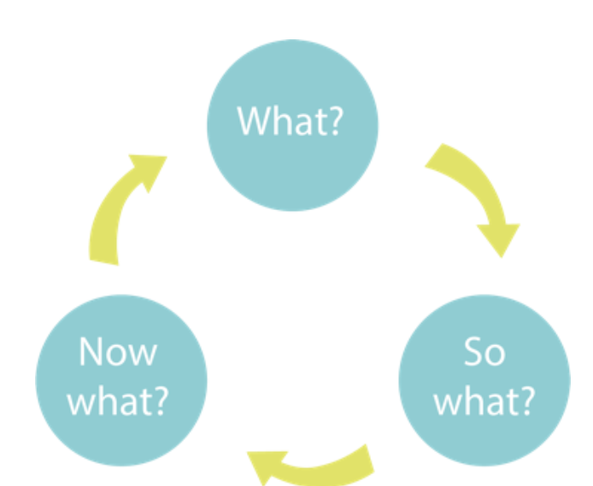
Reflection
Reflective practice is very closely linked to the idea of learning from experience
The act of reflective practice encourages autonomous learning & increasing confidence and responsibility for learnings
Reflecting on tacit areas of work placement practices, students improve their professional development, contributing to increased academic performance and advancement in their employability skills
Gibbs (1988)
Rolf (2001)

Slide 4
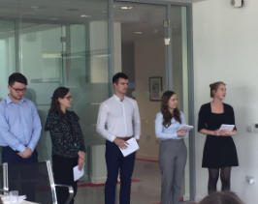
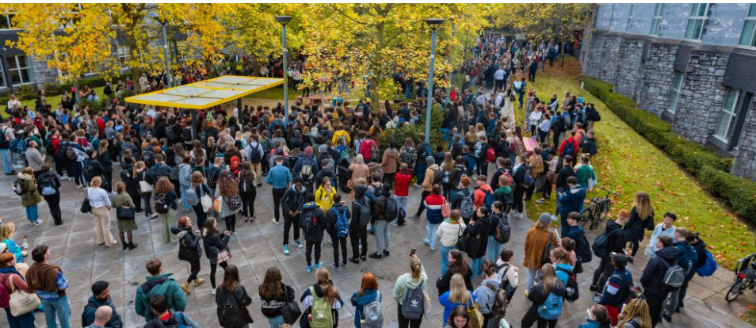
Reflection in Teaching
Reflection on work placement activities is widely used to support student learning in higher education programme
For many placement students in UCC, there is an absence of meaningful evaluation and reflection of their placement and professional learnings upon returning to their final year of study
Identified as a gap in a 360° work placement reflection cycle

Slide 5
Focus Group
BSc Food Science
BSc Nutritional Science
BSc Chemical & Pharmaceutical Compounds
BSc Data Science & Analytics
BSc Biotechnology
32 UG & PG placement programmes supported by UCC Career Services (c.1500 students)
Focus of this study - 11 UG work placement programmes (594 students [2024])
BA Psychology & Computing &
BA Digital Humanities & IT
Scan for a list of pre-placement supports & resources for Year 1 – 3 students
BCommerce
BSc Finance
BSc Accounting
BSc Food Marketing & Entrepreneurship
*BA Economics
*new for 2025

Slide 6
Work Placement Engagement:
Current Practice
Year 1: Light formal work placement/employability sessions; eg BComm Business Plan Competition
Year 2: CV building; Interview Preparation; Self-assessment; Industry Awareness; Job Research; Connection with employers
Year 3: Employability Sessions; Placement meetings; Work Placement
Year 4: No/low formal engagement with work placement experience; Students submit a Placement Summary; BSc Food Sc/Nutritional Sc have a Placement Networking Event

Slide 7
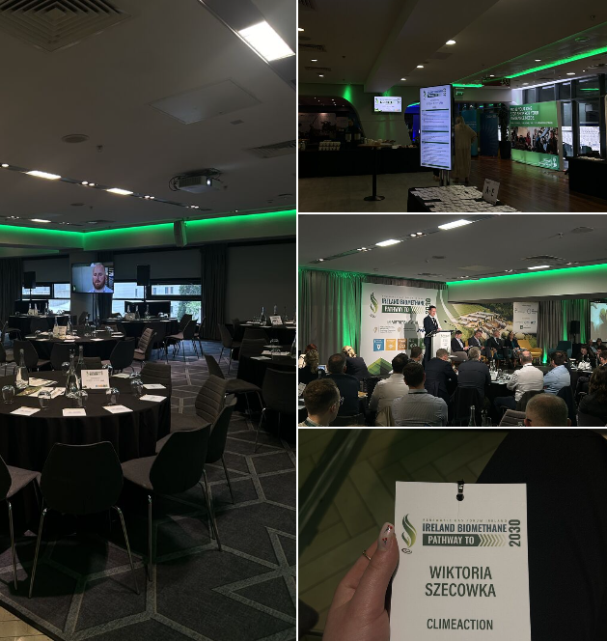
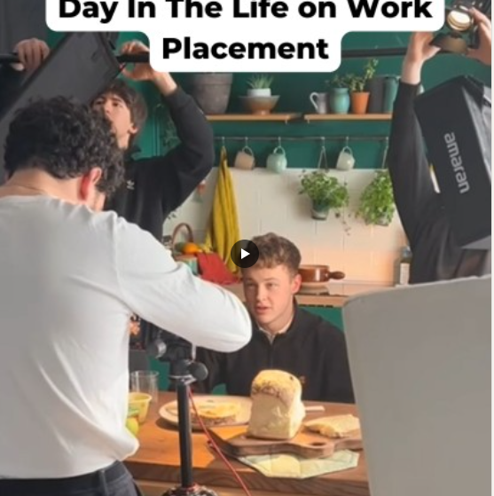
Showcasing Success on Placement
Presenting
Blogging
Vlogging
Podcasts
Journalling
#IAmRemarkable ​
A powerful initiative developed by Google that aims to empower individuals to embrace their achievements and speak openly about their unique talents, skills, and experiences.

Slide 8
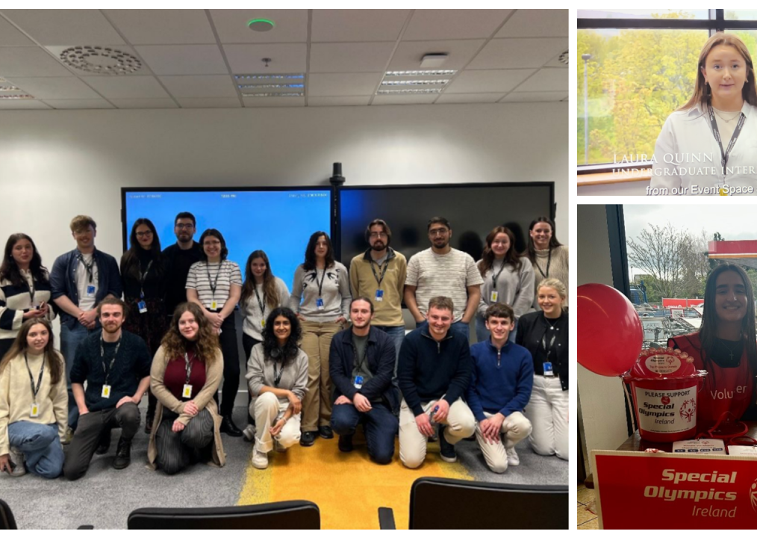
DELL Intern Blogging Experience 2024​
Lessons Learned: Reflections on My Internship
BComm year 3
https://www.linkedin.com/feed/update/urn:li:activity:7205906262687891456/
'As I transitioned from my role as a full-time Commerce student to a Project Management Intern on the Customer Success Team here at Dell Technologies, initially I was anxious that I would not be capable for the role, that I would struggle to make friends and that I would fall behind in comparison to the other interns.''
'I am excited to meet the person I become at the end of my internship.'

Slide 9
The Student Voice
“We did so many presentations on work placement.....then when we came back to college, I thought people would be a lot more vocal ....but people fell back into how they were before....” BSc Accounting Student Year 4
Hear the Student Voice
It’s mentioned in our placement reports, that we may be asked to complete a 10 minute presentation on our activities during placement and what we learned. So I put that together just in case I was asked about it.... but I didn't have a forum to do so in the end.” BA Psychology & Computing Student Year 4
"To prepare for my interview for a graduate programme in Year 4, I went back over my learning logs and final report from work placement which really helped me prepare".
BCom Student Year 4

Slide 10
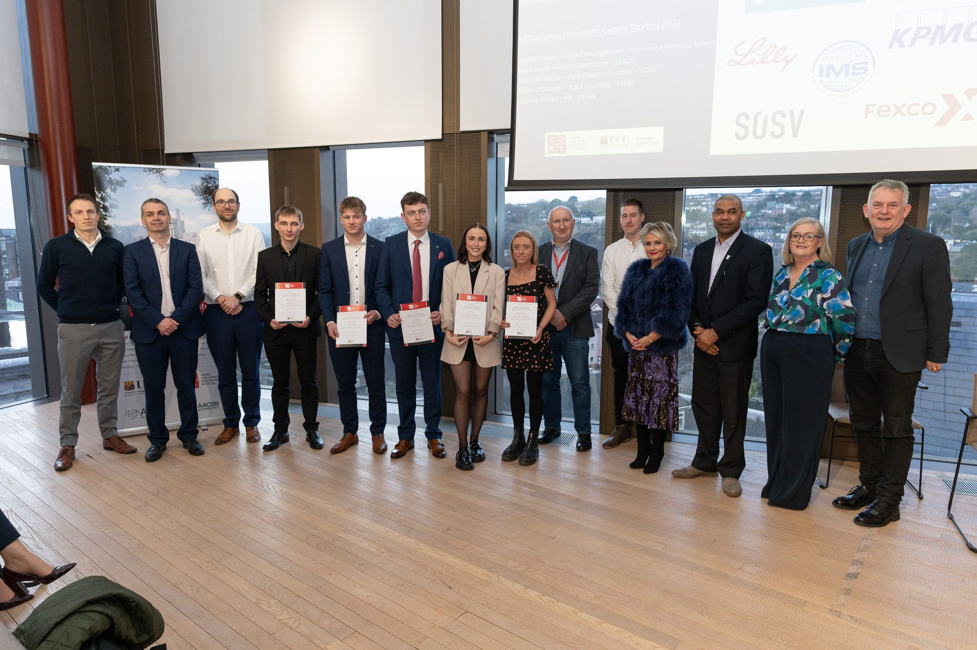
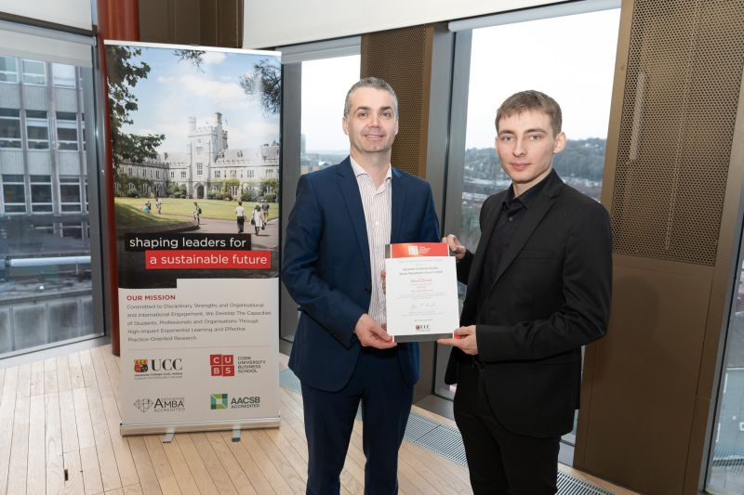
Work Placement Awards
Celebrating Student Success
BComm & Law (2012)​
All CUBS/B&L Undergrad
Programmes
(2024)

Slide 11
Continuous Development Pathways
Graduate Attributes | University College Cork (ucc.ie)
Your Compass | University College Cork (ucc.ie)
ResilienceBookletA4_AW_Interactive.pdf (ucc.ie)
UCC EmployAgility Awards | University College Cork

Slide 12
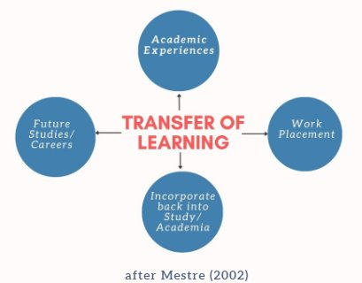
A 360° Approach to Problematising the Gap
Reflect & Connect
Year 2 & Year 3: Introduce a sustained and continuous pedagogical learning pathway to connect with reflection
Final Year: Using placement as a tool to connect with reflective practice

Slide 13
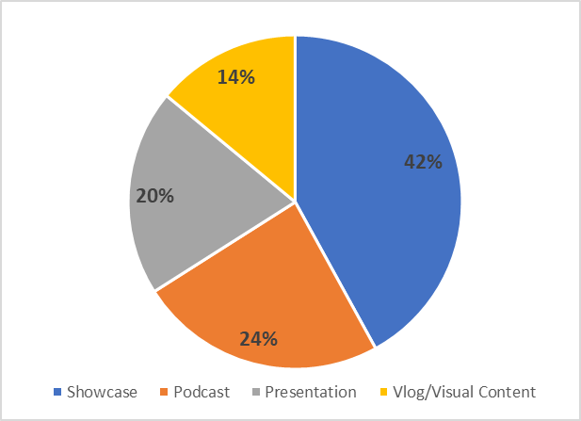
Student Feedback
BComm
Digital Humanities & IT
Psychology & Computing
200+ students surveyed
All respondents responded positively for a platform to showcase their placement learnings/experience

Slide 14
Reflection Strategies in Final Year

Slide 15
Student Success​
A student-centred, inclusive and learning environment​
A Connected Curriculum and an outstanding student experience​
To prepare graduates to make a positive impact

Slide 16
References
Gibbs G (1988). Learning by Doing: A guide to teaching and learning methods. Further Education Unit. Oxford Polytechnic: Oxford.
Kolb, D. A. (1984). Experiential Learning: Experience as the Source of Learning and Development. Englewood Cliffs, NJ: Prentice Hall.
Mestre, J., 2002. Transfer of Learning; Issues and Research Agenda (Report of a workshop held at the National Science Foundation: Department of Physics). University of Massachusetts, Amherst.
Freshwater, D., & Rolfe, G. (2001). Critical reflexivity: a politically and ethically engaged research method for nursing. NT Research, 6(1), 526-537.
Thank You

