Slide 1
Introducing a D&R Workshop designed for Student Leaders catherine.tormey@ucd.ie D&R Response Manager

Slide 2

Background
Incoming students in the first six weeks of term are particularly vulnerable - ‘Red Zone’
Students are most likely to disclose to a friend or peer (Sexual Experiences Survey 2020)
A broad range of Student Leader roles including; Peer Mentors, Residential Assistants, Access Leaders, Sports Club Officers, Society Auditors
UCD Student Support Professionals expressed a desire to make in-person D&R training available to the Student Leaders they support
All case-studies were developed in collaboration with students and Student Support Professionals
Additional video resources were requested and developed

Slide 3
Workshop Overview
Introduction
Core concepts
Case studies
Role, responsibilities and boundaries

Slide 4

Disclosures
Statistics tell us that some people in this room will have experienced bullying, harassment and sexual misconduct to varying degrees.
In order to keep us all safe can we all agree not to disclose personal experiences during this session? Thumbs/nod to show your consent!
Appointments with D&R Support Advisers can be arranged by emailing respect@ucd.ie.
Notes:
Obtain consent (via thumbs up sign) from all participants to ensure they understand their responsibilities and the support available to them.

Slide 5

Support Service Overview
Providing confidential & proactive support to students, employees and community members experiencing bullying, harassment or sexual misconduct
In-person and online appointments available
Supporting both informal resolution and formal complaints
Referring to internal and external specialist services
Independent support for those reporting, reported and bystanders (Three full-time specialist D&R Advisers)

Slide 6




Definitions
ADD TEXT
ADD TEXT
ADD TEXT
Unwanted conduct more than once.
Which could reasonably be regarded as undermining the individual’s right to dignity at the place of work/study
Examples: verbal, insults, humiliation, gossip, exclusion
Unwanted conduct related to the discriminatory grounds
Has purpose or effect of violating a person’s dignity and
creating an intimidating, hostile, degrading, humiliating or offensive environment
Covers a wide spectrum of inappropriate & unwanted behaviours of a sexual nature
Can be perpetrated by a person of any gender. Can occur between people of the same gender
Can occur between strangers, acquaintances including those involved in an intimate relationship

Slide 7


Bullying is not
Reasonable
Reasonable and essential feedback or constructive criticism arising from the management of conduct or performance
Actions taken which can be justified on the ground of safety, health and welfare at work
Differences of opinion, arguments or other interpersonal conflicts which can often occur in a workplace/place of study

Slide 8











THE DISCRIMINATORY GROUNDS IN UCD INCLUDE:
AGE
RACE
CIVIL STATUS
MEMBERSHIP OF THE TRAVELLER COMMUNITY
RELIGION
SEXUAL ORIENTATION
DISABILITY
FAMILY STATUS
GENDER
SOCIO ECONOMIC STATUS
Notes:
I’m sure you are familiar with most of the discriminatory grounds.
Let’s see if we can name them all together, I’ve added some symbols to help us along the way.
UCD has an additional discriminatory ground, which brings us to a total of 10 grounds– does anyone know what that is?

Slide 9
Actions the bystanders might take (4 Ds)
Distract
Delegate
Delay
Direct
Try to influence the situation indirectly such as by changing the topic
Involve other people – seek support
Take action after the situation ends such as checking in with the person or reporting the incident
Ask for the behaviour to stop by calmly addressing the person acting inappropriately where it is safe to do so
Notes:
Brightspace Modules.

Slide 10
Suggested Resolution Options
Highlight
Highlight the unwanted behaviour directly to the person or seek the support of another appropriate individual to highlight the behaviour.
Facilitation
Request a facilitated meeting.
Mediation
Request professional external mediation.
Formal
Submit a formal complaint with the support of your D&R Support Adviser.
Notes:
Not every option from this range is appropriate for each disclosure
The D&R Adviser can provide information and guidance on the options available but it is the person who is disclosing the issue who decides how they wish to proceed.

Slide 11



Case studies
8 minutes to read and discuss
Share your case study with the wider group
All participants will have the opportunity to share the group’s ideas

Slide 12



Questions to Answer
WHAT TERMS COULD BE USED TO DESCRIBE THE BEHAVIOURS?
HOW MIGHT THE PERSON AT WHOM THE BEHAVIOUR WAS TARGETED BE FEELING?
WHAT ACTION COULD BE TAKEN BY:
- THE BYSTANDERS?
- THE PERSON AT WHOM THE BEHAVIOUR WAS TARGETED?
- THE MANAGER?

Slide 13



Zara in the UCD Apartment
Maria and Zara have moved into their apartment in the UCD Village with two others. The group established a rota for chores and set up a flatmate’s WhatsApp Group to share key information about the flat-share. Zara feels the arrangement is working well until she inadvertently overhears a friend of Maria’s telling friends that her new roommate Zara is lazy and never cleans up after herself, despite having a rota. Zara decides to redouble her efforts of cleaning the apartment
Despite Zara’s efforts, Maria starts to leave notes around the apartment where Zara has tidied, making comments about the substandard level of cleanliness and questioning how Zara was raised. When the other flatmates see these notes, Zara feels humiliated and undermined. When Zara chats with the other flatmates, they agree that her contribution is at no less a standard than theirs. Yet Maria never queries their contribution.
One morning, while Zara is having a lie-in, Maria starts to bang on her bedroom door, shouting at her to get up out of bed and to stop being so lazy. Zara is a bit frightened and does not respond. Maria’s insults become more abusive. Eventually Maria leaves. Later that day, Zara notices that Maria has removed her from the flatmate’s WhatsApp Group. Zara is feeling quite overwhelmed and doesn’t know where to turn to for help.

Slide 14
Case studies
Case Study Question
IS THIS BEHAVIOUR BULLYING, HARASSMENT, SEXUAL MISCONDUCT OR SOMETHING ELSE?
Notes:
.

Slide 15
What terms could be used to describe the behaviour?
Repeated inappropriate behaviour, direct or indirect, whether verbal, physical or otherwise, conducted by one or more persons against another or others, at the place of work/study and/or in the course of employment/study which could reasonably be regarded as undermining the individuals right to dignity at the place of work/study, is bullying.
An isolated incident is not considered to be bullying

Slide 16
What behaviour can be identified?
Gossiping
Undermining & humiliating behaviour
Being treated less favourably than colleagues
Exclusion
Offensive/intimidating behaviour
Notes:
Bullying

Slide 17
Case Study Question
HOW MIGHT THE PERSON AT WHOM THE BEHAVIOUR WAS TARGETED BE FEELING?
Notes:
How might Zara be feeling?

Slide 18
How might Zara be feeling?
Helpless
Frustrated
Annoyed/Angry
Undermined
Alone
Disappointed

Slide 19
Case Study Question
WHAT ACTION COULD BE TAKEN BY:
- THE BYSTANDERS (IF PRESENT)?
- THE PERSON AT WHOM THE BEHAVIOUR WAS TARGETED?

Slide 20
Some possible actions
Check in with Zara and acknowledge what is going on (bystander - delay)
Call out inappropriate behaviour where it is safe to do so (bystander - direct)
Zara could seek support to highlight the unwanted behaviour
Zara could read the relevant D&R policy to help understand what is happening and what next steps might be
Notes:
Students who have already taken Active Bystander training may be familiar with the 4 D’s (distract, delay, delegate, direct).

Slide 21



Sam in the Student Society
Sam has recently been appointed to the social committee of a university student society and is working alongside two experienced society officers to organise a large social event to celebrate mid-term. He is really enjoying planning the event and making new friends in the society. Both society officers have been extremely nice to him and were very understanding when he was a bit late for the morning meeting with the main sponsor because he missed his bus.
One afternoon, Sam is tasked with arranging teams to provide hands-on support on the day of the event. When one of the society officers reviews his work, she tells him to take one particular society member off her team as “He is a Muslim, and it is well known that Muslims are particularly lazy during Ramadan. I will end up doing all of the work.”
Sam is visibly taken aback by the comment and the society officer asks him if he is Muslim. Sam says he is not religious but that his Dad was Muslim to which the society officer comments “that explains your lie in last week.” She then laughs and claps Sam on the back in a friendly manner.

Slide 22
Case Study Question
IS THIS BEHAVIOUR BULLYING, HARASSMENT, SEXUAL MISCONDUCT OR SOMETHING ELSE?
Notes:
.

Slide 23
What terms could be used to describe the behaviour?
Harassment is defined as any form of unwanted conduct related to any of the discriminatory grounds under the Employment Equality Acts which has the purpose or effect of violating a person’s dignity and creating an intimidating, hostile, degrading, humiliating or offensive environment.’
Harassment can be a one-off incident

Slide 24
What behaviour can be identified?
Verbal harassment (jokes, comments)
Inappropriate scrutiny of Sam’s activities/activities of his colleagues
Isolation/Exclusion from social activities
Notes:
Bullying

Slide 25
Case Study Question
HOW MIGHT SAM BE FEELING?
Notes:
Elicit the probable feelings from the group.

Slide 26
How might Sam be feeling?
Degraded
Offended
Intimidated
Humiliated
Angry
Unsafe
Vulnerable
Disappointed
Isolated

Slide 27
Case Study Question
WHAT ACTION COULD BE TAKEN BY:
- THE BYSTANDERS (IF PRESENT)?
- THE PERSON AT WHOM THE BEHAVIOUR WAS TARGETED?

Slide 28
Some possible actions
Intervene in the interaction changing the direction of the conversation (bystander - Distract)
Seek support from the Societies Council (Sam/ bystander - Delegate)
Speak to a D&R Support Adviser (Sam)
Highlight the university’s D&R policies and expectations (Societies Council)
Notes:
Sam’s peer has left herself open to a formal complaint.

Slide 29



Riva – Student in Access
Riva is an Access student who has been assigned to a project group with four male students. At their first meeting, Jeremy, a fellow group member, interrupted her as she shared her ideas and spoke over her as she attempted to expand on her thoughts. Riva felt dejected and unheard.
At the group’s second meeting while Jeremy was presenting his section to the group, he leaned over Riva and put his hand on her shoulder. Riva shrugged this off. Later in the presentation, Jeremy stood behind Riva and put his two hands on her shoulders. She tried to shrug it off again but she felt the position she was seated in made it difficult to do without causing a scene.
Later that evening, Riva saw Jeremy in the student bar. He came over with a friend to greet her and whilst doing so put his hand on her backside and told her she looked “good enough to eat.”

Slide 30
Case Study Question
IS THIS BEHAVIOUR BULLYING, HARASSMENT, SEXUAL MISCONDUCT OR SOMETHING ELSE?

Slide 31
What terms could be used to describe the fellow students’ behaviour?
Making unwanted remarks of a sexual nature is sexual misconduct.
Their behaviour may also fall under the Employment Equality Act’s definition of Sexual Harassment ‘..any act of physical intimacy, request for sexual favours, other act or conduct including spoken words, gestures for the production, display or circulation of written words, picture or other material that is unwelcome and could reasonably be regarded as sexually offensive, humiliating or intimidating.’
Their behaviour may also fall under Harassment as defined as ‘any form of unwanted conduct related to any of the discriminatory grounds under the Employment Equality Acts which has the purpose or effect of violating a person’s dignity and creating an intimidating, hostile, degrading, humiliating or offensive environment.’ Harassment can be a one-off incident.

Slide 32
What behaviour can be identified?
Unwanted remarks of a sexual nature directly
Behaviour of a sexual nature committed without consent
Touching inappropriately through clothes without consent
Verbal/physical harassment in a sexual context
Sexual harassment; physical contact (unnecessary & unwelcome)
Notes:
Remember: SM long list, wide spectrum of behaviours.

Slide 33
Case Study Question
HOW MIGHT THE PERSON AT WHOM THE BEHAVIOUR WAS TARGETED BE FEELING?
Notes:
Elicit the probable feelings from the group.

Slide 34
How might Riva be feeling?
Disappointed
Frustrated
Helpless
Inadequate
Angry
Overwhelmed
Unsafe
Vulnerable
Disillusioned
Alone
Notes:
Shame-societal stigma.

Slide 35
Case Study Question
WHAT ACTION COULD BE TAKEN BY:
- THE BYSTANDERS (IF PRESENT)?
- THE PERSON AT WHOM THE BEHAVIOUR WAS TARGETED?

Slide 36
Some possible actions
Seek support from fellow student (bystander - Delegate)
Call out the unwanted behaviour where it is safe to do so (bystander - Direct)
Seek support from her module coordinator (Riva)
Speak to a D&R Support Adviser (Riva)
Address the inappropriate behaviour directly with the student (module coordinator)

Slide 37


Actions the central person might take
Have a conversation with:
The person perpetrating the behaviour
Module coordinator/Residence Staff
Student Adviser
Fellow Student/roommate/Student Leader
Contact the UCD Dignity & Respect Support Service for proactive & practical support, information and guidance.
Formal complaint under UCD’s D&R policies. Support available from D&R Support Service.

Slide 38

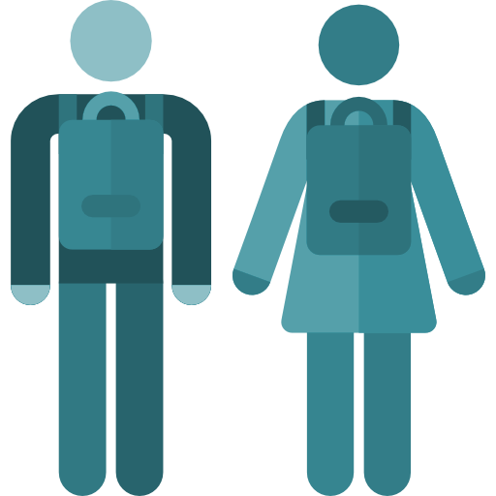




All UCD Community Members
Role, Responsibilities and Rights
Treat everyone with dignity, and respect. You have the right to be treated likewise
Challenge inappropriate behaviour when safe to do
Report inappropriate behaviour
Engage in D&R training
Be familiar with UCD Bullying, Harassment, and Sexual Misconduct policies.

Slide 39

Training
Active Bystanders Challenging Bullying, Harassment and Sexual Misconduct #NotInOurUCD (online student course)

Slide 40
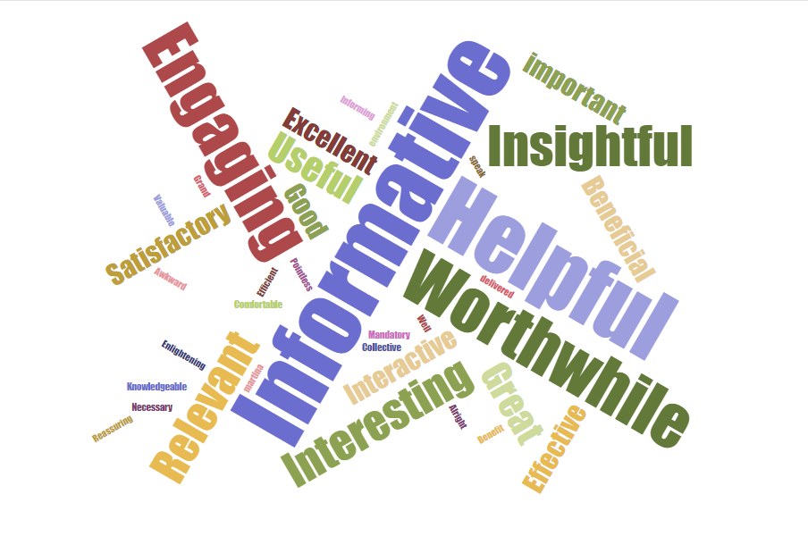
What the students said

Slide 41
Residential Assistants Workshop Feedback 2023/24
43 Residential Assistance provided feedback in 2023/24
This 50-minute training was delivered in groups no bigger than 25 by two different facilitators
93% agreed or strongly agreed they were satisfied with the workshop overall
93% agreed or strongly agreed that the style, pace, content, delivery methods were appropriate
91% agreed or strongly agreed their knowledge of the subject matter was enhanced
95% agreed or strongly agreed it was relevant to what they might expect to encounter
91% said they would recommend it to a friend

Slide 42
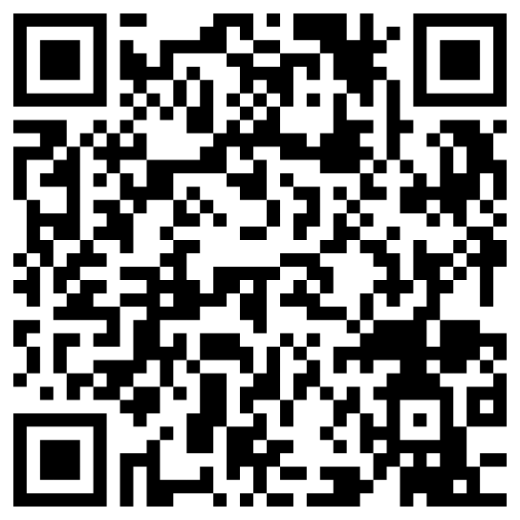
Feedback
I’d would appreciate your feedback!

Slide 43


Thank You
respect@ucd.ie
@UCD_Respect
ucd.ie/dignityandrespect

