Slide 1




Forge Your Future
An experiential workshop for final year undergraduates
Creating, Engaging and Enhancing Community for Student Success
Mary-Rose O’Sullivan
Careers Advisor & Coach, MTU, Cork

Slide 2

Overview
Origin of the idea
Design & Content of the Workshop
Expanding within the Department
Expanding within MTU to STEM courses
Evolving the format this year to engage 3rd year students.
Key features that create, engage and enhance community for student success .

Slide 3

The origin: Needs analysis
Mindset: Students were slow to approach employers and not pro-active re their future career.
Promote options: A need to show variety of job options with the degree in a fun way.
Need to motivate re career and develop tools – prompt action and provide support with career readiness skills and tools.
Sector growth: More opportunities for creatives in an increasingly visual world.
Confidence boost: grow students’ self-belief in job search: aimed to inspire and motivate by engaging with guests.

Slide 4
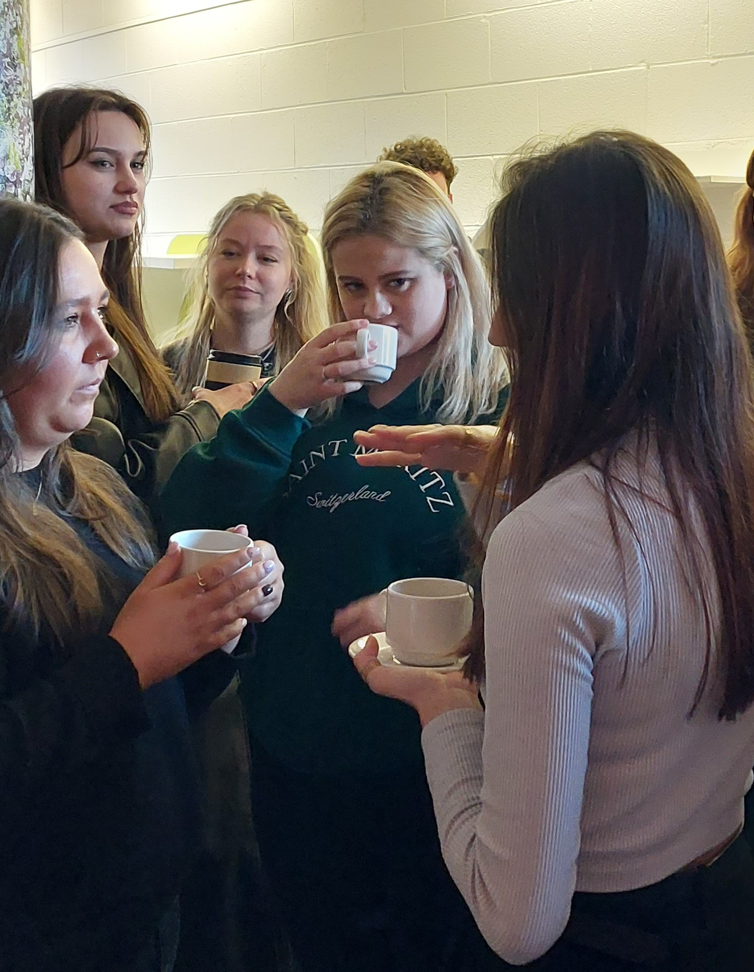
Workshop design & content
Group Work – capture ideas, information, thoughts & feelings about moving from college to work
Careers input of content x 2 chunks
Networking – group exercise and with guests over coffee
Individual reflection – capture learning & actions
Guests x 2 groups: recent alumni & experienced creatives
Demystify: it’s all about the pizza!

Slide 5
Agreed key messages for students
Use the increased self-awareness to decide on the job roles and work types that suit you
Response to change is individual, prepare, access free supports
Start planning your next step: regular actions brings results
Benefits and challenges of work types: Portfolio, Freelance, Employee
Networking is essential to personal brand
Networking grows connections; brings opportunities
Ongoing development of, and adding, skills is key for future success
Confidence comes with experience: believe in what you have learned in your degree and go for jobs as a graduate.

Slide 6
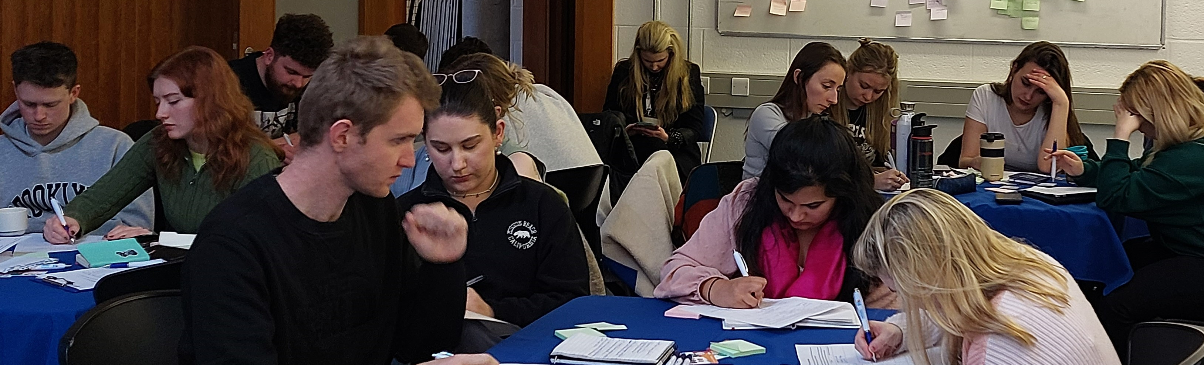
MTU Careers’ aims:
Facilitate students to engage with the process of preparing and planning next steps
Support students to work out their goals
Motivate & inspire via engaging with guests
Prompt action via peer-to-peer discussions.
Transitions – they are a part of life
Career planning process
Personal brand
Vision & setting goals​
Work types: Portfolio, Freelance, Employee
Networking.

Slide 7

Workshop practicalities
Timing: half day: 9.30am-12.30pm or 2pm-5pm, early in semester two of final year
Poster created to promote the event, especially guestd
Department invites recent graduates
MTU Careers & the department invites employers / freelance professionals
Promotion online and hard copy posters displayed on campus
Email to students a few days ahead with info and prep work
Class rep gathers students’ questions for guests in advance.

Slide 8








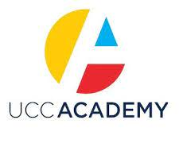


Examples of guests to date

Slide 9
Forge Your Future expands in MTU
BA in Visual Communications, 4 since 2021
Creative Digital Media, 2023 & 2024
Contemporary Applied Art, Cork College of Art & Design (CCAD), 2022 & 2023
Fine Art, CCAD, 2024
Cork School of Music: Drama & Performance & Musical Theatre, 2024
STEM: Biological Sciences, 3 since 2022,
Analytical Chemistry, 2024

Slide 10

Evolving the format: engaging 3rd year students
Professional Practice module in 3rd year: lecturers selected Forge Your Future as a project for event management experience.
Students in charge of all aspects: branding and promotion, PR writing, speaker liaison, venue and hospitality.
Students worked in dedicated groups but mostly had individual tasks.
The posters were designed individually (competition) but when one was chosen, design files were shared so others could work on design outputs (social media posts, agenda etc)
Third year students were invited to the recent Alumni present-ations and the networking coffee break.

Slide 11
Creating, engaging and enhancing community for student success
Links students with people who work in their sector in an informal way – over coffee and pizza, which breaks down barriers and provides students with a chance to engage with employers in a relaxed way
Discussing possible future careers together fosters community among students – universality of the experience, which reduces anxiety and helps to prompt action for success
Working together on planning for the future provides peer-to-peer support and promotes the concept that success is possible.
MTU Careers collaborating with an academic department enhances the sense of community among MTU staff and this works to strengthen the environment of support for students in MTU.
“Perhaps most importantly, Year 3 students interacted with Year 4 students. Though these students are in the same environment, they rarely interact and conversation between different levels is educational and motivational for both years. In addition, Year 3 students benefited from listening to some recent graduates and from networking with them and more accomplished professionals, fostering confidence and communication skills.”
Dr Gwen Lettis, co-creator of Forge Your Future & Lecturer in Design, CCAD/MTU

Slide 12
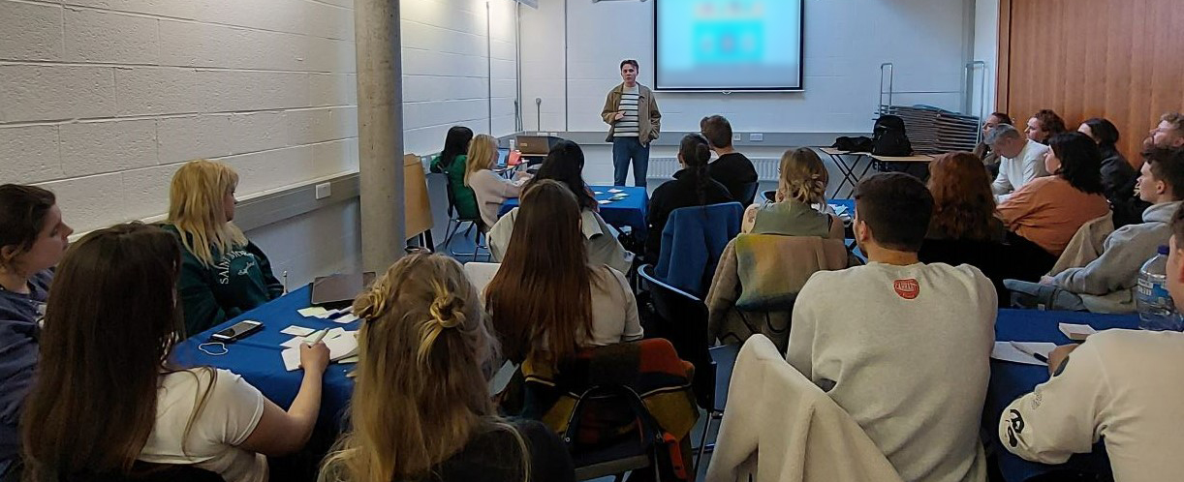
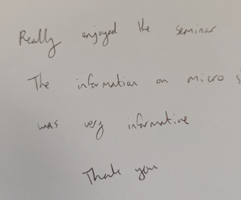
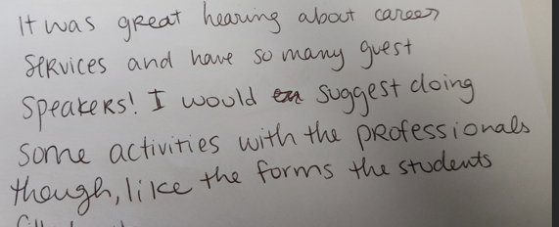
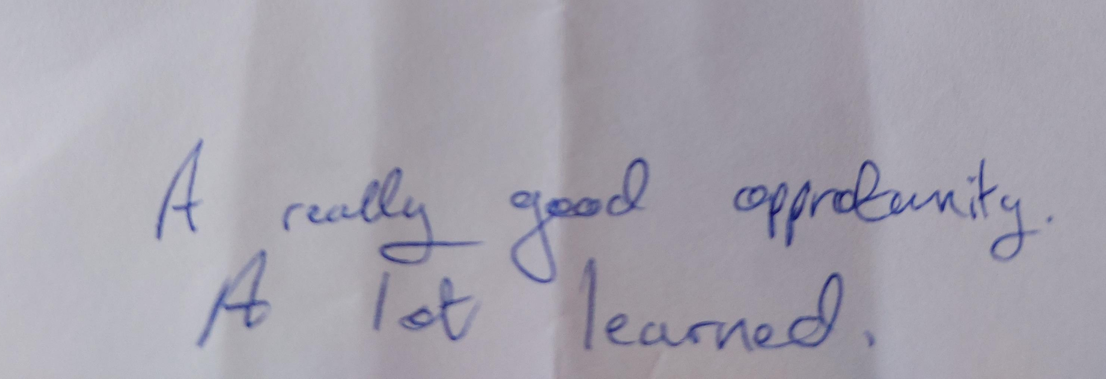
Students’ feedback

Slide 13
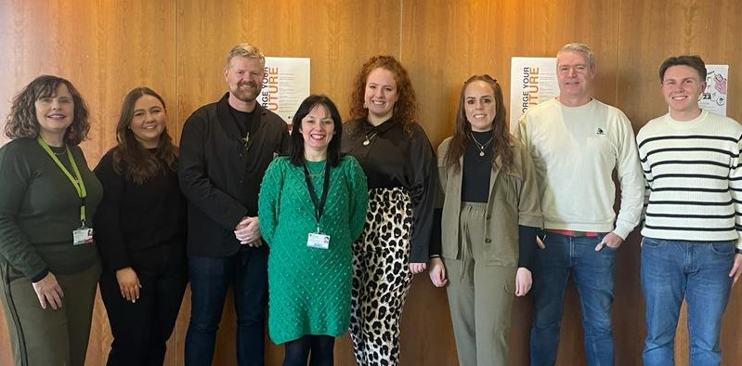

Thank You!
Mary-Rose O’Sullivan
Careers Advisor & Coach
Maryrose.osullivan@mtu.ie
Dr. Gwen Lettis,
Lecturer in Visual Communication, Department of Media Communications, MTU
Gwen.Lettis@mtu.ie

