Slide 1


Show me the money – how the 1916 Bursary enables success by providing direct financial support to Irish students during each year of their tertiary education.
Student Affairs Ireland – Summer Seminar – TUS: 18th June 2024
Dr Declan Reilly: Irish Universities Association

Slide 2
What is the 1916 Bursary?
The 1916 Bursary is co-funded by the Government of Ireland and the European Union and aims to encourage participation and success by students who are most socio-economically disadvantaged and from groups most under-represented in higher education.
The Bursary is a financial award worth up to 5,000 euro per year for the duration of a student’s course. The Bursaries are awarded to students from the priority groups in the National Access Plan 2022-2028.
Supports such as the 1916 Bursary are key to helping students from under-represented groups have the opportunity of third-level education and reach their full potential regardless of their background.

Slide 3

Launched in the 2017/2018 academic year and named to commemorate the Easter Rising of 1916 - the Bursary initially provided around 200 students a year with a bursary worth €5,000 during each year of their studies.

Slide 4
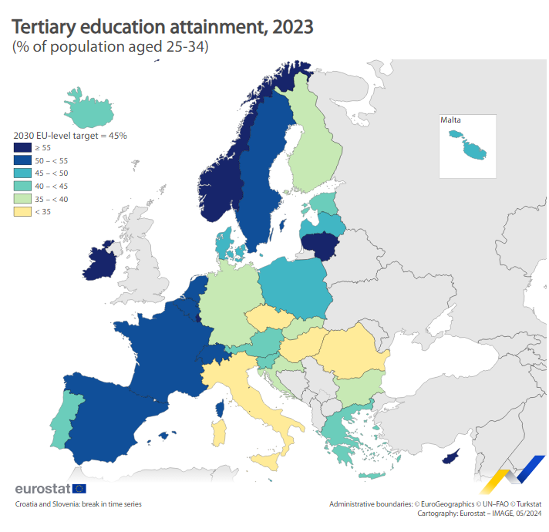
13 EU countries already reached the 2030 target:
Ireland (63%), Cyprus (62%),
Luxembourg (60%), Lithuania (57%), the Netherlands (55%), Sweden (54%),
Spain and France (both 52%), Belgium (50%), Denmark (49%), Malta and Poland (both 46%)
In contrast, the lowest shares were recorded in Romania (23%), Hungary (29%) and Italy (31%).
43% of EU's 25-34-year-olds have tertiary education - Eurostat (europa.eu)

Slide 5
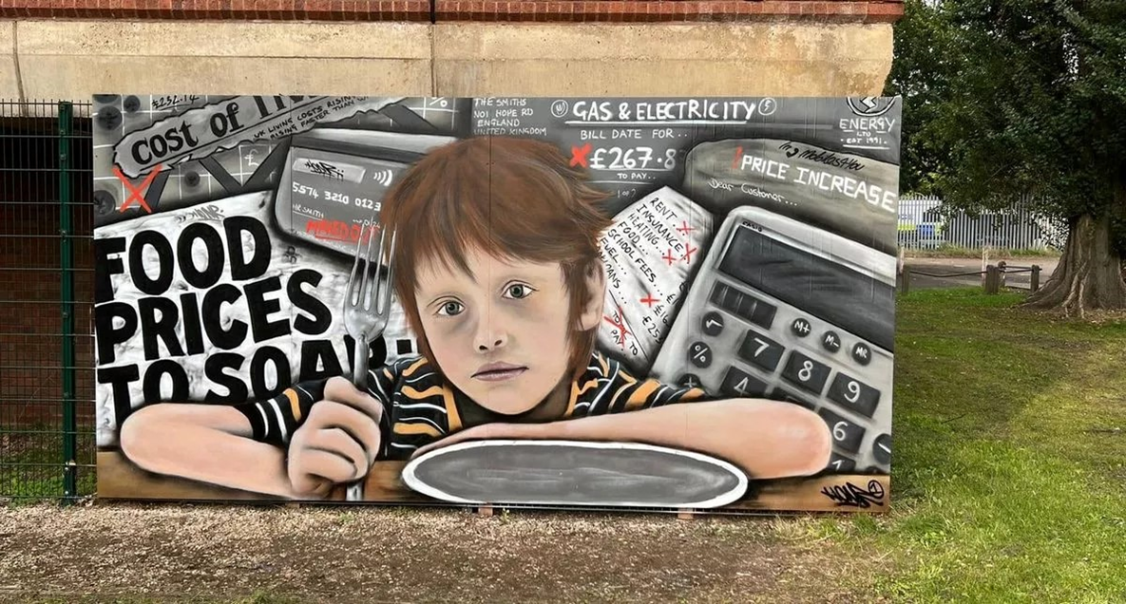

Slide 6
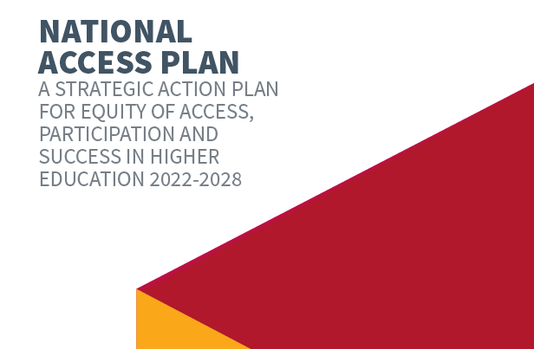
This National Access Plan (NAP) identifies three main groups who are underrepresented in higher education: students who
are socioeconomically disadvantaged;
are members of Irish Traveller and Roma communities and
have disabilities, including intellectual disabilities.

Slide 7
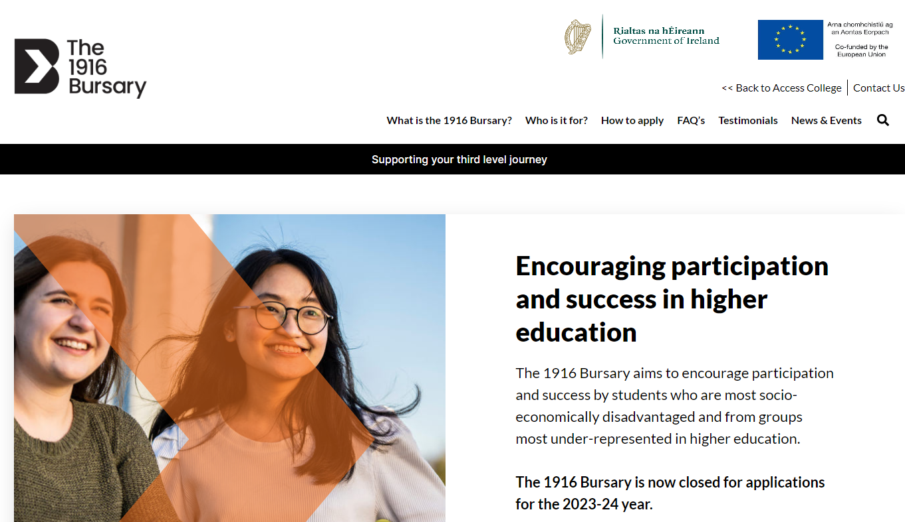

Slide 8
Bursary level 2023-24 | Number of students | Value per year | Totals - euro
Tier 1 | 400 | 5k per year | 2 million
Tier 2 | 200 | 2k per year | 0.4 million
Tier 3 | 840 | 1.5k year 1 | 1.26 million
Total: | 1440 |  | 3.66 million

Slide 9
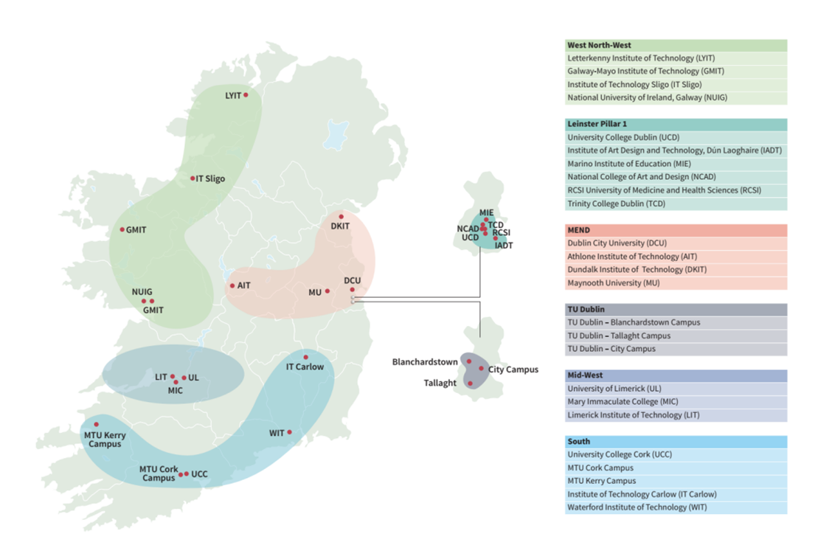

Slide 10
Who is the Bursary for?
Socio-economically disadvantaged communities
Socio-economic groups that have low participation rates in higher education
Students with a disability
Students who are carers
Students who are QQI or Further Education award holders
Lone and/or teen parents in receipt of a long-term means-tested social welfare payment
Members of the Irish Traveller Community
Members of the Roma Community
First time, mature student entrants and 2nd chance mature students
Persons from ethnic minorities who are lawfully present in the State

Slide 11
What are the criteria?
What are the College Entry criteria?
Applicants for the 1916 Bursary must:
Be a new entrant pursuing an undergraduate course and progressing to higher education for the first time
Have been a resident in the Irish State for three of the past five years
Be studying an approved full-time or part-time undergraduate course
What are the Financial Criteria?
Applicants must show that their household income meets the criteria for the SUSI Special Rate of Maintenance Grant; in 1 of 3 thresholds based on how many dependent children are in the household.
Less than 4 = €25,000;
4 to 7 = €27,400;
8 or more = €29,702.
The income threshold increases by €4,950 per additional person in college

Slide 12
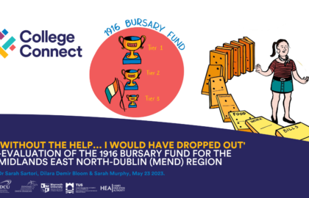
Evaluation and Impact
Our evaluation of the 1916 Bursary…between 2018 and 2021/22, indicates that the 1916 Bursary…is a significant resource that helps mediate some of the barriers associated
with pursuing higher education and contributes to the success and retention in
HE of students from groups traditionally underrepresented.
https://collegeconnect.ie/without-the-help-i-would-have-dropped-out/

Slide 13
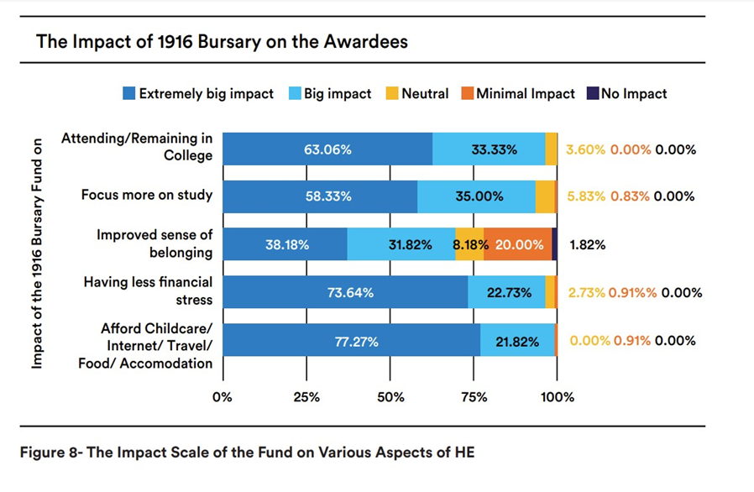
https://collegeconnect.ie/wp-content/uploads/2023/10/Without-The-Help-I-Would-Have-Dropped-Out.pdf

Slide 14
The 1916 Bursary has had a profound impact on my life. Growing up in a family of 10, financial struggles were a constant reality. Throughout my Leaving Certificate years, we lived in a cramped 2-bedroom hotel due to our lack of a permanent residence. Pursuing my studies in Cork, where rent is notoriously high, added to the burden. The bursary has been a lifeline, helping me pay for my rent and alleviating the financial stress that once weighed heavily on me. It has allowed me to focus on my education, giving me the confidence to pursue my goals without the constant worry of making ends meet.
1916 Bursary recipient from Munster Technological University

Slide 15
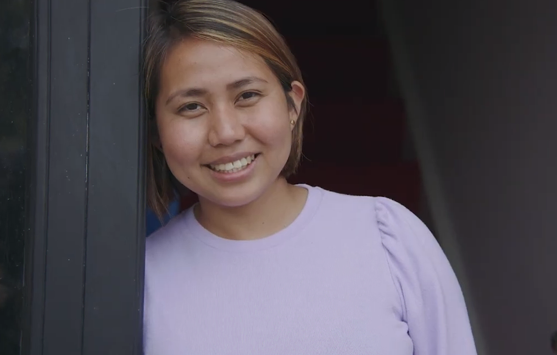
“Being a 1916 bursary recipient enabled me to strive towards completing my degree, contributing towards childcare costs and basic daily needs such as food expenses. In return, this helped me a lot to regain control over my anxiety and focus on my studies.”
Diana
Recipient of the 1916 Bursary, University College Cork

Slide 16


Slide 17
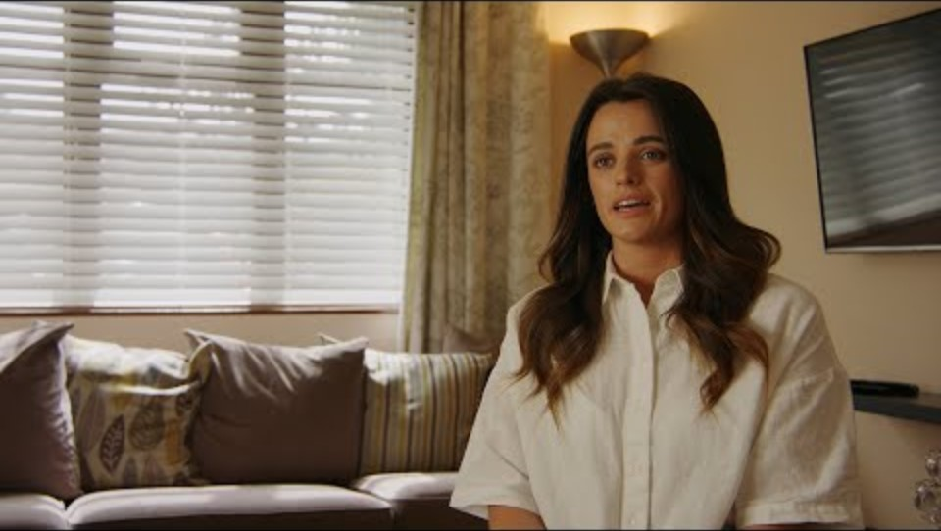

Slide 18
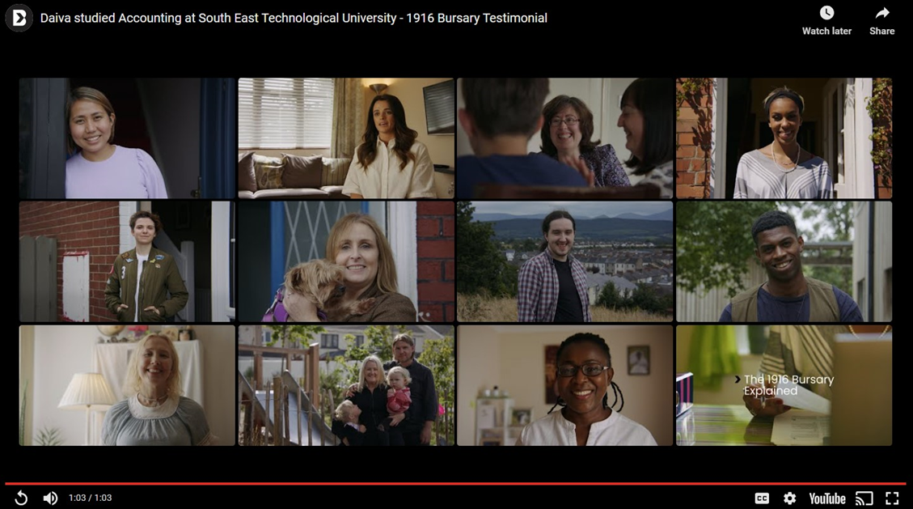

Slide 19



