Slide 1




Dr Lorraine Tansey
StudentVolunteer.ie Programme Manager
lorraine.tansey@ul.ie
SAI Summer Seminar 2024,
Theresa O'Leary, UCD in the Community

Slide 2

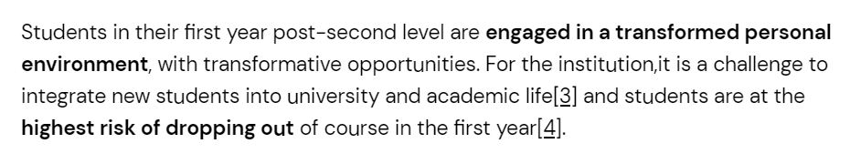

Slide 3
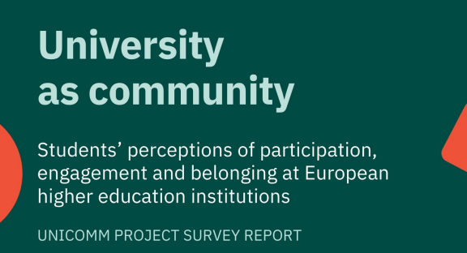
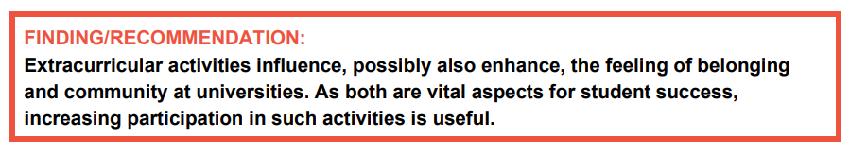
Volunteering activities within the university clearly represent the most frequently mentioned activity, with 37% of all students claiming that they have volunteered at their higher education institution.
On the other hand, Service Learning and outreach activities, as comparatively new forms of participation, were mentioned less frequently; possibly they are also unknown to students.
Notes:
https://wolontariat.uw.edu.pl/wp-content/uploads/2023/09/UNICOMM-Survey-Report-2023.pdf

Slide 4
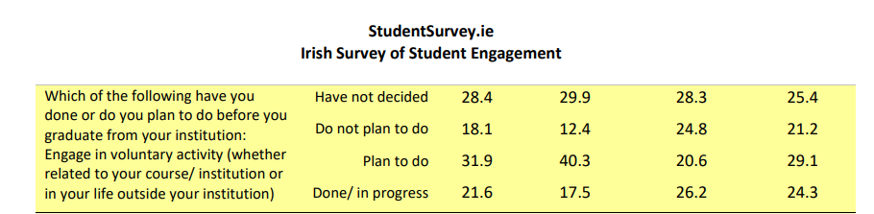

https://report.studentsurvey.ie/sites/default/files/2023-11/Appendix%203%20Tables%20to%20accompany%20Chapter%202.pdf

Slide 5
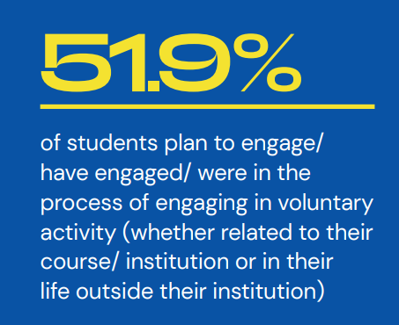
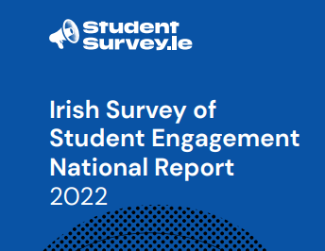
https://report.studentsurvey.ie/sites/default/files/2022-09/StudentSurvey.ie%20National%20Report%202022%20Executive%20Summary_0.pdf

Slide 6


Researching the
Problem
StudentSurvey.ie (2023) indicates 46.5% do not plan to volunteer and have not decided to volunteer.

Slide 7

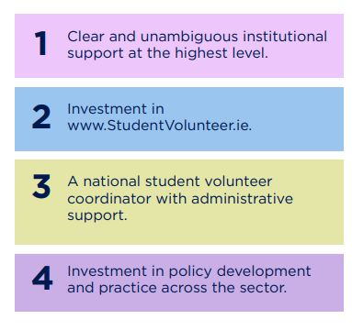

Strategic Priorities

Slide 8
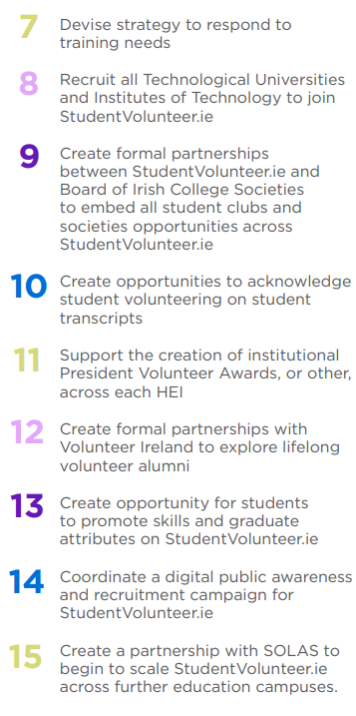
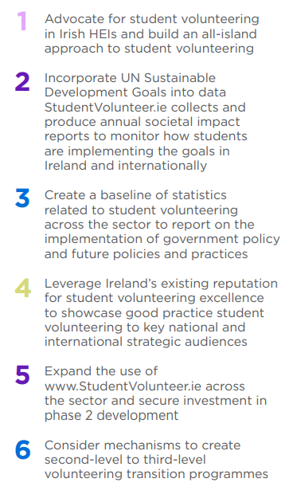
Objectives

Slide 9
Our Mission
To consolidate, strengthen, support, and promote higher education (HE) student volunteering in Ireland. Our work focuses on delivering HE civic engagement policies and practices by acknowledging, sustaining, growing, reporting, researching, and recognising student volunteers across the sector.
Our Vision
Every third-level student in Ireland has the opportunity to volunteer and this activity is recognised and supported throughout their volunteering journey.

Slide 10

Notes:
https://opencourses.ie/opencourse/enabling-student-volunteering/

Slide 11

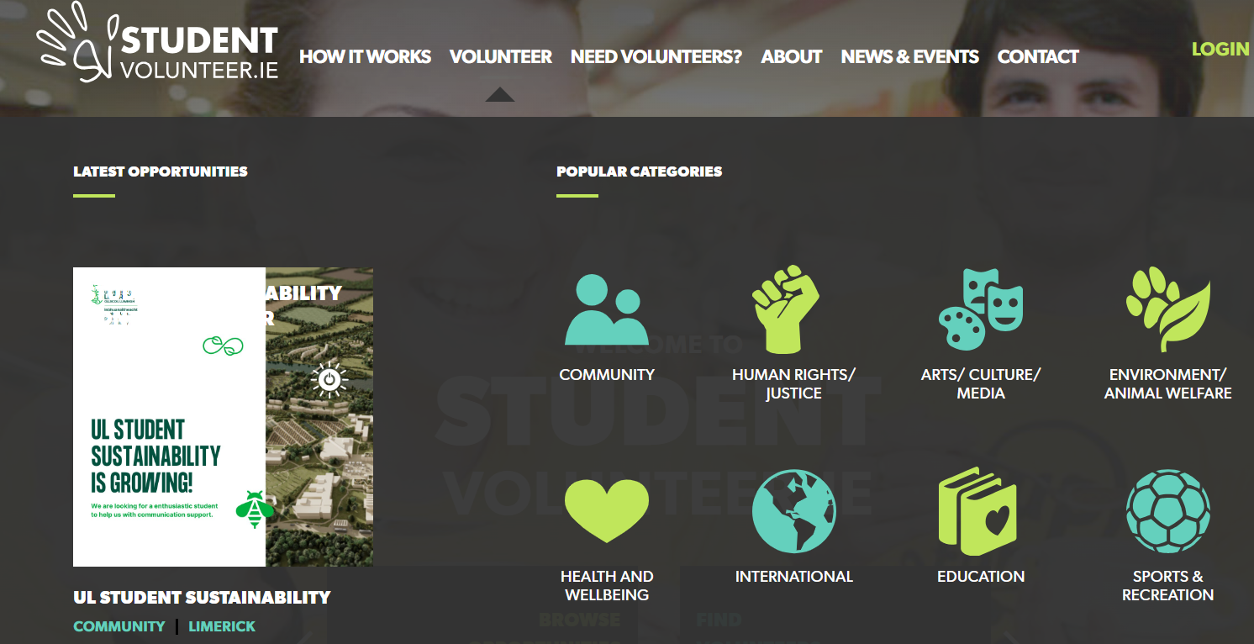

SDGs
Impact

Slide 12
Students, Education, Society
Impact
Students have logged 356,056 volunteering hours with community.
Total
Organisations accounts: 1,430
Volunteer Opportunities Online: 1,915
Student accounts: 22,494
Student Applications to Volunteer: 26,393

Slide 13


Slide 14
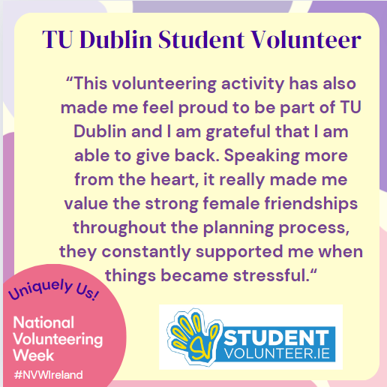

Slide 15
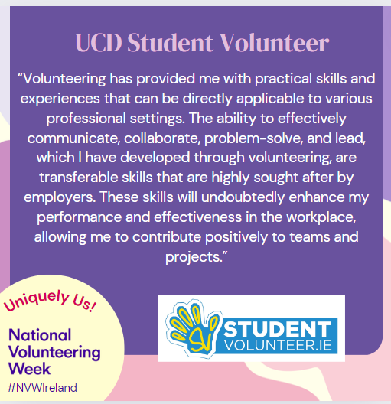

Slide 16


Slide 17
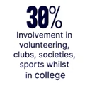

2024 Early Careers Employer Survey Results

Slide 18
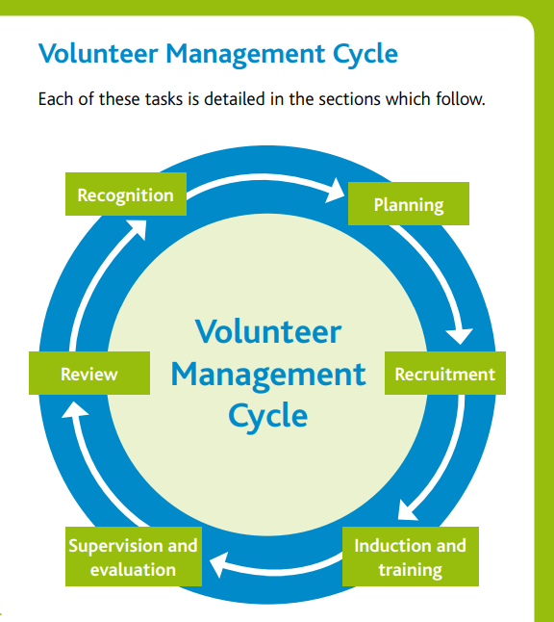
Technology to
Connect
Engaging
People
https://www.citizensinformationboard.ie/downloads/training/Managing_Volunteers_08.pdf

Slide 19
Dr Lorraine Tansey
StudentVolunteer.ie Programme Manager
lorraine.tansey@ul.ie
SAI Summer Seminar 2024,
Theresa O'Leary, UCD in the Community

Slide 20


