Slide 1

PEM: Professional Engagement Module Dr. Mary Surlis, Academic Manager
Access Centre

Slide 2
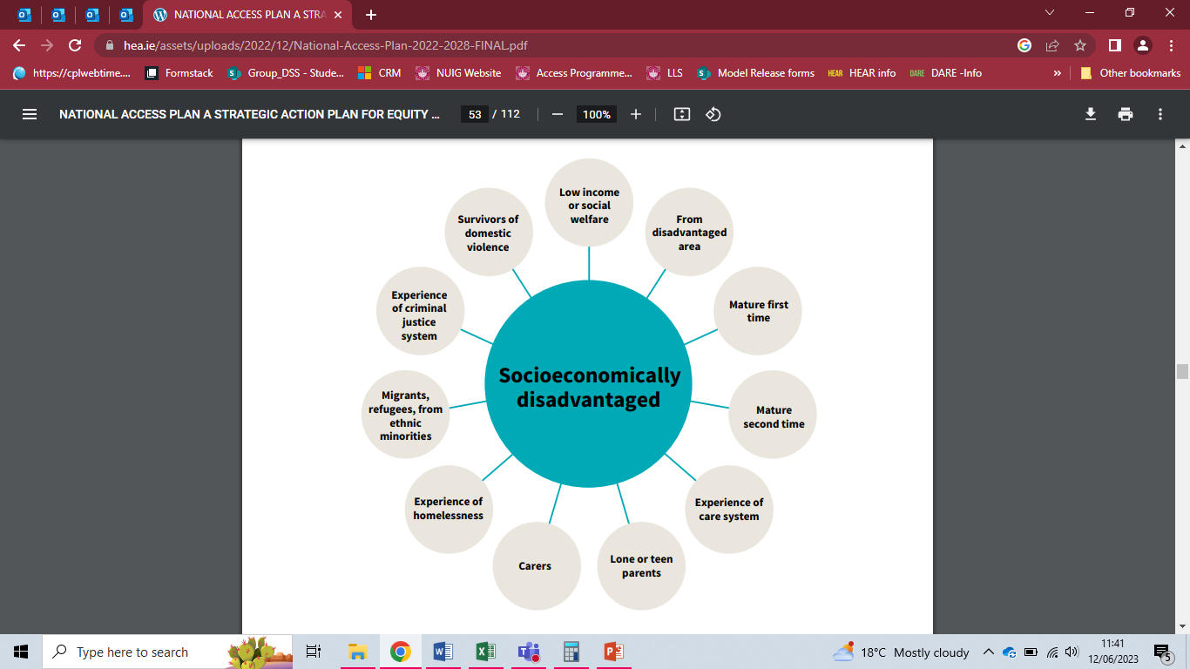
Access Target Groups

Slide 3
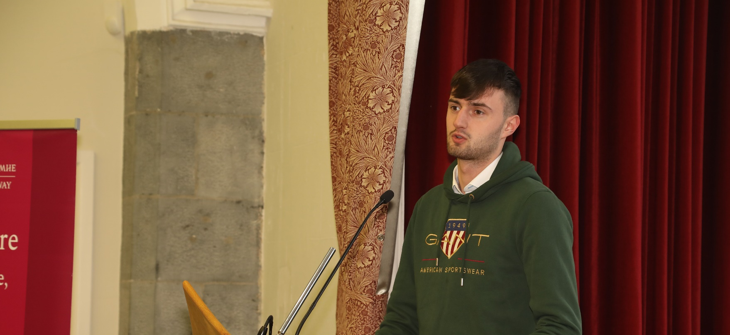
Improving Life Experience
Csikszentmihalyi (1996) speaks to the optimal experience of improving life by focusing on improving people’s life experiences. PEM is about improving life experiences.
Csikszentmihalyi, M.(1996) Allport, (1955)

Slide 4
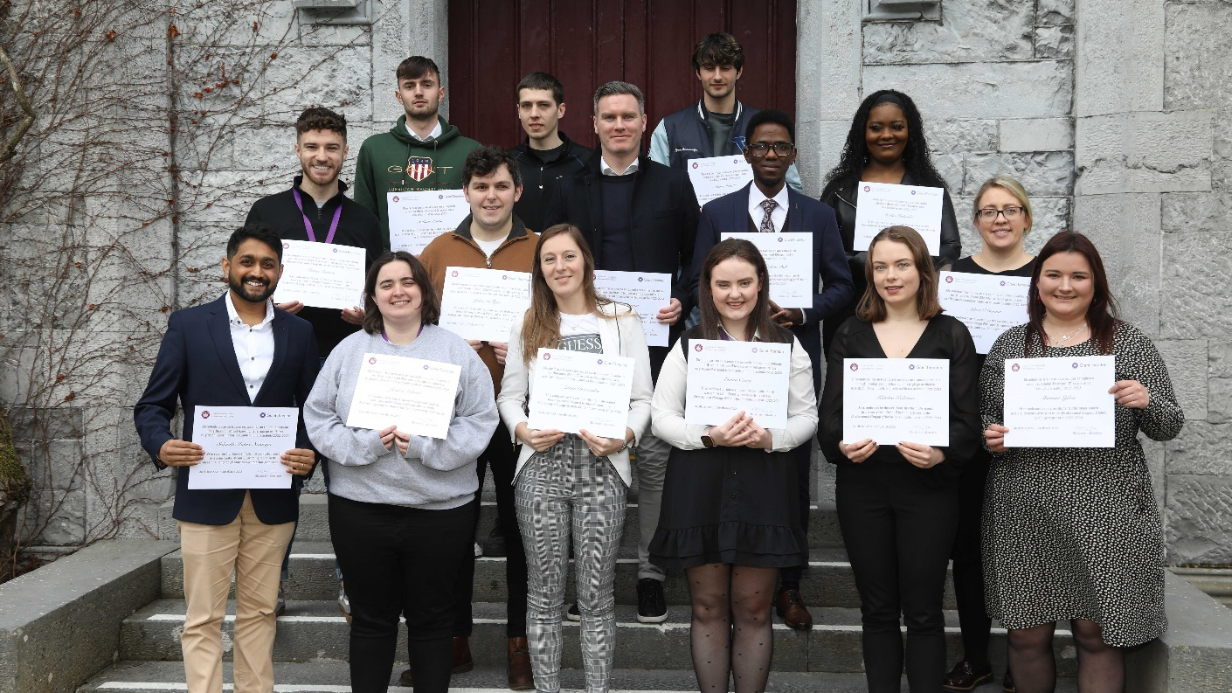
Positive Psychology
Positive psychology provides us with a possible foundation to:
Improve quality of life
Quality of performance
Quality of wellbeing

Slide 5
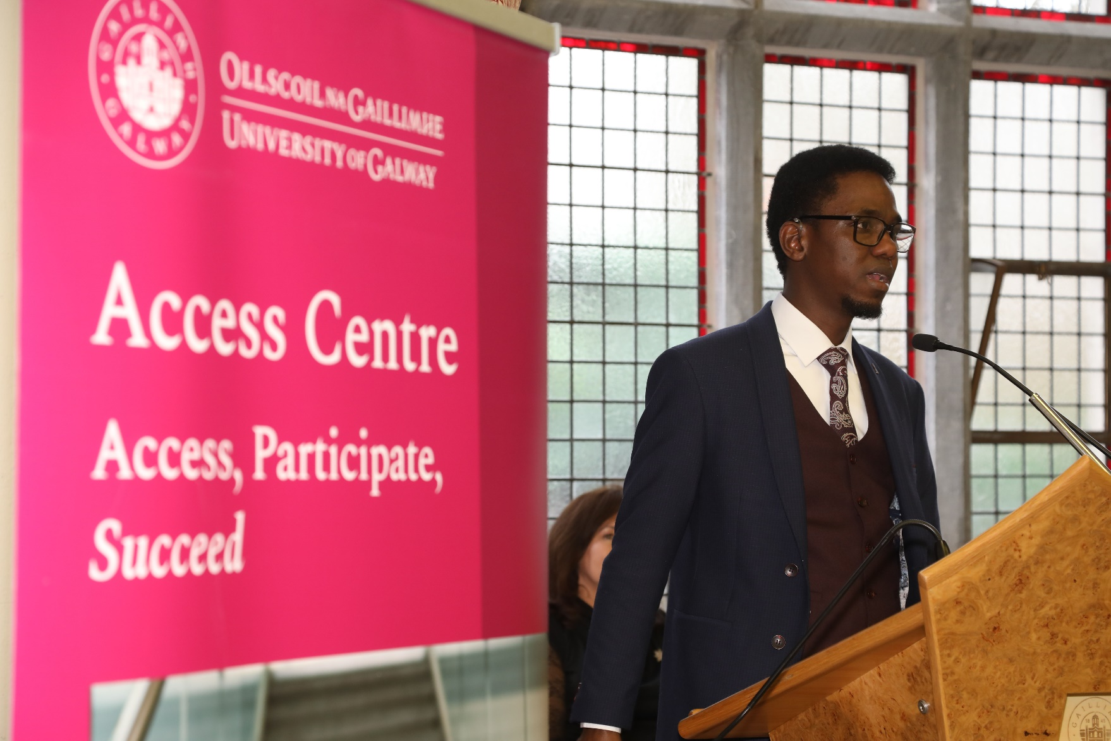
Positive Mentoring in PEM is about:
Creating an optimal learning condition in a physical and social aspect
Breaking the ‘negative experience’ cycle
Creating a positive learning experience allowing growth for autonomy, participation and choice.
Spreitzer, (1995)

Slide 6
PEM is an experiential programme of learning
Clear learning outcomes where on successful completion of the PEM programme, students will have:
Gained exposure to a professional working environment. Developed an insight into career progression. Honed a skillset for career readiness. Cultivated a working/ supportive relationship with their assigned Mentors. Developed an understanding and insight into the core requisites of a professional working environment. Key focus: On-site location

Slide 7

Learning through reflection
Students will complete a reflective journal noting their weekly engagement with the business which will be submitted to the Course Coordinator. Law (2013) points out that reflection as an exercise is effectively a form of ‘internal self-assessment’ which helps the learner to understand their own experience and draw conclusions, and plan actions from same.

Slide 8


PEM Partnerships
2018 – present: Grand Thornton – Financial Advisory Services 2024 – present: Medtronic – Galway 2024 – present: School of Education – University of Galway

Slide 9
Thank you Míle Buíochas

Slide 10
References - Allport, G. W. Becoming: Basic Considerations for a Psychology of Personality. New Haven, Conn.: Yale University Press, 1955. -Csikszentmihalyi, M.(1996) Creativity: Flow and the psychology of discovery and intervention. New York, Cambridge University press - Law, H. (2013) The Psychology of Coaching, Mentoring and Learning, John WIiey & Sons, Incorporated -Maslow, A. H. (1968). Toward a psychology of being (2nd ed.). D. Van Nostrand. - Spreitzer, G. M. (1995). Psychological empowerment in the workplace: Dimensions, measurement, and validation. Academy of Management Journal, 38(5), 1442–1465.

