Slide 1

An integrated student support and communications framework based on real time student needs
Student Affairs Ireland
Creating, Engaging and Enhancing Community for Student Success June 17 2024

Slide 2
Josephine Walsh
Head of Student Engagement Projects
Emer McGuire
Student Engagement Coordinator

Slide 3




At a glance…

Slide 4
Session overview…..
Effective channels to “listen “ to the student voice in real time
Process what we hear - “Seek first to understand”
Respond with targeted communications, initiatives and services to contribute to student success.
Partnerships

Slide 5
Institutional Context- Student Voice
Student Experience Survey – annual since 2016
Success Quiz – annually Sept- Oct – personalised feedback to student
Student’s Union Surveys – responding to specific issues
College surveys
End of module questionnaires
Partnership Agreement signed with the SU in 2023
Student Experience Executive
Student Success Strategy - 2024

Slide 6
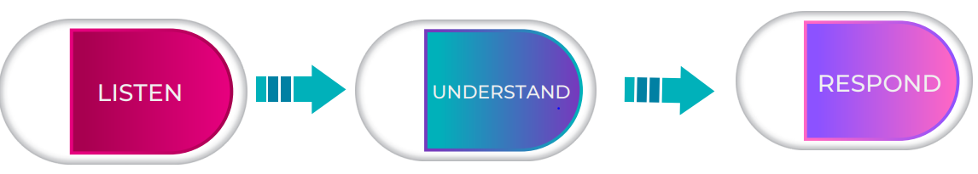
Student Engagement and Communications Framework
Cara – virtual info assistant
Student Enquiry Centre
Student Advisers
Accommodation Advisers
Financial Advisers
Student Welfare Group

Slide 7


Cara as the student voice

Slide 8


What can Cara do?
… answer questions on day-to-day student life
Accessible on web and WhatsApp
Option to transfer to a staff member
Featured questions based on student journey
Dashboard – reviewed every week

Slide 9

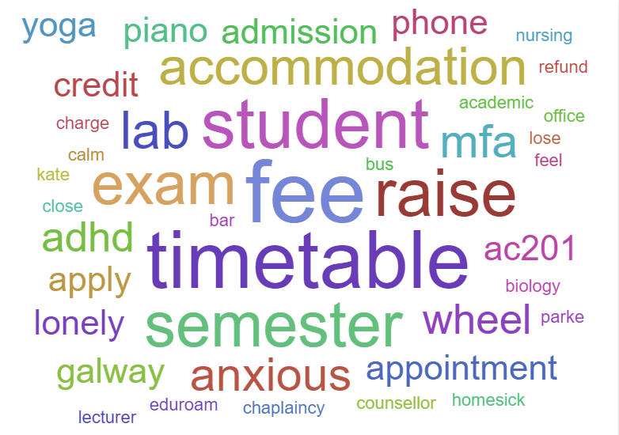
Trending keywords
Last 7 days
308 Qs

Slide 10
Student Engagement and Communications Framework
Cara
Student Enquiry Centre
Student Welfare Group
Student Advisers
Accommodation Advisers
Financial Advisers
Student Welfare Group
Student Journey Map Galway 100
Cara – reach out campaigns

Slide 11














University of Galway
Typical Student Journey
Get Started
Administration
Apply for
my course
Pay for
accommodation
Complete
registration
Set up campus account, student email & wifi
Learning &
Assessment
Search for
accommodation
Engagement
Attend
orientation
Get familiar
with campus
& Galway City
Get Student
& SU Card
Accept
my offer
Pay for
half of fees
Student Life
International Students
Get ready for student
life – bank accounts,
leap cards, cooking, etc.
Access timetable & create personal timetable
Attain visa
Semester
Get involved in campus life
(societies, clubs)
Engage with
Students Union
Explore career pathways
Use the
library
Engage with student & academic mentors
Attend lectures
& tutorials
Pay second
half of fees
Register modules
for semester
Avail of student
supports
Engage with volunteering
Complete
course work
Sit exams
Submit thesis/project
& assessment
Conferring
Receive &
submit feedback
Go on placement and/or Erasmus
Final Year
Apply for jobs and/or
postgraduate courses
Receive results
Connect with
alumni network

Slide 12

Galway 100
Student feedback panel
Representative of student demographics
Participate in focus groups
Complete/review surveys
Cara campaigns
Paid activities

Slide 13
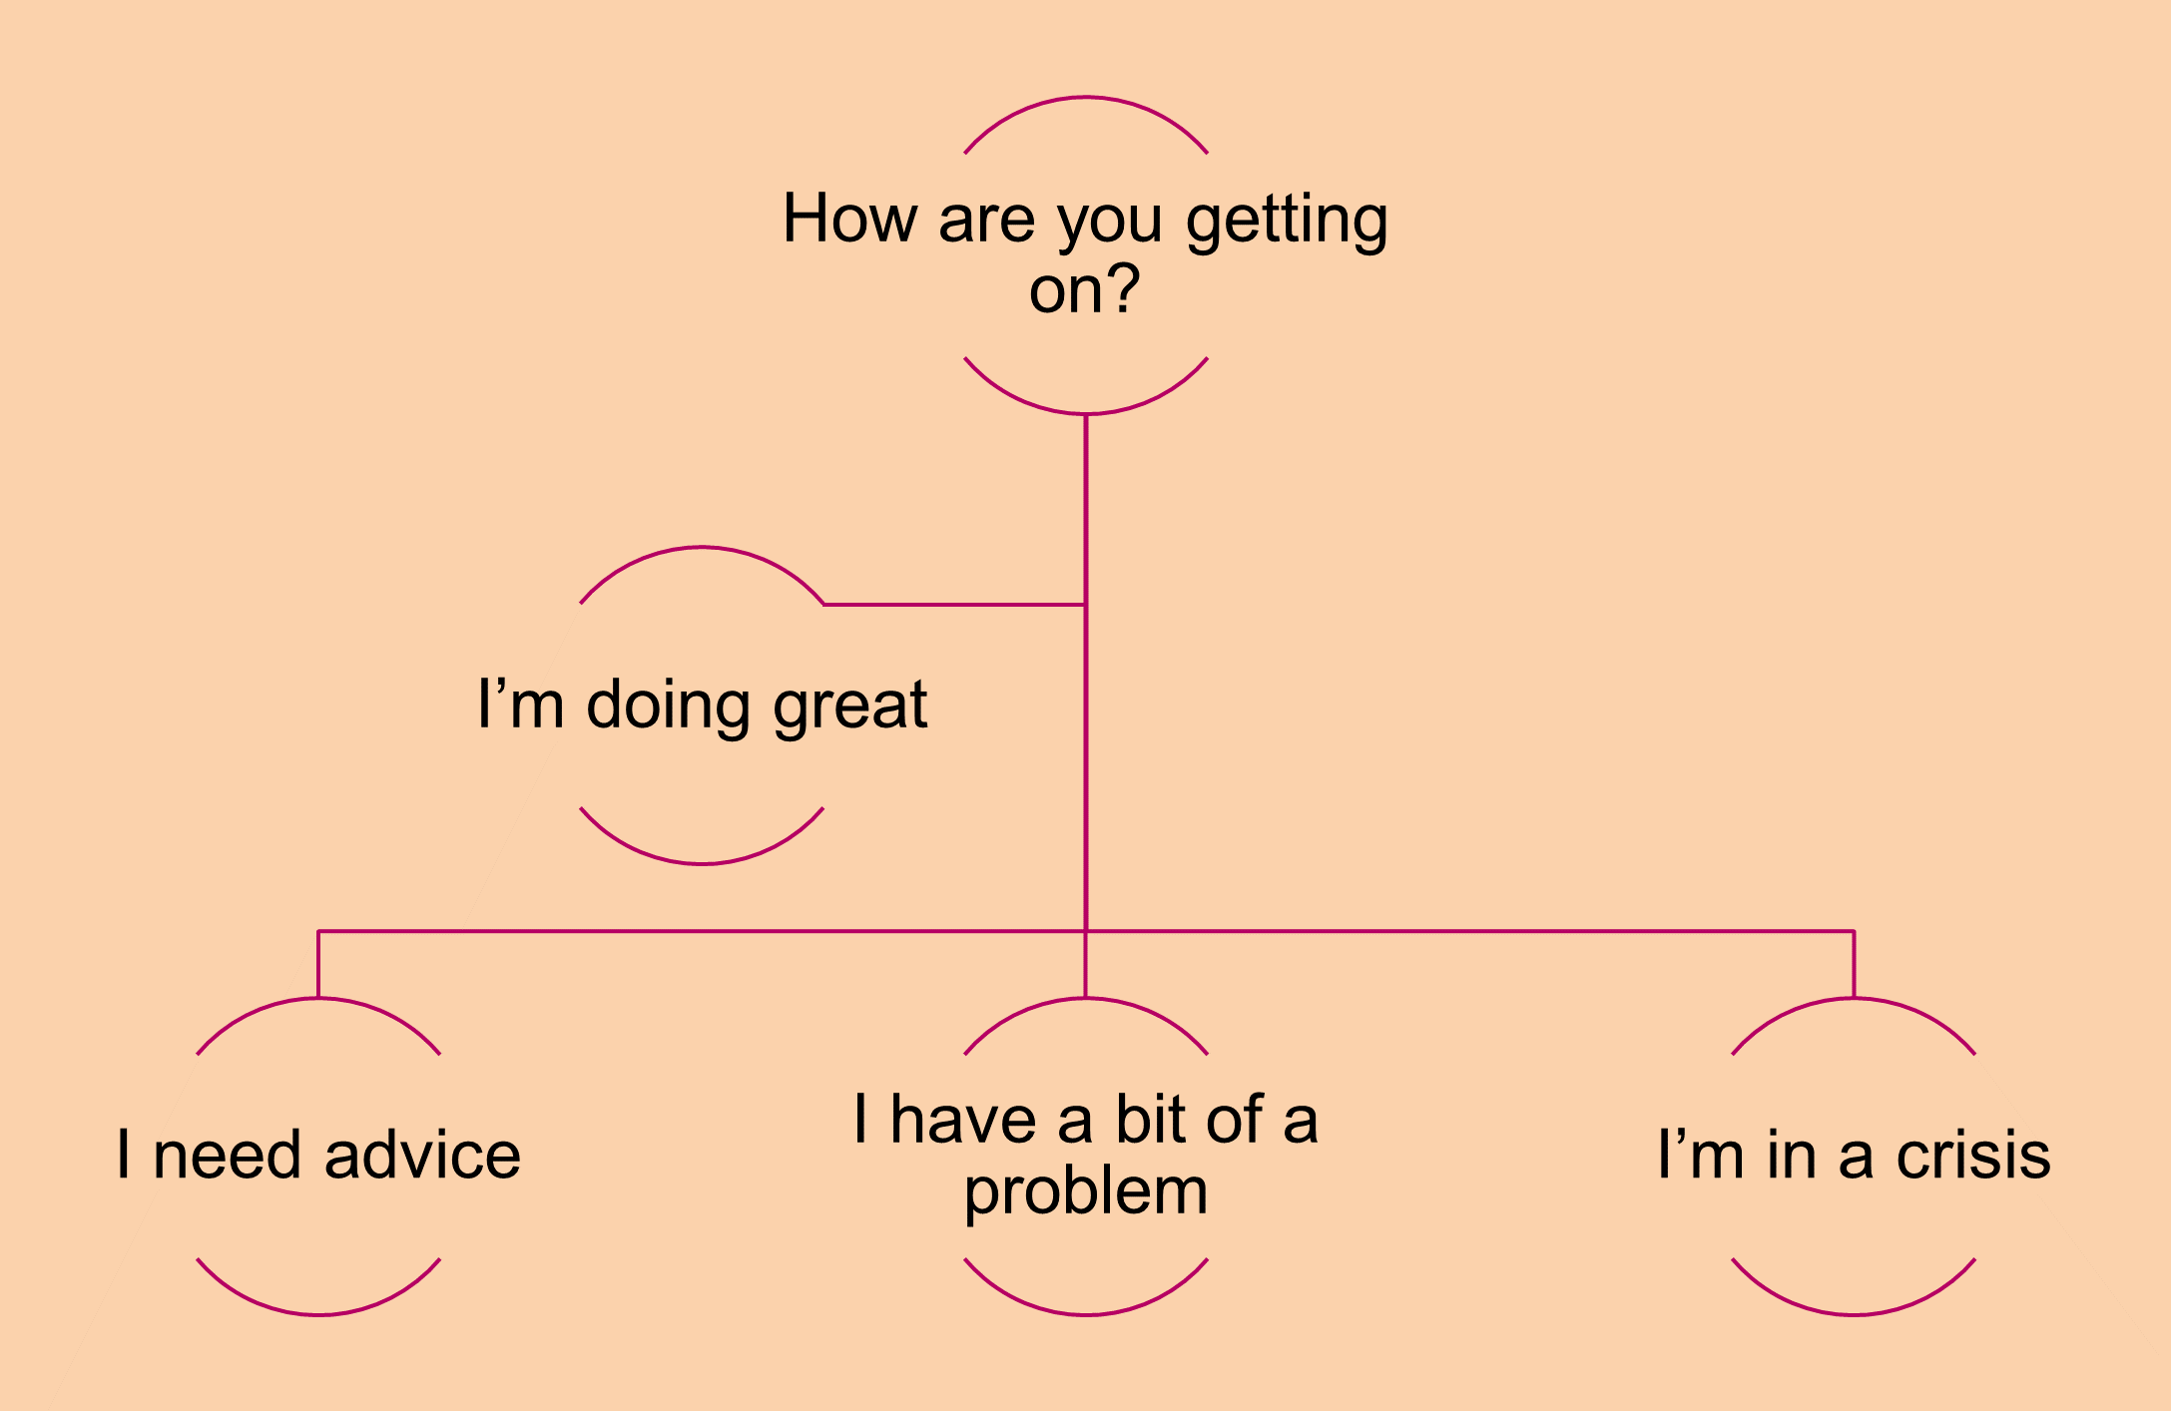
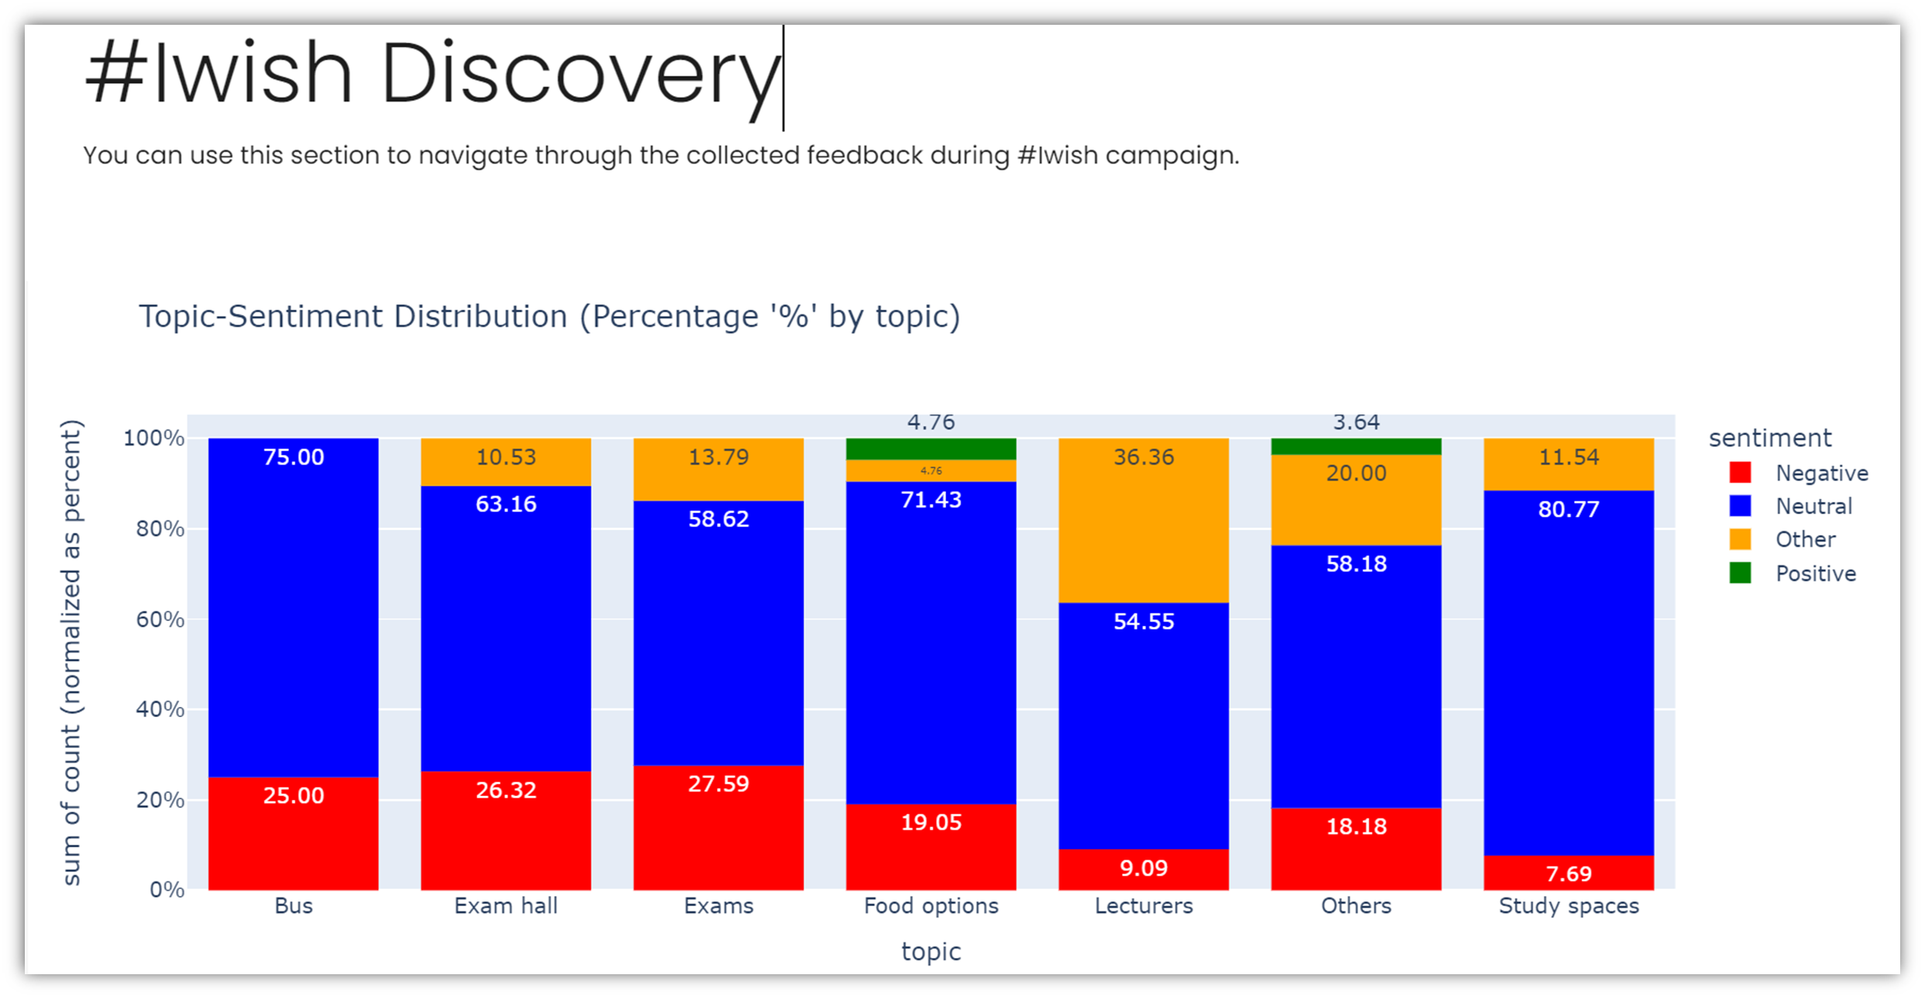
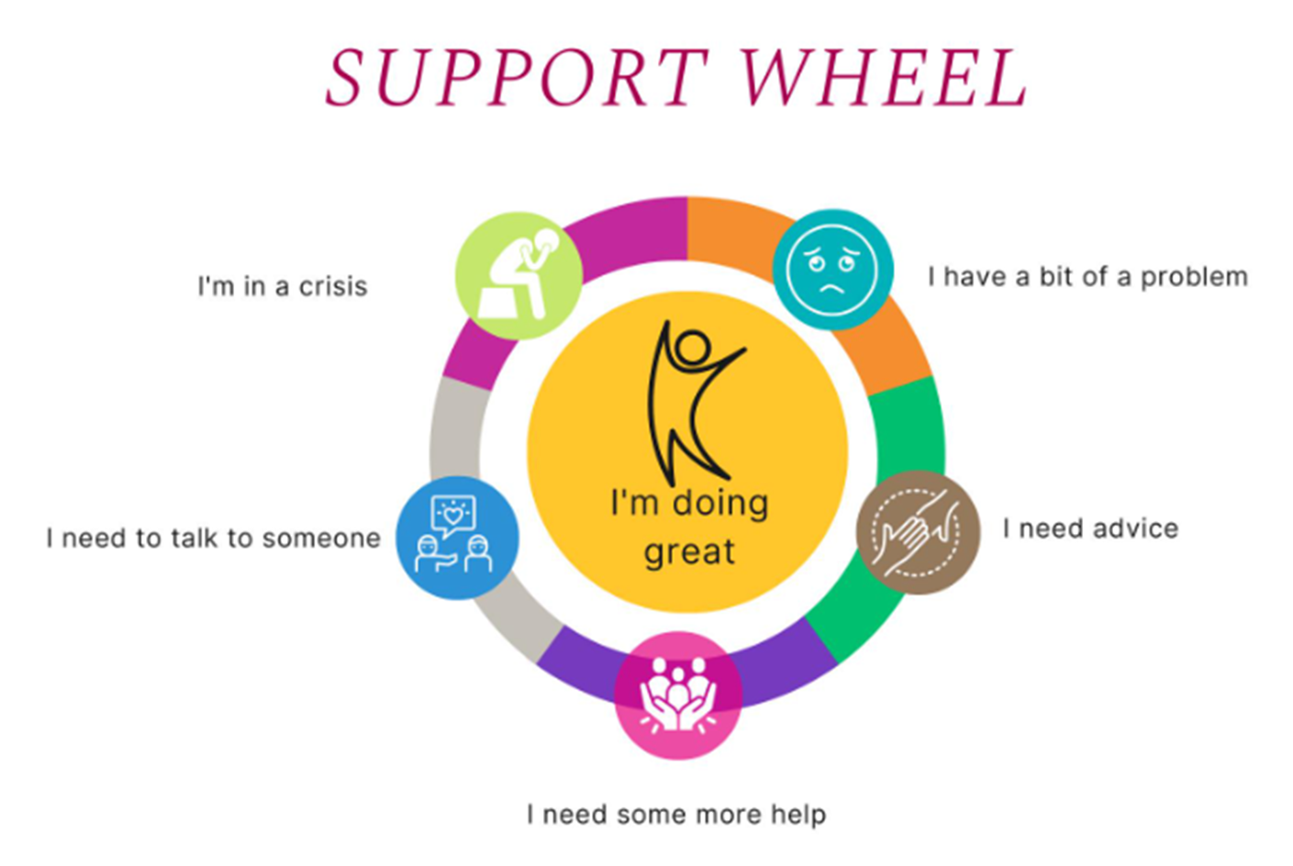

What can Cara do?
… answer questions on day-to-day student life
Accessible on web and WhatsApp
Option to transfer to a staff member
Featured questions based on student journey
Dashboard – reviewed every week
… ask questions on day-to-day student life
Student feedback campaigns
WhatsApp and email
Sentiment analysis – positive, negative, etc
Summary reports

Slide 14
Student Engagement and Communications Framework
Cara
Student Enquiry Centre
Student Welfare Group
Student Advisers
Accommodation Advisers
Financial Advisers
Student Welfare Group
Student Journey Map Galway 100
Cara – reach out campaigns

Slide 15

Bringing it all together…. listen, understand, respond

Slide 16


















CARA
University of Galway
Student Journey
Available 24/7
1600 queries/month
RESPOND
UNDERSTAND
Weekly Ezine
Events
Programmes
Update/teach CARA
STUDENT ADVISERS
Trends
Themes
Needs
9am-5pm weekdays
550 Connections/month
Listening to students’ issues
STUDENT ENQUIRY CENTRE
  Cara Campaign
  Galway 100
9am-5pm weekdays
1050
Queries/month

Slide 17

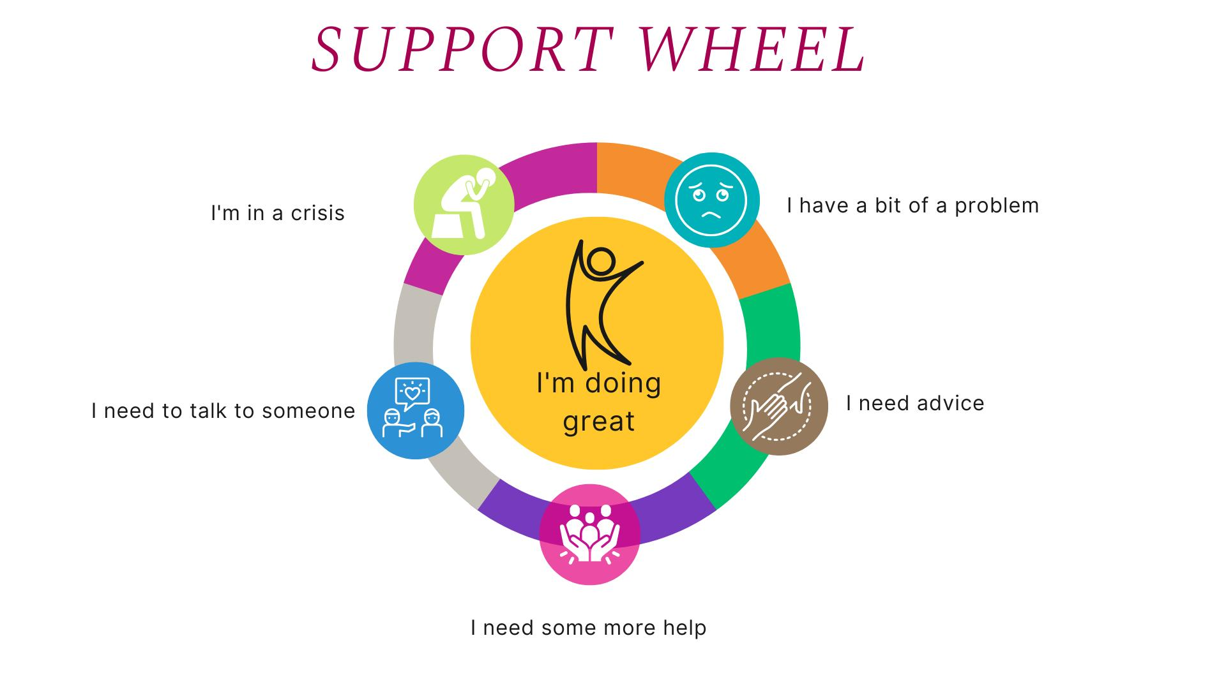
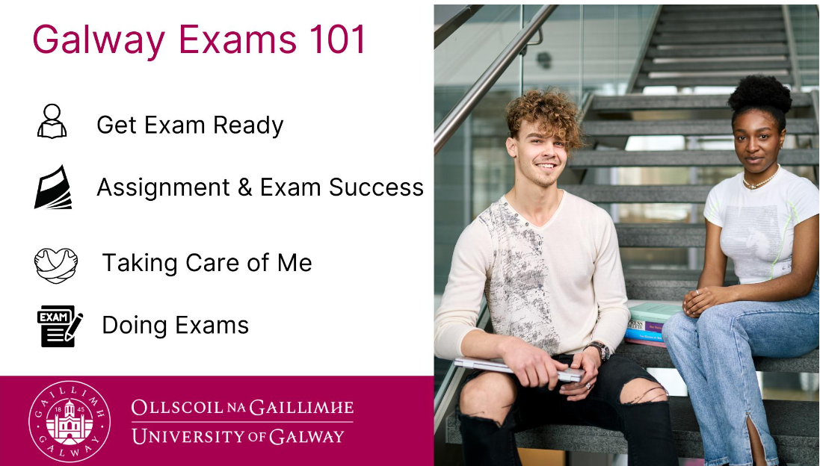

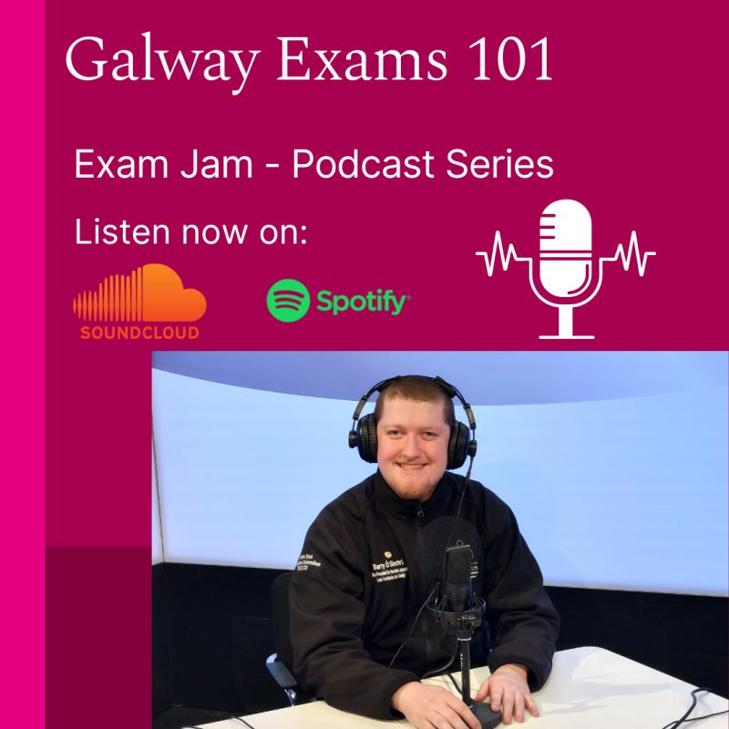


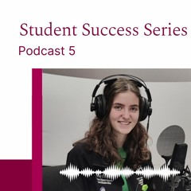

Student Engagement - Respond

Slide 18
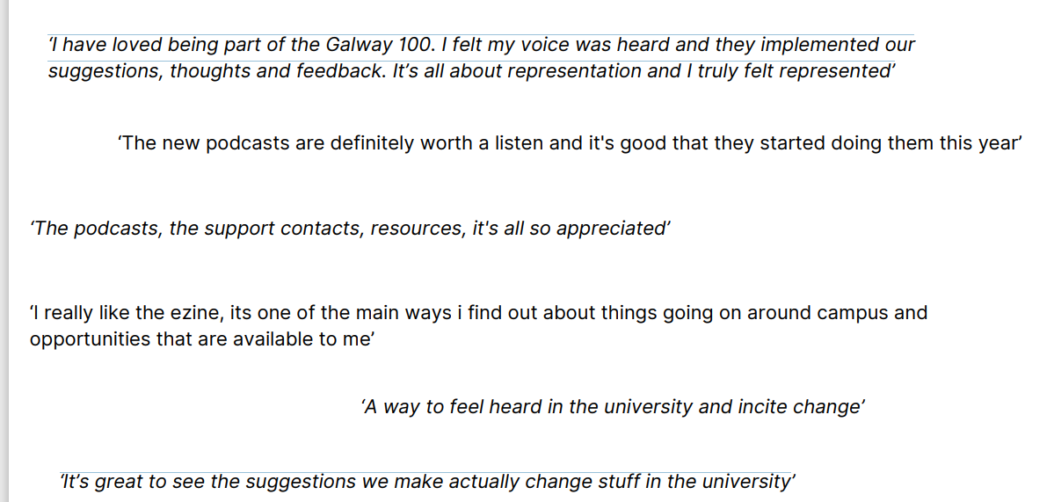
What do students think??

Slide 19
Session overview…..
Effective channels to “listen “ to the student voice in real time
Process what we hear - “Seek first to understand”
Respond with targeted communications, initiatives and services to contribute to student success.

Slide 20
Thank you!

Slide 21

Questions?

