Slide 1

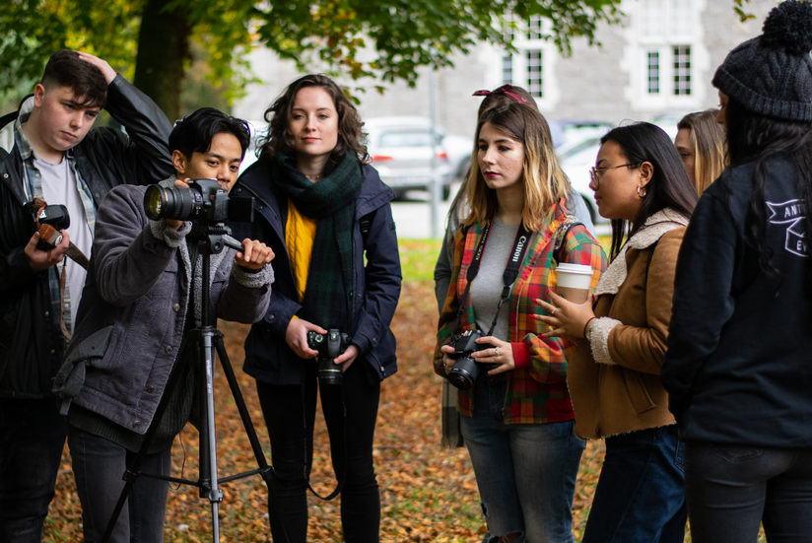

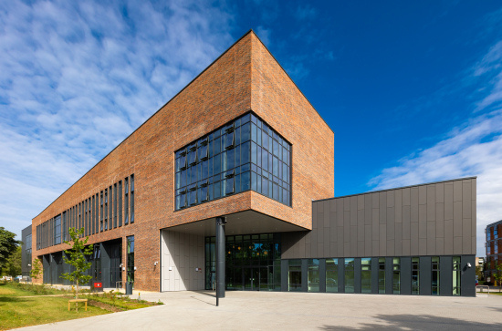
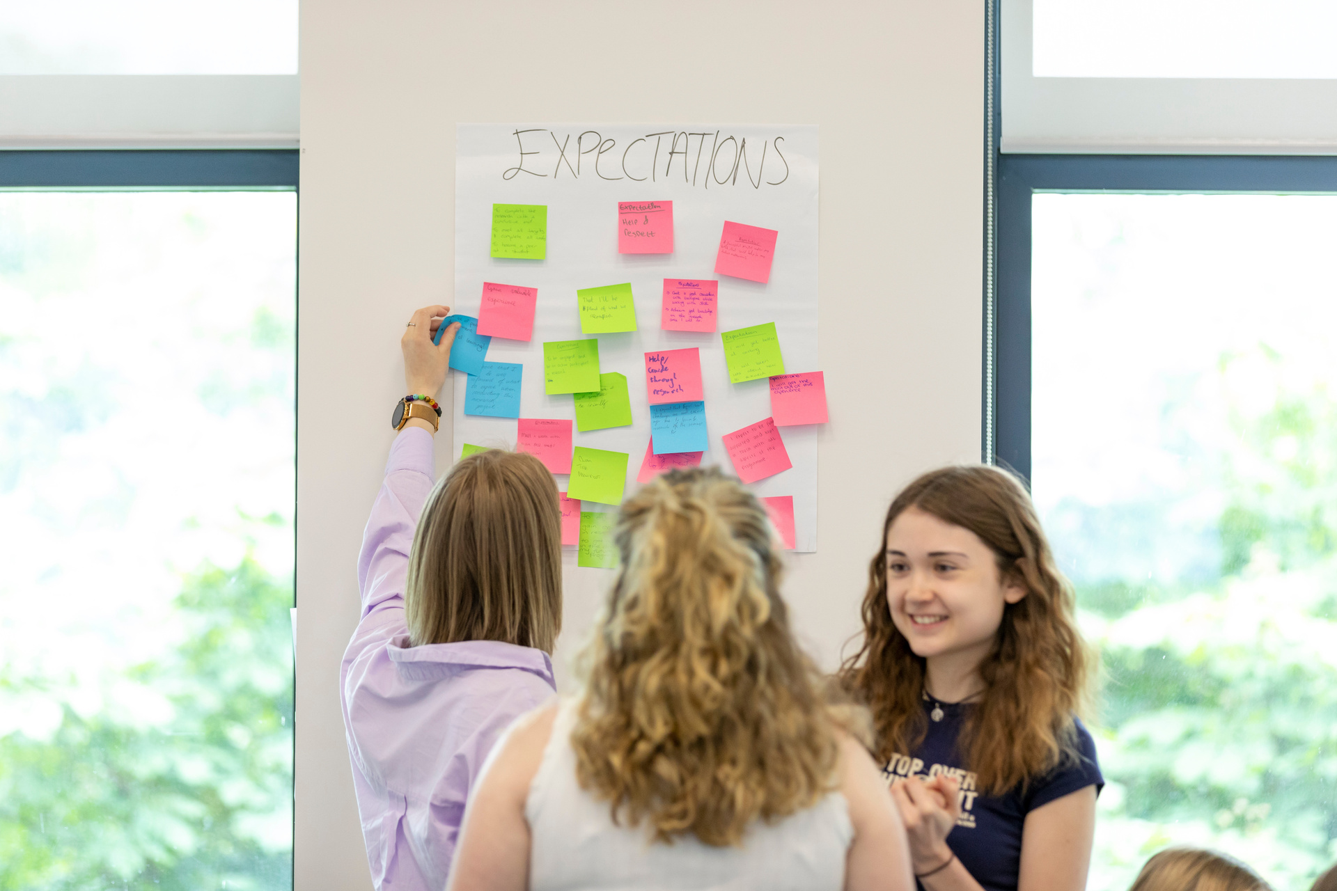
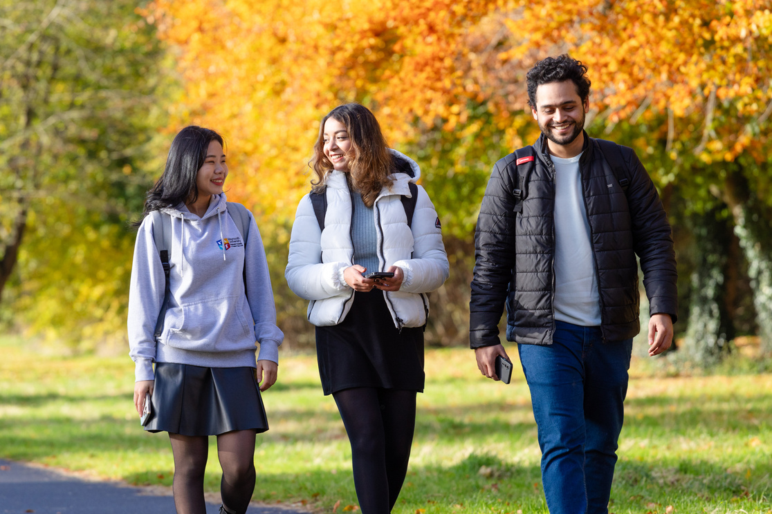

Belonging at University:
To What and to Whom?
An interactive session exploring what Belonging
means within the University setting
Student Affairs Ireland Summer Seminar
June 2024
Eddie Corr
MU Student Success Officer

Slide 2
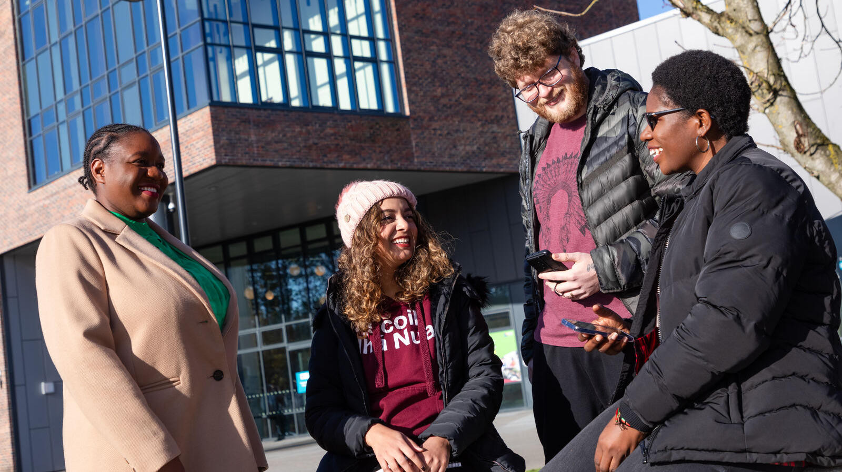
Welcome!
Part 1: Exploring ‘Sense of Belonging’
Part 2: Enablers and Barriers to Belonging Workshop
Tionscnamh RATHÚ
THRIVE Initiative
Notes:
Link to Social Justice

Slide 3

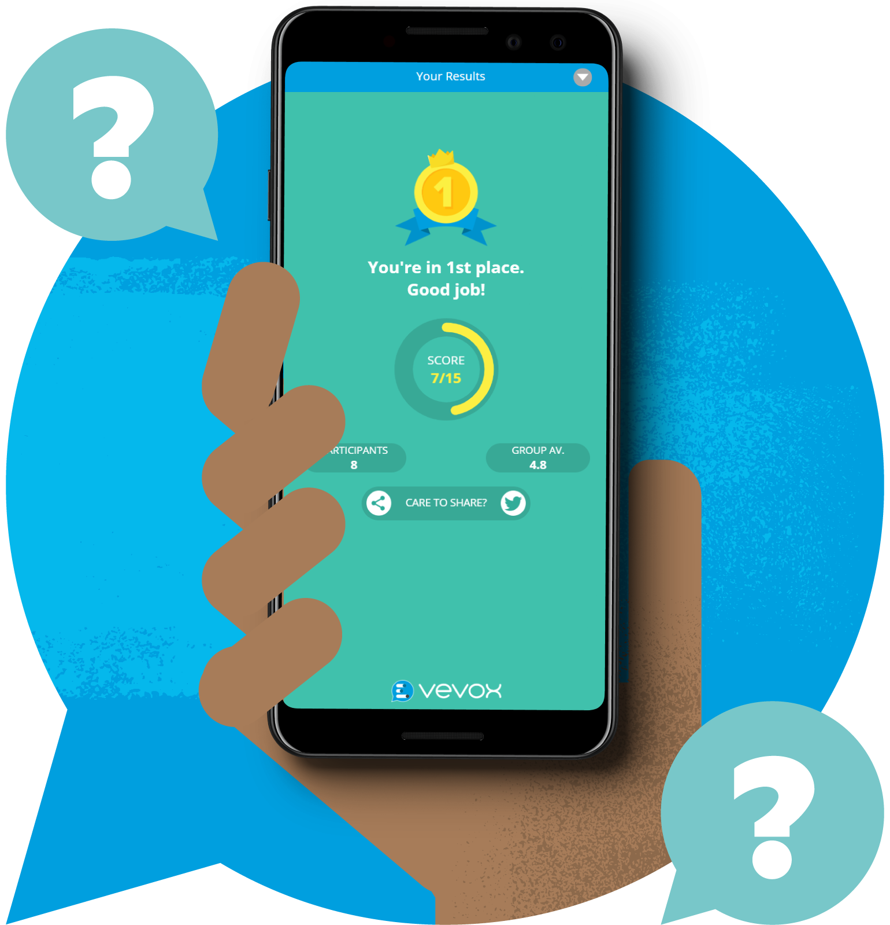
Join the Vevox Session
Go to vevox.app
Enter the session ID: 172-559-009
Or scan the QR code
Tionscnamh RATHÚ
THRIVE Initiative

Slide 4
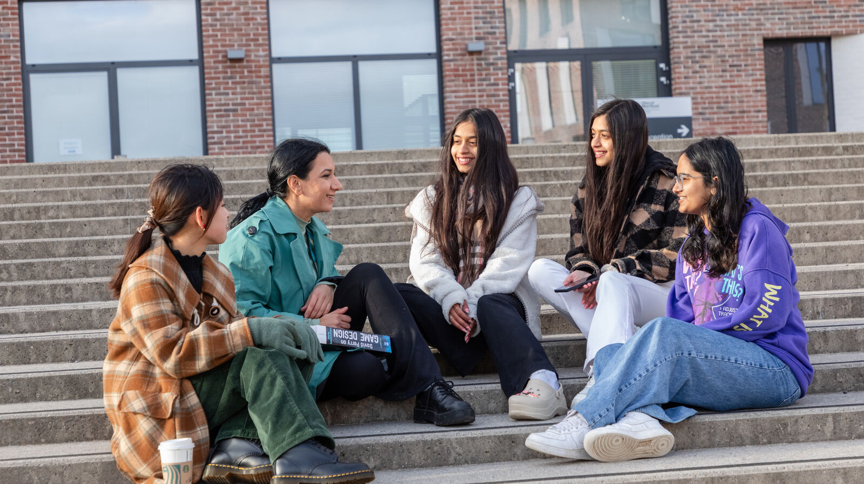
Recognising ‘sense of belonging’
We will embed a culture of partnership with students that nurtures engagement, belonging and community
(MU Strategic Plan, 2023)
The plan recognizes the importance of (…) creating a sense of belonging in education
(National Access Plan, 2022)
HEIs need to foster the development of student wellbeing through (…) engagement and belonging.
(National Student Mental Health and Suicide Prevention Framework, 2020)
Tionscnamh RATHÚ
THRIVE Initiative
Notes:
We have a consensus within Higher Education that a ‘sense of Belonging’ is something important.
It is something that should be created, nurtured & developed
Belonging is often referenced in policy and frameworks in this manner, often without the further context of ‘What Belonging Is’, ‘What does it mean to Belong’ and ‘What are we Belonging to?’
That’s what we want to explore today.
Transition
We are going to start with you! We will shortly open our first Vevox Question…

Slide 5
0/1
Join at: vevox.app
ID: 172-559-009
Question slide
Over to you…
What does belonging mean to you?
Notes:
What does Belonging mean to you? created, nurtured & developed
You can consider this from an holistic point of view- what does belonging mean to the University as a whole
Or a personal context- what made me feel like I belonged (or not belong) as a staff member or student?
There’s no right or wrong answers and you can submit multiple responses
Transition
Progress to Open Vevox Poll

Slide 6

What does belonging mean to you?
0
Join at: vevox.app
ID: 172-559-009
Showing Results

Slide 7
A wicked problem… Defining a ‘sense of belonging’
‘belonging... is often used in a way that implies a common understanding of what belonging is and why belonging is important. Needless to say, no such common understanding exists’
(Mee and Wright, 2009, cited by Carruthers Thomas, 2019)
Tionscnamh RATHÚ
THRIVE Initiative
Notes:
Read Quote
A wicked problem - many interdependent factors with no definitive formula - making it seem impossible to solve
We saw references to Belonging earlier- What you will often see mentioned in relation to it are areas such as; social support on campus; connectedness; mattering or feeling cared about; feeling valued by the campus community
This is one of the most interesting things about Belonging- Contested term – Our understanding cannot be assumed as the same as our students.
Transition
To asking questions

Slide 8
Over to you…
When considering ‘sense of belonging’:
To what?
To whom?
When?
Tionscnamh RATHÚ
THRIVE Initiative
Notes:
What is clear is that Belonging covers a lot of areas, issues and feelings.
And that’s the challenge for building belonging.
This begs some questions about Belonging to help us understand it better and to find common ground
We need to continually explore What are we trying to build Belonging with? Who? And When are we building it?
Transition
Vevox Question: To What?

Slide 9
0/1
Join at: vevox.app
ID: 172-559-009
Question slide
Over to you…
When considering ‘sense of belonging’:
To what?
Notes:
What are we building Belonging with?
Something tangible, like a building or a place?
Or something intangible like your area of study, or a community?
Transition
To Findings

Slide 10

Belonging: To What?
0
Join at: vevox.app
ID: 172-559-009
Showing Results

Slide 11
Belonging: To Whom?
0/1
Join at: vevox.app
ID: 172-559-009
Question slide
Over to you…
When considering ‘sense of belonging’:
To whom?
Notes:
Who are we building Belonging with?
Is something intrinsic, like ourselves?
Or something more external like your classmates or particular student groups?
What about staff, particularly lecturers or support staff?
Transition
To Findings

Slide 12

Belonging: To Whom?
0
Join at: vevox.app
ID: 172-559-009
Showing Results

Slide 13
0/1
Join at: vevox.app
ID: 172-559-009
Question slide
Over to you…
When considering ‘sense of belonging’:
When?
Notes:
When are we building Belonging?
When does a sense of Belonging start?
When does your sense of Belonging to a University end?
What about staff, particularly lecturers or support staff?
Transition
To Findings

Slide 14

Belonging: When?
0
Join at: vevox.app
ID: 172-559-009
Showing Results

Slide 15
Why is Belonging important?
A ‘basic human need’ and motivator (Strayhorn, 2019)
To counter isolation (Tinto, 2013), disconnectedness and ‘imposter syndrome’ (Ramsey and Brown, 2018) i.e. wellbeing (Beniston and Harris, 2017)
The link between engagement and belonging
(Cook-Sather and Felton, 2017)
Retention and satisfaction (Thomas, 2012; Humphrey and Lowe, 2017)
Tionscnamh RATHÚ
THRIVE Initiative
Notes:
We have explored some of the Key Questions around Belonging.
We know that our policy and frameworks emphasise its importance and I think deep down in our gut we know its important. But why?
It is important to consider why it is significant. Why does it matter? Well, the research back up our gut feelings on Belonging.
There are many reasons why the literature says it is key.
Strayhorn draws on Maslo’s Hierarchy of Human Needs. Takes it even further- it’s a motivator.
If I feel like I belong before arrival I will be motivated to choose Maynooth.
If I feel like I belong I will overcome adversity and I will want to stay.
If I feel like I belong my identification as a student will grow and that bring academic benefits with it.
Social connectedness & wellbeing- friends, societies staff Challenging times.
If I feel like I belong am likely to be more engaged, if I feel engaged I am more likely to feel like I belong.
Lots of research showing a positive link between students identifying as Belonging and retention and satisfaction
Basic human need that keeps us motivated is really significant.

Slide 16
And yet… Belonging is transitory
Students transition through multiple stages during their ‘student journey’, each impacting (negatively or positively) on their sense of belonging.
(Mee and Wright, 2009, cited by Carruthers Thomas, 2019)
Tionscnamh RATHÚ
THRIVE Initiative
Notes:
Read Quote
Quickly move to Transitions

Slide 17

Which comes first?
Belonging
Engagement
Belonging
Engagement
A lack of engagement begats a lack of belonging and vice versa’
(Cook-Sather and Felton, 2017)
Tionscnamh RATHÚ
THRIVE Initiative
Notes:
Which comes first- Belonging or Engagement?
Do I have to Belong in order to Engage? Or am I more likely to Engage once I feel like I belong?
Is there a direct line between the 2, or is it a bit fuzzy or like a continuous cycle
Alison Cook-Sather and Peter Felton argue that there is absolutely a link and one brings about the other
If I feel like I belong am likely to be more engaged, if I feel engaged I am more likely to feel like I belong.
What does this mean for us when designing activities to engage students and to build belonging? No answer, just something to consider

Slide 18
What transitions impact Belonging?
Choosing your course/university
Pre-admissions
Orientation
Your first 100 days
Exams & assessments
Expanding your interests
Developing citizenship
First to second year
Into placement/Erasmus, and back
Thinking about your career
Graduation
Alumni
Tionscnamh RATHÚ
THRIVE Initiative
Notes:
Transition now understood as more than just ‘going to university’. Research now acknowledge multiple points of transition.
Students continually negotiating new contexts, tasks and identities.
Really re-enforces that Belonging is transitory and context specific. We need to consider the different points that students move through and as practitioners how can we support students through those transitions.
As students move from one phase to another they may be shifting from a place of certainty to uncertainty. Being challenged in their knowledge and sense of self.
Examples:
New entry first-year student, captain of sports team at school, very popular, joins a large programme, doesn’t know anyone, has to try out for the college team- identity feels different
Successful first year student – move to second year where I take on new modules or shift programmes, academic conventions are different, classmates are different, new lecturers, new types of assignment
Transition:
Students will negotiate many transitions, each having a positive or negative impact on their Belonging. How can we build activities and opportunities to best support them?

Slide 19
What activities impact Belonging?
Student admissions & outreach
Orientation
Peer schemes (academic & pastoral)
Staff-student partnerships (pedagogical & developmental)
Student representation (MSU) & groups (sports, societies)
Student Supports (welfare & learning)
And where?
In the classroom • Online • Placement
Social spaces • Virtual spaces • Abroad
Tionscnamh RATHÚ
THRIVE Initiative
Notes:
Belonging can be inherent on many existing activities within the University.
Whether as a direct aim or as a by-product of that activity
How do we build effective methods for building Belonging at University?
What are the Enablers and Barriers to Belonging?
That’s what you are going to consider!

Slide 20
Workshop Time!
Working in groups, you will consider how we can enable Belonging
Identify activities/actions that might support or enable belonging within different settings e.g. Orientation, Timetabled peer mentoring
Discuss how these activities/actions enable belonging?
e.g. providing social support, developing skillsets
Are there any physical/structural/cultural barriers to consider? e.g. Mixed class groups, social space
Tionscnamh RATHÚ
THRIVE Initiative
Notes:
Online will be put in Break out Rooms
You will get 10/15 mins to discuss in groups
Nominate a note-taker who will report back
We will spend 10 mins discussing as a group

Slide 21
Enabling Belonging...
Staff / Student Engagement
Orientation Programmes
Extra-Curricular Activity
On-Campus Accommodation
Campus Spaces & Infrastructure
Finances & Budgeting
Peer Support & Mentoring
Identify 1 activity/action that might support or enable belonging within these different settings:
- On Campus
- In Classroom (physical & virtual)
- Learning/Support Services (physical & virtual)
Discuss how this activity/action enables belonging
e.g. providing social support, developing skillsets/resilience
Are there any physical/structural/cultural/tech
barriers to consider e.g. Mixed class groups, social space
Tionscnamh RATHÚ
THRIVE Initiative
Notes:
You will get 10/15 mins to discuss in groups
Nominate a note-taker who will report back
We will spend 10 mins discussing as a group

Slide 22
Sense of Belonging
Basic Universal human need
Related to ‘mattering’
Context, time and factors determine importance
Fundamental motive sufficient to drive behaviour
Influenced by intersection of identities
Produces positive outcomes
In Conclusion…
Sense of belonging matters and it is sufficient to drive human behavior
Belonging is vital to our existence and optimal human functioning
Social support is a necessary, but insufficient condition for belonging
Feeling ‘out of place’ can raise doubts about one’s capabilities
Belonging leads to positive outcomes and success — finding belonging but not being forced to ‘fit in’
Must be satisfied on a continual basis
Likely to change with circumstances
(Strayhorn, 2019)
Tionscnamh RATHÚ
THRIVE Initiative
Notes:
Everybody wants to belong and worrying about it is common
Feeling valued as a member of the community
Worries about belonging are common in vulnerability and fleeting – feeling safe in learning spaces
Viewing adversity, hardship or self-doubt as malleable motivates behaviour to change it
Belonging is shaped by how students ‘see’ themselves – acceptance, community
Enduring perceptual changes is possible through short-term adjustment
Must be satisfied on a continual basis and likely changes with circumstances

Slide 23




Thank You
I Belong Here,
We All Do.
Tionscnamh RATHÚ
THRIVE Initiative

