Slide 1

Employability Events
Claire Butterly and Caitriona McGrattan

Slide 2
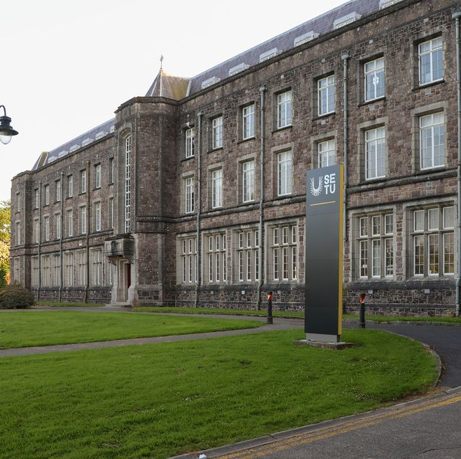
Introduction
SETU Summerhill Road Campus is based in Wexford.
It is the smallest of the full-time campuses
It is hoped we will get a new campus by 2028.

Slide 3
Presentation Overview
With this presentation, we will:
Provide an overview of the N-TUTORR project;
Discuss the employability events I organised as part of N-TUTORR week;
Highlight what worked well and personal learning from the events.

Slide 4

N-TUTORR Project
Partnership across entire Technological HE sector
Emphasis on working collaboratively together with shared goal across an agreed set of ambitious streams of activity and work-packages
Transformative in concept and design (value 38 million euro).
NRRP proposal evolved from the concept of a shared digital transformation in Higher Education.
The project will support a transformation in Teaching and Learning that will positively impact on 9,600 students and 4,000 staff
SETU Targets: 2120 Students, 650 Staff
Project commenced in April 2022, with run out to Dec 2024

Slide 5

The N-TUTORR Project
Why do we exist?
To transform learning in the Technological University Sector.
What do we do?
We empower students and educators with the tools and skills necessary to develop new ways of digital learning.
What do we do it for?
To develop sustainable digital ecosystems that cater for an improved student experience and equal access to education.

Slide 6
Courses in SETU Summerhill Road Campus
BA in Art
BA in Visual Communications and Design
BA in Applied Social Studies in Professional Social Care
BSc in Sustainable Farm Management and Agribusiness
BSc in Tourism and Event Management
Bus in Business
BEd in Early Childhood Education and Practice

Slide 7
Courses in SETU Summerhill Road Campus
BA in Art
BA in Visual Communications and Design
BA in Applied Social Studies in Professional Social Care
BSc in Sustainable Farm Management and Agribusiness
BSc in Tourism and Event Management
Bus in Business
BEd in Early Childhood Education and Practice

Slide 8
Objectives of the Employability Events
The purpose of these events were to
enhance the employability skills for all students in SETU;
Provide opportunities for professional development and growth;
Offer access to expert knowledge and practical training sessions.
I wanted this event to be inclusive of all students regardless of if they had a placement element in their programme or not.

Slide 9

Sustainable Development Goals
SDG 4: Quality Education
SDG 8: Decent Work and Economic Growth
ThePhoto by PhotoAuthor is licensed under CCYYSA.
Notes:
Goal 4.4 in particular discusses increasing the number of people with relevant skills for financial success
Goal 8.5 is in relation to full employment and decent work with equal pay

Slide 10

Step 1: Apply for funding
N-TUTORR announced a funding call in November 2023 to run workshops and events as part of N-TUTORR week.
Funding was for up to €3000
Events had to happen between the 26th of Feb and 1st of March and needed to align with at least on of N-TUTORR's Themes.
I applied under the Theme of Employability to host several events to support student's employability.

Slide 11
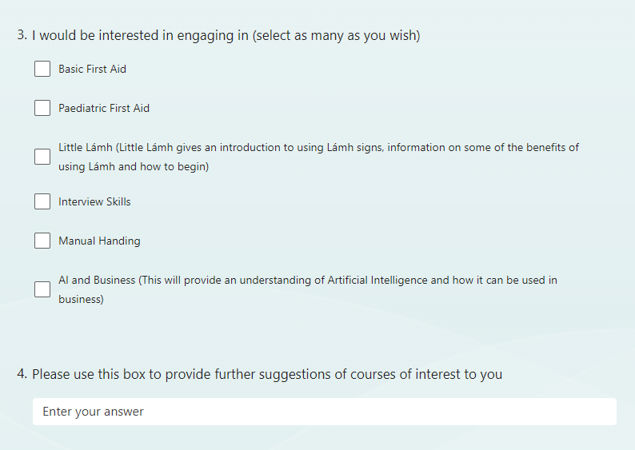
Step 2: Survey students to gauge interest
I sent out a survey to all students on the Wexford campus during the first week of the new academic term.
I gave suggestions for possible workshops and provided space for students to suggest their own workshops

Slide 12
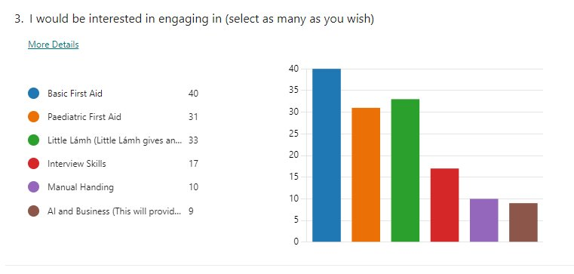
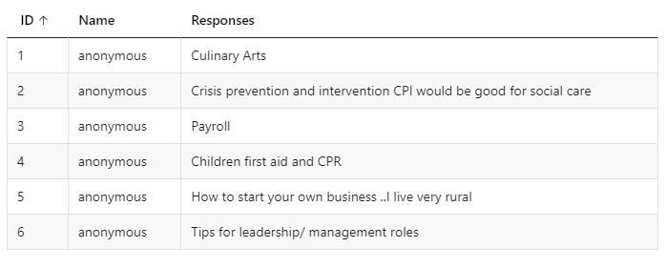
What the participants said:
49 participants responded

Slide 13
Step 3
Basic and Pedatric First Aid
Little Lámh
Interview Skills Webinar
AI and Business Webinar
Manual Handling was planned but did not proceed
Research, plan and organise the events

Slide 14
First Aid
To make it as accessible for all students, I decided to run two iterations of the First Aid workshop, one which took place on a Monday AM and the other on a Wednesday PM.
The class took place in SETU Summerhill Road, and invitations were open to students on other campuses to apply for an available space.
Key topics included paediatric and adult CPR, Wound Care and Emergency response.

Slide 15
Little Lámh
3 sessions of Little Lámh were scheduled, and 2 went ahead.
Objective of this training was to introduce participants to Little Lámh. It was mainly students engaging in Early Childhood who availed of this training.
Topics covered included what Lámh was. Students learned 24 basic signs on the day.

Slide 16
Interview Skills Webinar
This webinar took place on Zoom and was streamed from one of the rooms on the Wexford Campus. Participants from other campuses could register and be sent the Zoom link
The objective of this event was to enhance participants interview skills.
Key topics included Common Interview Questions, how to present for an interview and using the STAR technique.

Slide 17
AI and Business webinar
This event took place on Zoom and was open to participants from all SETU campuses
The objective of this webinar was to help prepare participants for AI in business
Key topics here included AI applications, future trends and creating a LEAN business plan

Slide 18

Manual Handling (Cancelled)
The Friday before the training was due to happen, it was identified that the company who was due to deliver the training did not have the €6.5million insurance liability which was required by SETU.

Slide 19
Participant Engagement
 | Booked in | Participants who engaged
First Aid | 28 & 29 | 22 & 15
Little Lámh | 9 & 2 & 13 | 8 & 13
Interview Skills | 76 | 58
AI and Business | 74 | 35
Manual Handling | 12 | 0

Slide 20
Impact and Outcomes
Participants commented on how they confidence grew from engaging in the workshops.
Some felt better prepared for future work.
Other participants have discussed more motivation and focus on their career path

Slide 21
Impact and Outcome - Testimonials
Students commented on their increased knowledge: This was a very engaging class, and getting to learn by doing was very beneficial (especially for the likes of the epi-pen and cpr). The environment was positive, relaxed and judgement free, everyone was allowed to ask questions without fear of judgement.
Another student commented on how Little Lámh will benefit them when they are employed: I really enjoyed the Lámh workshop. The background and reason for the use of Lámh was well established and explained, it was very beneficial to learn some signs and getting to learn them correctly. This workshop will forever be beneficial for my future career in the early years

Slide 22
Impact and Outcome: Testimonials
A Student commented the following on the Interview Skills webinar: I found the interview skills webinar to be very helpful. I now know about STAR and how to use it in an interview
A participant stated this in relation to feedback on the AI and Business webinar The graphic/logo design element of the class was really informative as I had not known previous the capabilities AI such has chatgpt had.

Slide 23
Challenges and Learnings
Challenges
Lessons Learned
Student engagement
Marketing and Time of year
Alignment of providers and spaces available
The insurance requirements
Payment processes
While it is good to support local, sometimes it doesn't always work out.
The students who engaged really benefited from the experience

Slide 24
References
United Nations. (2015). Transforming our world: The 2030 Agenda for Sustainable Development. Available from https://sustainabledevelopment.un.org/post2015/transformingourworld

