Slide 1

Hearing But Not Listening
Student Experiences of Applying to the Higher Education Access Route (HEAR) Scheme
Daniel McFarlane - Access Manager - Irish Universities Association
SAI, Tuesday the 18th of June, 2024
Notes:
1.7.2013
Introduce ourselves
‹#›

Slide 2

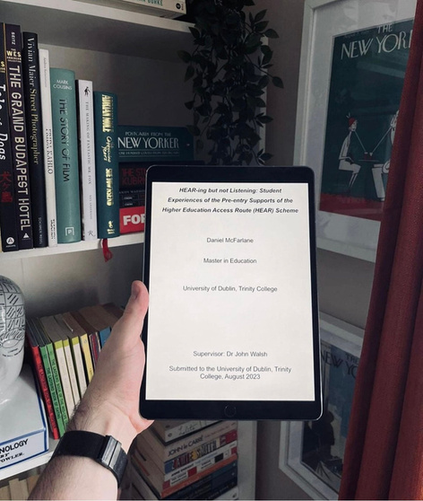
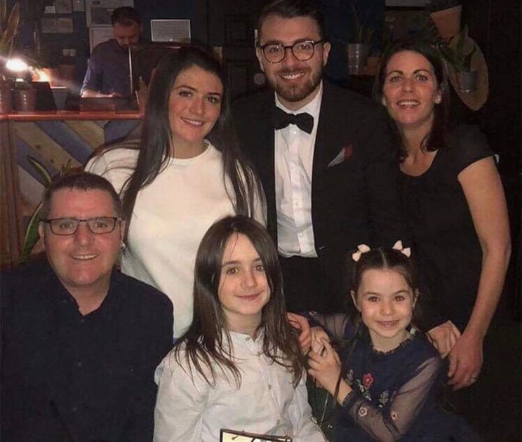
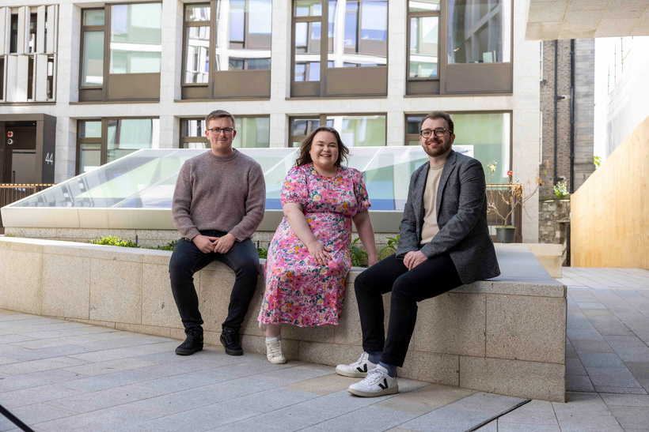


A Little About Me...
Notes:
1.7.2013
‹#›

Slide 3
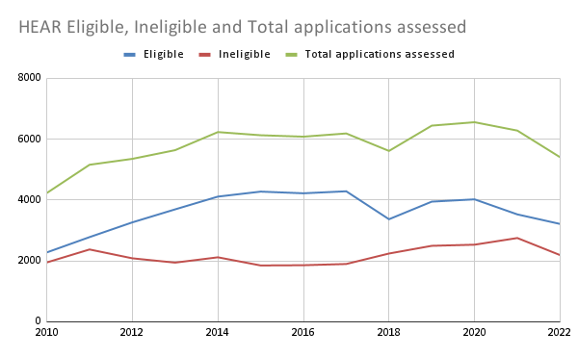
Background
Personal Experience/Practitioner Experience.
‘’Access’’ discourse in the Irish Society.
New demands of NAP 2022 - 2028.
Downward Trends for HEAR Engagement.
Lack of Student subjectivity in policy.
Pandemic pressures for educational inequality.
Notes:
1.7.2013
D20
‹#›

Slide 4
Research Question:
1. How did students engage with pre-entry support on the HEAR scheme?
2. How does this support influence students in applying to the Scheme?
Research Approach:
Qualitative-based data research is akin to Merriam & Grainer's (2019) stance on qualitative data’s potential to create "meaning as socially constructed by individuals interacting with their worlds" (p. 3). Informed by Denzin and Lincoln's (2005) view of qualitative data as a means to unlock rich experiential reflections.
The research was underpinned by the theory of Community Based Research (CBR). The core belief of this ethos aims to ensure that the participants need to see and understand the data that represents them. The genesis of CBR, as defined by Mcllrath et al (2014), is "a research question or puzzle generated by, and of significance to, the community." (p.103).
Research Approach: The Case for Case Study
The research questions aimed to interpret qualitative data and can be determined by returning to Denzin and Lincoln (2005) for their definition of qualitative research as a process of attempting to “interpret phenomena in terms of the meanings people bring to them” (p. 3).
Notes:
1.7.2013
D20
‹#›

Slide 5
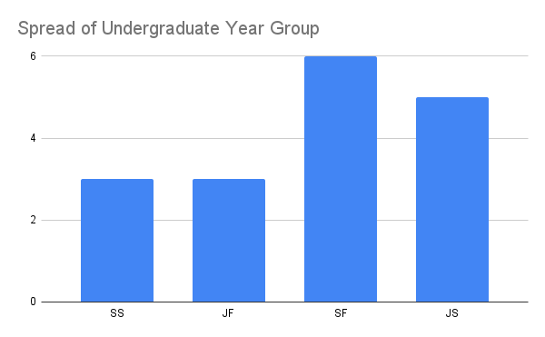
Research Methods
Convenience sampling was employed as TCD HEAR-eligible undergraduate students participated via Convenience Sampling. 11 attended a DEIS school, whereas 14 did not.
The course representation included 66% of students in Arts & Humanities, while 23% from Health Science and 11% from Science, Technology, Engineering and Maths.
Semi-structured focus groups with each focus group having approx. 5 - 6 participants.
Notes:
1.7.2013
D20
‹#›

Slide 6
Student Quotes:
Family Finances
‘’I actually didn't know the financial circumstances of my family until I had to get those documents. And for me to be eligible for HEAR and you know, we weren't doing great, but I only realised we were not doing great when we actually have to get this document and have conversations with my parents about finances and stuff.’’
Class Anxieties
‘’For many people, especially for my mum, you know, being working class…being a single parent and with money issues in the family… to be confronted with that question [are we disadvantaged or not] by your child is a very difficult thing, especially when it's attached to something so big as their dream college.’’
Disability Hindering the Application
‘’My mom was the one who did all the paperwork herself, like, shout out to her. I didn't have a clue, but she got it all done. It was incredibly challenging and like I don't believe I would have got HEAR if I had to do it myself. Like the same thing with DARE. My mom did it all for me. Like even to this day I still get help from her on that stuff, I just find paperwork specifically to be very challenging.’’
Geographical Class Difference
‘’Just like coming to Dublin as a non-Dub, like as you’re seeing like people coming from like very different and much more privileged backgrounds. Still, there’s not a single day where like I don't feel like I don't belong but it's still something that I'm like always conscious of and just to invite that difference as it exists. It's not even necessarily a value positive or value negative thing, it's just something that is there and I'm conscious of.’’
Notes:
1.7.2013
D20
‹#›

Slide 7

Findings
Student success varied between siblings, parents and ethnicity.
Challenging interactions with guidance counsellors impacted students' confidence.
Parental involvement varies (no student mentioned a father figure), influenced by factors like language barriers and digital literacy.
Exposure to the scheme heightened class awareness.
Suggestions included automating processes, and enhancing social media campaigns.
Addressed some but identified more research gaps.
Notes:
1.7.2013
D20
‹#›

Slide 8
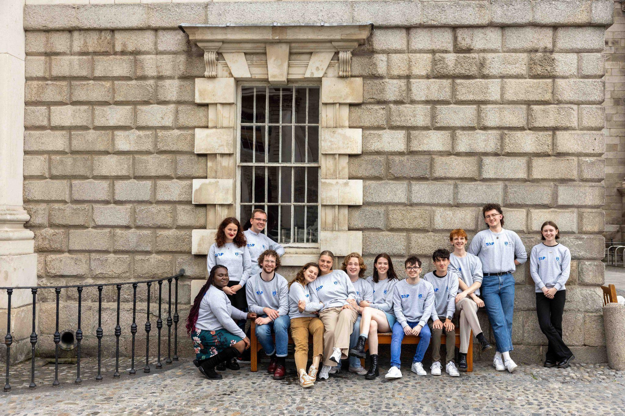
Conclusions
A better understanding transitions to HE and ‘’lived-reality’’ of applying to the scheme.
A need to address factors affecting decision-making and administrative efficiency.
The reality of access work and the policies are currently at odds.
Recommendations
Enhanced and targeted communications
Training and CPD for teachers in DEIS/Non-DEIS
Implementing tailored communication strategies aligned with NAP goals.
Notes:
1.7.2013
D20
‹#›

Slide 9



Thank You & Questions
Reference List (here)
daniel.mcfarlane@iua.ie
Notes:
1.7.2013
65
‹#›

