Slide 1



An investigation into the Implementation of The Donegal Wellness Café Peer Led Model & it’s impact in creating a supportive campus environment for students
Sharon Ferguson Mental Health & Wellbeing Project Officer
ATU Donegal
Brian Herron Peer Facilitator
Melanie Baxter Peer Facilitator

Slide 2
What is aWellness Café?
The Wellness Café is a peer led community-based model developed to support the recovery and inclusion of people with mental health problems in becoming active citizens. It is a model of support that exists outside mainstream mental health services and operates from a social rather than a medical perspective.
“no closed door”
Engage - Create campus communities that are connected, safe, nurturing, inclusive and compassionate HEIs need to foster the development of student wellbeing through community connectedness, purpose, engagement and belonging. Institutional culture needs to reflect diversity, inclusivity and compassion (National Student Mental Health & Suicide Prevention Framework 2020)
“no closed door”

Slide 3
THE PEER FACILITATOR EXPERIENCE
Overall Peer facilitators experience has been positive
Most students have been able to attend meetings & facilitate the wellness café regularly
Challenges for facilitators has been Scheduling/Timetable, coursework
So glad I signed up, I love it!
I am really enjoying being a peer facilitator for the Wellness Cafe..it has been really fun getting to meet and get to know other peer facilitators as well as service users 😀
It’s been a positive experience meeting students that I probably would not have engaged with outside the cafe
It is a great initiative and students seem to be responding. Hope it grows with time.

Slide 4

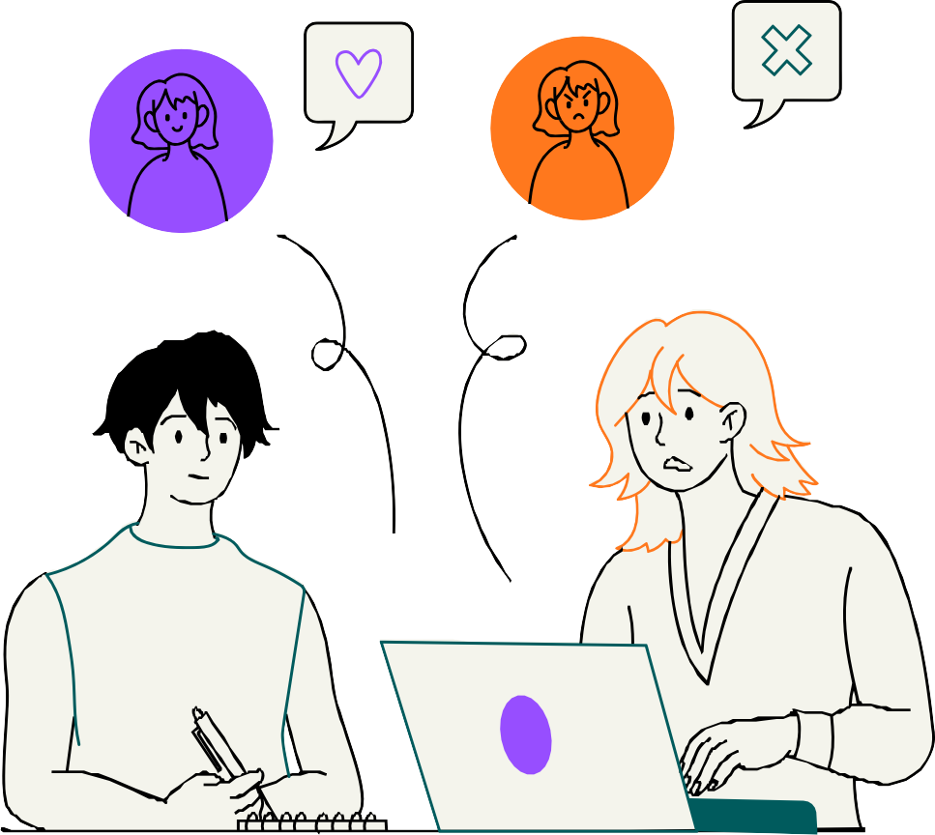
THE
SU PEER EXPERIENCE

Slide 5

THE
STUDENT PEER EXPERIENCE

Slide 6



Our
Recommendations..

