Slide 1
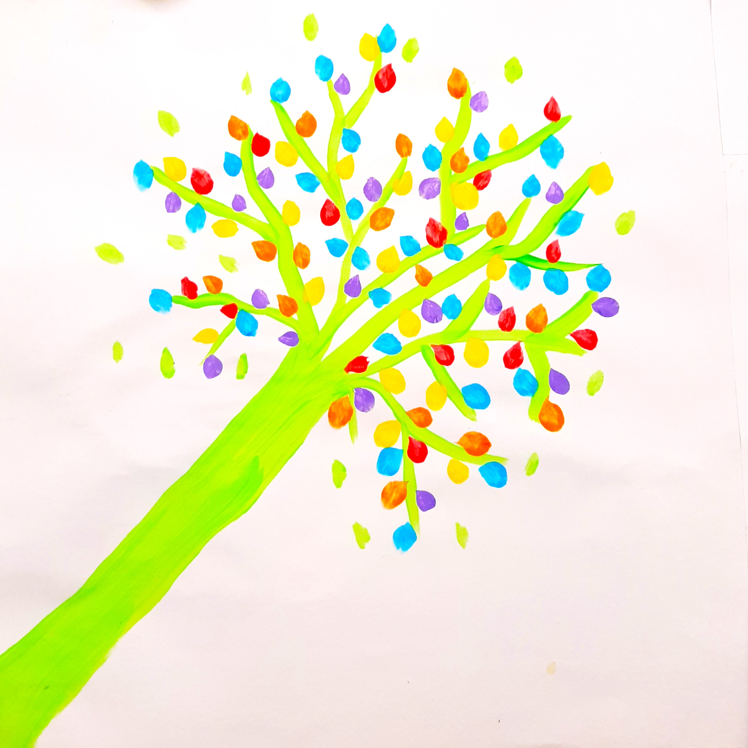
Eating Disorder Recovery Group Programme
Cristina Galvin & Grace Harrison
Psychotherapists & Student Counsellors

Slide 2
Presentation Overview
Current Context of Eating Disorders
Eating Disorder Recovery Group Programme Overview
Pilot Study of the Programme
Results of the Programme
Student Testimonials & Experiences (Quotes)
Evaluation of Eating Disorder Recovery Group Programme
  Most Helpful Aspects
  Least Helpful Aspects
  Recommend it?
  Future Improvements
Implications & Future Developments

Slide 3

Eating Disorders- Statistics
* EDs have highest mortality & morbidity risk of all mental health disorders (Kerswill et al, 2023).
* EDs the cause of 80 annual deaths in Ireland (Wilson, 2024).
* Mortality rate for females with anorexia is 200 times overall female suicide rate (Wilson, 2024).
* EDs affect 13% of females and 6% of males (Stice et al. 2013). Men = ¼ of UK ED cases (Manning et al, 2022)
* Most common age of onset 12-25, i.e., emerging adulthood a high-risk period & high prevalence in college populations (Manning et al, 2022)
* Prevalence among American college students: between 12% & 16.4% (Egbert et al, 2024).
Notes:
The COVID-19 pandemic saw an increase in new and relapsing cases of ED, with surges of referrals to both pediatric and adult general hospitals and to community services (McNicholas et al, 2023). The gap in access to services in Ireland is much higher than reported in the UK, where in the most recent national mental health survey, 66.4% of youth with disorders had accessed services (Lynch t al, 2023). studies generally agreed that the majority of youth identified as meeting criteria for a psychiatric disorder were not receiving professional help and fewer still had contact with CAMHS (Lynch et al, 2023).
CAMHS report identified ‘repeated failure by State agencies to build the necessary capacity to provide adequate mental health services to children and adolescents’. Funding dropped from 13% in 1984 to 6% now. (Leahy & McNicholas, 2024)
Incidence rates of anorexia in males are found to be lower, usually by more than a factor 10, in comparison to females. The rates in males should be interpreted as an underestimation because of underdetection due to a double stigma: the stigma of having a psychiatric disorder, and an additional stigma of suffering from a ‘female-specific’ disorder (Van Eeden et al, 2021). the finding that the incidence of anorexia nervosa is increasing in younger girls (<15 years) has important implications for future research into risk factors, the development of prevention programs for younger subjects, and the planning of healthcare services (Van Eeden 2021).
recent findings accentuate high mortality rates for anorexia nervosa and bulimia nervosa, with highest rates among those who received inpatient treatment for anorexia nervosa. Although results are still inconclusive, the suggestion that males have a probably higher mortality risk than females underscores the clinical relevance of detecting and treating anorexia nervosa and bulimia nervosa in males.

Slide 4
Eating Disorders- Irish Context & COVID
∼ 200,000 people in Ireland experience an ED in their lifetime, equating to a lifetime prevalence of ∼ 5% of the population (HSE, 2021). ∼ 1800 ED cases annually (HSE, 2018).
Higher incidence during & after COVID (Katzman, 2021; Rafferty et al, 2024; O’Driscoll et al, 2023).
Studies show COVID also worsened symptoms (Kahn et al, 2024; Murray et al, 2024) & fuelled increase in referral complexity, with a higher proportion reporting suicidal ideation and eating psychopathology (Rafferty et al, 2024).
Ireland saw a 66% rise in hospital admissions for EDs during pandemic, well above the international average of 48% (Barret & Richardson, 2021).
210 hospital admissions for EDs in 2022 - majority female. Highest level of admissions in a decade (Matthews, 2024).
Pandemic had marked impact on referral rates of children & adolescents with EDs (Murray et al, 2024; Rafferty et al, 2023); Incidence of early onset EDs increased (McDonnell et al, 2022) & remains at a high level (Wilson, 2024). Despite increasing prevalence rates, current findings suggest that the majority remain untreated (Sanzari et al, 2021).
3 public beds for adults with EDs in Ireland, 16 for children (Wilson, 2024).

Slide 5
Programme Overview
OVERVIEW
Unique 8-week programme to reduce body dissatisfaction and eating disorder behaviours.
First initiative of its kind in an Irish university.
Enables students build strong foundation for recovery via structured programme of group sharing, art, expressive and behavioural exercises, yoga and psychoeducation.
Includes input of specialist dietician and guest speaker with lived experience of an eating disorder.
Suitable for young women with an eating disorder (anorexia, bulimia, binge-eating disorder and eating disorders not otherwise specified).
Connects students with wider supports and resources.
AIMS
To support students who struggle with eating disorders to:
(a) become aware of the seriousness of the condition;
(b) understand some of the underlying issues;
(c) challenge unhelpful patterns of thinking and behaviour;
(d) make behavioural changes in recovery, including drawing on specific supports to help them ongoing.

Slide 6
Pilot Study of the Programme
Programme launched in September 2023.
Three groups took place during the academic year 2023/2024.
16 female participants completed the programme and a majority report implementing positive changes (both ED-specific & broader self-care). 1 student dropped out.
Recruitment: Student Support Services (Student Health Unit, Student Advisors, Student’s Union, and the Disability Support Service) were contacted with information on the programme should they have any suitable referrals.
Referrals came from one-to-one counselling (Student Counselling Service) and Student Health Unit.
Referrals were contacted and an individual readiness and suitability assessment was conducted with each student by the counsellors leading the programme. Students were provided with an overview of the programme, the requirements for participation and the attendance policy to sign.
Attendance policy stated that students had to attend at least 6 of the 8 sessions and to engage to the best of their ability in the programme activities. Letters of support were offered to anyone who needed to be excused from lectures should the group time clash.
Students with a BMI lower than 18.5 were required to sign an agreement that they would attend their GP a minimum of 3 times during the programme, to have weight monitored.

Slide 7
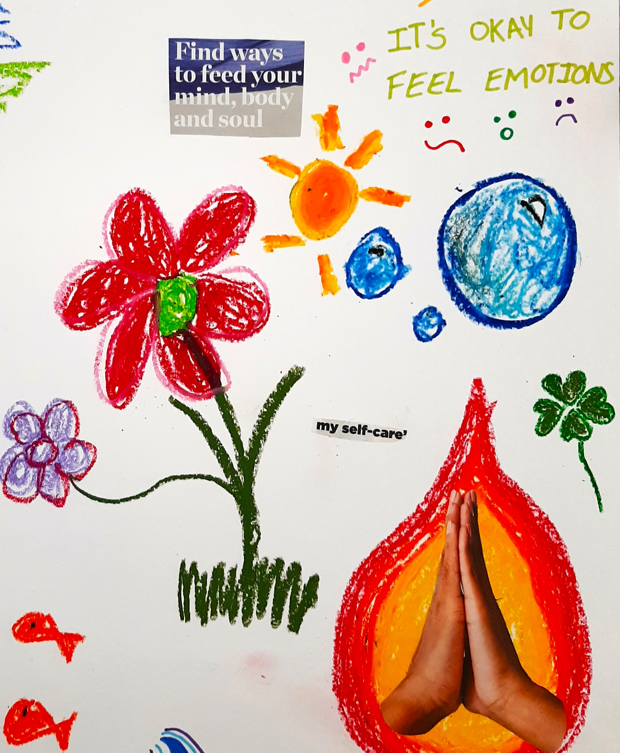
Results: Engagement
All participants honoured the attendance policy and showed up for minimum of 6 out of 8 sessions.
Participants actively engaged in group activities including completing home exercises assigned.
Missed sessions were for genuine reasons: illness, medical appointment, compulsory college class/ placement.
Fact only 1 dropped out attests to overall programme effectiveness, thoroughness of assessment and participants’ connection with peers and therapists.

Slide 8
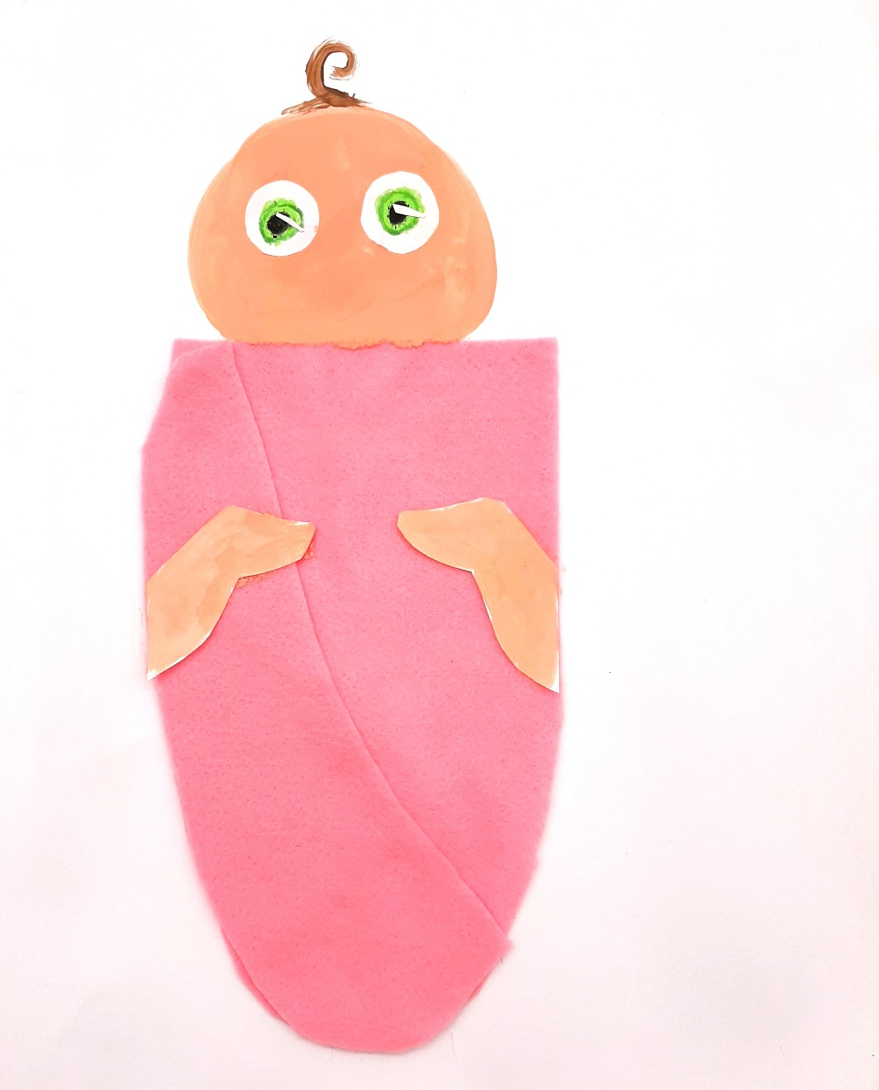
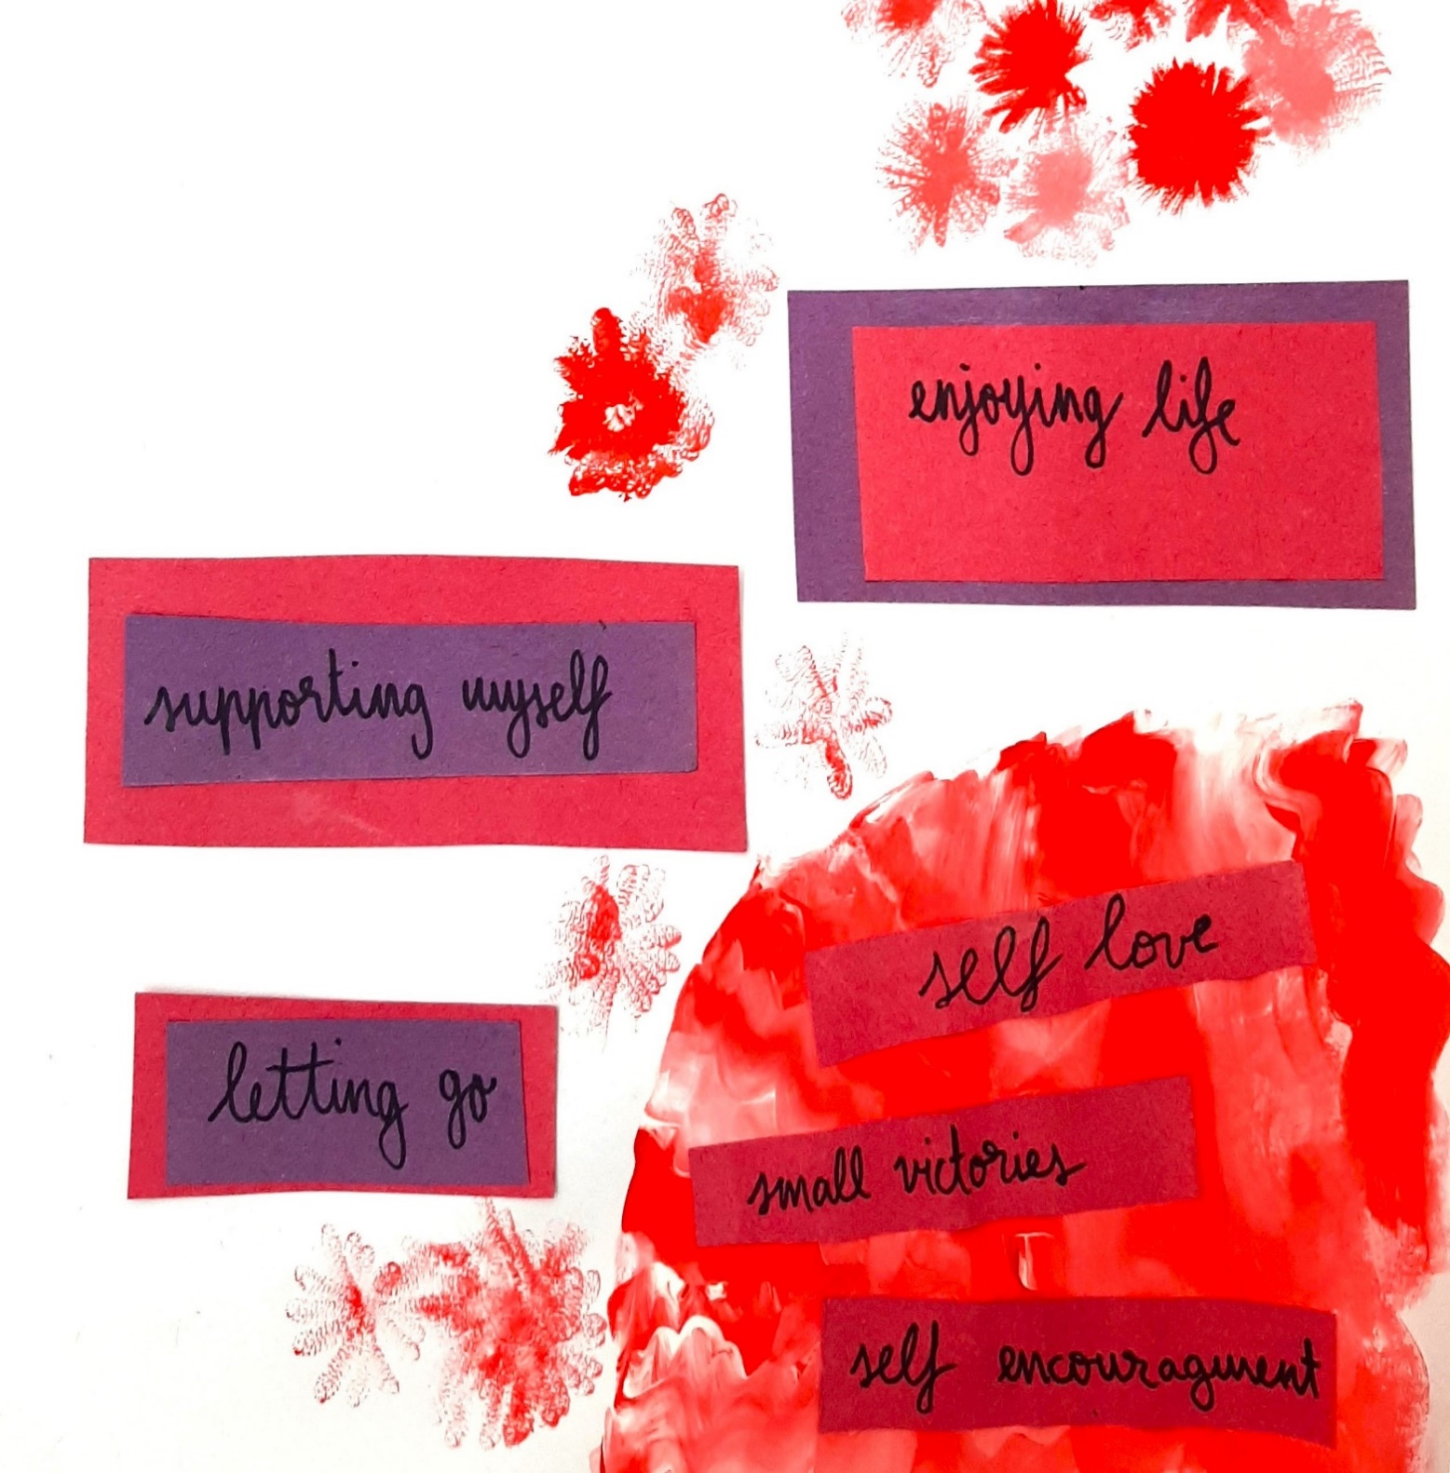
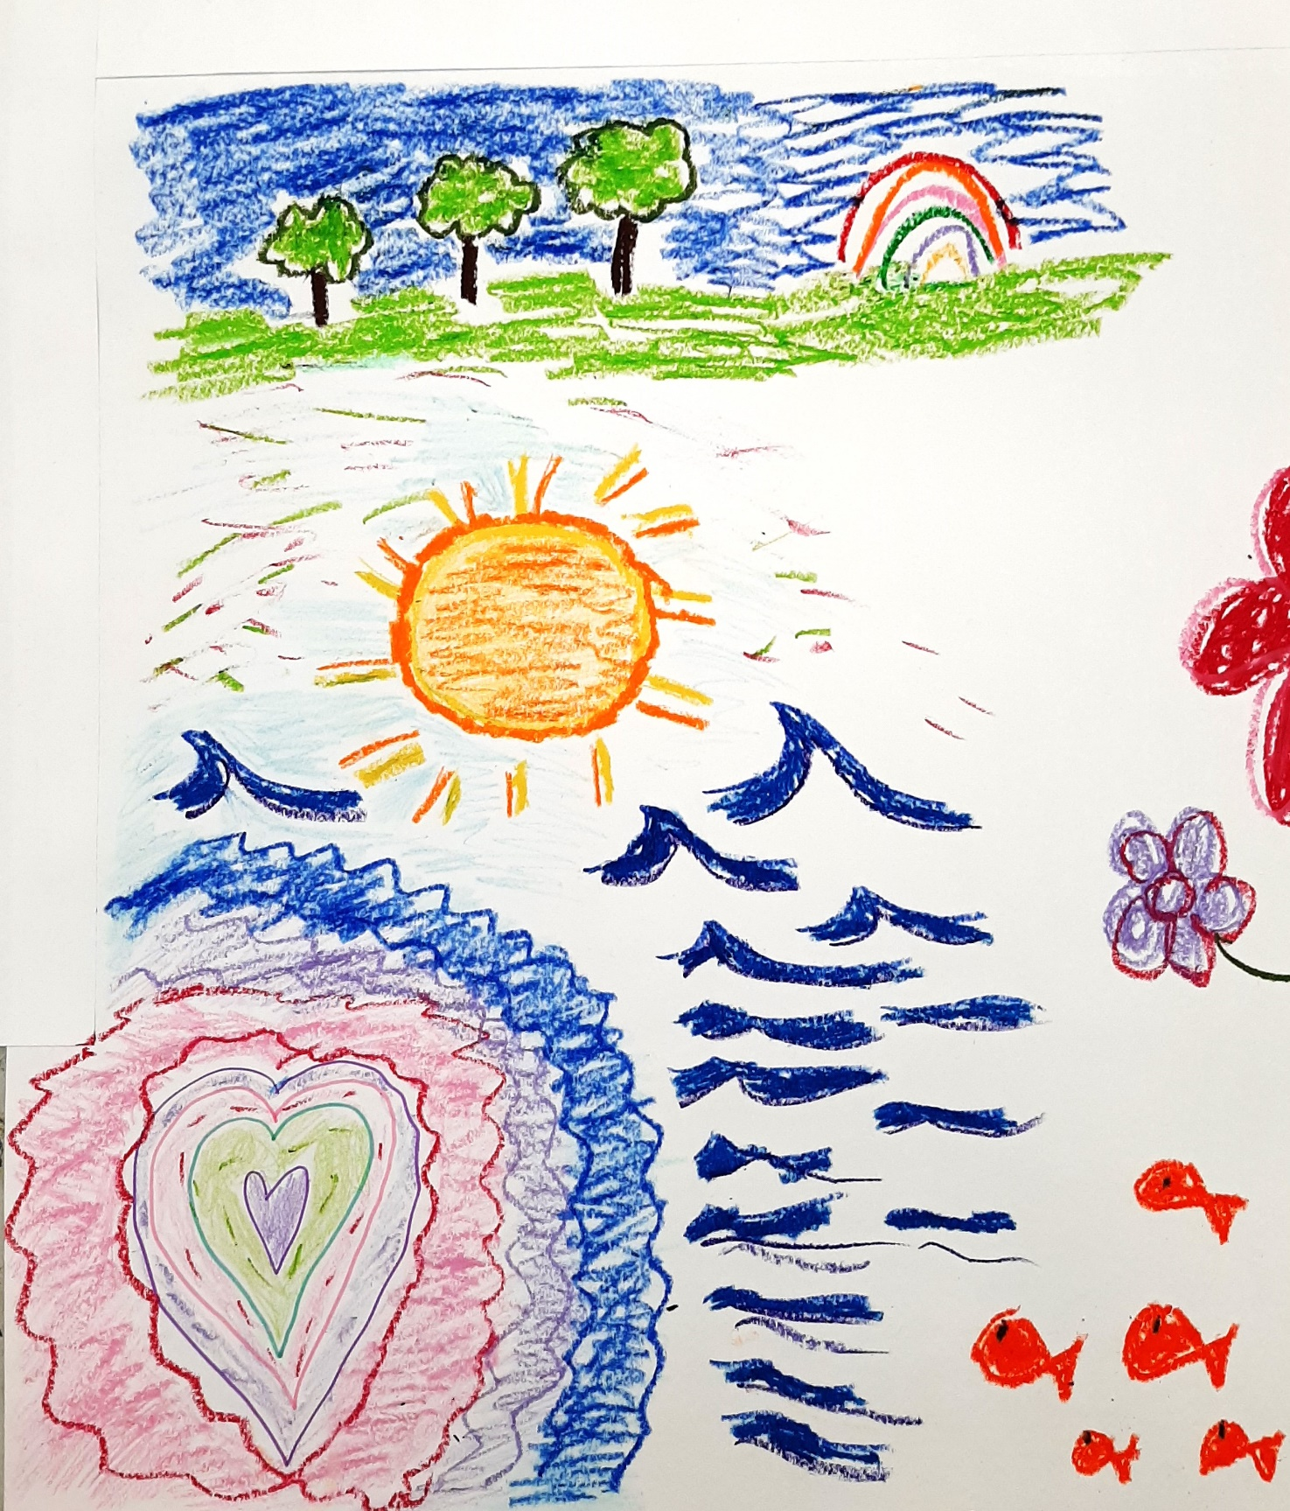
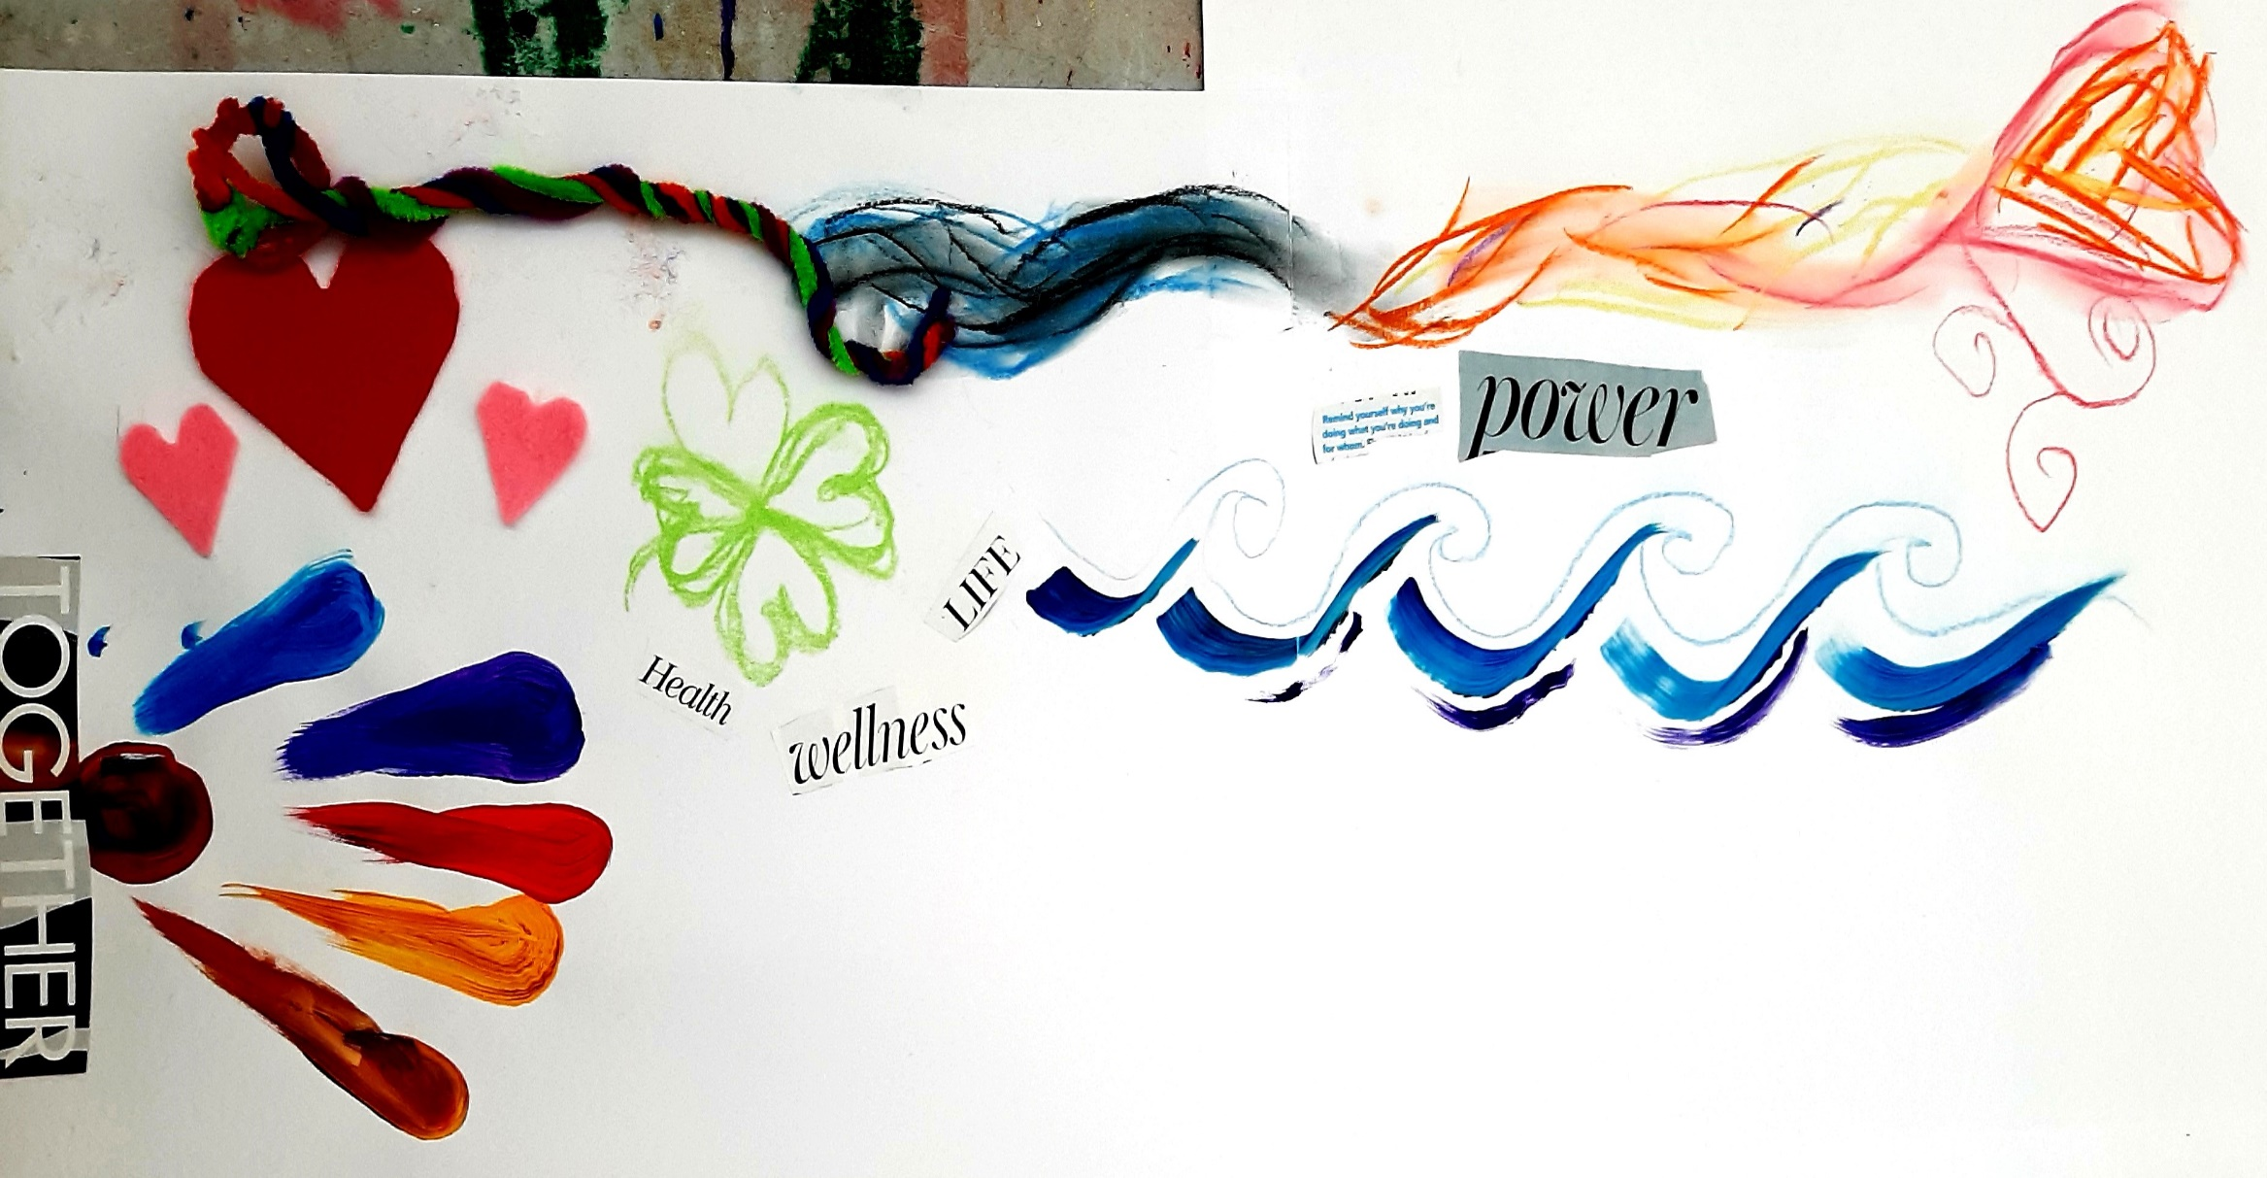
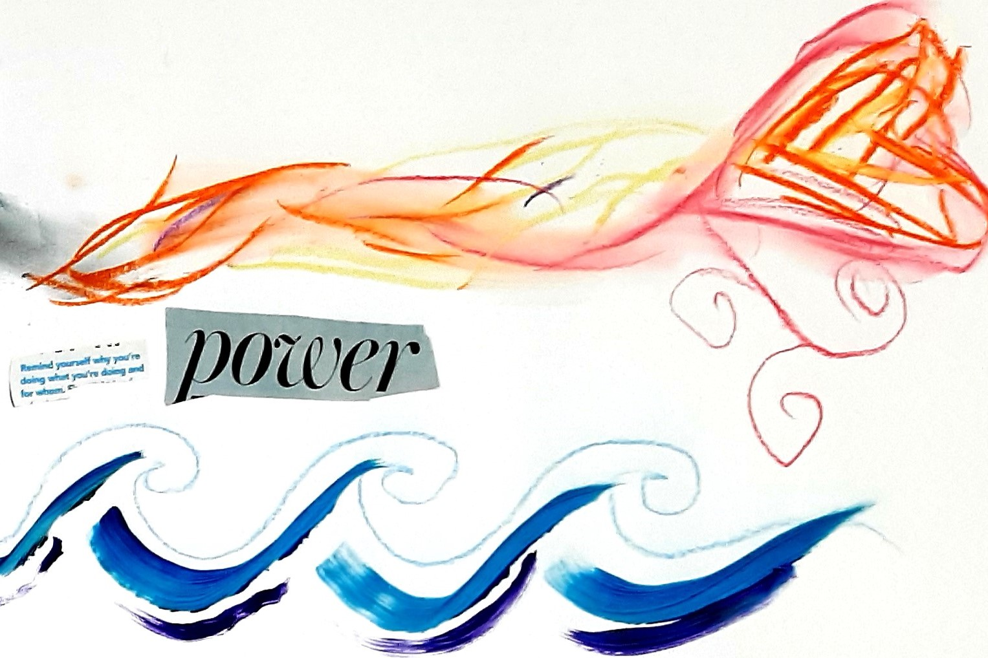

Slide 9
Student Testimonials
“It’s definitely so much better than when I first started the group. I don’t binge as much. I barely ever really restrict anymore.”
“I was very hesitant at first, felt I was being dramatic or I was fine, but it was the best decision I’ve made to join this group. I am so aware of how I can help myself and what I need to do to start living a healthier, happier, life.”
”Over the eight weeks of being here I have made bonds with the other girls, have support and people to relate to, most of all I have myself and I feel confident to take care of myself.”
“I found this programme amazing. And I didn’t even know that something like it existed or would work. I had never come across the option of a group like that in Ireland before. I thought it was amazing.”
“The exercises were very good and gave me great awareness of my eating disorder as well as giving me tools on how to cope with it. I really appreciated having a session with a specialised eating disorder dietitian and I definitely recommend to everyone to attend, as I wished it lasted longer.”
“It’s been the biggest support I’ve had so I’d 100% recommend it to someone who is struggling with an eating disorder. It gave me a lot more insight into the triggers and it made me feel like I wasn’t alone.”
“Before starting the group I was really nervous and I had no idea what to expect but the last 8 weeks have been better than I could have ever imagined. I learned so much about myself, and the tools I can use to help me on my way to recovery from my eating disorder. I am so glad that I decided to take part.”

Slide 10
Student Experiences
“I’m kind of a bit more relaxed about how I eat, like I'm not thinking about it constantly and I don't feel like binging, stuff like that.”
“It was great to not feel alone for once and being able to share my thoughts and concerns about food without feeling judged or different.’’
“It's been the most substantial non-academic intervention I've had in college and I've tried a lot of stuff but this is definitely one that worked the best because it just felt like they really knew what they were doing…and it was so respectful and well researched. It was really refreshing…having these specific groups is pretty impressive….and I think it's such an amazing resource.”
“I was quite worried…part of having an eating disorder is, am I sick enough….and I went in thinking that, I don't know, no one would take me seriously based on how I looked, but once I went in there, that worry melted away.”
“This group can change your outlook on food and show you you’re not alone.”
“I can say definitely, that I can recognize when I'm slipping back into behaviors, and I know who my support group is now. I can tell them when I'm feeling bad and I don't feel the shame around it as much, or the need to hide as much, even when I'm having a bad week.”
“If anybody was struggling, I would definitely recommend going because it's a very safe space…like, I don't know really how to explain it…it was really hard and frustrating, but it was worth it…in the long run…I would definitely say it’s a brilliant program!”
“It was all quite helpful. It pushed me out of my comfort zone…just enough.”

Slide 11
Evaluation of Programme Effectiveness
The programme was evaluated by an Assistant Psychologist, Christina Gleeson.
Of the 16 participants who completed the programme and were contacted for interview, 11 participated in a semi-structured interview. Interviews lasted approximately 35-40 minutes.
9 interviews were completed in-person and 2 were conducted online on MS Teams due to participants being out of the country at time of interview.
All interviews were conducted within 6-8 weeks following programme completion.
Participants’ names were not included in the transcripts or audio recordings as a pre-measure to ensure that their identity was kept anonymous.
Data will be held on a password-protected computer for up to 7 years. Participants consented to interview via first contact email and consented to audio recording prior to interview.
Participants were not given remuneration for participation.
Interviews were transcribed and analysed by the Assistant Psychologist.

Slide 12
Evaluation of Programme Effectiveness
Semi-structured interview questions included:
What was your experience of joining the eating disorder group programme?
What were your initial thoughts about joining the group?
What were the most helpful aspects of the programme?
What were the least helpful aspects of the programme?
Would you recommend the programme to others? And why?
How could we improve the programme?
Is there anything else that you would like to add?

Slide 13
Most Helpful Aspects of the Programme?
The Dietitian Assessment:
  Structured meal plan with flexibility devised by a professional (countered ED voice- “I could sort of calm the eating disorder voice down and say you know this isn’t unhealthy, this is how much you’re meant to eat in a day, a professional is telling you this so you can’t argue with that”)
  Specialisation in eating disorders specifically
  Tailored specifically to the individual (e.g. meal plan with Indian food in mind)
Peer Community- Support & Feedback:
  Hearing and resonating with others’ experiences, often quite unexpectedly (“made you feel like you weren’t alone” “as soon as you could see someone getting better, all of us strived to get better” “didn’t have to explain as everyone understood why I was doing that to myself”)
  Diversity in group members’ backgrounds, ages (countered imposter syndrome), ED behaviours & stages of ED recovery (gave hope)
  “They need me to be there”- showing up for others helped to show up for self
  Giving and receiving support and advice to each other (“we became friends through it all” “a support system I didn’t expect to find” “gave comfort” “the kindness of the girls, they would soak every single word I said” “we even created an Instagram group”)

Slide 14
Most Helpful Aspects of the Programme?
Structure of the Programme:
  Manageable time commitment & pace (consistency, length)
  Small group size (“close-knit circle” “would have felt lost otherwise” “all got enough time to share” “building trust”)
  Having tasks to complete between sessions (“keeping recovery at forefront of your mind” “Keeps you active”)
  Gaining hands-on skills & practical tools to utilise outside of sessions (e.g. reframing thoughts)
  Combination of different modalities (e.g.art, yoga & mindfulness, insightful discussions)- having a variety of options for self-expression, “just peace for awhile as can be a lot of talking, can be very heavy” “to be creative, it was so lovely to rediscover that part of myself”)
  Follow-up session- accountability
Guest Speaker from OA
  “Inspiring”, “Made me realise there’s no quick fix”
The Counsellors’ Input
  Feeling understood & that everyone’s experiences were valued & listened to (a safe space to let it all out)
  Keeping the group on topic and providing psychoeducation (comparison to other ED groups)
  Being taken seriously

Slide 15
Most Helpful Aspects of the Programme?
  Greater Insight & Self-Compassion
    Hearing others’ experiences (“It helped me find out things like my eating disorder more came from anxiety…it turned into being more about control. So in my mind I was different to everyone else because it wasn’t about like you know being attractive…but I realised that through the group…that I’m not different to everyone else just because it started a different way.”)
    Letters to ourselves home exercise (“could sympathise with myself and be a lot kinder”)
    Recognising ED self- thoughts and feelings- vs. healthy self (“I would be annoyed when I was in there when we’d be suggested to do things but I guess that was the eating disorder not wanting to get better”)

Slide 16
Least Helpful Aspects of the Programme?
The Length/ Timing of the Programme/ Interventions
  Group running longer would be preferable
  Timing & number of Dietitian appointments (“Important to have more than 2 sessions that follows up to check how things are going as progress goes up and down” “I don’t think one session with dietitian was enough” “I don’t think I was ready for that stage…it would have been really helpful maybe now…she was giving me loads of alternatives and I was like, I’m not gonna use that…it was just a bit like too advanced.”)
Specific Interventions:
  Food Diary- “I’m not very good to write my thoughts. I’d prefer to draw. Wasn’t beneficial in such a short time.” “I personally found that so hard, because it was just so triggering, to go back to being…. to being aware of what you eat, what kind of like what type of exercise you do, because then I was kind of competing with myself…”
  Art- “Some of the art stuff, replace it…one where we like painted masks, I didn’t enjoy that…like, not everyone is creative.”
  Challenging Thoughts- “There was this thing about like, the eating disorder self and then challenging those like thoughts with like, rational thoughts, and its like…. I know, I'm thinking irrationally, but it's the fact that I can’t change it.”
  Feelings- “I get why they're asking about [feelings at] the same time, I don't think it was always needed to know, like, what feeling was connected to certain things that we talked about…”

Slide 17
Least Helpful Aspects of the Programme?
Guest Speaker from OA
  Her way of recovering was triggering- “She does not eat sugar at all…that works for her but I feel like my eating disorder, that week in particular, took that and ran with it” “For me, and I think other people in the group maybe shared the same, we were trying to undo those thoughts of some food groups being off limits. And then it was kind of disheartening being like well maybe that’s the only way.”
Communication in the Group
  “Sometimes there’d be silences as no one had the courage to go first.”
  “Maybe one girl that was a bit more dominant” “One girl…she liked to speak a lot…the weeks that maybe she wasn't there….we get a lot out of it...”
  “Sometimes I felt like I was being misunderstood (by counsellors)…they were trying to make us see the positive side but sometimes it felt maybe a little forced.”
Other:
  Not diverse enough- “Coming from a queer perspective was a bit unusual as a lot of it was very, woman orientated, which is valid, but I suppose I didn’t really get that at all” “I struggle mostly with ARFID…whereas they were kind of more like a binge/restrict so they would talk about that a lot…I felt a bit silly for being there sometimes.”
  Desire for greater support- “It was like you joined the group or you have your counsellor, you had to pick one or the other…during the week I would have loved someone to talk to.”
  Appearance of counsellors- “It would have been great if the counsellors didn’t look like the stereotypical ideal of what a woman should look like” (belief that the counsellors wouldn’t understand what it feels like to be fat)

Slide 18
Any Improvements for Future Groups?
Dietitian Assessment:
  To have weight & BMI information- “How is this meal plan going to actually cover my needs if she doesn’t have my BMI…that was kind of just a worry for me you know whether or not it was really covering my caloric needs if you know what I’m saying if I wasn’t weighed you know”
  Have assessment earlier- “If you see the dietitian at the fifth session then you have just three to go to follow up. I think this is where people start to realise how to cope with the food and then they immediately lose the support”
  (In contrast: “It was actually nice to have it after…sometimes during it, it was overwhelming, learning a lot of different skills... it was almost nice to have it separate”)
Length of Programme & Aftercare
  Longer programme- “I wish it was a bit longer.” “Would have loved option to continue the group for two semesters.”
  “I found it very difficult at the end of the 8 weeks, it was just like…done. It would be nicer to have it a bit longer or more spaced out.”
  Greater frequency of follow-up sessions- “They’re inviting us back in September but 1-2 sessions in between would be important, even online, so no one’s gone off track.”
Food Diary- Need for Greater Support
  “It made me more aware of how much I was eating and my ED brain was switched on…I was like, oh no, I can’t go back to that place.”

Slide 19
Any Improvements for Future Groups?
More Flexibility in Approach & Schedule:
  “If someone needs to talk more, you wouldn’t mind if they moved away from the timetable, if someone is feeling crappy…I feel like you should have a chance to speak more if you need…give them 5-10 extra minutes.”
Greater Diversity:
  “Maybe if there was more of a mix in the group”- for one girl who was very shy and was more restrictive than the others.
  More content in the programme & information on other ED types, specifically ARFID.
Programme Interventions:
  Explore physical activity- “It would be nice to have even a weekend or something where it’s possible to explore different sports or a different option because I feel like sometimes people don’t work out because they don’t know what they like and it could be interesting to just explore a couple of things.”
  “Maybe a bit more (information) about exercising and gym culture…I struggled a lot with over exercising to compensate.”
  “Would have been nice to learn a few different techniques for emotion regulation.”
  “Another story from a guest speaker could be just as powerful and show the same things without being so triggering.”
  “We would have benefitted from a bit of informal chatting and getting to know each other…maybe towards the end of the first session.”
  “More arts and crafts.”

Slide 20
Implications & Future Developments
Provide information on the various types of EDs (less known EDs like ARFID & orthorexia).
Give greater attention to exercise & gym culture- psychoeducation.
Add mindfulness- helpful emotion regulation tools.
Dietitian- ensure weight, height and BMI is provided by each participant. Reassess timing of this.
Review food diary exercise. Provide greater support for this intervention.
Experiential activity on movement for joy- arrange a group activity day or free class passes (for a variety of different activities e.g. dance, tennis, yoga) to support exploration of movement for joy. Opportunity for informal way to connect.
Informal chatting space- create opportunities for this in the programme.
Guest speaker- provide guidelines & consider having 2-3 to showcase diverse presentations.
More frequent follow-up sessions (online and in-person).
Revise programme to ensure it is relevant to gender diversity.
Aim to include males in programme in forthcoming term.
Create a support app?

Slide 21
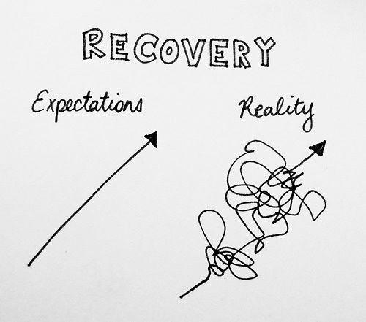
‘Recovery is
Not Perfection’

Slide 22

Notes:
My work with Jo therefore entailed basic support—containment and holding. Establishing a safe space for connection and trust to develop between us was fundamental.
The overall approach I adopted with Jo was person-centred—namely placing her and her concerns at the centre of the picture.
This derives from Rogerian theory (from Carl Rogers, the father of Humanistic movement and integrative approach to psychotherapy) which adopts a stance of empathy, congruence and unconditional positive regard towards the client and their issues.

Slide 23
References
Barret, E. & Richardson, S.C. 2021. Eating disorders during the COVID-19 pandemic. Irish Medical Journal, 114(1): 233.
Egbert, J., Luke, A., & Qeadan, F. 2024. Intersectionality of demographic characteristics in self-reported anorexia nervosa, bulimia nervosa, and probable eating disorders among college students. International Journal of Eating Disorders, 57(1): 132-145.
Health Service Executive (HSE). 2018. Eating Disorder Services: HSE Model of Care for Ireland. Dublin: Health Service Executive.
Kerswill, S., Kuhar, M., kalim A., Parker, S. 2023. The incidence and management of paediatric eating disorders requiring admission to a hospital in South-East Ireland over a five-year period. Archives of Disease in Childhood, 108: A372-A373.
Stice, E., Nathan-Marti, C. & Rohde, P. 2013. Prevalence, incidence, impairment, and course of the proposed DSM-5 eating disorder diagnoses in an 8-year prospective community study of young women. Journal of Abnormal Psychology, 122(2): 445-57.

Slide 24

Thank you
Contact: cristina.galvin@universityofgalway.ie
gharrison@universityofgalway.ie

