Slide 1

Promoting Student Success in UCD:
Using Data to Help Personalise and Visualise Success
SAI Summer Seminar 2024:
Creating, Engaging and Enhancing Community for Student Success
John Wyatt, UCD Institutional Research
University College Dublin

Slide 2
Overview
Role of Data
UCD LEAP Project
UCD Student Success Project
Takeaways

Slide 3
Role of Data: Context
SAI Summer Seminar subthemes:
- Examining the role and effectiveness of technology in student success
- Innovation in mental health and wellbeing support for students
Key Question:
What is technology’s role in enabling innovation in mental health, wellbeing, and student success?
Predictive models used for student retention purposes since the 1990s (Campbell & Oblinger 2007)
First International Conference on Learning Analytics and Knowledge in 2011
National Forum’s Online Resource for Learning Analytics (ORLA) created in 2017
ORLA launched Using Learning Analytics to Support the Enhancement of T&L in 2021

Slide 4
Role of Data: Sources
Institutions have more data available than ever that can be used to help predict student support needs:
Engagement: VLE engagement & Building access
Facilities use: Extracurricular interests & Library access
Entry pathway: Leaving Certificate points & Secondary school attended
Socioeconomic background: Distance from campus to home, Fee status
… and it generally doesn’t matter which one you use!
“The consistency of associations we observe here is powerful” - (Waddington et al, 2016)
Improving early warning systems with categorized course resource usage. Journal of Learning Analytics, (2016): 3(3), 263–290.

Slide 5
Role of Data: Supporting Innovation
New challenges facing in student support practitioners in Irish Higher Ed:
Modular curricula can make implementing programmatic approaches more challenging
Increased hybrid delivery & student diversity increases the need to personalise experience
Socioeconomic pressures on housing & cost of living leading to more commuting students
LC point inflation leading to fewer first-preference course allocations, elevated withdrawal risk
However, institutions responding to challenges with programmatic initiatives underway in DCU, Trinity
UCD’s Belonging Project underway which is helping understand wellbeing needs
Creating systems which distill the wealth of data already collected by HEIs can help enable innovation

Slide 6
UCD LEAP Project
Aim
Help students transition to third-level by linking analytics with student support mechanisms
Approach
Develop engagement monitoring system giving Advisers real-time programme-level engagement data
Enhanced Student Supports
Engagement Model
VLE Engagement Oversight
Student Advisor Intervention
Notes:
Conceptual
Develop a student engagement model, cognizant of challenges and opportunities facing HEIs.
Technical
Assess and optimize VLE engagement experience.
Develop VLE disengagement signposting architecture.
Operational
Undertake feasibility study of VLE engagement monitoring system.
Create scalable analytics framework for UCD-wide implementation.
Support
Supplement student supports with digital/analytic tools, assisting in timely and targeted engagement supports.
Key Questions
Re-evaluate student engagement against the challenges and opportunities currently facing HEIs. How should we understand engagement, conceptually and practically, in the context of the current student HE experience?
helping staff create additional pathways for digitally-mediated student supports, while also achieving a more comprehensive picture of the student experience than would traditionally be available within module-specific engagement silos.

Slide 7
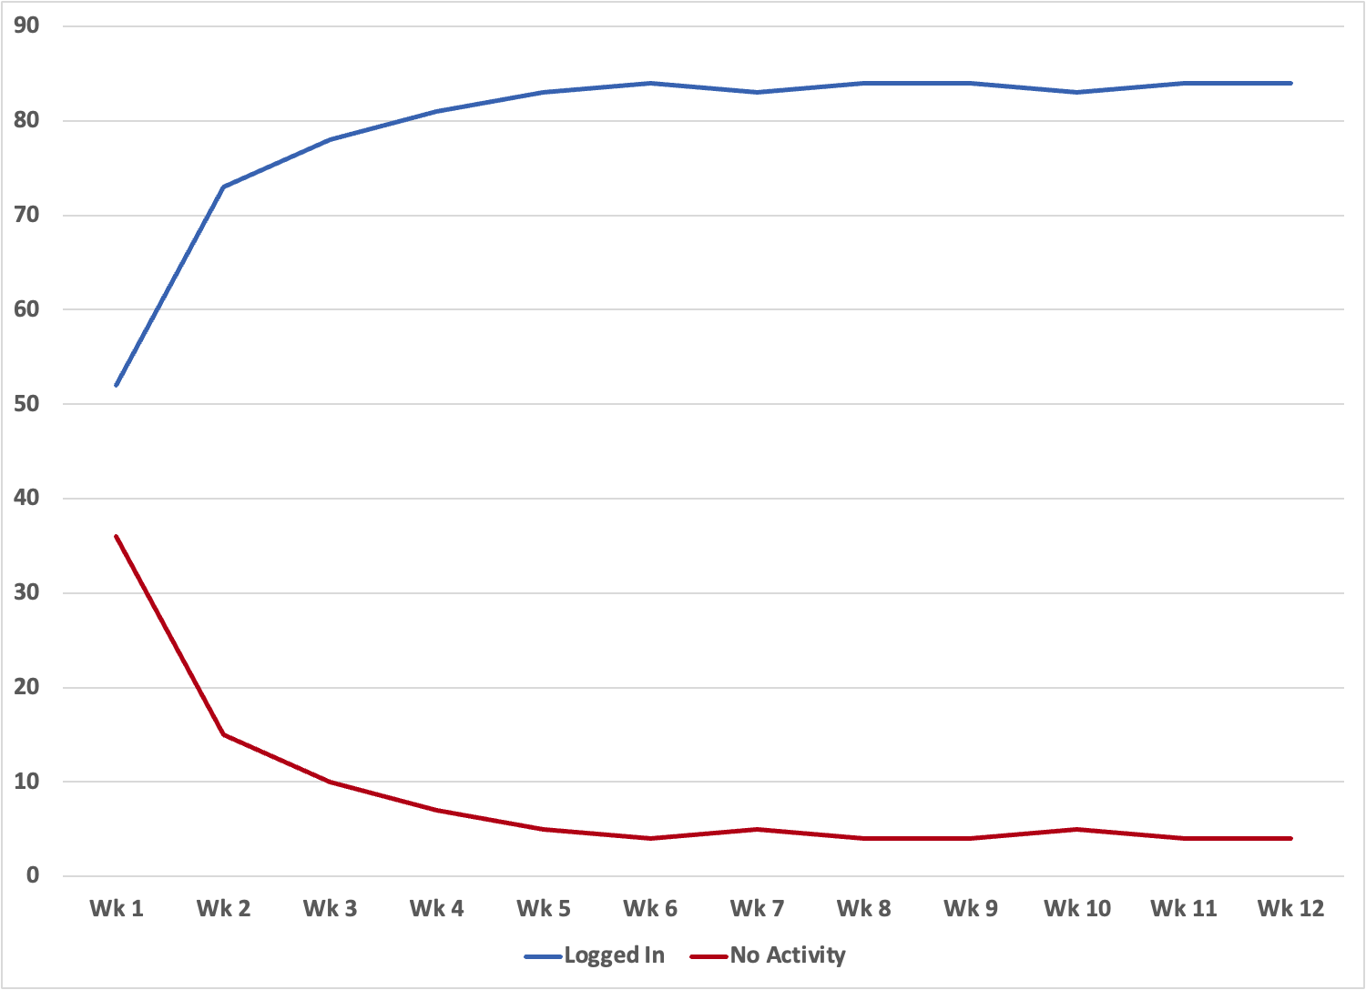
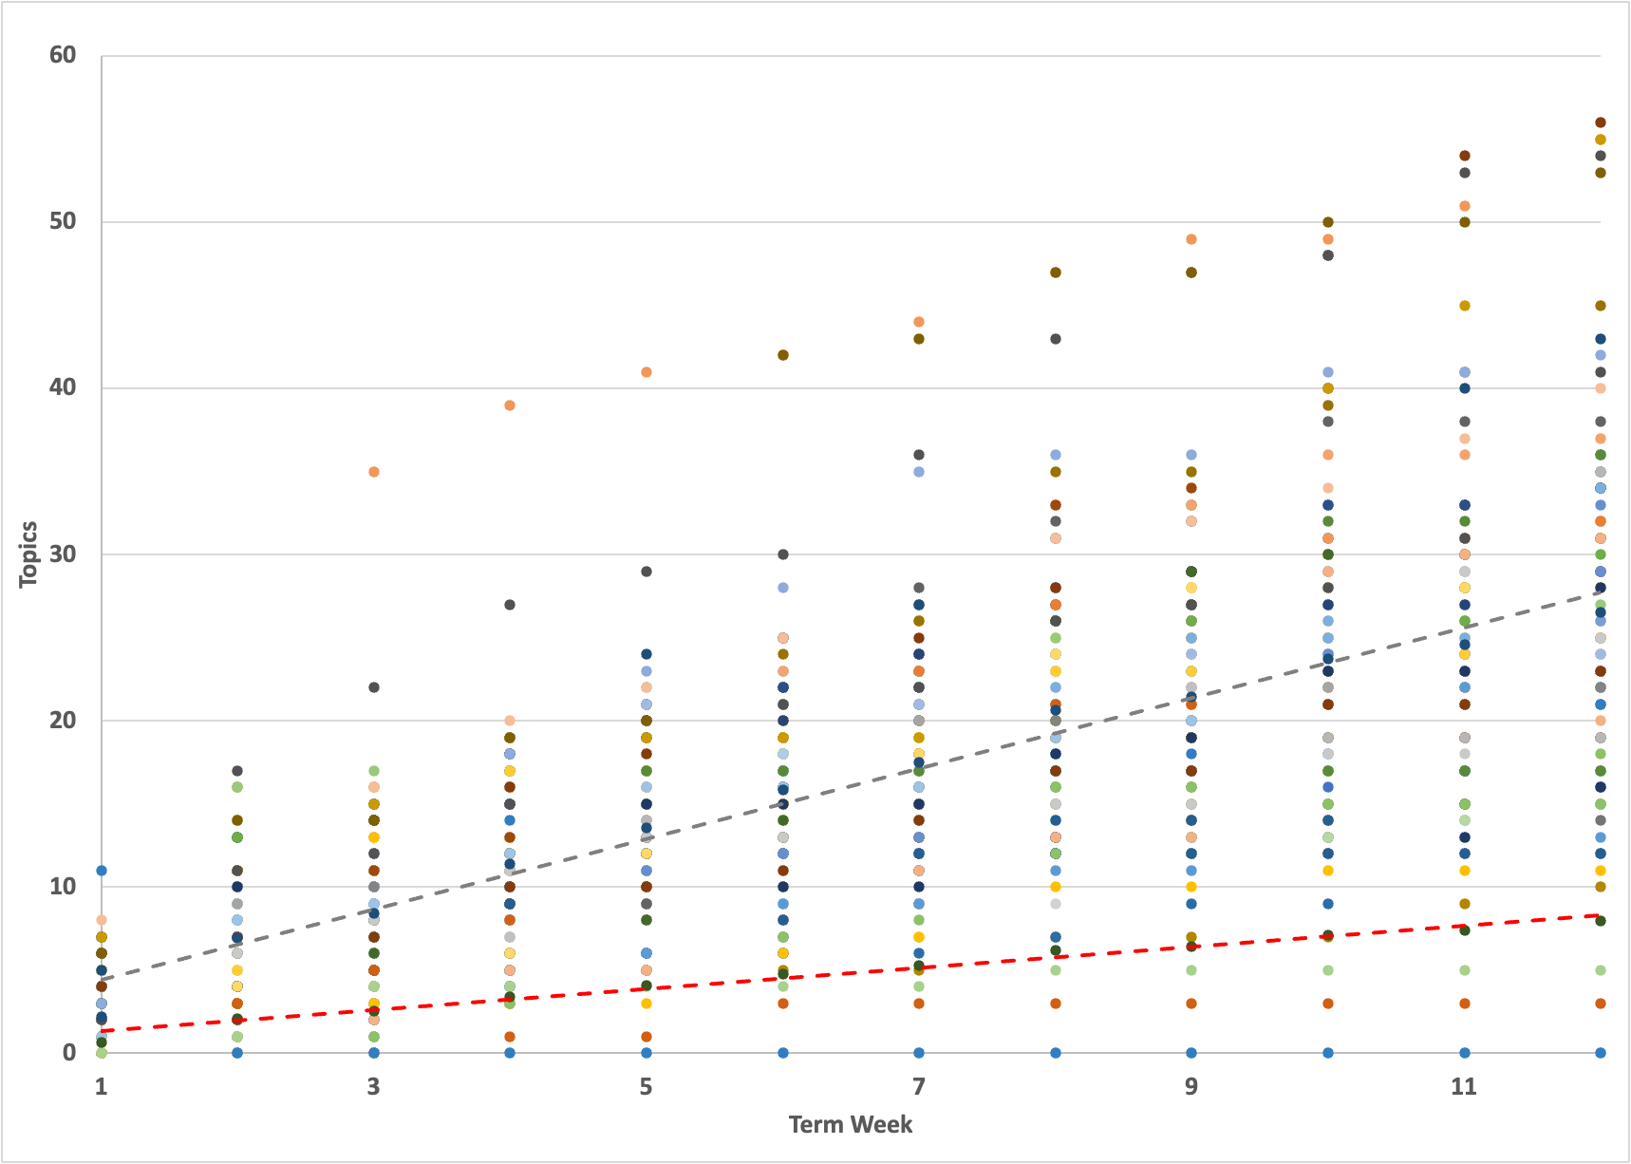
UCD LEAP: How do we flag students?
1: Student has NOT logged into D2L in 7 days OR 2: Student topic access is <30% of Peer Avg.
Module Login Data Example
Topic Access Data Example
Tps.
Weeks

Slide 8
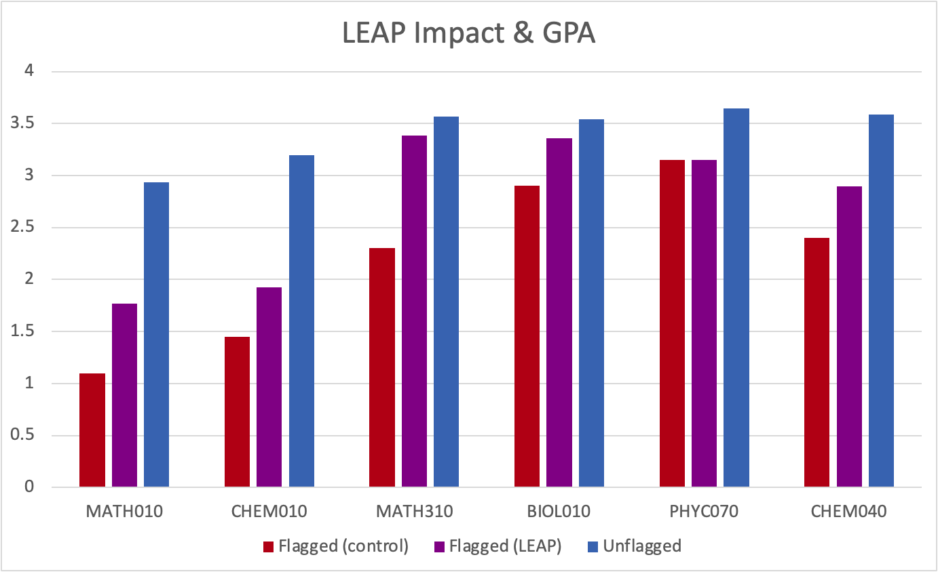
UCD LEAP: Measuring impact
- UCD-wide access
- Active use
across Colleges
-Highly Predictive:
P < 0.001

Slide 9
What do our students think?
Theme | 2020 | 2021 | 2022
Adviser Importance | “Wouldn’t be here without them” “Helped my personal growth” | “(Adviser Name) is a great help” “She is amazing and so helpful” | “They are AMAZING” “(SA) is wonderful, important”
Intervention Endorsement | “Reaching out is nice” “If it’s not helping everyone but is helping one person, you like that” | “Great to know a readily available Adviser is looking out for you” | “I think this is a great idea” “Mental health supports are incredibly important for all”
Site: UCD Methodology: Mixed Methods Instruments: End of year survey & focus groups 2019-2022 N: 103 Analysis: Reflexive Thematic

Slide 10
Student Success Project: Background
Although LEAP is successfully implemented, scope of project is focused on at-risk students
Promoting & Measuring Student Success Project part of UCD’s Strategy
Informed by the Seven Cs of Student Success toolkit developed by the NFT&L
Aim of Student Success project is to enable the following:
1: Students to reflect on their progress
2: Staff to measure intervention success & ability to support students
3: UCD leadership to demonstrate UCD’s ability to promote & report on success indices

Slide 11
Enabling Student Success: Our Approach
The approach taken to help enable Student Success was:
Develop a UCD-specific understanding of Student Success through consultation
Ascertain the extent that the NFT&L’s Student Success Enablers are embedded in UCD
Identify common themes that emerge and use recommendations for an Implementation Plan

Slide 12
1: UCD-Specific Understanding: Consultation
Student consultation took place via UCD’s Student Partnership Forum
Students were asked three questions about Student Success:
"What is Student Success?"
"What aspects of Student Success are important for UCD students to reflect on?"
"What aspects of Student Success are important for you personally to reflect on?"

Slide 13
1: UCD-Specific Understanding: Consultation
Personal
Student Success
Support
Support
Academic
Social
Career
Support

Slide 14
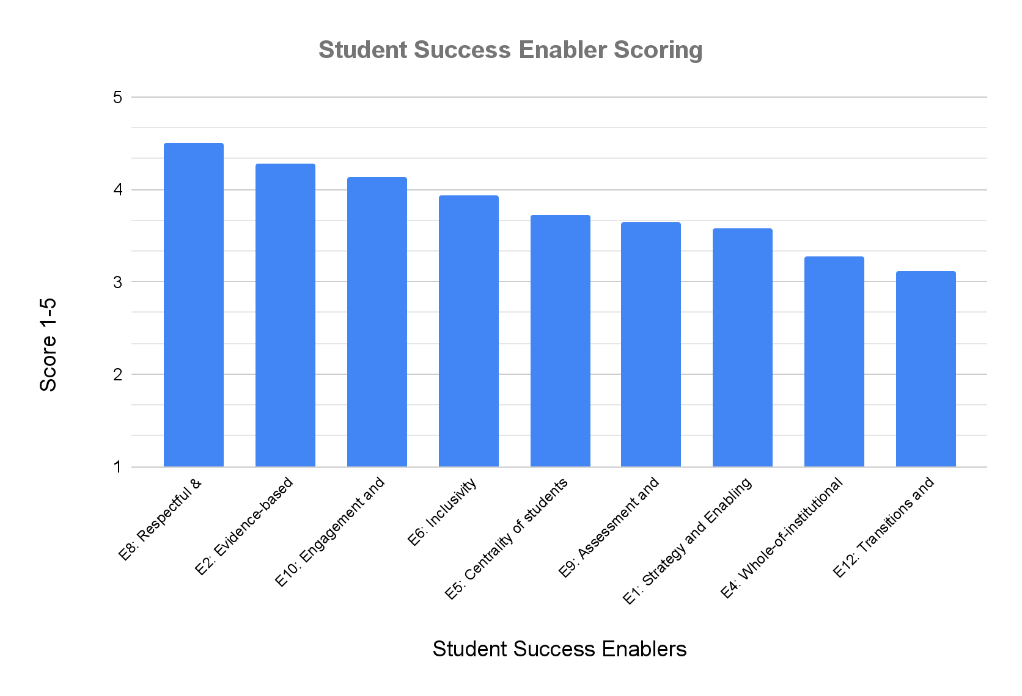
2: UCD Success Enabler Scoring
Next step was a Capacity Review
WG used NFT&L Success Toolkit
WG included students & staff
Strengths
Evidence-based decision making
Respectful & meaningful relations
Engagement & Partnership
Weaknesses
Cultivating Belonging
Communication
Whole-of-institution approaches
Support

Slide 15
3: Common Themes & Recommendations
Communication:
Improve pathways through which Success initiatives are communicated
Self-reflection:
Identify UCD-wide mechanisms for students to reflect on what success means to them personally
Dashboard Reporting:
Develop indices to help proactively identify gaps and surface progress being made to enable success
Enable Further Partnership:
Ensure feedback representative of all students & reduce the risk of overloading existing mechanisms

Slide 16
2024/25: Implementation Plan & Next Steps
Communication: Facilitate implementation of UCD’s Student Communications Project findings
Self-reflection: Streamline gaps and overlap in the ownership domains of UCD’s self-reflection tools
Dashboard Reporting: Identify roles specific to usage and ensure alignment with HEA requirements.
Prior to building dashboard, create matrix of:
A: Types of indices aligned to student perspective (P/C/A/S)
B: Role-specific safeguards for who would see each index
C: Determine what data sources exist already and what needs to be created
Enable Further Partnership: NStEP to hold workshop in Summer 2024 to identify expansion areas

Slide 17
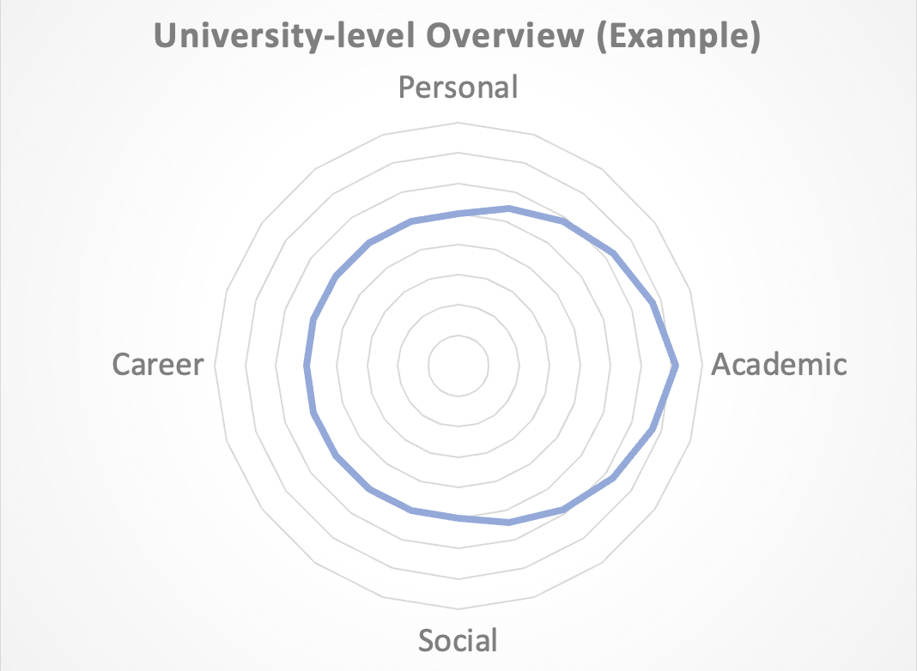
2024/25: Next Steps - Dashboard Example
Personal: Data Sources
Diploma supplements (Banner)
Translational Skill Development (SIS)
Social:
Clubs & Socs membership (SIS)
Partnership activity (SIS)
Academic:
LEAP (Brightspace)
Pass-fail data (Banner)
Career:
Careers Connect usage (SIS)
Internships & Placements (SIS)

Slide 18
Key Takeaways
Finding data is easy (we have more information than ever!)...
… But using it to enable innovation is trickier
Technology’s role in student success and improving the student experience is about:
1. Enabling localised innovation for practitioners in wellbeing roles
2. Enabling that innovation to be both Programmatic and Personalised
Explore data your HEI already has, and see how you can involve staff & students to enhance usability

Slide 19
Thank you!

Slide 20
Reference Material
University College Dublin:
UCD LEAP Project: https://supportingstudentsuccess.ucd.ie/
UCD Strategy for Education & Success 2020-24: https://www.ucd.ie/registrar/t4media/Education_and_Student_Success_Implementation_Plan_2020-2024.pdf
UCD Belonging Project: https://expertise.ucd.ie/the-belonging-project/
UCD Student Partnership Forum: https://www.ucd.ie/secca/t4media/SPF_flyer.pdf
National Forum for Teaching and Learning:
Toolkit User Guide: https://studentsuccess.teachingandlearning.ie/wp-content/uploads/2021/10/Toolkit-User-Guide.pdf
National Understanding of Student Success: http://tinyurl.com/4k2e8sju
Online Resource for Learning Analytics: https://www.teachingandlearning.ie/our-priorities/student-success/online-resource-for-learning-analytics-orla/
ORLA Using Learning Analytics: https://hub.teachingandlearning.ie/wp-content/uploads/2021/06/TL_LA-Briefing-Paper_WEB.pdf
Additional References and Resources:
Academic analytics: A new tool for a new era. (2007). EDUCAUSE Review:
https://er.educause.edu/articles/2007/7/academic-analytics-a-new-tool-for-a-new-era
View of improving early warning systems with categorized course resource usage. (2016). Journal of Learning Analytics:
https://learning-analytics.info/index.php/JLA/article/view/4674/5762
Exploring student progression in higher education – Conference information | Higher education authority. (2024). Higher Education Authority:
https://hea.ie/assets/uploads/2024/03/Exploring-Student-Progression-in-Higher-Education-Conference-Final.pdf
Brunton J., Costello, E., Farrell, O. & O’Keeffe, N (2018) Attaining 21st Century Skills Online: A Programmatic Approach
https://doras.dcu.ie/22873/1/Attaining%2021st%20Century%20Skills%20Online_A%20Programmatic%20Approach.pdf
Programme-focused approaches - Centre for academic practice, trinity teaching & learning - Trinity college Dublin. (n.d.)
https://www.tcd.ie/academicpractice/resources/academic_integrity/programme-focused_approaches/

