Slide 1

Student carers in higher education institutions
Dr Maria Pierce
School of Social Policy, Social Work and Social Justice
Student Affairs Ireland Summer Seminar 2024: Creating, Engaging and Enhancing Community for Student Success
TUS Midwest, Moylish Park, Limerick
18 June 2024
UCD School of Social Policy, Social Work and Social Justice
Scoil an Pholasaí Shóisialta, na hOibre Sóisialta agus na Córa Sóisialta

Slide 2
Overview
Scope, definitions and conceptualisation
Prevalence estimates
Relevant national strategies
Irish research on student carers in HEIs
What is known from international literature
Support needs
Examples of (best) practice
Concluding remarkers

Slide 3
A narrow definition of carers
People who provide regular unpaid personal help or support to a family member, neighbour or friend with a long-term illness, health issue, an issue related to old age or disability (Census 2022)
Almost 300,000 people (5.8%) self-identified as carers in 2022
Often referred to as ‘family carers’ or ‘informal carers’
Broader definitions include (e.g. ESRI, 2024):
Young people’s caregiving to younger siblings
Parental care to children
Notes:
Hamilton et al

Slide 4
Defining ‘Student carers’
(using narrow definition)
‘anyone who cares, unpaid, for a friend or family member who
due to illness, disability, a mental health problem or an addiction cannot cope without their support’ (Carers Trust, 2015: 7)
‘Young adult carers’ - 18 to 25 years (as distinct from ‘young carers’)
Mature students too may have caring responsibilities
Notes:
Hamilton et al

Slide 5
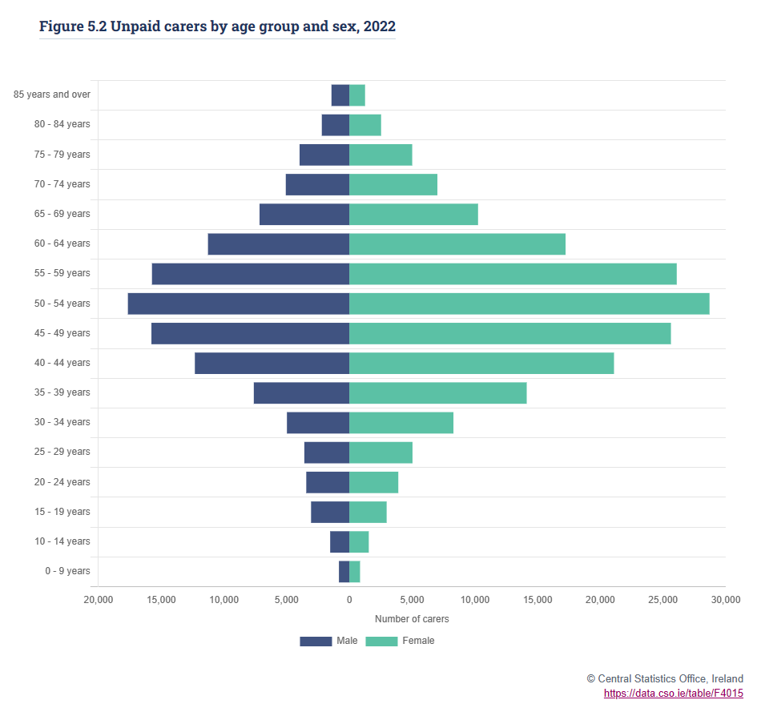
Who provides care in ireland?
Census question has changed leading to an increase in number of people in Census identifying as carers (CAI, 2022)
Irish Health Survey 2019 showed 92,000 (8%) of people aged15-24 years provide care at least once a week (CSO, 2019)
Notes:
Hamilton et al

Slide 6
How many student carers in HEIs?
Not easy to get an accurate number of student carers
Estimates from some other countries, but these vary
UK – between 3% and 6% of student population are student carers (NUS, 2013)
Norway – estimated at 5.5% (Haugland et al. 2020)
USA – 5.7% of students (Armstrong-Carter et al., 2022)
France – 15% of university students are young adult carers (Chevrier et al., 2023)
Ireland – not known
Crude estimate - between 7,704 and 15,407 students in HEIs
Notes:
USA – campus wide survey
France – students in higher education all over France using MACA-YC18 and other measures

Slide 7
Many Ways of thinking about care
Hours, type and intensity of caring; characteristics of carers
Models of caregiver stress, burden and burnout (e.g. Pearlin, 1990; Demerouti et al., 2001)
Feminist perspectives on care – gendered nature of care and the implications
Ethics of care – emphasises interdependency and foregrounds relationships (e.g. Joan Tronto)
Political ethics of care – university care culture, government policy and social services
Ecological systems theory – a whole systems approach, students nested in and influenced by different levels (Bronfenbrenner 1979)
Notes:
USA – campus wide survey
France – students in higher education all over France using MACA-YC18 and other measures

Slide 8





National Strategies and Plans
National Strategy for Higher Education to 2030 - highlighted low level of part-time study opportunities (Department of Education and Skills, 2011, p. 46)
National Access Plan - being a carer contributing to disadvantage and underrepresentation of students in HEIs; included as a priority group; need for more reliable data (HEA, 2022)
National Carers Strategy (Department of Health, 2012)
National Youth Strategy (Department of Children and Youth Affairs, 2015)
Young Ireland (DCEDIY, 2023)

Slide 9
research in Ireland
Limited but emergent:
Interviews with small sample of HEI access officers (CAI, 2012)
Study including survey of young adult carers (n=48) and their experiences of education (Kelleher, 2023)
Caregiving among young adults (broadly) using data from Growing Up in Ireland Survey (ESRI, 2024)
Young carers transitioning through school, education and employment (Moloney et al., 2023)
Irish and European wide studies showing higher levels of depressive symptoms among young carers (Bowman Grangel et al., 2024; Gallagher et al., 2024)

Slide 10
Accessing higher education
Transition to higher education is reduced, especially for young women (Yeandle and Bruckner, 2007)
Underrepresented in higher education
Young adult carers have lower educational attainment levels than other young adults
Caregiving impacts students’ choice of where and what to study
Staying close to home
Avoiding courses with placements / internships
Some choose care-related courses

Slide 11
Characteristics of StuDent carers in HEIs?
Student carers are not homogenous
More likely to be:
female, who also provide greater levels of care
mature students, but significant implications for younger students (at a critical life stage)
from immigrant or ethnic minority families
from single parent households
Higher among widening participation students (Alsop et al., 2008)
May or may not be living with the caree
Relatively little know about intersections of caring with other social categories and inequalities
Undergraduate, postgraduate and international students
Notes:
Priority of the National Access Plan is to consider ways to collect more reliable data on higher education students who are carers (HES, 2022)

Slide 12
Attending higher education
Benefits associated with attending higher education
Juggling education and caring can cause stress – planning studies around caregiving responsibilities; interruptions; workspace
‘Time poverty’ – tiredness, missed deadlines, being late or missing lectures and tutorials
Can negatively impact academic performance; dissatisfaction with academic performance - ‘only doing enough to get by’
Forgo work experiences and other extra-curricular activities
Four times more likely to drop out of higher education (Kettell, 2018)
Student carers concerned about future employments prospects
Student carers may not disclose their caregiving responsibilities
Notes:
Priority of the National Access Plan is to consider ways to collect more reliable data on higher education students who are carers (HES, 2022)
Benefits – a sense of accomplishment, life skills, and independence

Slide 13
Complex Decision-making
Auto-ethnographic study provides insights into why student carers may not make seemingly logical decisions (Burford and Hook, 2019)
Overwhelming to even think about finding out what is possible
Contradictory social positions of carer and student - not wanting to be treated differently, concerns about being ‘outed’ as a carer rather than a full-time, dedicated autonomous student
Unpredictability and ever-changing nature of caring – putting decisions off due to living in a situation in which there are no easy way through, filled with lots of uncertainties (such as not knowing the duration of caring)
Altering/reducing workloads means being out of sync with other students on their programme, getting left behind and ending up with even fewer peer supports
Notes:
Priority of the National Access Plan is to consider ways to collect more reliable data on higher education students who are carers (HES, 2022)

Slide 14
impacts of caring on students
Caregiving can be rewarding!
Negative impacts on physical and mental health
Physical pain due to caregiving, tiredness
98% stressed, 64% at risk of clinical depression (Kelleher, 2023)
Negative impacts on social life
79% feeling lonely (Kelleher, 2023)
Notes:
Priority of the National Access Plan is to consider ways to collect more reliable data on higher education students who are carers (HES, 2022)

Slide 15
Voices of Students carers
“I didn’t tell anyone until he passed away … it’s very hard for people to relate to … I haven’t met anyone else who’s a young carer … I [don’t like] talking … about it … they don’t have any [idea] … how difficult it is. (F:21-yrs.)
“Yeah, most definitely. When mum and dad are really sick or in hospital … it’s just … always in the back of your mind. So, when you’re sitting … in front of your computer trying to do an assignment or listen to a lecture or do some readings, it’s just so easy to … lose concentration and focus on them rather than your work.” (F:19-yrs)
“I’ve never associated the two together. I’ve always thought about it as I’m a student and a carer, but not a student carer.” (HE student carer, woman, age 28)
“It would be nice [to be involved] … I just don’t really have the time”
Day, 2021; NUS, 2015
Notes:
Priority of the National Access Plan is to consider ways to collect more reliable data on higher education students who are carers (HES, 2022)

Slide 16
Financial issues and employment
Elevated financial hardship
UK studies (NUS, 2015; Kettell, 2018) show student carers:
worry about money and is an added pressure
less likely to receive a student loan
more likely to be in receipt of a student grant
more likely to be in receipt of discretionary funding from higher educational institutes
Carer’s Allowance (Ireland) – Ineligibility = must not participate in training or any education courses for more than 18.5 hours a week
Less likely to be in employment, but many still work to cover their own and household costs
Lack access to information about financial supports available
Notes:
Priority of the National Access Plan is to consider ways to collect more reliable data on higher education students who are carers (HES, 2022)

Slide 17
Implications of being a student on caring
Positive
Schedule more flexible than work environment
Provides a physical and mental break from caring
Negative
Feeling unable to provide necessary level of care
Placements as part of degrees can pose challenges
Students feeling that studies are taking them away from their responsibilities as a carer
Sense of guilt, less patience
Notes:
Priority of the National Access Plan is to consider ways to collect more reliable data on higher education students who are carers (HES, 2022)

Slide 18
Supports needs
Support to access higher education – in UK duty of LAs, but barriers still exist
Clear and transparent formal procedures needed – ensure student carers disclose without discrimination and when they do access necessary support
When available, student carers tend to access supports
Supports need to be flexible – attendance, timetabling, deadlines, online access
Early and ongoing support
Staff trained to understand issues and given access to information and services providing support
Access to information about financial supports, targeted to student carers and tailored to each student carer’s unique situation
Peer support
Students commend creative and compassionate thinking about the particular needs of student carers – does not involve substantial financial investment

Slide 19









Lots of initiatives in HEIs in Ireland
University policy
Various education programmes
Workshops
Access programme
Peer support and mentoring

Slide 20
A structured approach?
UK - most ‘advanced’ country
Model frameworks developed by Carers Trust (2015) in UK to guide the implementation of a structured approach to supporting student carers in HEIs
A. Model for setting up a framework of support
A. Model for setting up a framework of support
Acknowledge challenges and high-level commitment to responding
Have a dedicated lead assigned
Engaging with young adult carers through widening participation – under-represented group to include
Raising awareness of the needs of student carers among staff and how they can be supported
Ensuring support systems are promoted and accessible
B. Model for working with student carers
Identifying student carers
Establish involvement of staff
Initiate support systems (range)
Initiate wider supports (for student and family) from local services
Ensure ongoing monitoring and support

Slide 21
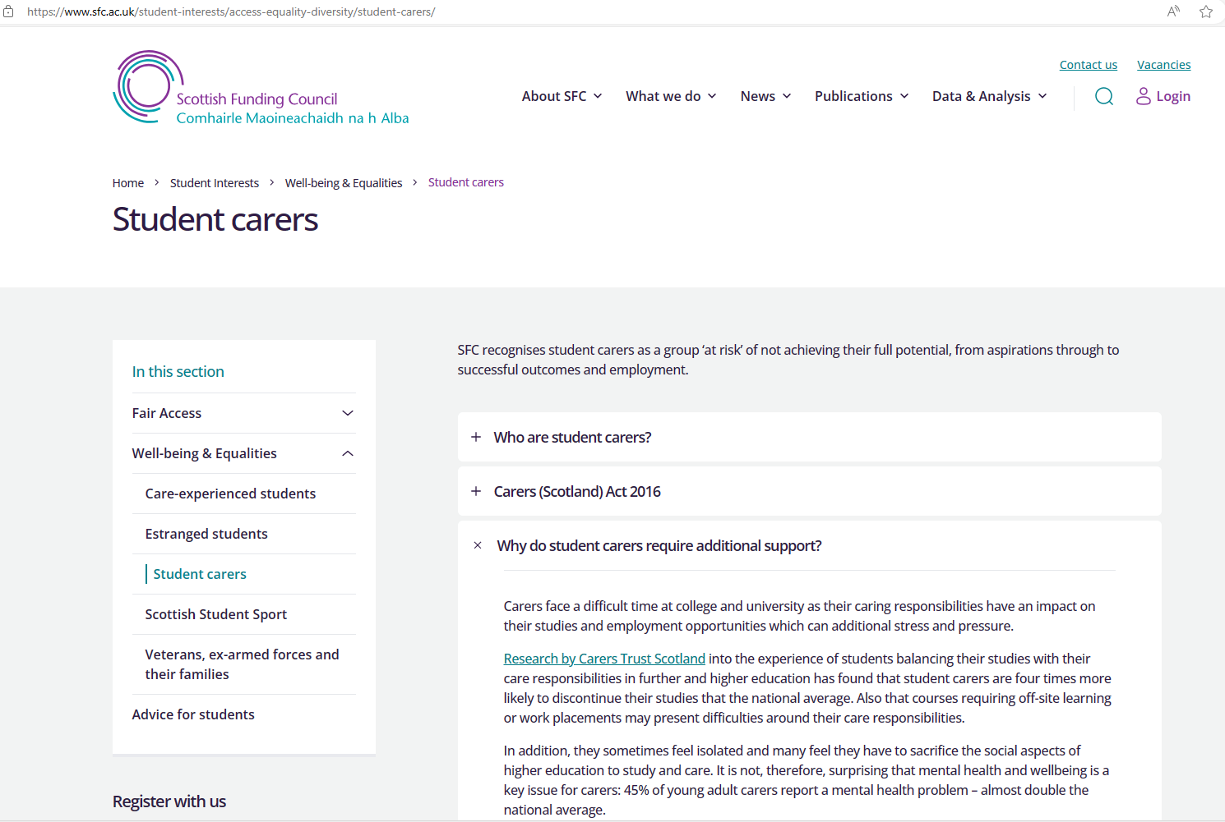
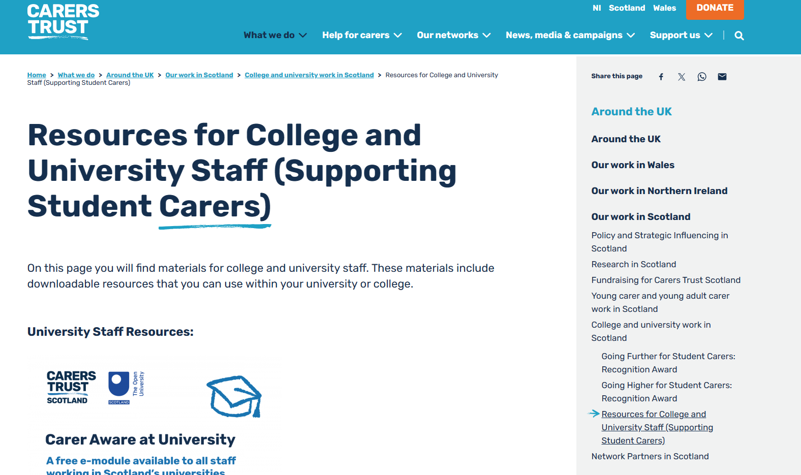
Scotland
Scottish Funding Council
institutions required to have a published Student Carers Policy
recommended to have a signed Student Carer Statement of Intent
Carers Trust, Scotland
Going Higher for Student Carers Recognition Award - aimed at Scotland’s 19 universities, underpinned by 3 principles: identify, support and report on student carers, and recognise good practice
Guidance on student carer policy, statement of intent, student carer action plan
Care Aware – e-module for staff with digital badge

Slide 22
Facilitating student carers to self-identify
From point of application to HEIs (e.g. UCAS in UK) and ongoing through entire student life cycle
Information that HEIs provide to applicants
Information provided in applications (e.g. Mature student applications)
At the time of admissions / enrolment, e.g. question to identify student carers
Information at Open Days, by student services, Students Union
Applications for extenuating circumstances/financial support
Communication to students at the start of and throughout academic year to encourage self-identification
Staff training – all staff approach
Partnership with community and voluntary sector / strengthening links with schools
NB: Appropriate support must be available and follow disclosure
Notes:
Multiple opportunities to disclose

Slide 23
Concluding remarks
Likely to see an increase in student carers in HEIs due to population ageing
More reliable data needed on student carers in HEIs in Ireland
How student carers are identified and conceptualised matters
Growing body of international literature including on access, prevalence, characteristics, experiences, impacts and issues
UK most ‘advanced’ with respect to student carers in HEIs, with Scotland leading the way
Ireland an ‘emergent’ country with respect to policy and research
Interest in student carers in HEIs in Ireland is growing
Structured whole of university / society approach warranted
Useful frameworks, approaches and resources available
Need to think beyond the university

Slide 24
Thank-you Questions?

