Slide 1
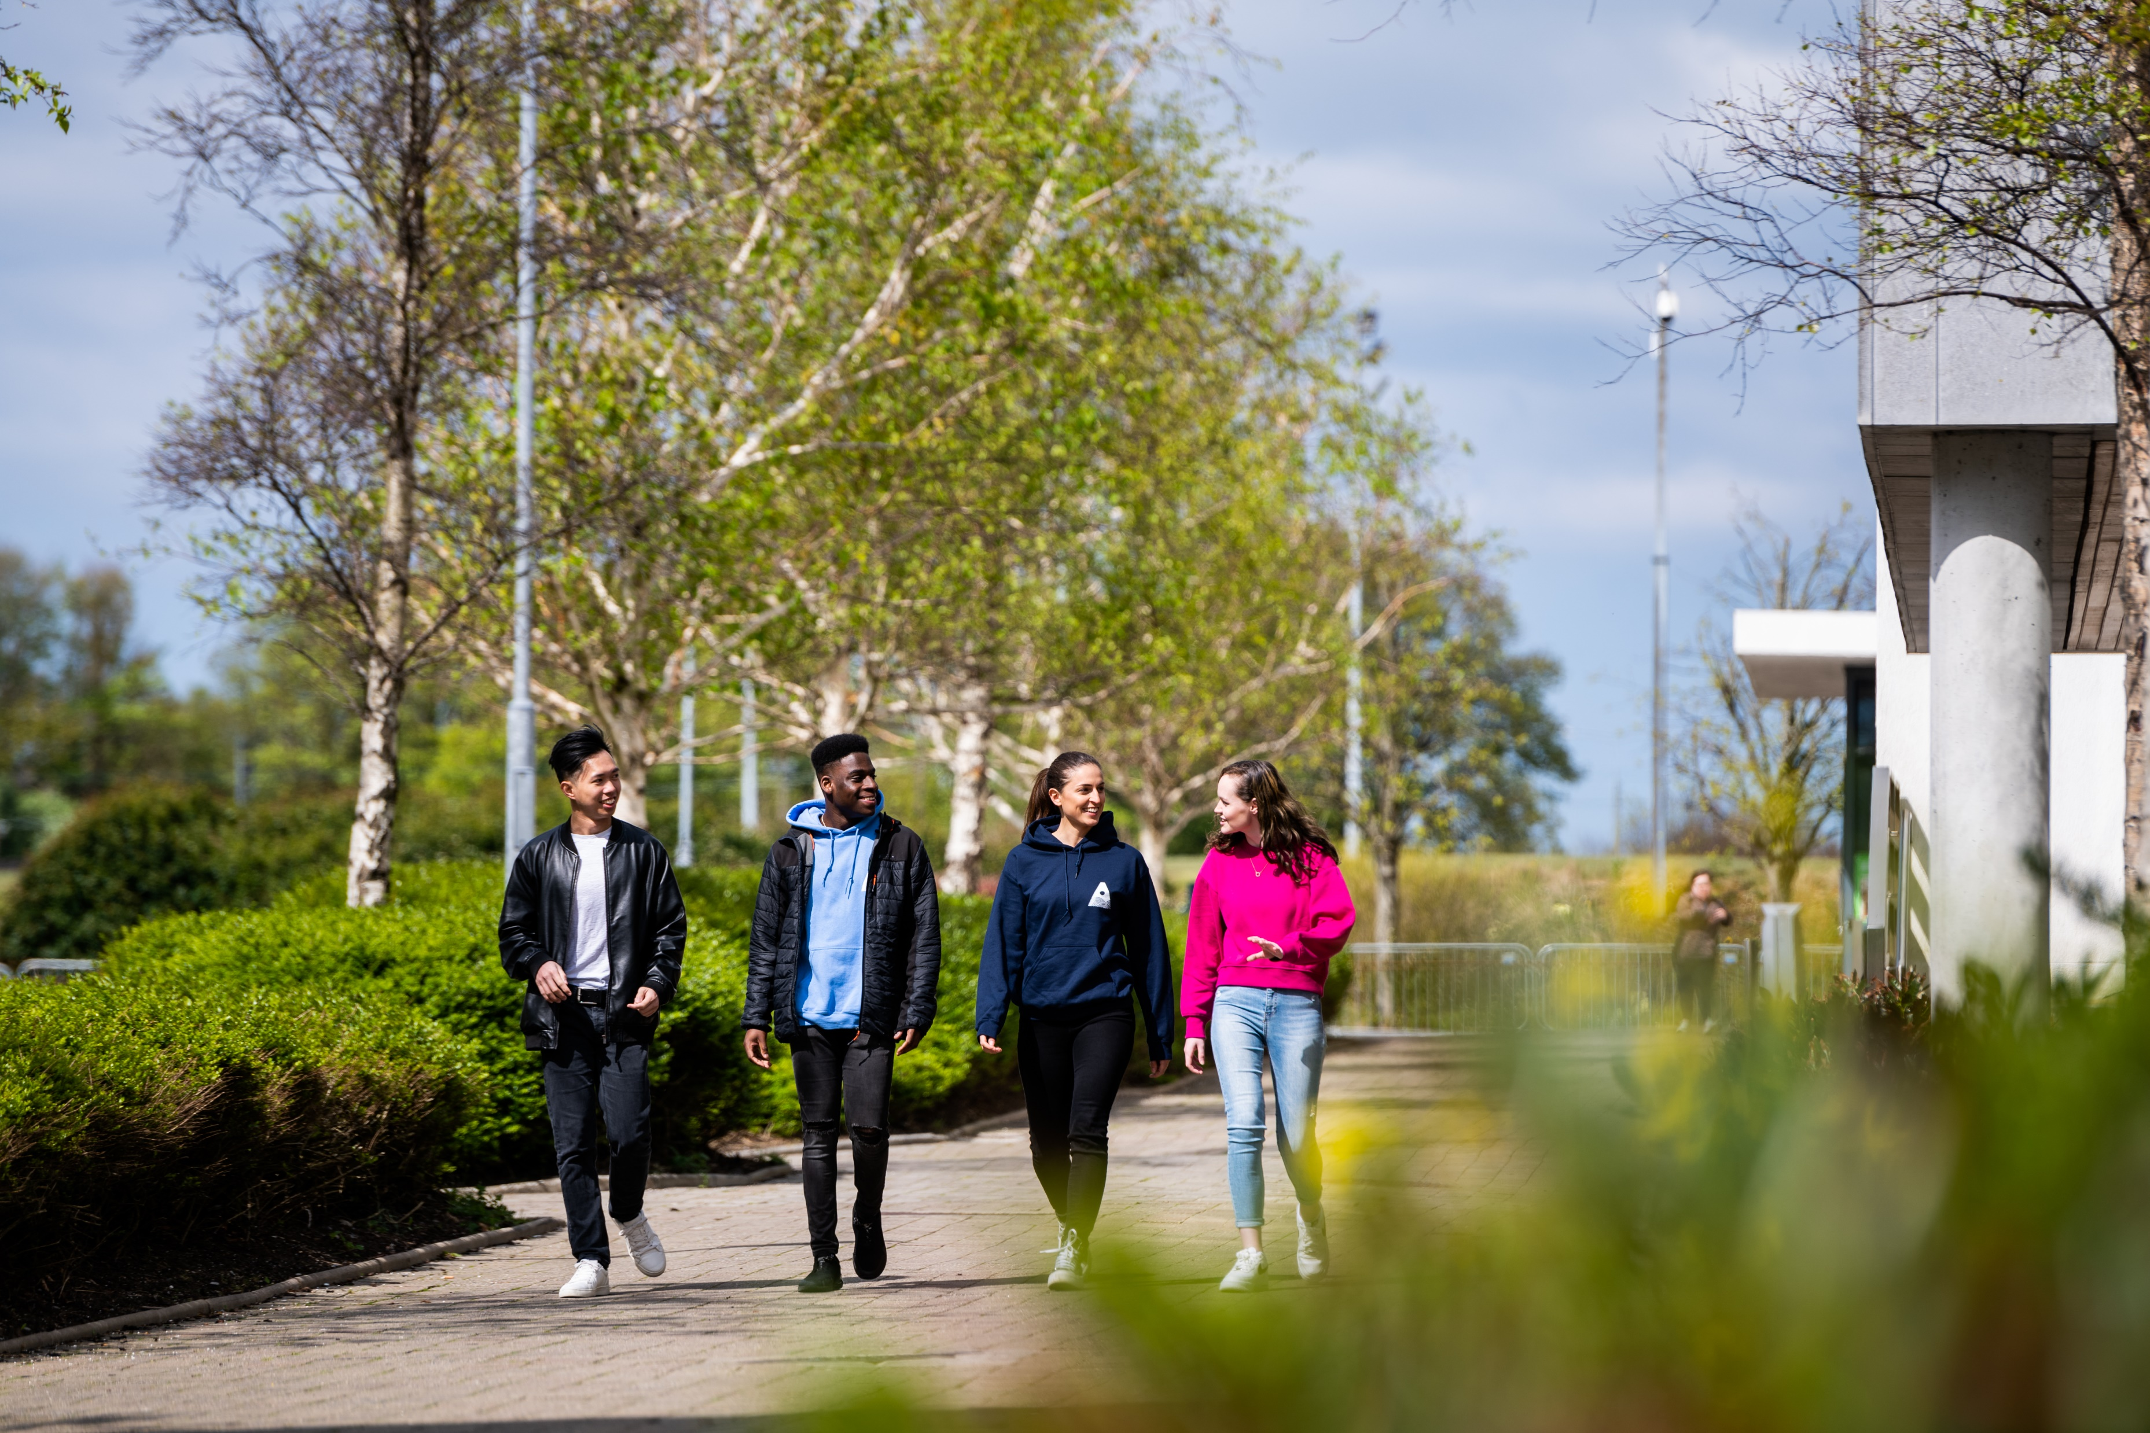
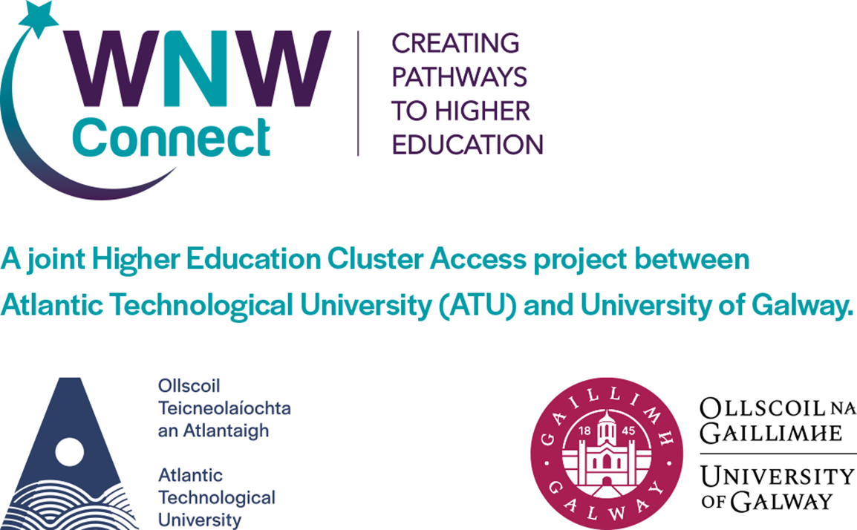
Mentoring for Access, Retention and Progression in Higher Education:
Reflecting on Innovative Practice

Slide 2

The WNW Connect Project is based in the Student Services and Access Services of the WNW Cluster of Higher Education Institutions.
Vision for WNW Connect Project
To create and promote accessible routes to Higher Education in the West North-West Region through engaging with, and supporting, individuals who are socio-economically and/or educationally disadvantaged.

Slide 3

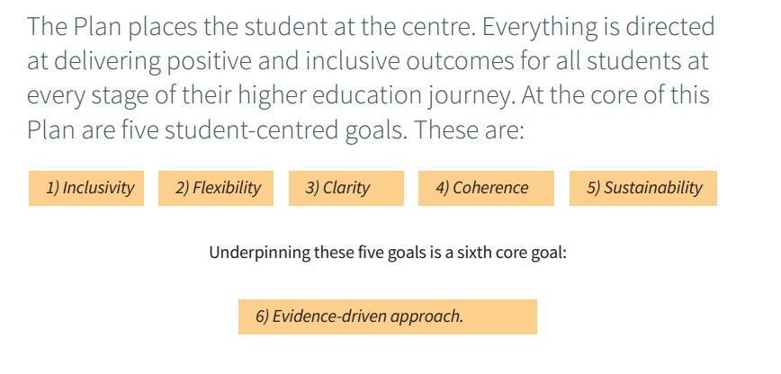
Strategic Context
Goal: Provide supports and opportunities for learning to all, recognising the needs of vulnerable learners and the most marginalised, and assist people in access to and progression through higher and further education and training, so as to grow prosperity across communities and build social cohesion.
Notes:
Setup in 2015 – 2019 but PATH 3 wasn’t brought in till 2019
that the higher education student body, at all levels and across all programmes, reflects the diversity and social mix of Ireland’s population, and
that our higher education institutions are inclusive, universally designed environments which support student success and outcomes, equity and diversity.

Slide 4
WNW Connect Education Mentoring Project
Strategic Alignment
Communication
Best Practice
Action Planning

Slide 5
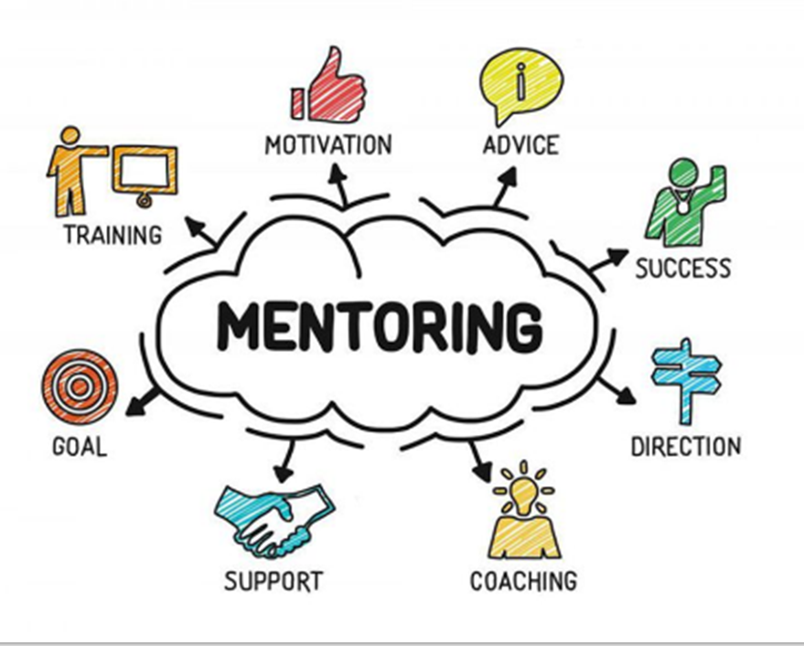
What is Mentoring within WNW?
Mentoring for access, retention and student success refers to activities designed to support students in accessing, participating, and progressing in their journey to and through higher education.
  Can be:
    1 to 1
    Group
    Peer
    Formal / natural

Slide 6
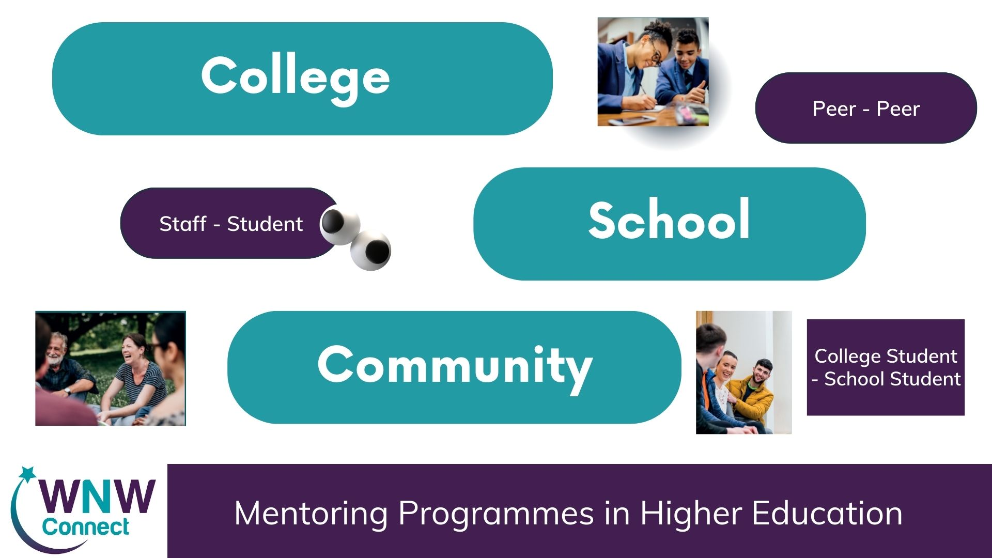
The WNW Connect Project is strategically developing mentoring programmes across Community, Schools Further and Higher Education Institutions.

Slide 7
World Café
Community Mentoring
School Mentoring
HEI Mentoring

Slide 8

2024 Research
To profile current PATH 3 funded mentoring initiatives focused on access, progression, and retention currently in place in ATU and the University of Galway.
To understand the perceived strengths and challenges of the mentoring initiatives from the perspectives of stakeholders.
To reflect on issues arising for the future development and evaluation of mentoring initiatives.
Notes:
Use this slide to discuss the three mentoring elements of WNW
Methodology:
Ethical approval
Literature review
Semi-structured interviews with 23 stakeholders
Thematic analysis

Slide 9

Findings
A. Profile of three key contexts in which mentoring is deployed:
Schools
Community
Higher Education
B. Issues, challenges & future development - Six cross-cutting themes

Slide 10

Community-Based Mentoring
Rationale: Targeted support in communities with low rates of educational progression
Model components:
Education mentor based in community
Supports and encourages young people and adults to consider accessing a further or higher education course
Wraparound tailored support
Accredited training for local mentors
Initiatives:
Ballybane Community Mentoring Programme, ATU Galway
Cranmore Community Mentoring Programme, ATU Sligo
Notes:
information and advice about the college experience, help
prospective students build their awareness of college courses, how to apply, and the benefits of a college education”

Slide 11

Community-Based Mentoring: Perceived Benefits
Flexibility:
‘You are the person there that is going to help alleviate barriers that they are facing, no matter what it is. ..... it is like how can we alleviate those barriers? It’s that wrap around support for them.’ (mentor)
Continuity of support:
‘it’s not a service that has an expiration date on it.’ (mentee)
‘having someone there dedicated to helping you progress’ (mentee)
Changes outlooks:
‘changes your thinking about your life choices’. (mentee)
‘I felt paralysed before mentoring. I now realise there are no wrong decisions- just to keep stepping forward.’ (mentee)
Notes:
information and advice about the college experience, help
prospective students build their awareness of college courses, how to apply, and the benefits of a college education”

Slide 12

School-based mentoring
Rationale: At ages 11-15, children begin to think about going to higher education, grades start to fall for socioeconomically disadvantaged students (Wimberly & Noeth, 2005; Levine & Nidiffer, 1996; Swail & Perna, 2002).
Model components:
In-school activities
Campus visits with mentors from similar backgrounds
Peer mentoring in schools
Initiatives:
Uni4U (University of Galway)
Strive Mentoring (ATU)
Notes:
Objectives:
to encourage primary and second level students in DEIS schools to explore options in higher education by engaging directly with third level students.
to expose primary and second level students to third level campuses with a focus on meeting people from their own communities in order to demystify access to education.
to support the development of peer mentoring initiatives within DEIS post-primary schools through relevant training and resources.

Slide 13
School-based
Mentoring
Creates a positive attitude towards higher education:
  Visiting campuses and meeting staff and students can be an ‘eye opener’ for children,
  making HE feel ‘less alien’ and more accessible to them.
Raises awareness among children that people have different pathways to and through HE:
‘makes them realise that you don’t have to have high points, or a certain background, that anyone can go to college’ (Mentor).
Fosters children’s self-belief in capacity to go to HE:
Mentors from their own communities act as role models, connect with children on topics that interest them
Notes:
Note: Emphasise the relationship piece

Slide 14

HEI-Based Mentoring
Rationale: Students are at a high risk of dropping out of higher education within the first year, particularly students from underrepresented groups (HEA, 2023).
Model components:
Students ‘matched’ with trained mentors (peer or staff)
Matched based on commonalities
Provides a supportive, friendly relationship
Removing barriers to progression from FE to HE
Initiatives:
ATS Mentoring (University of Galway)
Foróige’s Third Level Mentoring Programme (ATU & University of Galway)
FE2HE (University of Galway)
Notes:
Objectives
To ensure students (first generation students in particular) have access to formal and natural mentoring support.
To provide mentoring support in further and higher education that enables participating students to successfully achieve their educational objectives by building on networks of acquired social and cultural support.
To support students to explore and follow progression pathways.

Slide 15

HEI-based mentoring: Perceived benefits
Emotional and practical support
Greater sense of security and confidence in college
Staff understanding of the needs of students
‘If you have a consistent staff member checking in with you .. your mentee will be able to tell you that they might be experiencing difficulties, and you’d be able to kind of guide and navigate them, towards certain supports that they might need’ (Mentor)
‘We clicked straight away – as soon as we met it was like I was just talking to a friend. … I knew I could ask whatever I liked and that she was there to help … She pointed me in the right direction, how the college works, she helped me get to know other people in my class. Very practical, helpful support’. (Mentee)

Slide 16
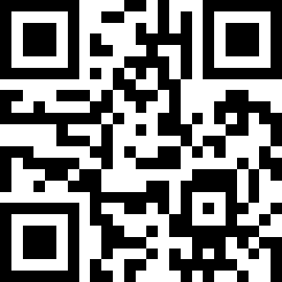
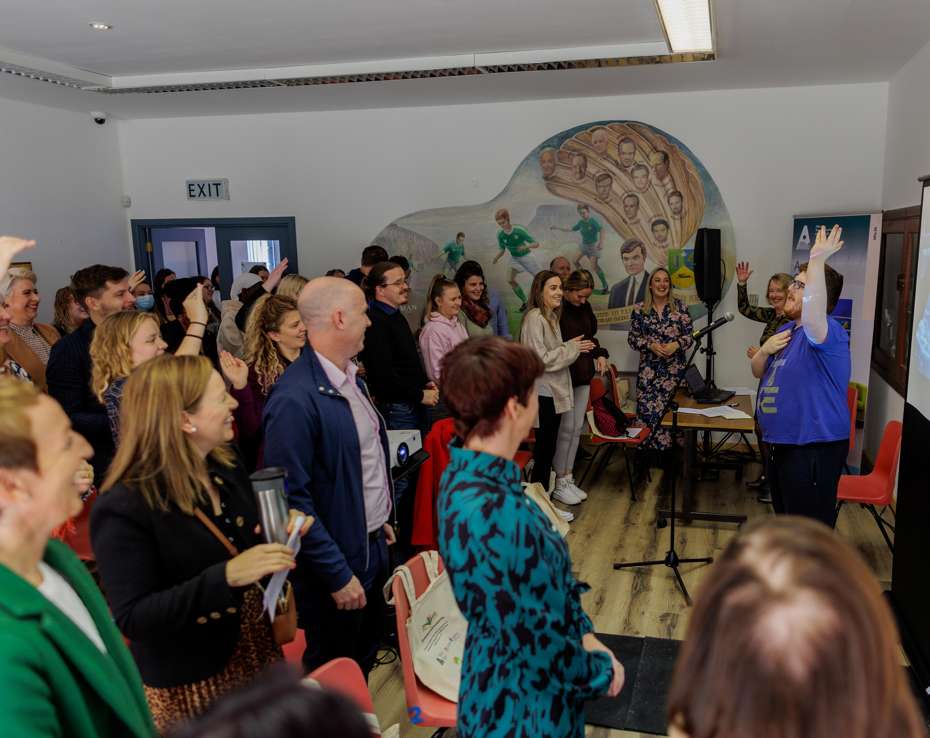
Six – cross cutting themes
Targeting & take-up of programme.
General awareness of the meaning & importance of mentoring.
Importance of partnership with schools & voluntary organisations.
Building & sustaining mentoring relationships.
Evaluation, impact & evidence-based practice.
Sustainability of mentoring programmes.
Notes:
1. Targeting & take-up of programmes:
Not available outside DEIS schools.
Lack of awareness of role of community mentor / slow engagement.
Confusion about who HEI mentoring is ‘for’ / perceived ‘stigma’.
Variability in demand from year to year.
2. General awareness of the meaning & importance of mentoring:
Many mentoring models, varying degree of closeness, contact, etc.
Need for more awareness of the purpose & value of mentoring.
Scope for mentoring to be part of HEI culture for staff & students.
3. Importance of partnership with schools & voluntary organisations:
Ensures mentoring is appropriate to local context
Can draw on specific expertise
4. Building & sustaining mentoring relationships:
Trusting relationships take time
Having similar interests a key facilitator
Structured training, co-ordination & support is essential
6. Evaluation, impact & evidence-based practice:
Measuring impact / outcomes is complex & challenging
Progression may not be linear
Short-term funding
Dearth of evidence based programmes for progression & retention
6. Sustainability of mentoring programmes:
Concern that promising initiatives will end with current funding cycle
Appetite among stakeholders to build on learning to date / adopt a strategic approach

Slide 17
Mentoring for Access, Retention and Student Success – Research document

Slide 18
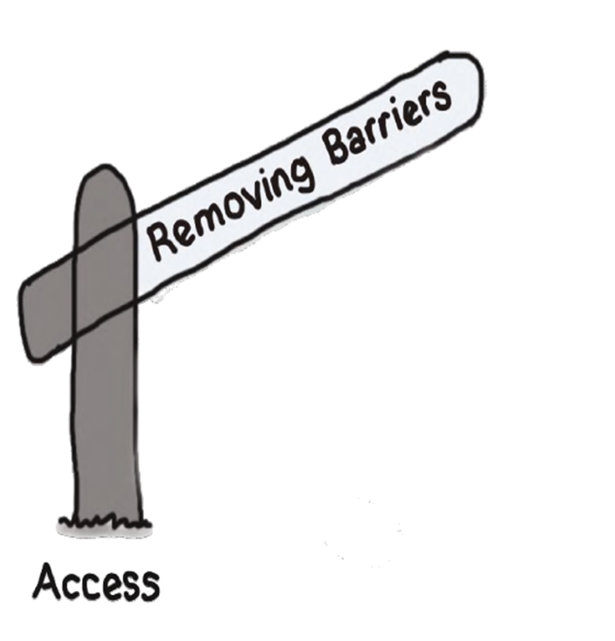
Conclusion
PATH 3 funded mentoring initiatives are being provided in a range of contexts.
Perceived to be a valuable part of the overall package of measures targeted at access, progression and retention of under-represented students.
Principles for practice proposed to guide for future development.

Slide 19


Thank You
Kirsten Lowe
Community Mentor
ATU Galway
Programme Coordinator ATU CONNECT Project
Email: kirsten.lowe@atu.ie
Ronan Cox
Community Mentor
ATU Sligo
Community Mentoring Programme
Email: ronan.cox@atu.ie

