Slide 1
MIEA
Mindfulness Institute for Emerging adults
Teaching mindfulness to college students and other emerging adults.

Slide 2
Contents
MIEA
Practice
Definitions
Scientific research
Closing

Slide 3
Mindfulness is….

Slide 4
Introduction
Institute for Mindfulness for Emerging Adults developed a
four-session introduction to mindfulness course.
Specifically designed to meet the developmental needs of emerging adults in higher education.
Notes:
Consider talking about:
Psychology
Definitions arising in modern teaching of meditation
Other usages

Slide 5
Mindfulness is proven to help.
Mindfulness cultivates
confidence, compassion, resilience, and wisdom.

Slide 6
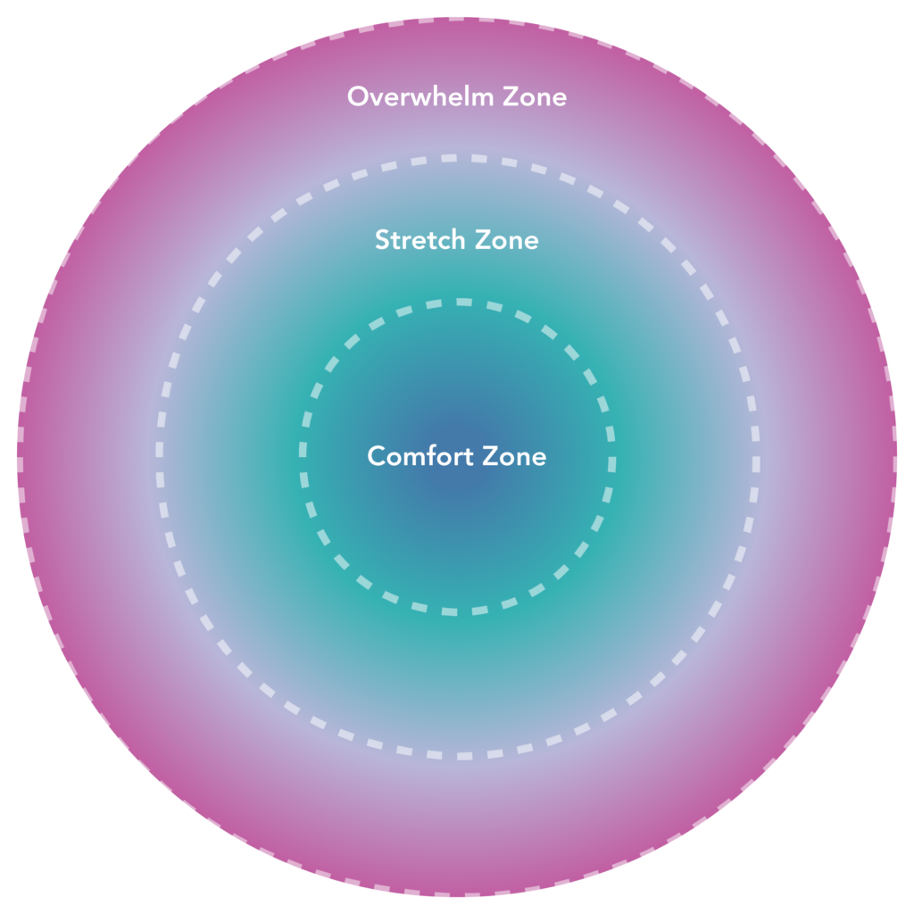
Zones of Activation
Notes:
Consider talking about:
Sati and smṛti
Translation
Alternative translations

Slide 7




.
MIEA was as effective as longer programs that are less accessible for young adults
MIEA’s randomized, controlled trial at Duke University shows MIEA as a very effective mindfulness intervention with students reporting significant improvement in the following:
Less stressed
More rested
Greater self-compassion
More mindful
Notes:
MIEA’s randomized, controlled trial at Duke University shows MIEA as a very effective mindfulness intervention with students reporting significant improvement in the following:

Slide 8

Practice
Bringing awareness to the present moment using the breath as an anchor.
Body Scan
The Gatha
Notes:
Consider talking about:
Watching the breath, body-scan and other techniques
Timings
In Buddhist context; moral precepts

