Slide 1
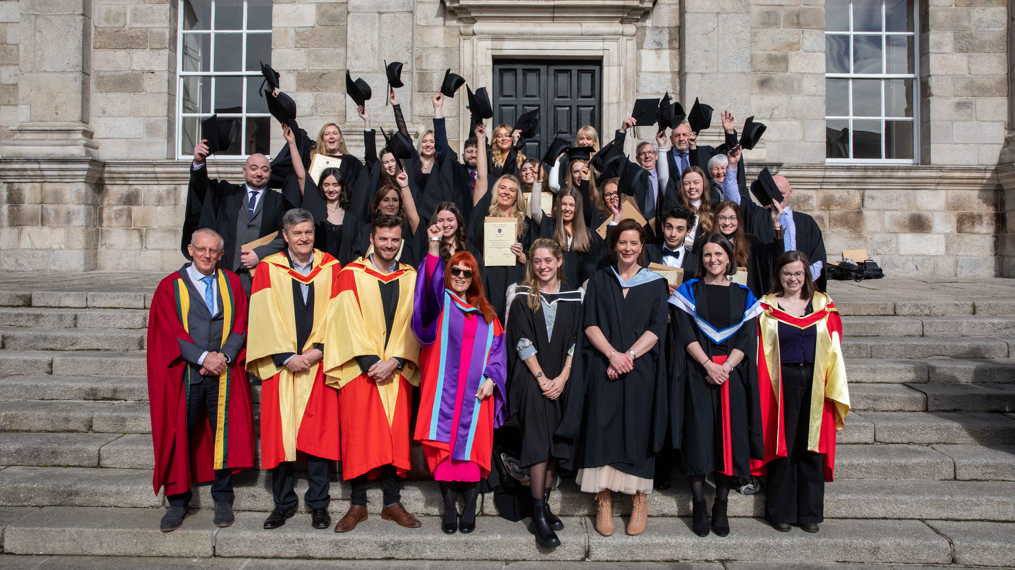
AN INTEGRATED APPROACH TO STUDENT SUPPORT THROUGH MIND BODY MEDICINE
Sarah Grimson & Heidi Jackson (TCD)

Slide 2

OUTLINE
* CONTEXT
* MBM HISTORY
* WHAT IS MIND BODY MEDICINE
* BENEFITS FOR STUDENTS & COLLEGES
* RESEARCH APPROACH & FINDINGS
* MBM IN ACTION
Notes:
S

Slide 3
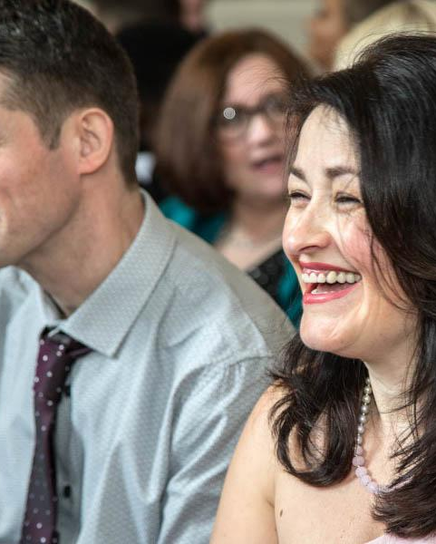
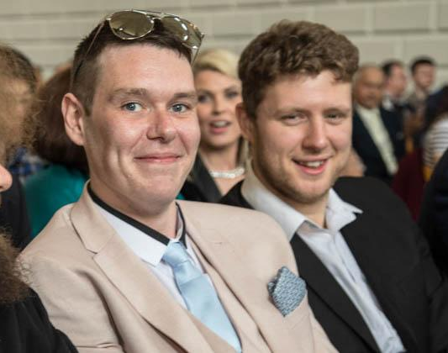
TAP FOUNDATION COURSE FOR MATURE STUDENTS
Offers another way to third-level education for mature students whose social, economic and cultural experiences have prevented them from going to college.
Personal, social and academic preparation
Full time
Student centered
Sample academic subjects
Skills development
Notes:
S

Slide 4
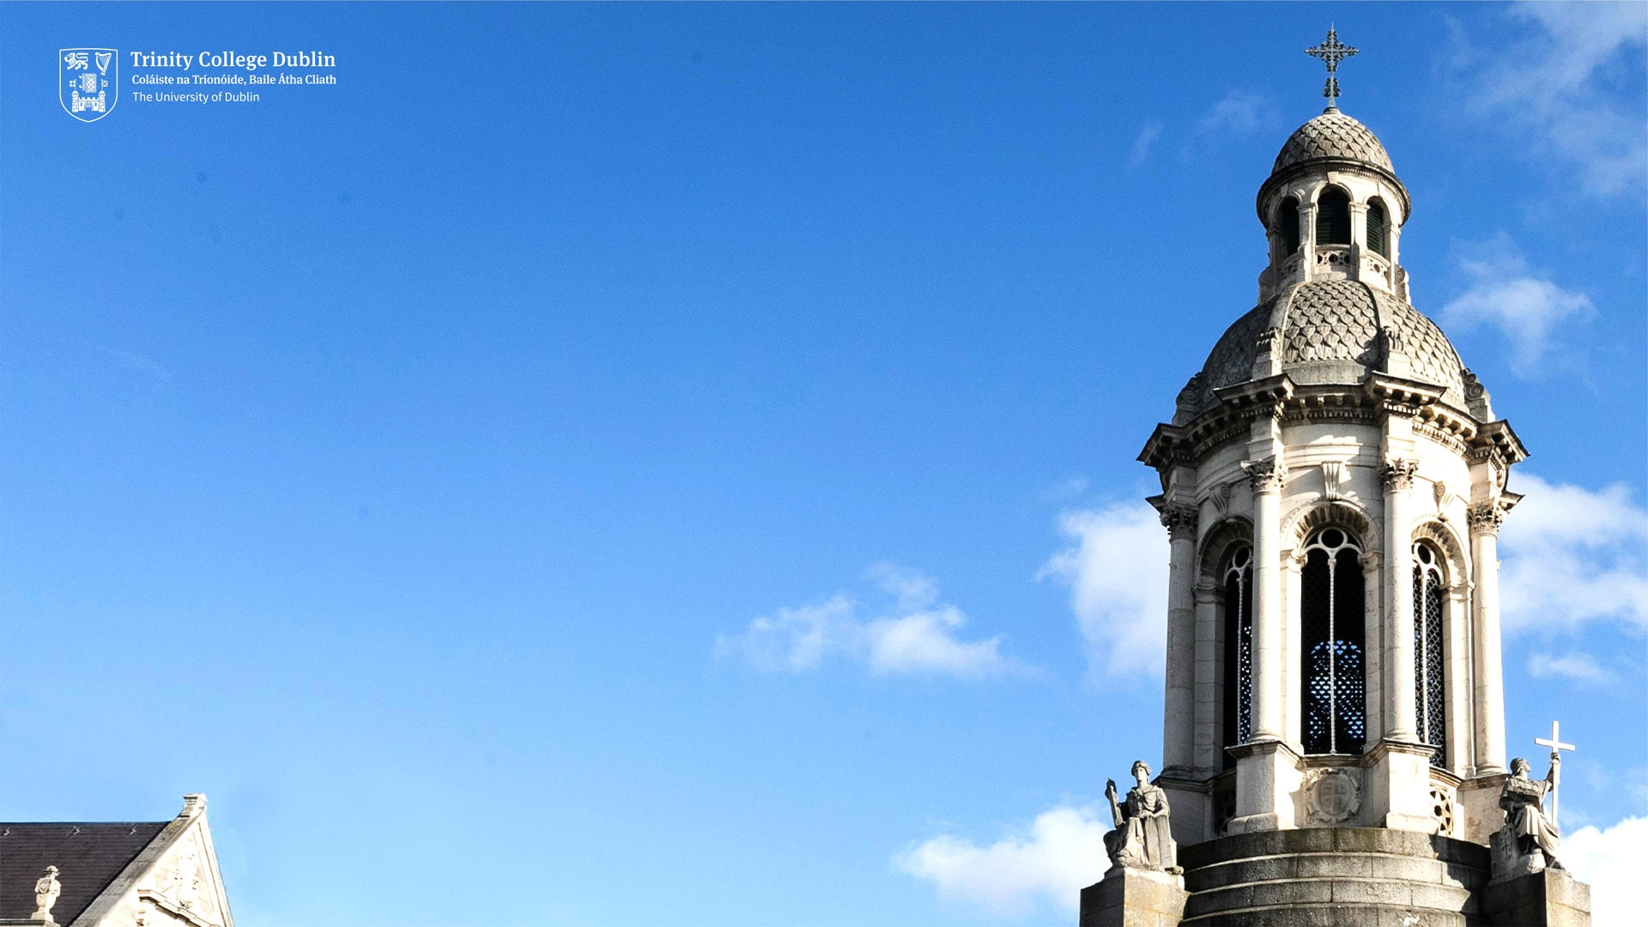
CONTACT US
Rationale for introducing MBM
College stress (challenge – confidence)
Life stress
Past trauma
Increasing demand for 1:1 counselling
Upstream, pre-emptive, community based approach
Students can be referred/self refer to Student Counselling Service, MBM ‘holds’ them.
Notes:
s

Slide 5
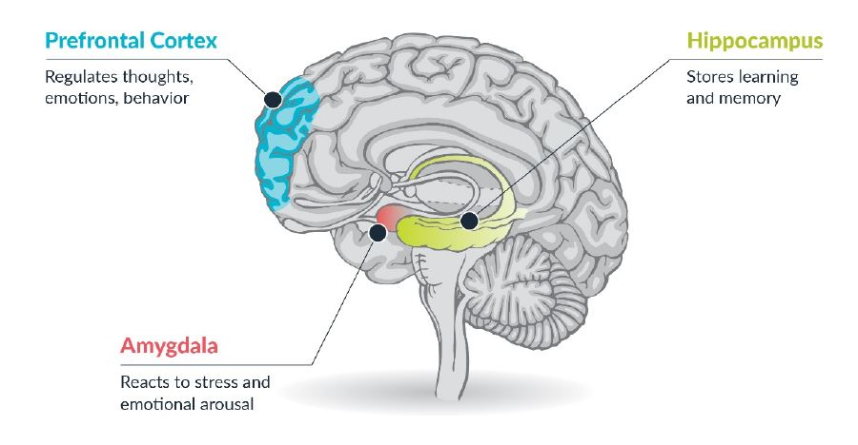
Parts of the brain that need to work seamlessly to facilitate learning
Notes:
H
Focus/ Concentrate and Plan/Organise and be able to Memorize information

Slide 6
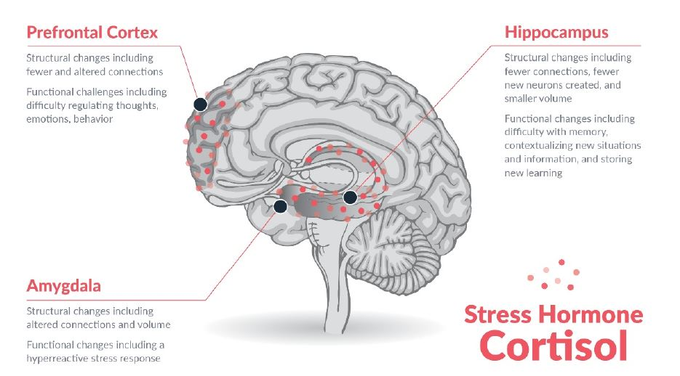
The effects of stress on the brain
Notes:
H

Slide 7
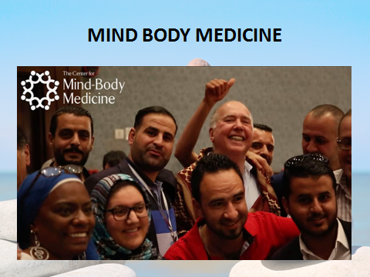
History of Mind Body Medicine
Dr James Gordon, Harvard trained Professor of Psychiatry at Georgetown University hospital started the Centre for Mind Body Medicine in 1991
Saw the bio medical model wasn’t working…experimented with the techniques for himself and then brought it to his patients and to his medical students and numerous populations in Washington…those with Aids/ cancer/ inner city kids/ ‘burnout’ professionals
MBM In Action:
  1997 Bosnia/ Kosovo…Part of the national mental health programme
  War zones: Middle East/ Sudan/Jordan/VISN 8/Ukraine
  Natural Disaster Zones: Haiti/Puerto Rico/Sonoma/New Orleans
  Shootings: Broward County/Texas 80% reduction of PTSD symptoms
  Firefighters/Police Force
  Prisons: Inmates and their staff
2023: 160 faculty worldwide ‘Teaching thousands to heal millions’
10,000 healthcare professionals/educators/community leaders trained.

Slide 8
What is Mind Body Medicine?
It focuses on the interaction between the mind and the body and the powerful ways in which mental, emotional, social and spiritual factors can directly affect health and well being.
It emphasizes an approach that uses scientifically validated techniques that respect and enhance each person’s capacity for self knowledge and self care, the techniques include:
      Drawings
      Meditation
      Relaxation
      Guided Imagery
      Movement
      Self Hypnosis
      Biofeedback
      Writing
      Diet
      Genograms
Small groups of 8-12 students for 2 hour sessions over 8-10 weeks
6 guidelines…confidentiality/mutual respect/I pass rule/commitment/punctuality and ‘ownwork’
I hour check in
1 hour to learn about and practice a new technique and give feedback.
Notes:
H

Slide 9
Benefits of MBM for Students
Group format: Mutual support, not feeling alone, learn from each other
Encourages self expression without judgement/analysis or ‘trying to be fixed’
Free from ‘stigma’ of mental illness
Enhances sense of self control
Encourages them to experiment with their own abilities
Techniques are:
  Varied
  Short & Practical
  Fun & Interesting
  Can be passed on to family and friends
Notes:
H

Slide 10
Advantages of MBM in Higher Education
Cost effective - group setting of 10 students
Complements existing student support systems
No stigma attached -seen as educational support
Time efficient - 2 hours a week over 8-10 weeks
Flexible delivery
Empowers students to help themselves.
Handouts & recordings for ongoing support
Notes:
H

Slide 11
CMBM Research with Higher Education Students
Allgeny College Maryland
https://cmbm.app.box.com/s/usqnk13yjhk5fzjpw5sezg8yx4y9hpz3
https://docs.google.com/document/d/1t4P0RpeG18Dyt1VmHhk2_dNXHYXsitSjsecTPdy7sSE/edit?usp=sharing
Medical Students and MBSGs
http://www.biomedicalcentral.com/1472-6920/14/198.
Ranjbar N, Erb M, Tomkins J, Taneja K, Villagomez A. Implementing a Mind-Body Skills Group in psychiatric residency training [published online ahead of print, 2021 Aug 2]. Acad Psychiatry. 2021;1-6.
Williams MK, Estores IM, Merlo LJ. Promoting resilience in medicine: The effects of a mind-body medicine elective to improve medical student well-being. Glob Adv Health Med. 2020;9:2164956120927367. Published 2020 May 21.
Kosovo University students
https://fb.watch/kSKcdZlHYj/

Slide 12


RESEARCH
2021-2023
Focus Group
Anonymous Online Survey
Notes:
S
Practitioner led
Pilot
Focus group 4 students - Arts Humanities, EMS x2, HS. QL and QT.
77/506 (15%) – 57 HEAR, rest FC and ETB partnership, all 3 faculties. 33 AHSS, 29 EMS, 15 HS
Structure of research Qs and presentation - Engagement, representation and expression
Journey map – 4 students HCD

Slide 13
65% of students have established a consistent mind-body practice
Stress Management
Self Care & Confidence
93% would recommend the module to other students
Trauma
Wider Benefits

Slide 14
Stress Management
The breathing techniques have supported me relaxing my body and mind when I am stressed. It has also supported me with controlling my emotions when frustrated or feeling down.
It has picked me up by taking the time to sit with the feelings.
I found this module to be very beneficial. I was struggling at the time with sleeping and stress and the meditations that I was introduced to were a game changer for me.
It has given me some valuable tools to support me in times of stress.
Self Care & Confidence
Gave me confidence and practices to help at difficult times.
As a woman we put family first, but with mind body medicine you put forward self care first and learn to let go of societal pressure and internally check in, because mature students - wear different hats.
I learned self care – giving it time, focus and skills.
Trauma
Issues from my past resurfaced, reminded me not to be too hard on myself.
Positive - it opened up stuff that was buried.
Wider Benefits
Some students shared the MBM skills with their families.
The fellowship / community aspect of the programme was valued.

Slide 15
HIGHLIGHTS
The closeness of the group, the confidentiality and the relaxation
Guided meditations and imagery
Soft belly and shaking
The family tree, it highlighted so much for me about my family history
Learning new techniques, understanding that we are not alone
Giving myself the time to focus on my own thoughts and realise that I wasn't alone in my fears

Slide 16
Recommendations from Participants
Maybe I didn’t have the right mindset but in some sessions, there were too many personal feeling and emotions for a group session
For the module to be beneficial, participants must stick to the routine
Life just got in the way of my engaging with this module
Better room for next time/a more relaxing environment
The course should take place at the start of the first semester
Have a follow up session after a few months to embed practice
Would love a podcast

Slide 17
SHORT EXPERIENCE OF MIND BODY MEDICINE PRACTICE TO CLOSE
‘Soft belly breathing’.
Notes:
Challenges are not unique to access students.
Everybody’s business – this is about learning and teaching but so much is wider than that, tricky thing culture…

Slide 18
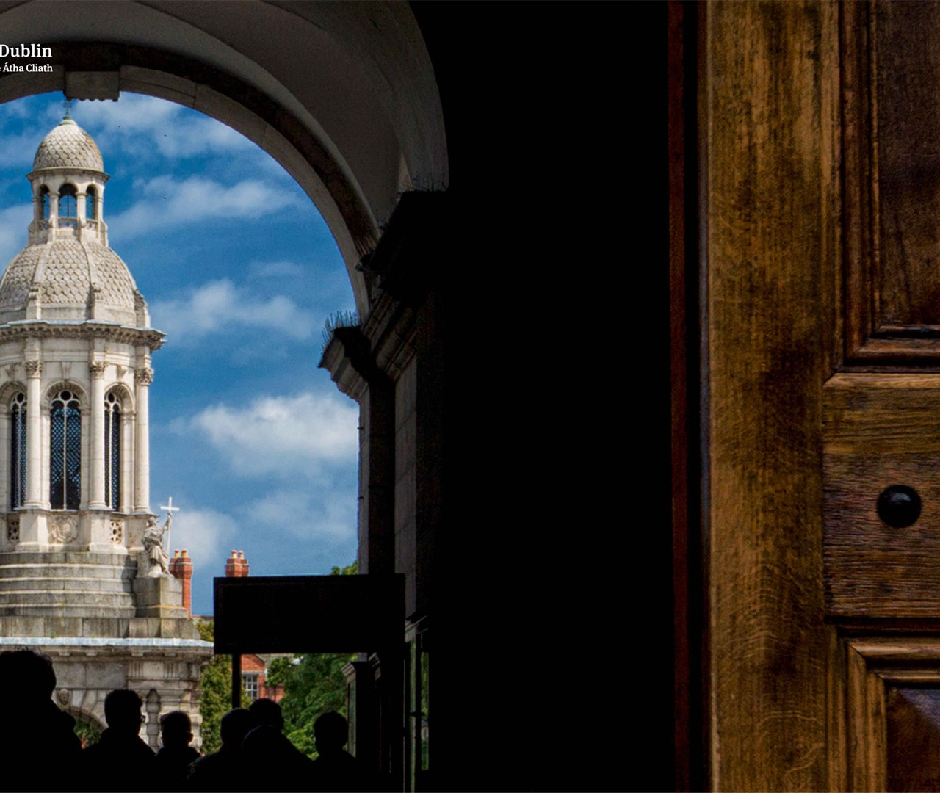
QUESTIONS
Contacts:
Sarah Grimson grimsos@tcd.ie
Heidi Jackson heidijackson@mindbodymedicine.ie

