Slide 1


Artificial Intelligence and Academic Integrity: ChatGPT in Learning and Teaching
Dr Loretta Goff, Academic Integrity Education Officer
loretta.goff@ucc.ie
Tadhg Denney, Research Support Officer
tadhgdennehy@ucc.ie

Slide 2
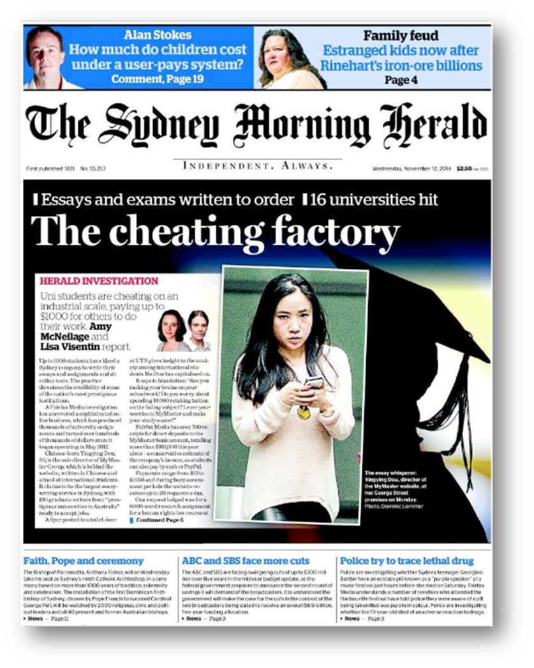

Slide 3

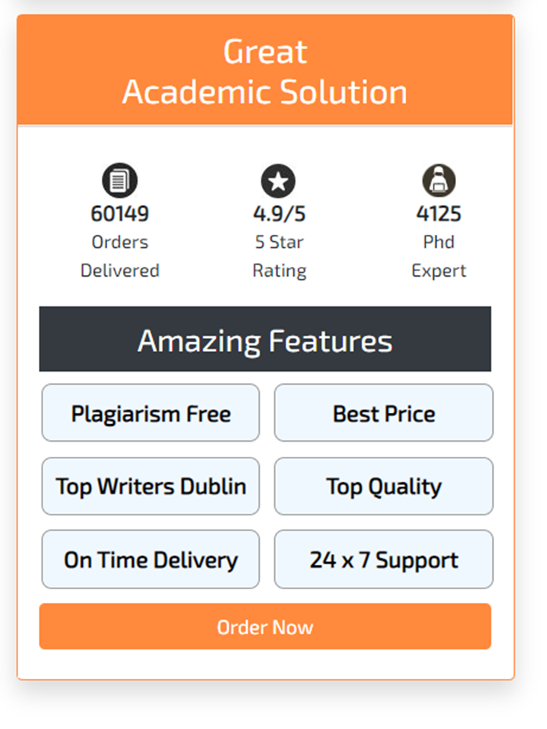

Slide 4




Slide 5
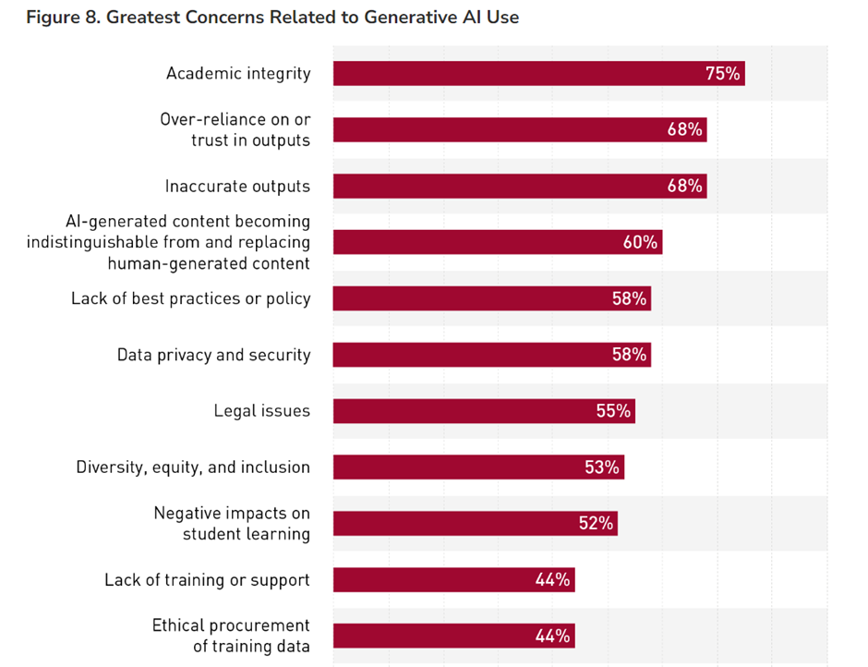
Muscanell N. & Robert J. (2023). “EDUCAUSE QuickPoll Results: Did ChatGPT Write This Report?” EDUCAUSE Research Notes, Emerging Technologies and Trends. February 14. https://er.educause.edu/articles/2023/2/educause-quickpoll-results-did-chatgpt-write-this-report

Slide 6


Slide 7
Toolkit for the Ethical Use of Artificial Intelligence in Learning and Teaching
Lexicon of Common Terms
Artificial Intelligence and Academic Integrity: Ethical Guidelines
Common Forms of Assessment: Risks and Redesigns
Case Studies of Good Practice

Slide 9
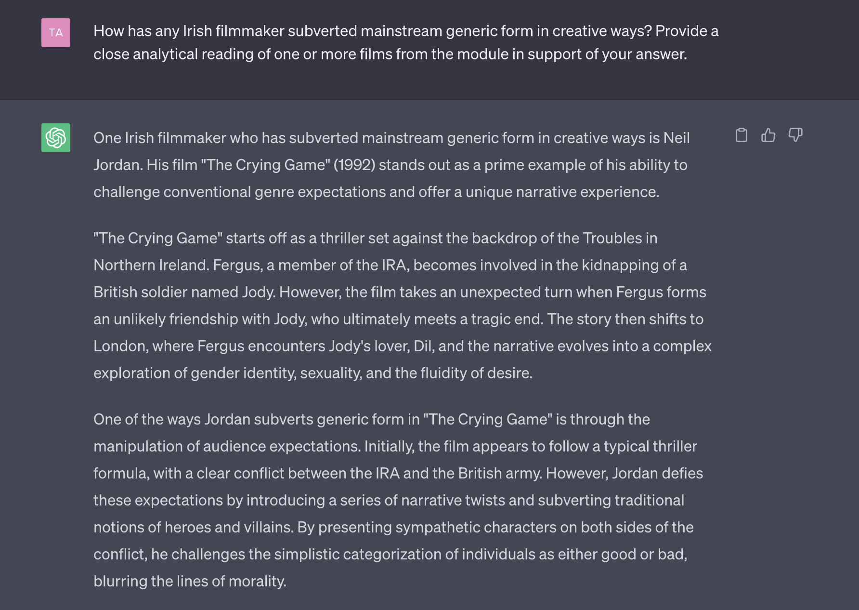

Slide 10
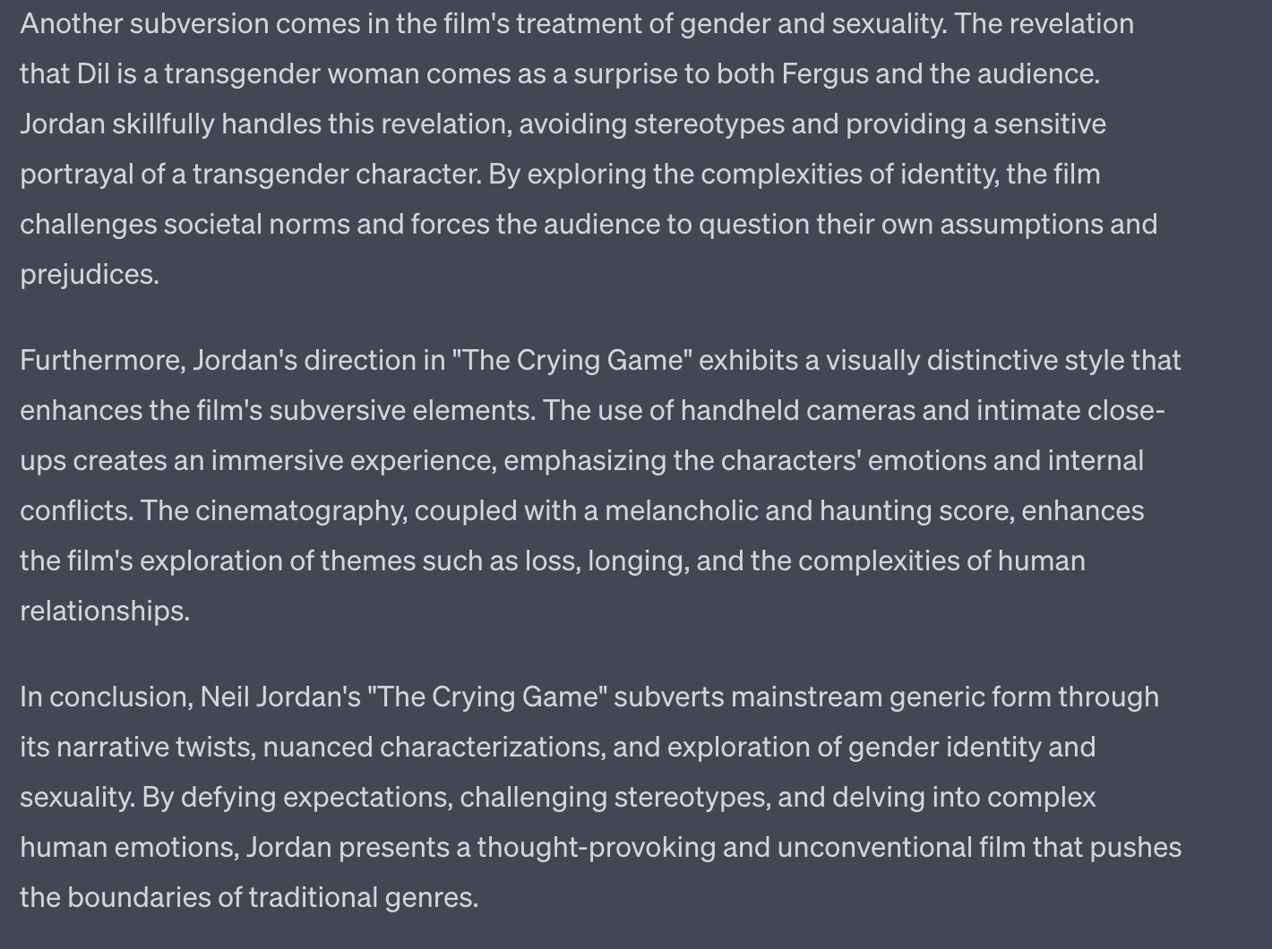

Slide 11
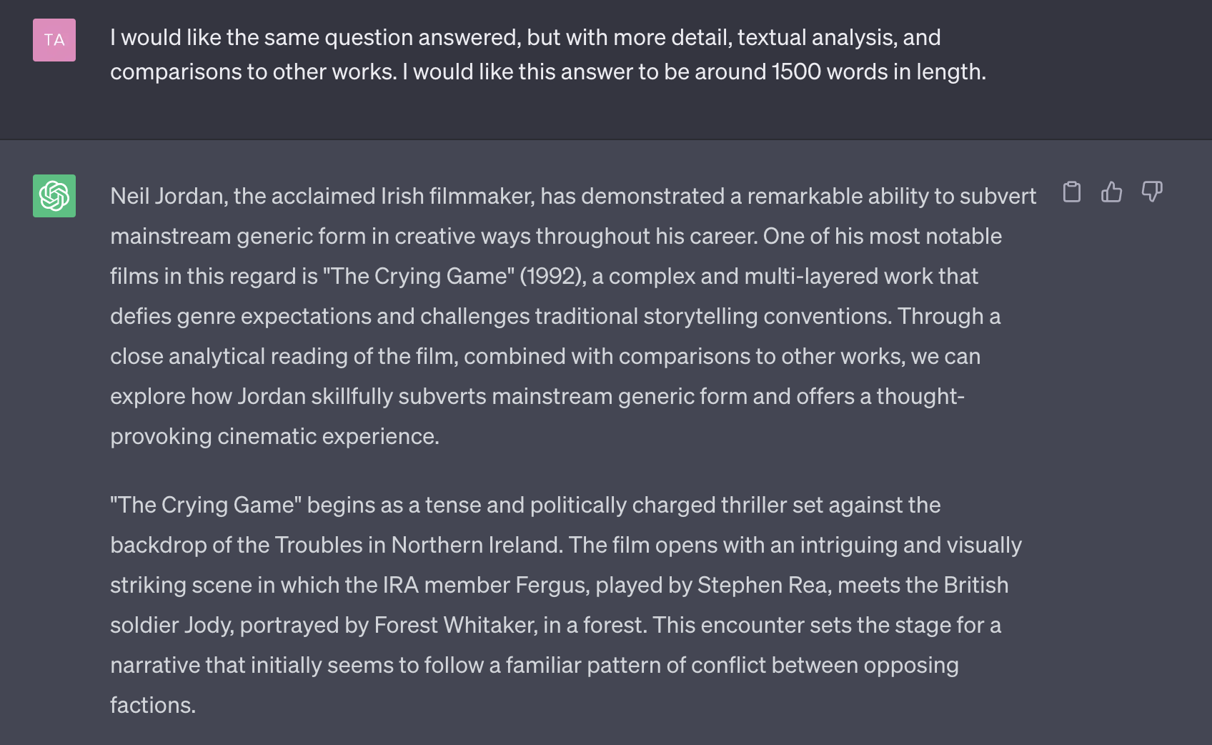

Slide 12
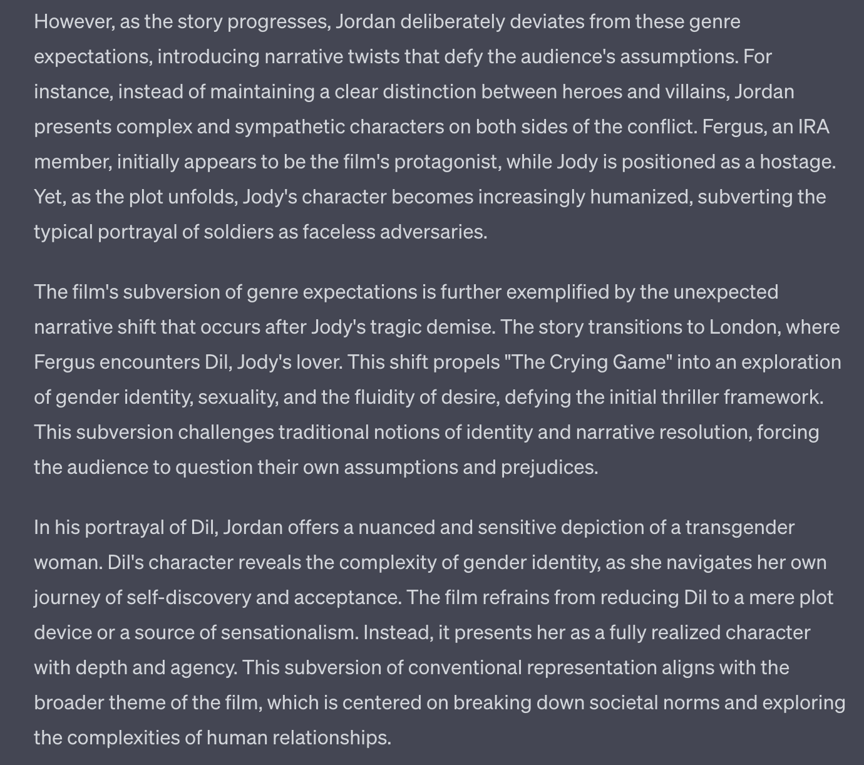

Slide 13
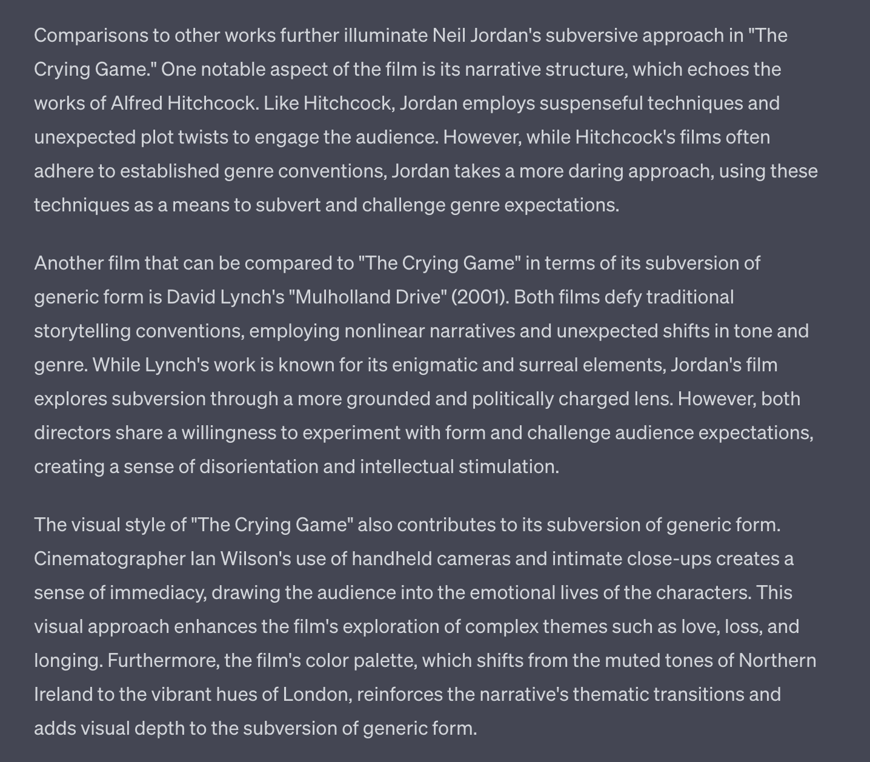

Slide 14
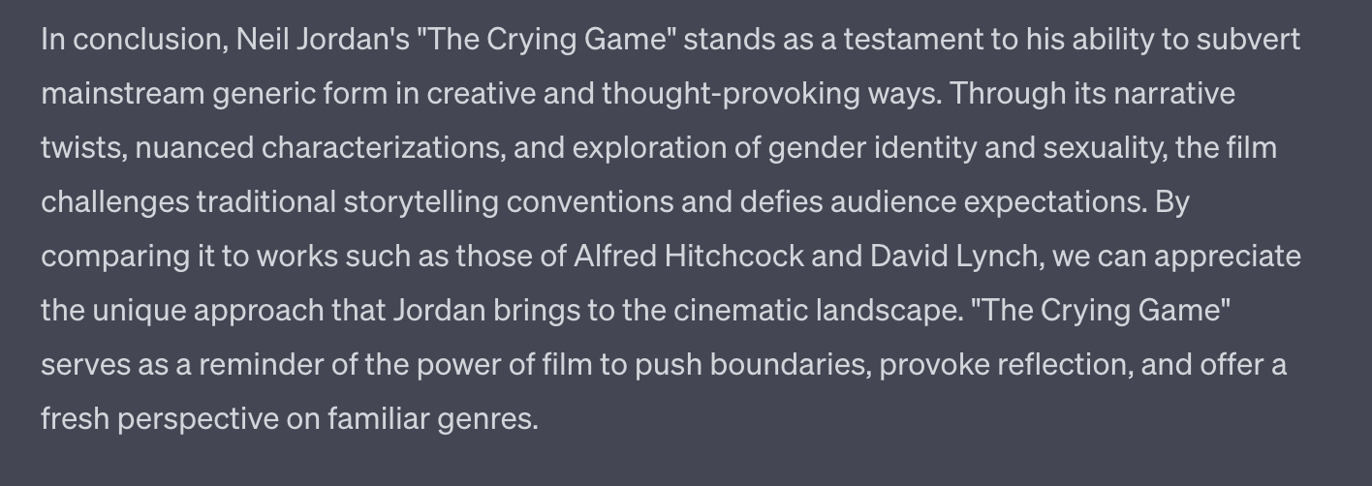

Slide 15
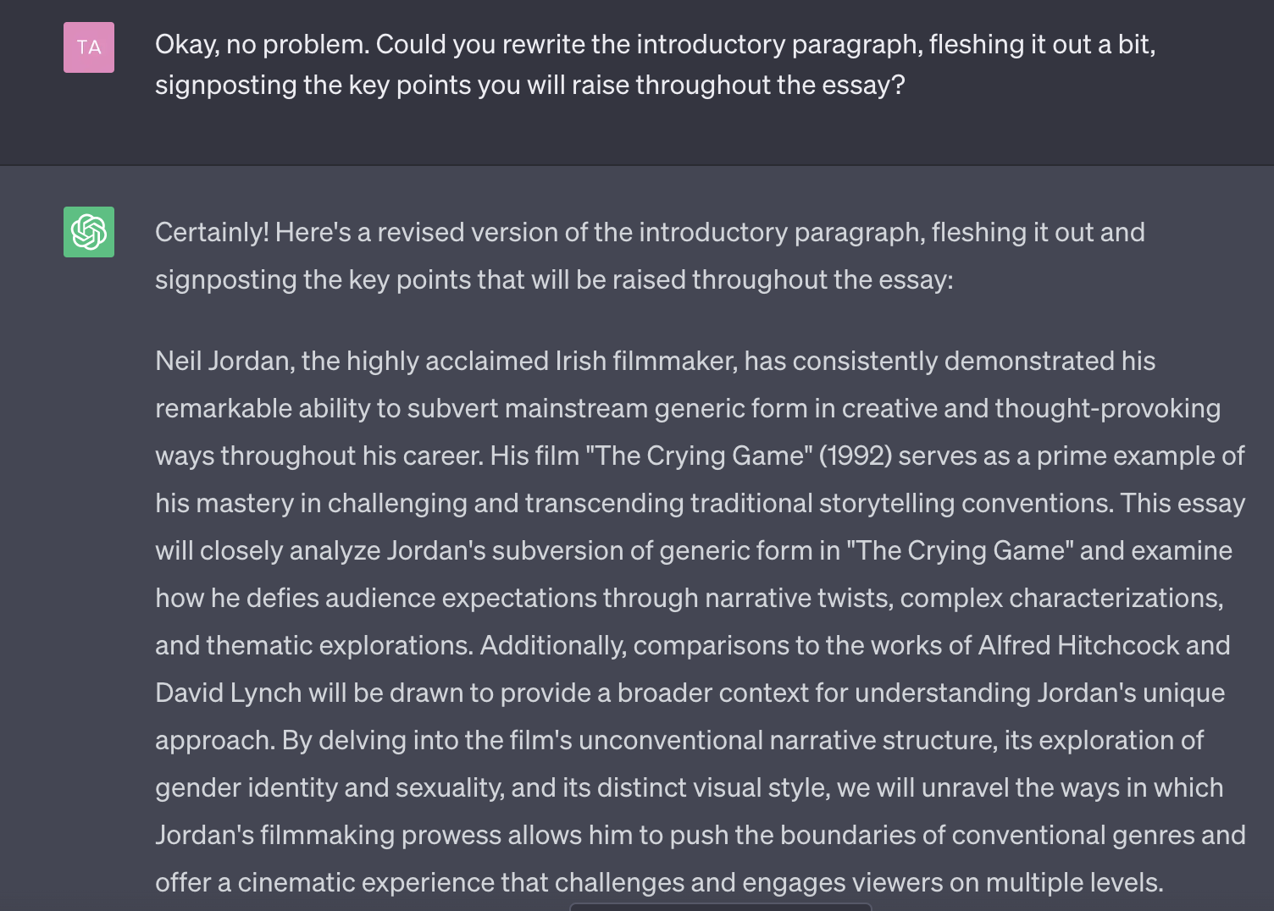

Slide 16
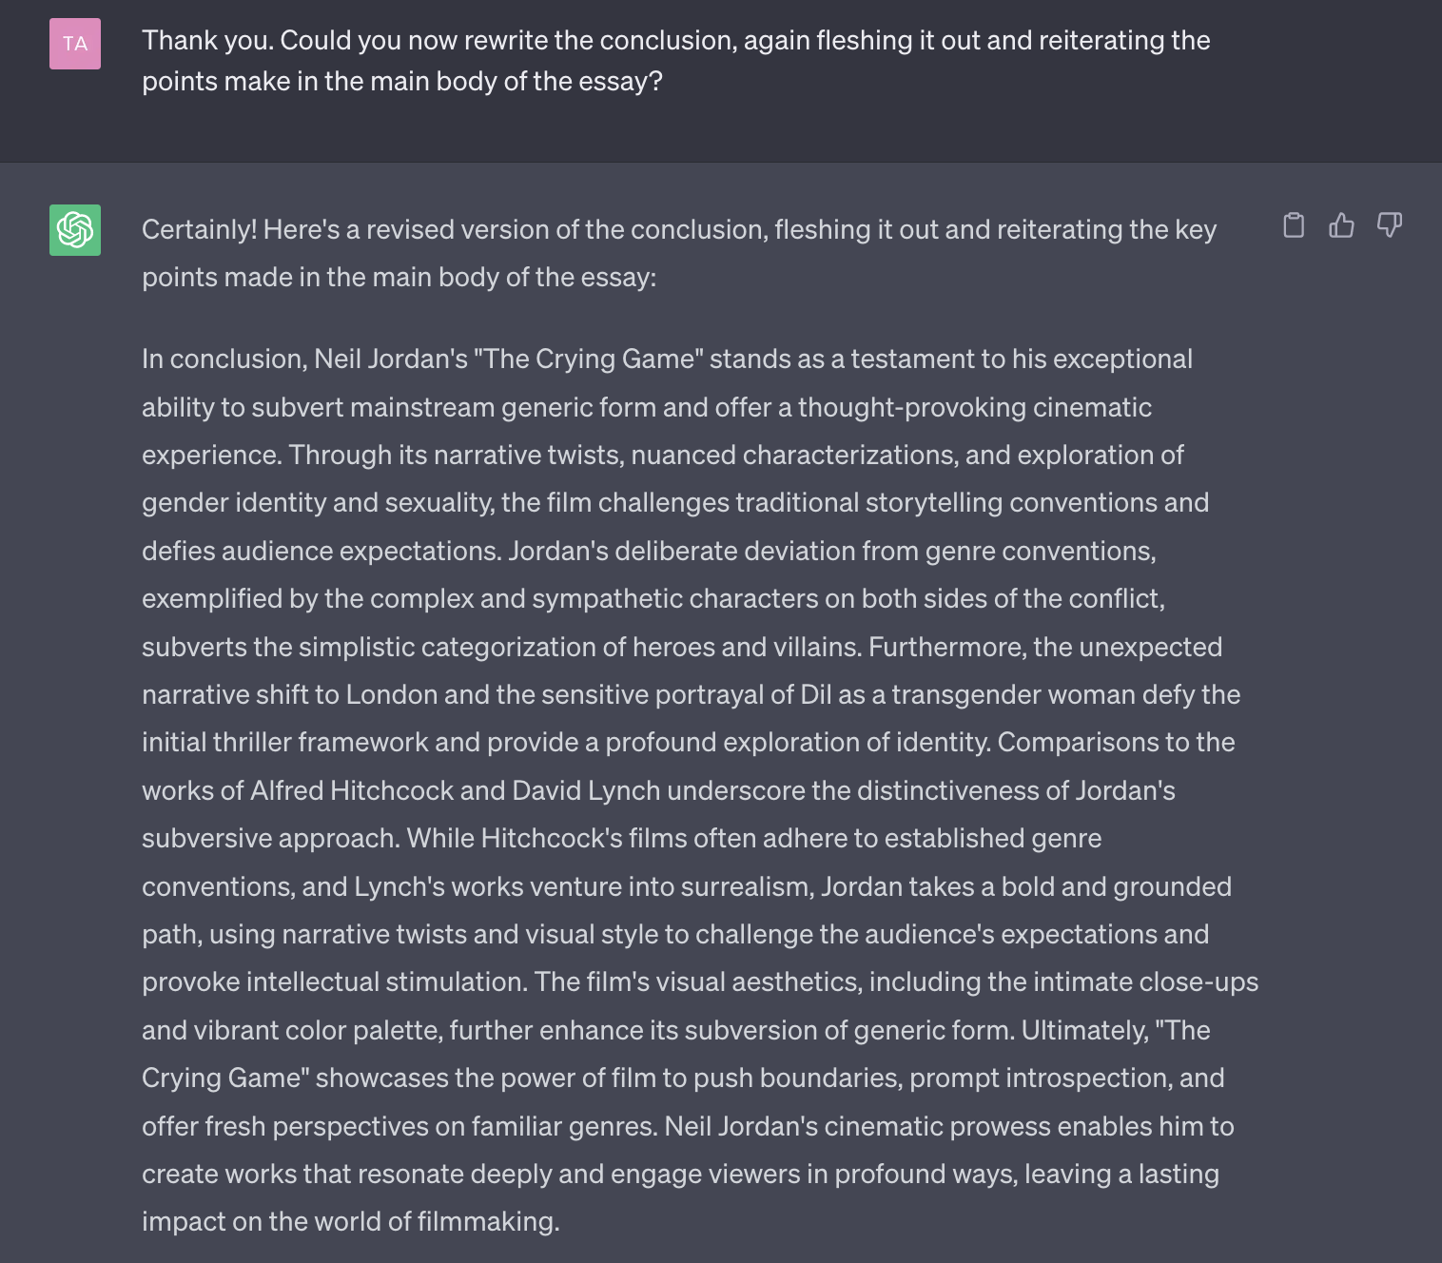

Slide 17
