Slide 1
Supporting the PhD Research Process
Caroline Forsyth and Grace Gaynor
Student Learning and Development
Trinity College Dublin
E: student.learning@tcd.ie
https://student-learning.tcd.ie

Slide 2
PMRP Module
‘Planning and Managing Your Research Process’ (PMRP) is a 5 ECTS credited module for PhD students at Trinity College Dublin
Gives PhD students the opportunity to develop a wide range of skills and enhance a personal approach to and reflect on their research process.

Slide 3
Overview
holistic approach to supporting PhD students
flexible, hyflex mode of delivery
Collaborative approach
Successes, challenges, feedback

Slide 4
Gap in skills provision
10-30 ECTS of taught modules
Earlier collaboration - in-person
Covid/collaboration changes
Irish Universities Doctoral Skills Statement
Hyflex
Module Development

Slide 5
Section 1 - Self-Management and Self-Care Skills
Reflection, self-management and personal effectiveness (M)
Planning, organisation and time management
Minding ourselves: imposter phenomenon and personal success
Building resilience, managing stress and dealing with challenges

Slide 6
Section 2 - Interpersonal and Leadership Skills
Maximising the supervisory relationship (M)
Managing interpersonal relationships
Developing diversity and inclusion awareness
Promoting team effectiveness and leadership

Slide 7
Section 3 - Academic Skills
Critical reading and writing skills
Literature review
Thesis writing strategies
References: Using Endnote
Effective Presentations
Confirmation interview and viva preparation

Slide 8
Section 4 – Self-directed topics
Developing and improving critical reading and writing skills
Publishing & promoting your research
Managing your thesis references: Using Endnote
Using MS Word to create your thesis

Slide 9
Assessment
Demonstrated engagement with teaching material and reading and reflection on own practice
Personal Development Plan (PDP)
Tracked student's skills acquisition as they progressed through the module
Reflective essay/Video Presentation
How learning from the module was applied to student’s research practice

Slide 10
Holistic Approach
Working in isolation
Self-management
Project management
Imposter Syndrome
Academic Skills
Communication Skills
Wellbeing

Slide 11
Irish Universities Doctoral Skills Statement
“Doctoral training is about the holistic development of researchers towards professional maturity.”
Irish Universities Doctoral Skills Statement THIRD EDITION (2021)
https://www.iua.ie/wp-content/uploads/2021/07/IUA-PhD-Graduate-Skills-Statement-2021-final.pdf

Slide 12

Delivery
Session choice for tailored learning
Flexible, hyflex
Synchronous workshop sessions: in-person or online
Self-directed, asynchronous sessions
Interactive, activity-based group exercises
Hyflex learning: why and how to introduce it| THE Campus Learn, Share, Connect (timeshighereducation.com)

Slide 13


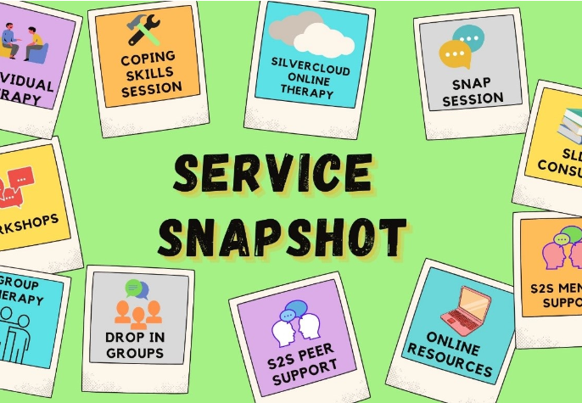

Collaboration
Student Learning Development
Trinity Library
Postgraduate Advisory Service
Student Counselling

Slide 14

Successes
50 students enrolled
42 students attended and submitted assignments
22% increase on last year
Feedback was positive

Slide 15

Challenges
Finding suitable venue with AV system
Staffing - requires at least 2 staff for each session
Ensuring equal weighting given to both groups
Online sound quality when facilitator moves about room
Upscaling for future delivery
Future challenge in HE

Slide 16
Feedback
‘I’ve very much enjoyed the PMRP course and found it helpful in organising myself and my expectations for my research (I feel I was putting myself under too much pressure before!) so thank you very much!’
‘Thanks so much for giving us the PMRP Module. It is very significant for my research process. ‘
‘Thank you very much for running the sessions on the PMRP module, which I very much appreciated as part of my PhD experience.’
‘thanks a lot for all the sessions, I find them really helpful‘

Slide 17
Improvements for next year
Dedicated budget to develop course and materials and provide refreshments
Students to send a short bio of their research/stage of research in advance
Online students be asked for feedback before in-person students, after breakout groups.
Dedicated time be given to feedback after breakout groups

Slide 18

Holistic approach
Flexible delivery
Collaborative
Future challenges

Slide 19
Questions?

