Slide 1

The Postgraduate Pushthrough
UCC Skills Centre
Éadaoin Regan
Email: eadaoin.regan@ucc.ie

Slide 2
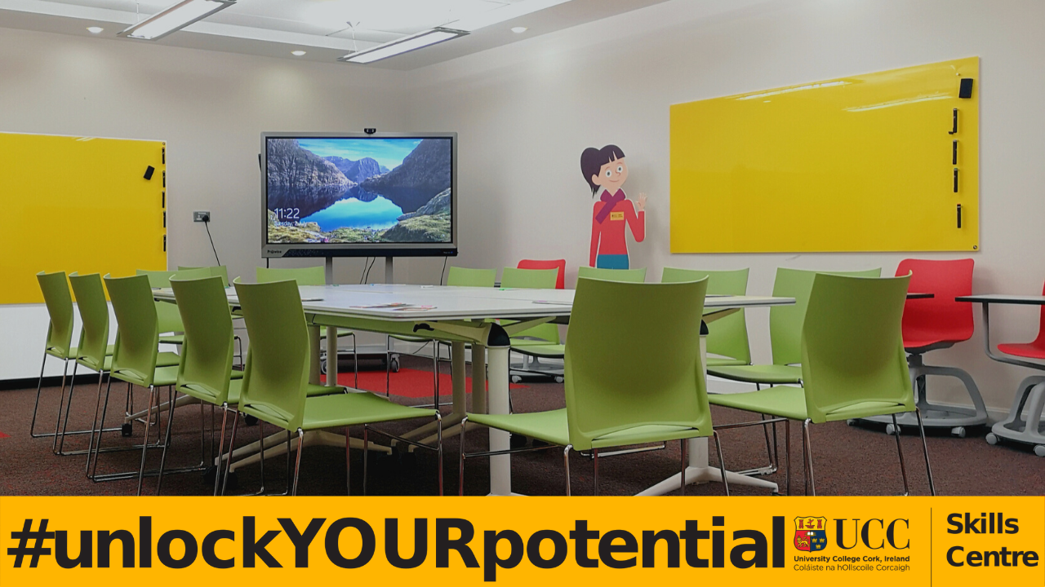
The Postgraduate Pushthrough:
Our Story
Concept
The Pilot Year: 2020/2021
Returning to Campus: 2021/2022
Surprising Outcomes: 2022/2023
Increased Demand

Slide 3

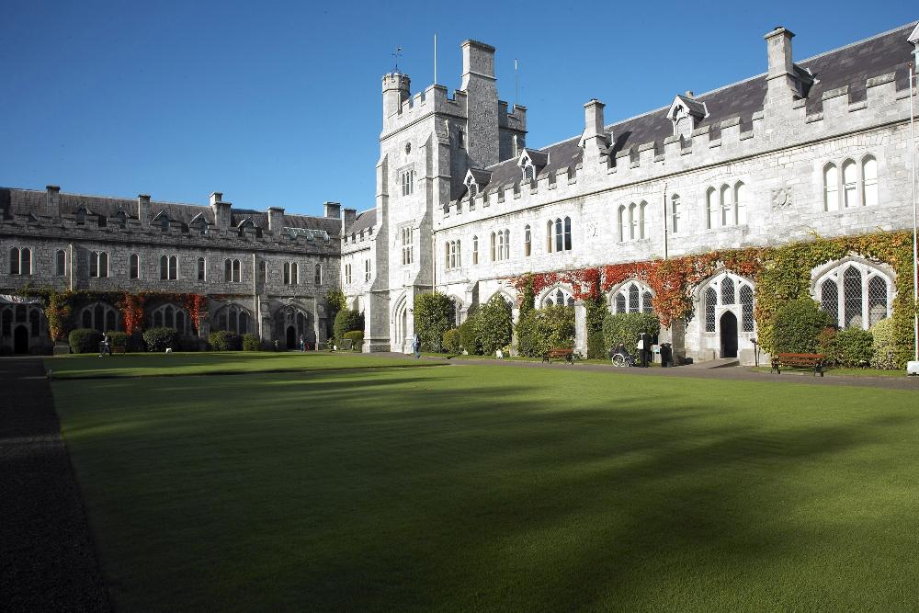


Concept

Slide 4


The Pilot Year: 2020/2021
Microsoft Teams, Mon 21st June 2021-Friday 25th June 2021
Initial Signup of 60 students. Between 12-50 attended throughout the week, with 32 students consistently attending at least one writing block per day
Attendees encouraged to manage own time throughout week
1.5-2 hour long writing slots with Pomodoro timer on screen
Students encouraged to keep camera on
Moderated by Skills Centre tutor for entire week

Slide 5
The Pilot Year: 2020/2021
Schedule
9.15-9.30am Goal setting for the day
9.30-11.00am Writing Block
11am Coffee Chats
11.15-1.00pm Writing Block
1.00-1.30pm Stamina Steps
1.30-2.00pm Lunch and Learn (Guest Speakers)
2.30-4.00pm Writing Block
4.00-4.30pm Reflection
Guest Speaker Topics
Managing your project and self
Academic writers block
Mindfulness in a PG degree
How to know when to stop researching
The final months: conversation with a recent phd student

Slide 6
The Pilot Year: 2020/2021
Day Two: I'm delighted so far, 6000 words down. Should have this chapter drafted by Friday!!
Interesting thing happened along the way ... I haven't procrastinated once this week. Not once! I haven't even longed for a distraction either, which in itself is magical. Every break I took either physically or mentally was mindful and purposeful within self-care. I simply can't tell you the last time I lived like this for a day never mind a whole week.
So glad to have decided to join this push through this week, I've really been struggling to come up with a routine that works for me and this week's structure has really been so helpful. It's been so nice listening to everyone's advice and stories on completing a postgrad degree and knowing we're not alone in any obstacles we face. Especially in Covid times, it's been hard to talk to other students and relate our shared experiences and be able to vent and relieve our stresses and worries. So I'm very happy that this study group will continue and I know that there is always a place to come back to regroup if needed
I would be delighted to continue with similar study group, as it has been really helpful. Even knowing how many words, or what areas I've actually covered has been really helpful. Also, I feel that my free time REALLY is free.
Will this group continue after this week? I'm in the final stages of PhD write up and would be up for continuing this on over the summer if others are as I've found the accountability and comradery helpful.

Slide 7
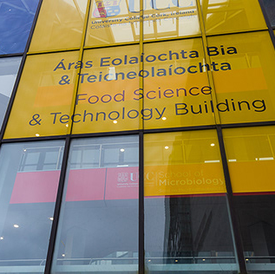
Returning to Campus: 2021/2022
Blended Event: Microsoft Teams and Campus
Digital Humanities Room (an open workspace) and simultaneously on Microsoft Teams from Monday 13th June – Friday 17th June 2022.
Room facilities allowed for continued contact and visibility between those attending online and in person
Realtime countdown clock on shared screen in the DHR and on Teams meeting to ensure everyone was on the same page
Camera equipment allowed for continued socialisation between those in person and at home
Catering of 2 coffee breaks and lunches provided for those attending in person

Slide 8
Returning to Campus: 2021/2022
Guest Speakers:
Daily habits for success
Managing your supervisor and you
Making the most of postgraduate modules
Group Workshop: Predicted vs Expected PG experiences
A conversation with 2 recent PhDs: ‘The Last Push’
Guest Speakers

Slide 9
Returning to Campus: 2021/2022
I would attend one every month if I could!
Support of being in the company of fellow research postgrads with structured goals … (e.g. what do I aim to complete this morning?) was tremendously motivating. Also, greatly appreciated the lunchtime speakers who clarified and advised on interactive structure between student and supervisor.
Such a successfully structured combination of individual work time and interactive student exchanges, along with excellent lunchtime speakers. Worked really well. Actually organising to have coffee and sandwiches at lunch-time together was a great idea. Thank you
Most importantly, being in the company of fellow research postgrads from a variety of disciplines was both stimulating and highly motivating.
It is very isolating working alone and it increased my productivity phenomenally to be part of a working group.

Slide 10
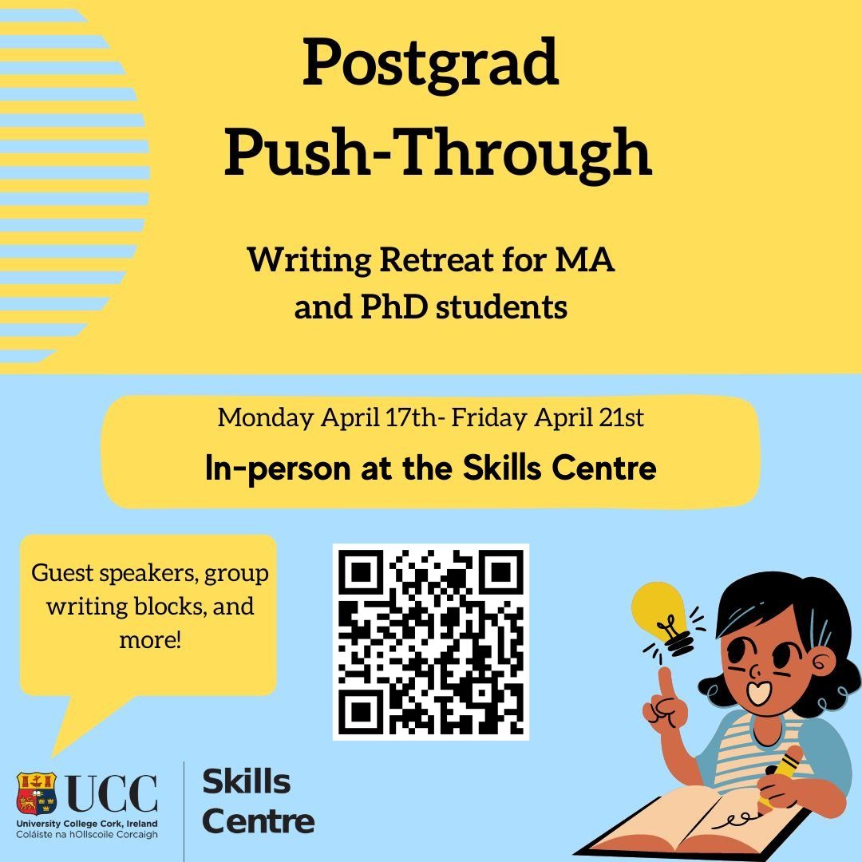
Surprising Outcomes: 2022/2023
Monday 17th April – Friday 21st April to help draw in more masters students as deadlines for projects across the colleges was end of April
Initially blended but moved to fully in person by Tuesday afternoon based upon demand
Capped at 23 due to room capacity
Fully catered: 2 coffee breaks and lunch every day
4 guest speakers instead of 5 as the discussion based sessions of previous year led by recent graduates were a huge success. 5th day was provided as a purely social lunchtime for this reason

Slide 11

Surprising Outcomes: 2022/2023
Guest Speakers
Time management during the summer months
Teaching as a postgraduate student: pedagogical concepts
Alternative academic careers
Perfectionism in graduate writing
Social lunch for attendees

Slide 12
Surprising Outcomes: 2022/2023
The PhD process is very isolating so it was great to feel that you were amongst your peers and to be able to engage in peer learning and support.
Supportive fellow research postgrads and facilitators reduced feeling of isolation and greatly helped motivate me to again focus on writing.
I'm thankful the Skills Centre exists and they continue to run exciting and innovative programmes and initiative such as the Postgraduate Pushthrough. it has undoubtedly enhanced my undergraduate and now postgraduate experience.
Feeling of isolation diminished greatly by being in such a supportive surrounding with fellow research postgrads.
Doing a research orientated post-graduate degree can be extremely isolating. It was so refreshing to be in a motivated setting with like minded students.

Slide 13
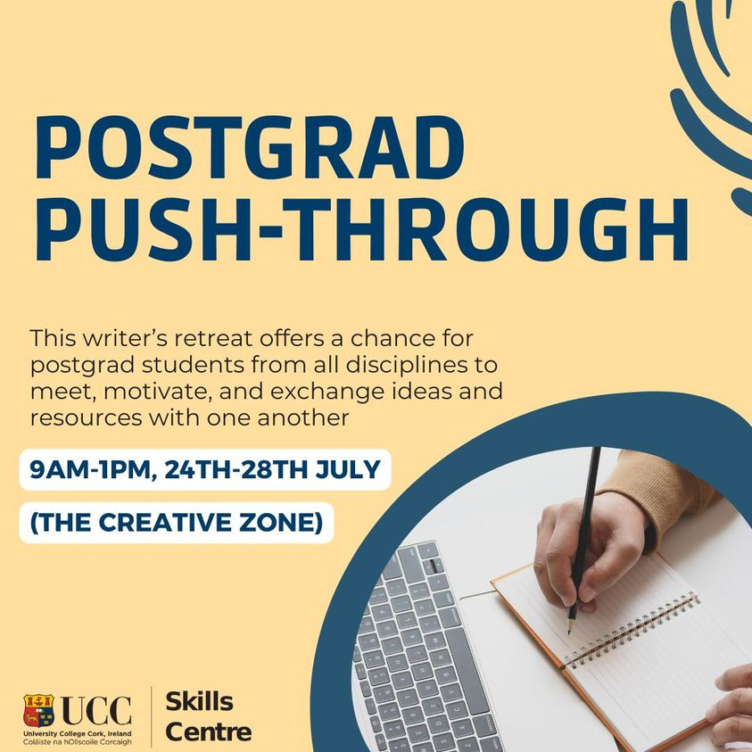
Increased Demand

