Slide 1
ICT- Digital Response
A University wide approach to support student's trough ICT support through COVID-19 .

Slide 2

Overview/Agenda
Access UCC – Laptop Loan Scheme Overview
With the onset of COVID-19 and the announcement by the Department of Further and Higher Education, Research, Innovation and Science announced the introduction of a scheme in September 2020, whereby undergraduate and postgraduate students may be eligible to receive a laptop, on a long-term loan, at no charge in order to assist with their online learning.
The Aim was to support students from lower socio-economic backgrounds, ethnic minorities, traveller students and other under-represented financially challenged backgrounds to overcome the obstacles of remote learning due to the global pandemic

Slide 3

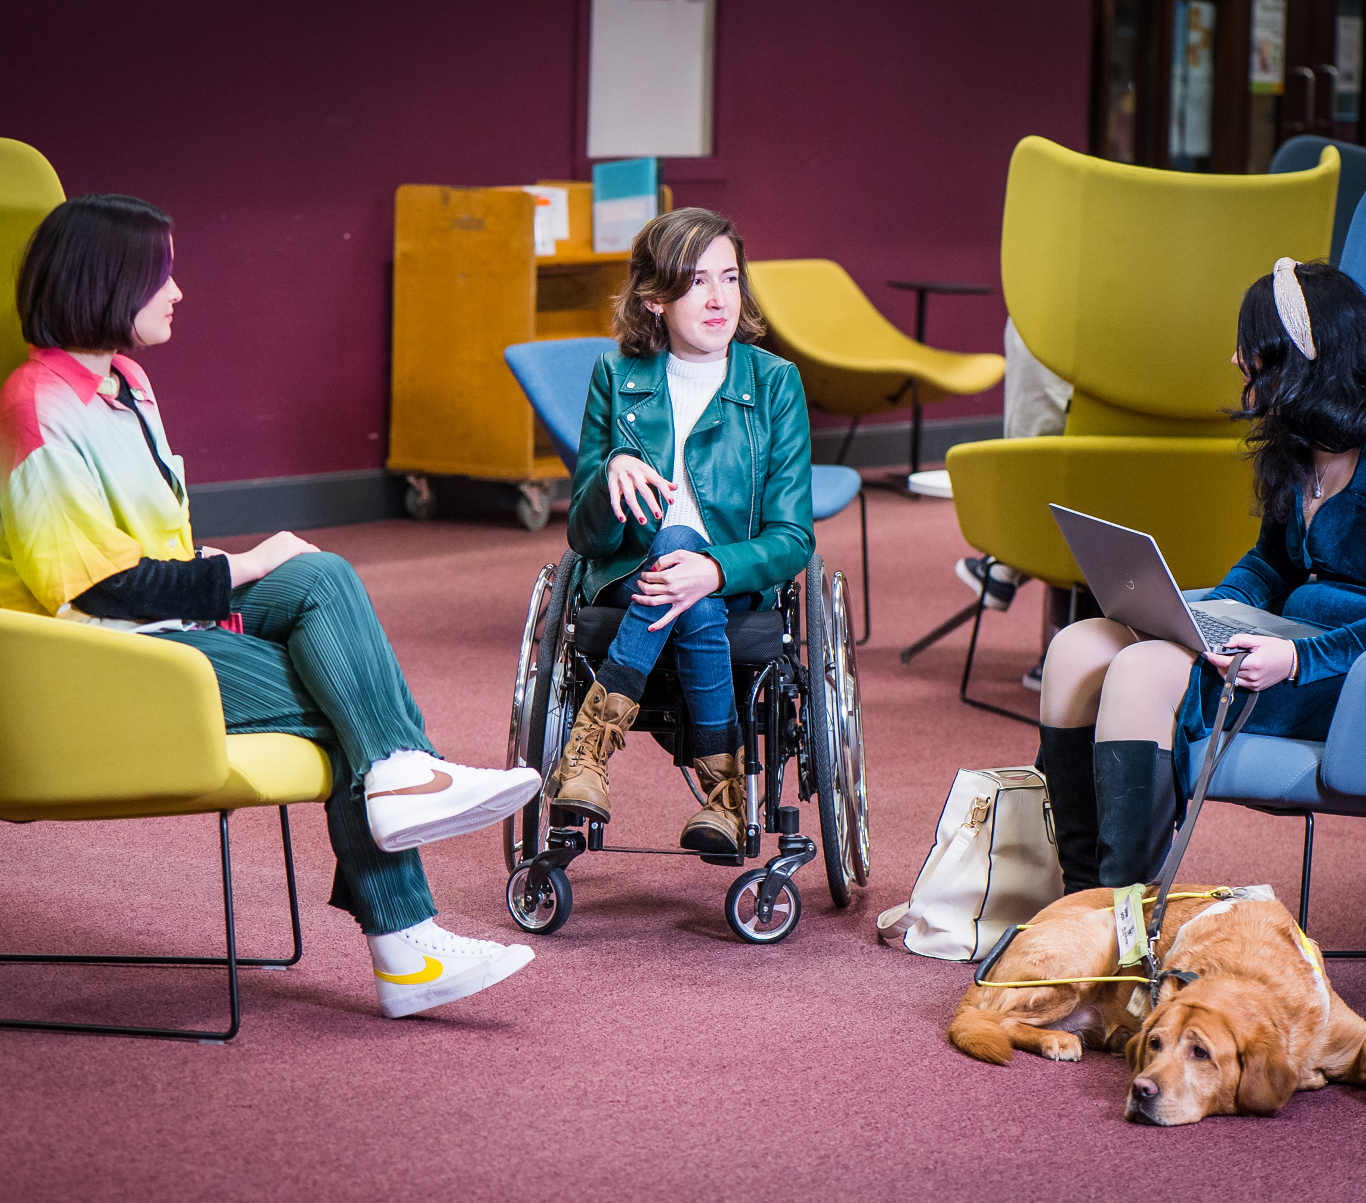


Intro Slide
In the Beginning
The Challenges:
Procurement/Types of devices
Developing a robust application process
Communications Strategy
Distribution Logistics
Repairs & Returns Policy

Slide 4




About Us/Overview
Access UCC
Procurement
The development of the Laptop Loan scheme spanned across multiple Department within the University.
IT Services/Security
Procurement
Students Union
Notes:
Working together with colleagues from Access, IT Services, Procurement & the Students Union, we came up with and outline of what types of devices would be required, how we would set about obtaining them (remember there was now also a global shortage on electronics).
In the 1st year 550 laptops, chromebooks & macbooks were purchased
The scheme has been topped up each year since with approx. 160 devices

Slide 5
Application Process
Used Cognito Forms to develop online application system.
Using skills and expertise from the Student Financial Assistance Fund Team, ensured that development and implementation of the Laptop Loan Scheme was pretty seamless and straightforward
Broadly used the SAF guidelines & assessment criteria to assess needs of non-HEAR Entry Route students
HEAR Student Entry Route automatic approval
Auto Approval for SAF awarded applicants
Notes:
We had good working knowledge of Cognito Forms as this was the system used for the Student Assistance Fund, we utilised the skills in this area, and once we had developed SOP’s for the programme, we developed and easy to use application form.
Students who entered through the HEAR entry route automatically qualified for a laptop loan, as by the assessment process for HEAR ensured they met the criteria of the Laptop Loan Scheme.
Any Student who had applied for SAF in the previous year and been awarded also automatically qualified, if they had a current SAF application in process, once this was finalised then a decision on the laptop loan would be decided

Slide 6
Communication Strategy
Students Union
While the HEA initiated a lot of external information about the scheme, however many students were unsure as to how it affected them.
Many departments within the University were utilised to disseminate information about the scheme.
UCC Media & Communications Teams
Student Assistance Fund Website
Access UCC Websites
Notes:
UCC Student Union – used their social media channels, e.g. twitter, Facebook, Instagram & their website
UCC’s media & communications team used their social medial channels
Access UCC & the SFSA office used their website, emails to all students

Slide 7
Distribution Logistics
In-person collection
Many different methods were adopted for laptop distribution
DHL Logistic
Student Experience Officers
Students Union Officers
Notes:
SSO – DSS, PLUS Programme, MSO & SU
DHL Courier for any student that could not make it to campus
In person collections through appointment booking, ensuring no cross over of people to keep in line with social distancing.

Slide 8
Repairs & Returns
Volume of Repairs
This was challenging as the time, cost and logistics of repairs was not fully addressed in the initial stages of the scheme.
Type of warranty required
Additional Accidental Damage – Yr 2
Returns Procedure
Notes:
Initial warranty was only the standard 5 year parts warranty for DELL
Quickly became apparent that the C-ports on laptops were not robust or reliable
Significant cost of repair
Resources required to assess returns & repairs and decide what could be fixed internally and what needed to be fixed externally

Slide 9



Slide with text/image background
Where we are Now
Robust Process
Resourced Scheme
Increased Return Rates
Ongoing Challenges

Slide 10
Robust Application Process
Streamlined Application Form
As the programme evolved each year, adjustments were made to the application process, to ensure ease for students
Accessibility Checks
Phraseology and use of plain understandable English
Full-Time Resource assigned
Notes:
The application form was reviewed and any changes addressed to ensure the form was accessible and comprehendible for students.
Programmes were used to ensure that the English used was easy to understand and straight forward. (challenges came when we used specific terminology that was clear to us practitioners but not necessarily clear to students)
A full time resource was assigned to the scheme. It became evident that the volume of work in running and maintaining a scheme of this size would need to be resourced.

Slide 11
Infographic slide 3
Increased Return Rates
20/21
21/22
22/23
79 Due to be Returned
108 Due to Be Returned
215 Due to be Returned
15%
95%
43%*
*this is only for part of the 22/23 year, laptops are still being returned by students and all laptops are not due back until August 2023.
Notes:
It must be noted that in the 20/21 Academic year there was no full-time resource on the Programme hence the extremely low return rate.
From 21/23 a resource was incorporated into the office and time divided 70/30 between Laptop Loans & SAF.
The return rate for laptops significantly increased once a resource was put in place to manage it.
The return rate for this year is looking positive, however it should be noted, that a lot of returns in 21/22 came from the 20/21 academic year. The team member spent a large amount of time following up and contacted students who should have returned devices in 20/21.

Slide 12

Slide Break
Ongoing Challenges

Slide 13
Slide with boxes
Funding
Resources
There is always a concern around funding:
Initial Funding was large & not included in Capital Funding.
Ongoing nature of inclusion in Capital Funding
Where will it Come From
How Long will it be in place
What happens should it be cut
Resources is a constant challenge for every HEI.
Ensuring full resources are available to manage the magnitude of the scheme year on year.
Ongoing Challenges

Slide 14
Thank You
Get in touch
The Hub, Main Campus, UCC.
Thank you
ucc.ie/en/sfsa
deirdre.falvey@ucc.ie

