Slide 1


Trinity Access
​Increasing participation in education by students from under-represented groups
Jen Maguire Donohoe

Slide 2



Provost Dr Linda Doyle
Every time I see a group of students pass through Front Square, I imagine what is possible. I imagine the lives and opportunities that lie ahead of them. If we can help support those students through university, if we can help them overcome the challenges they face and removed the financial and economic barriers that are blocking them, imagine the impact that they could have on the economy, on society, on health care – on the world.
Trinity College Dublin, The University of Dublin

Slide 3

30 Years of experience and growth
2022 in numbers
17,179 Primary and Secondary school students engaged
1,215 teachers engaged
67 School Partnerships
150,000 participants in College Awareness Week
222 undergraduate scholarships awarded
Trinity College Dublin, The University of Dublin

Slide 4



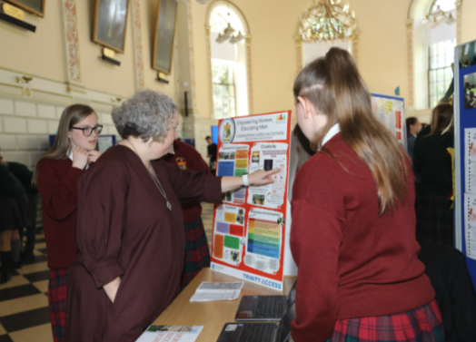


Nurturing Potential
Trinity College Dublin, The University of Dublin
4

Slide 5
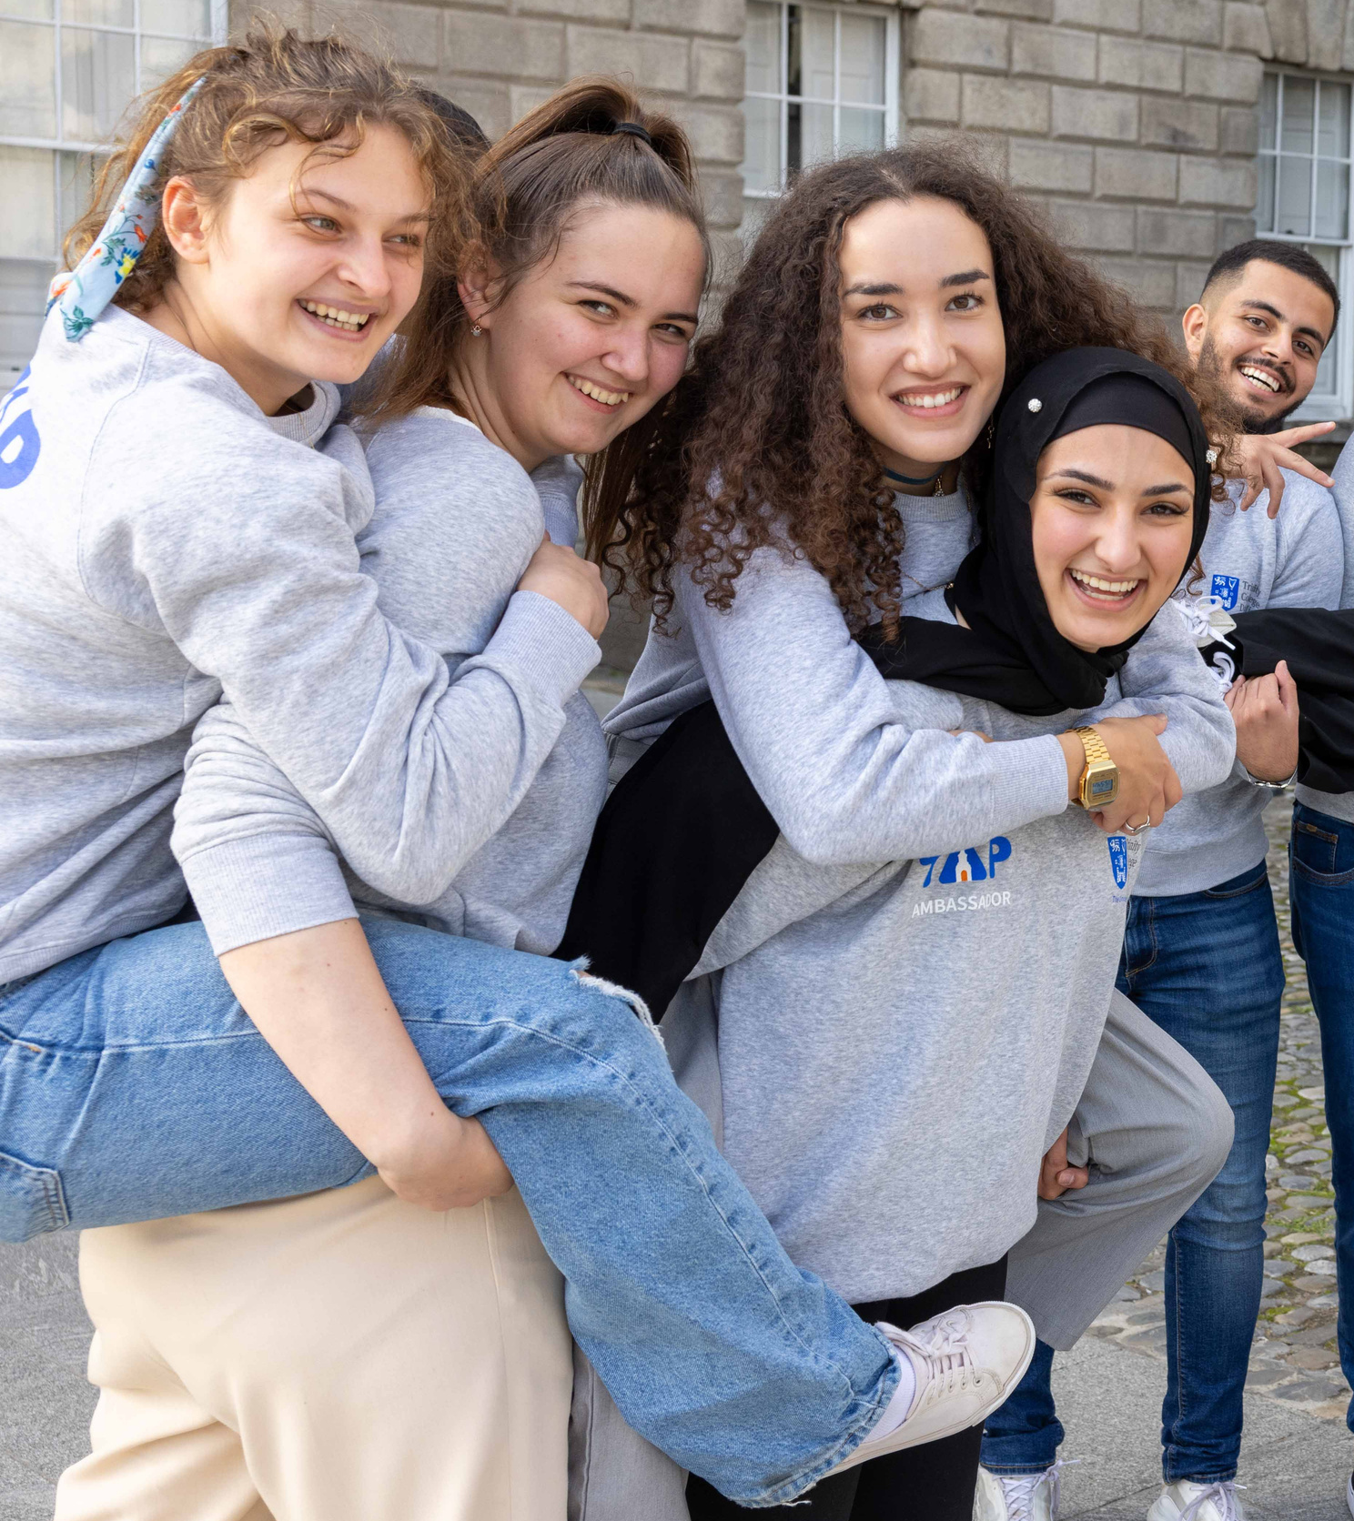




Undergraduate 2023 evaluation
873 undergraduate students invited to complete a survey designed on Qualtrics.
216 responses consisting of students from each year group:
1st (36%)
2nd (25%)
3rd (21%)
4th (17%)
5th (1%)
Topics included:
Student bio
Use of student supports
Academic experience
Financials
Accommodation
Employment
Trinity College Dublin, The University of Dublin
5

Slide 6
Undergraduate 2023 evaluation- Parental third level obtainment
Trinity College Dublin, The University of Dublin
6

Slide 7
Undergraduate 2023 evaluation- Working during the academic year
Trinity College Dublin, The University of Dublin
7

Slide 8
Undergraduate 2023 evaluation- Engagement with college supports
Have you engaged with the following areas during the last academic year?
Trinity College Dublin, The University of Dublin
8

Slide 9
Undergraduate 2023 evaluation- Academic skills
Do you have issues with the following areas of your studies?
Trinity College Dublin, The University of Dublin
9

Slide 10
Undergraduate 2023 evaluation- Accommodation
Trinity College Dublin, The University of Dublin
10

Slide 11
Undergraduate 2023 evaluation- Withdrawing from college
Trinity College Dublin, The University of Dublin
11

Slide 12

Undergraduate 2023 evaluation- Actions
Further analysis of family college attainment amongst our cohort
Incorporate skill development sessions into our Pre University Orientation programme eg note taking, time management etc
Explore additional financial wellness training
Continue to actively fundraise for scholarships so students can work less hours
Coordinate with the Student Union to sign post their Accommodation Advisory Service and highlight more affordable accommodation options
Continue to advertise campus wide supports and encourage students to utilise the interventions available to them
Trinity College Dublin, The University of Dublin
12

Slide 13
Thank You

