Slide 1



Using the VLE to Assess Student Engagement and Enhance Student Supports
Dr Niamh Nestor, UCD Student Adviser based in UCD Veterinary Sciences
SAI Summer Seminar in ATU Galway
June 13, 2023

Slide 2

Outline
UCD LEAP and its origins
Design and implementation
COVID-19
VLE design changes
Key findings
Lessons learned and the future

Slide 3
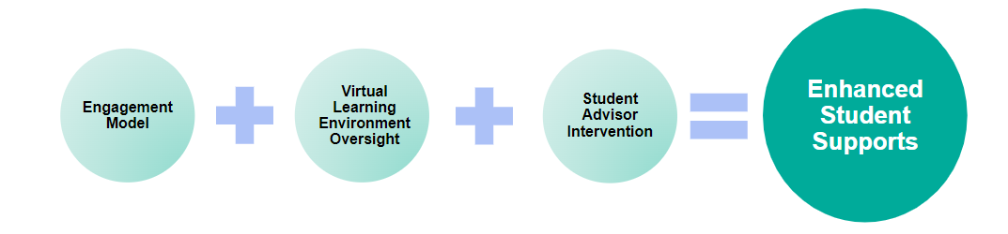
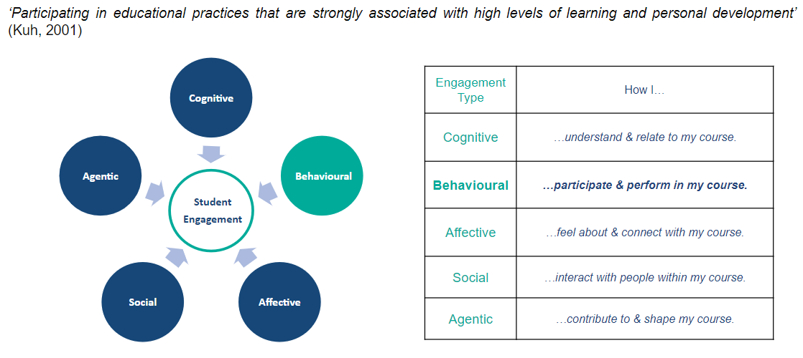
Notes:
The main aim of the LEAP is to help students transition to HE, specifically by linking analytics with student supports. The approach we’ve taken is to develop a broad model of engagement and developing a system informed by RT data which monitors prog. level engagement by students.
The desired outcome is to enable proactive targeted interventions specifically by student advisers
Our model recognizes engagement as multi-faceted. External factors can negatively impact any of these elements of engagement and it can be challenging for institutions to have visibility of these areas. However, universities have an opportunity here to use a behavioural engagement marker, like VLE data in our case, to gain insights into other aspects in real time, and this informs our intervention activity.

Slide 4
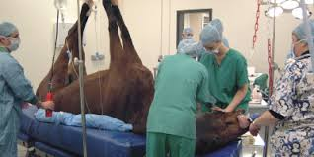
Origins of UCD LEAP
C. 200 annual intake of 1st years
30% approx. international
Top 50 QS World Subject Ranking
AVMA, EAEVE, VCI accredited
Classroom and practical components
Intense workload; high demand on time; perfectionism
Notes:
Classroom and practical components – even with a dedicated adviser, challenges maintaining visibility of engagement overall, which we’ll move on to talk about now.

Slide 5
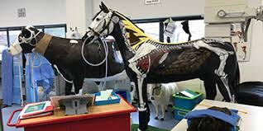
Origins of UCD LEAP
Support delivery concerns
Supportive environment but ongoing concerns in the profession about wellbeing
Disengagement: apparent after exam results
Difficulty re-engaging students
Existing supports underutilised
Changes needed
Real-time engagement information needed
Linking support interventions to data
More immediate and targeted support
Signposting generic and tailored supports
Notes:
This project began as a result of some of the issues listed here on the left.
Outside of certain FTP concerns, attendance isn’t strictly mandatory – UCD academic regs. Positive that autonomy is encouraged.
Post exams – point at which it’s challenging to remediate grades and re-engage students, etc. Existing supports are also underutilised in these scenarios. Any interventions are possibly not as effective as they would be using RT data.
The idea of the project was to use RT attendance data to help engage and enable proactive interventions by student advisers when potential disengagement occurring. The hope was that getting RT programme level visibility in place would positively affect student wellbeing and increase use of supports and avoid the use of supports too late to have a positive impact.

Slide 6
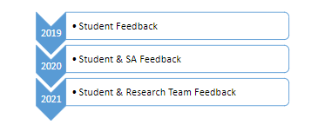
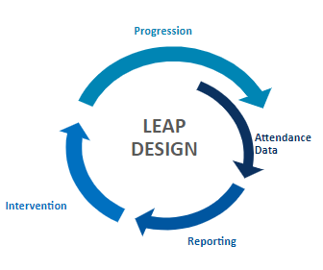
Initial plans
Initial design: Bluetooth attendance data smartphone app
Interventions commenced; ‘at-risk’ students identified
Underpinned by Self-determination Theory
Preliminary data confirmed relationship
Setup issues; embedding issues
Consistent attenders? Support gap
Notes:
After an initial pilot study, here is how the project looked from a design point of view.
Explain the way it worked – students identified as at risk were contacted by the SA.
Initiative underpinned by SDT – student autonomy with the app being self-populated and students encouraged to self-reflect
The project had a long timeframe; ensure value add – regular feedback gathering was embedded into the project with the goal being to adjust interventions and supports offered in response to emerging student needs.
Here’s how it went!
The system was adopted for about 300 students over stage 1 and some from stage 2. Bluetooth beacons in 50 classrooms facilitating check-ins for the entire timetable.
Most importantly, student receptivity was high; GDPR concerns were resolved. The students could see the value add; it was also very valuable for the SA who could track attendance at a prog level and offer targeted RT support which more than likely would not have otherwise been delivered.
Preliminary findings confirmed a relationship between flagged students and lower GPA outcomes.
Some concerns – how to make sure those not flagged were also receiving information on supports

Slide 7

Student feedback and changes
“Trusted persons” sought out
Light-touch, check in: ‘How are things going for you? I’ve noticed…’
Generic supports regularly signposted
VLE as a key engagement source
COVID-19? Loss of 1000s of data points
Qualitative feedback indicated students supported early warning systems and interventions → needed to try to maintain the work
Notes:
In terms of student feedback, the project reflected previous institutional findings – they preferred seeking out trusted persons as a first point of support as opposed to seeking out more specialized supports
First flag was adjusted to be as light touch as possible – some concerns around disciplinary; supports regularly signposted; VLE flagged as a key engagement source – important and fortunate given what happened next!

Slide 8
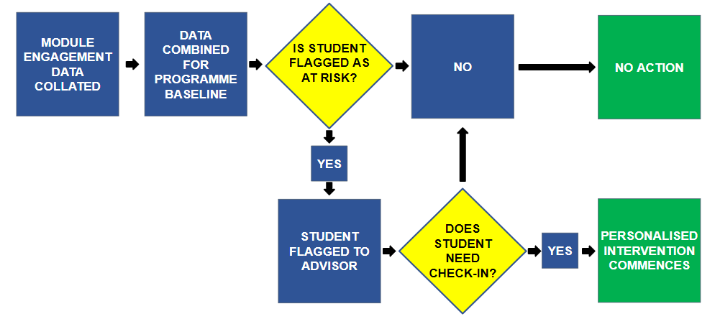
VLE design – programme view Login frequency and total topic access
Notes:
Looking at how we intervene and support, we collect online module data and combine it together to get a baseline total engagement across all classes. Based on this analysis, a report is created that includes all students flagged as potentially at risk.
The advisory staff assess – check in or not?
This ensures emerging issues are addressed earlier in the student journey reducing the likelihood any problems compound over time

Slide 9
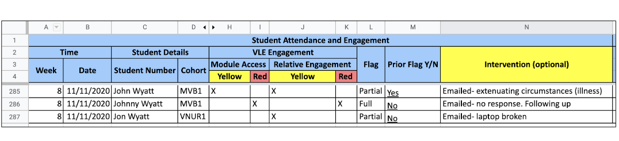
Automated reporting

Slide 10
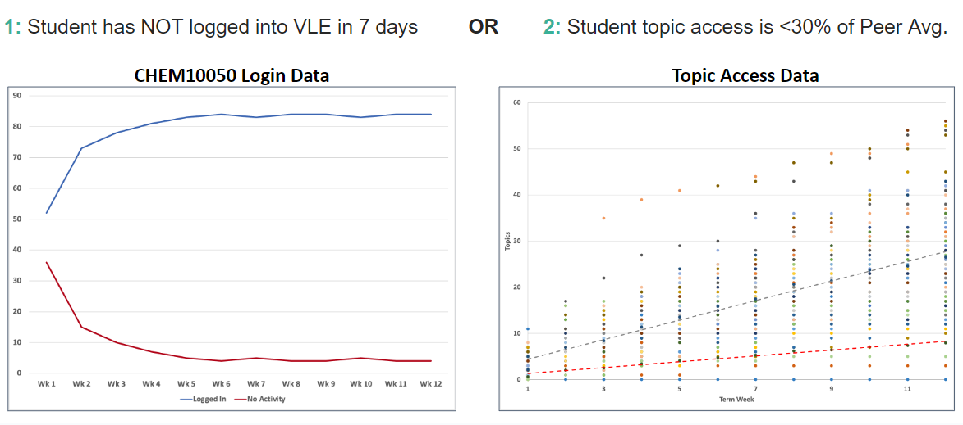
How do we flag students?
Notes:
We use 2 criteria as seen here. Not logged in for majority of modules; secondly topic access less than 30% - below the average for other students in their programme. Together, these flags help to pinpoint which students are at risk of disengaging

Slide 11
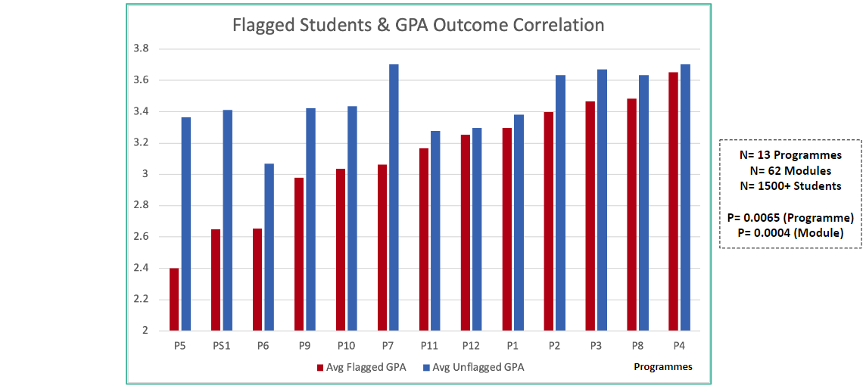
How do we identify disengagement?
Notes:
Looking at effectiveness, through an analysis of GPA outcomes, we can see a clear link between flagged students and lower GPA, demonstrating we are targeting relevant students.

Slide 12
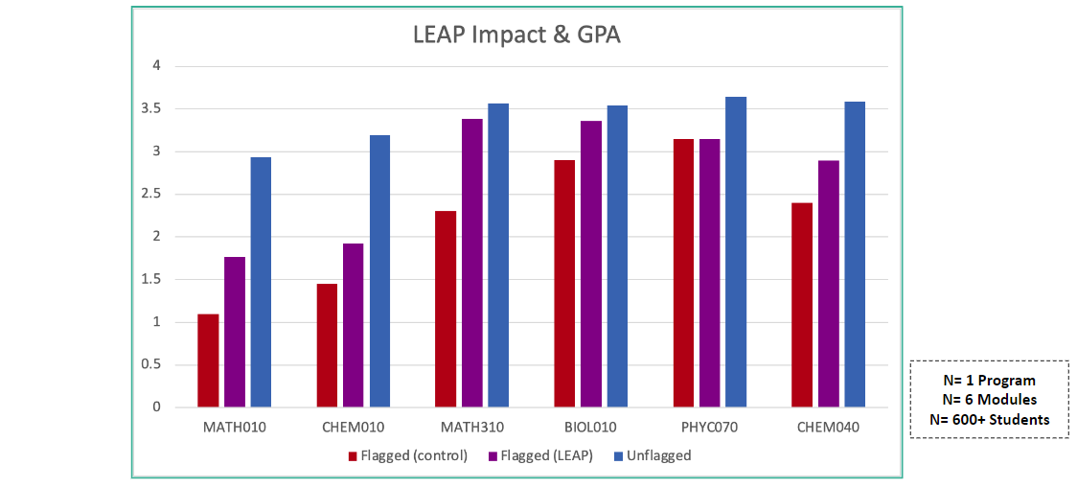
Is our impact positive?
Notes:
Additionally those that were flagged and availed of support interventions had higher GPA outcomes than not which shows the positive impact of analytics informed interventions by advisory staff

Slide 13
Key challenges
VLE adaptations to reporting
Reports needed to remain GDPR compliant
Roll-out and scalability → mainstreaming always a key aim (Arts &Humanities, Science, Social Sciences)
University-wide availability
Scope to review longitudinally
Notes:
Needed to remain GDPR compliant while still retaining enough actionable data for interventions which could then be replicated

Slide 14
Key challenges for Student Affairs
Resources
Time and timing
Student perceptions
Interventions – may not see immediacy of response
Remit/boundaries

Slide 15
Thank you!
CONTACT
Email: niamh.nestor@ucd.ie
LinkedIn: https://www.linkedin.com/in/niamhnestorucd/

Slide 16
References
Black, A. E., & Deci, E. L. (2000). The effects of instructors' autonomy support and students' autonomous motivation on learning organic chemistry: A self-determination theory perspective. Science Education, 84(6), 740–756.
Kinsella, M., Nestor, N., Rackard, S., Last, J. & Wyatt, J. Using Attendance Analytics as a Motivational Tool for First-year University Students: The Live Engagement and Attendance Project (LEAP). The European Conference on Education 2020 (ECE2020), 16th-19th July 2020 University of London. IAFOR.
Kinsella, M., Wyatt, J. & Nestor, N. 2021c. Responding to Acute Changes in Higher-education Engagement: Insights from UCD ‘Live Engagement and Attendance Project’. Ireland International Conference on Education (IICE 2021). Dun Laoghaire, Ireland.
Kuh, G. D. (2001). Assessing What Really Matters to Student Learning Inside The National Survey of Student Engagement , Change: The Magazine of Higher Learning, 33:3, 10-17, DOI: 10.1080/00091380109601795
UCD Agile: Mapping our Student’s Experience of UCD – Executive Summary: https://www.ucd.ie/agile/whatagiledoes/mappingourstudentsexperience/thestudentperspective/

