Slide 1



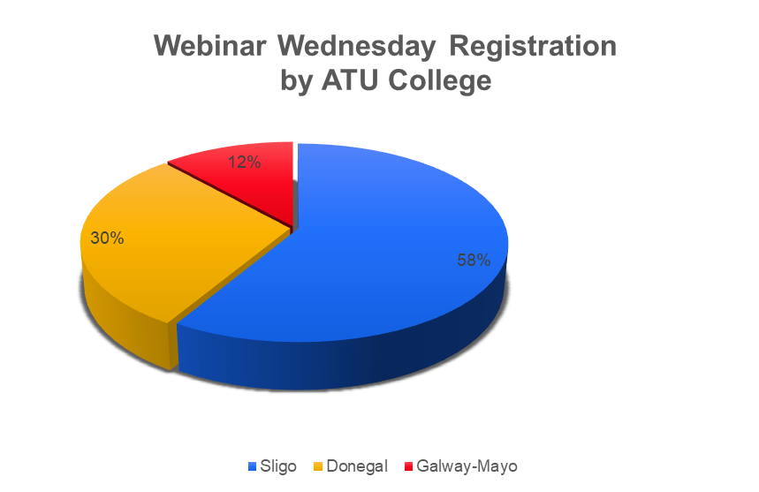

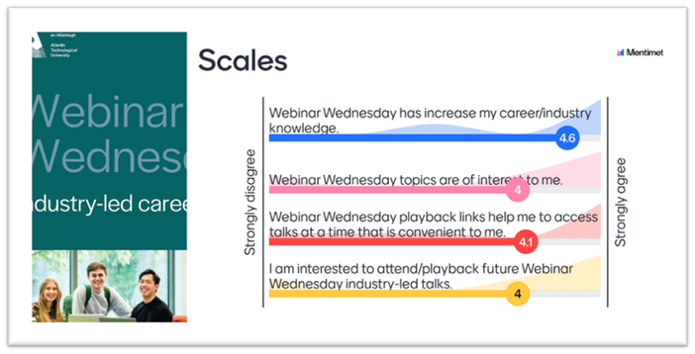
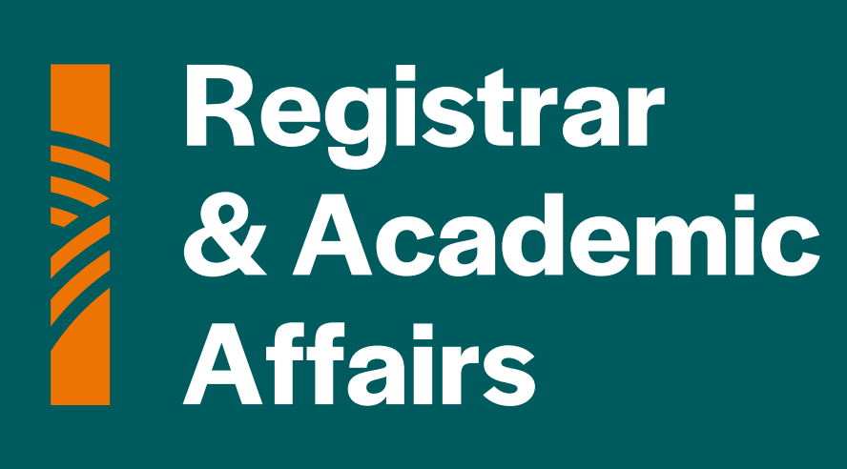

Webinar Wednesday
ATU Industry-Led Careers Series
Providing all ATU learners with the opportunity to grow their industry and employability knowledge and to extend their professional networks in an accessible, cost effective and sustainable format.
Supervisor name
PMSS:
ATU Careers Service
Careers Officers:
Catherine Lyster
Fiona O’Donnell
Adette Ring
Deborah Seddon
Companies:
Background
The ‘Webinar Wednesday’ concept was conceived in 2020 as a direct response to the pandemic to provide an online platform for industry and cohorts at the Institute of Technology Sligo ‘to connect’ whilst campus-based activity was restricted.
Rationale
Atlantic Technological University (ATU) was established on 1st April 2022. Rolling out ‘Webinar Wednesday’ ATU-wide provided a platform for Careers Practitioners to collaborate with a common purpose. A key objective was to find sustainable and streamlined solutions to unite learners from all campuses in their career exploration and development.
Alchemy Tech
All State
CIMA
Colas Ireland
CPA Ireland
Dell Technologies
Enterprise Rent a Car
ER & M
For Purpose
Gradcracker
Grant Thornton
Innopharma Technical Services
Intertrade Ireland
Jameson Graduate Programme
JET
Job Trust
Leicestershire Partnership NHS Trust
Musgrave
Procloud
Regeneron
SOTI
TCS/Tata Consultancy
Teaching Council
University of Galway
USA Summer Camp
USIT Travel
Vodafone
Washington Ireland Programme
Careers Officers
Design
ATU ‘Webinar Wednesday’ has been collaboratively developed to optimise impact, reach and relevance with minimal/no cost implications. Webinars are scheduled in late afternoon at the same time each week and limited to 30 minutes. Webinars are delivered via MS Teams and subsequent recordings are uploaded and edited via Panopto. Playback links are available via Visual Learning Environments. Registration is captured via ATU College, as is attendance. Presenters express their interest via Eventbrite, and assessment is made in relation to topic suitability prior to booking confirmation.
atu.ie
Student Voice
Student voice is central to the philosophy and students are encouraged to suggest topics and presenters. Essentially 92% agreed webinars had increased their industry knowledge and 80% agreed webinar topics were of interest to them. On a practical level 82% agreed the timing of webinars was convenient and importantly 80% agreed they were interested in attending future webinars and/ accessing playback.
Most Popular Webinar: CV and Interview Workshop with Dell Technologies – 124 registrations.
Evaluation and Conclusions
During academic year 2022-23, 28 companies delivered 34 webinars, saving >50,000km in travel. There were >1000 registrations and 43% joined live sessions. 95% of webinars were available to playback and >100 playbacks have been captured to date.
Webinar Wednesday offers a cost-effective, accessible, and sustainable solution to the challenge of multi-campus industry engagement.
Faculty
Head of Department
ATU Sligo

