Slide 1
myATU
Judith Frazer-Klug

Slide 2

Journey towards myATU
How we got here
01
N-TUTORR Prototype
2025
02
TSAF funding received
2 roles created
03
Kick-off October 2025
Focus groups, student surveys
04
Agreed scope & began build
Iterative testing throughout
05
Soft Launch
April 2026

Slide 3

“I struggle to "keep up" with what events are happening in the university on certain days due to the amount of emails I get”

Slide 4

“Assignments and timetables are awful to access as you have to click into so many links to actually get to the regularly used links”

Slide 5

“Make the timetable better formatted and customised to the fit my phone”

Slide 6
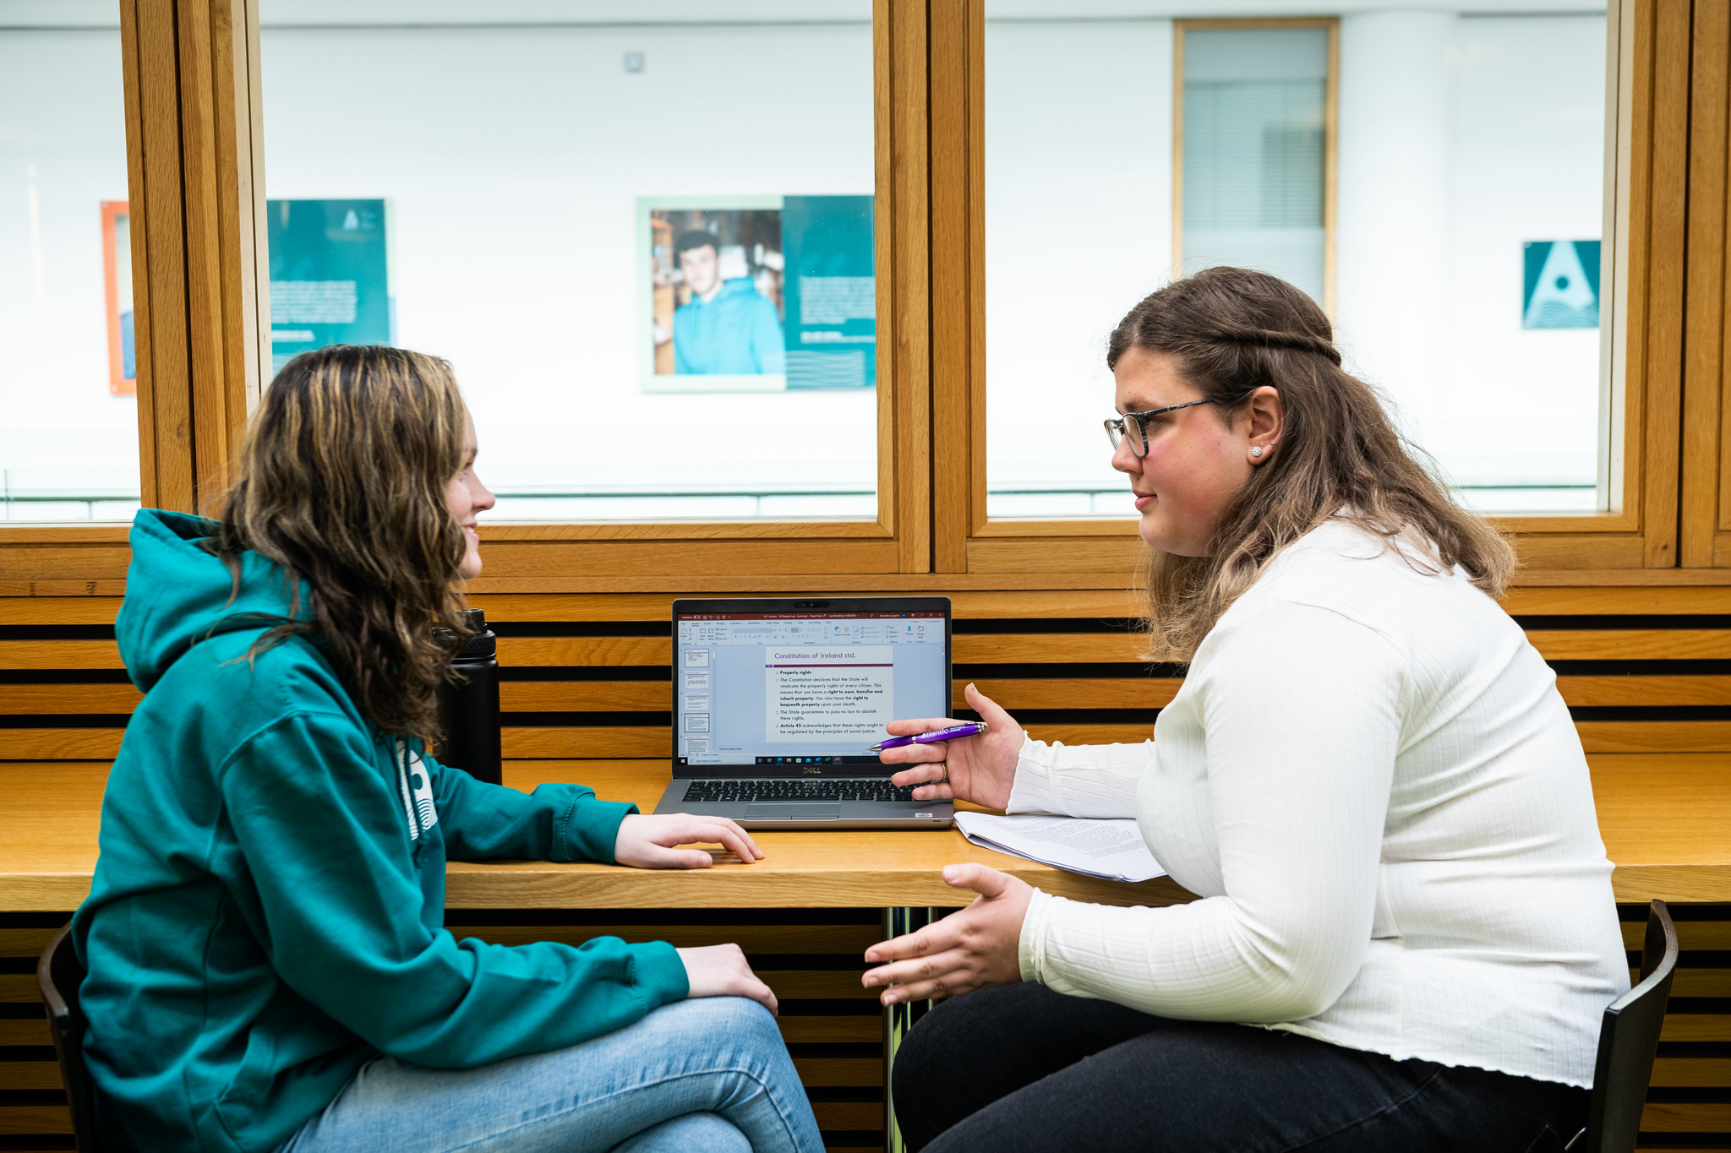
“Exam results have a strange layout, print layout of timetable is not available therefore you have to have two screenshots”

Slide 7
Biggest pain points for students…
Loading Times & Slow Performance
Navigation & Usability Issues
Timetables & Scheduling
Platform Fragmentation
Information Overload & Communication
Login & Authentication

Slide 8


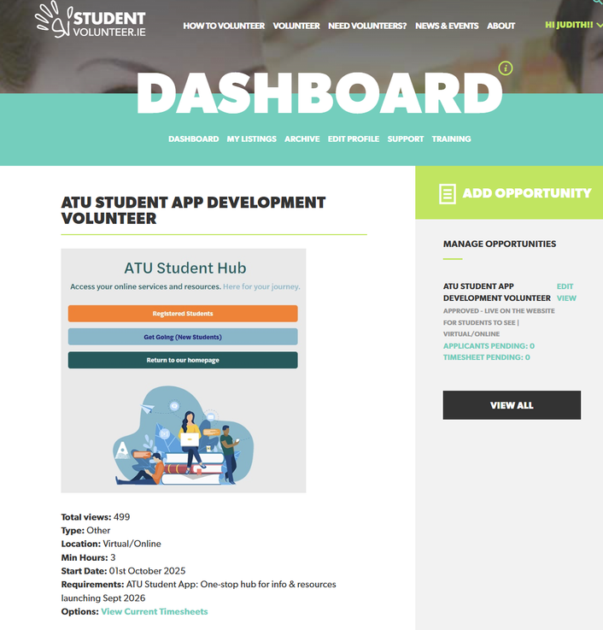
Student partners

Slide 9
Our technology landscape
Banner Student Information
x3 instances
atu.ie
StudentHub
SharePoint
Timetabling
x3 instances
Exams scheduling
x3 instances
Microsoft Fabric Data Lake
Manual uploads to myATU

Slide 10
Our scope for Phase 1
3
Campus life
  Campus Maps
  Events Calendar
  Social media feed
  Campus notices
4
2
Academic
Critical comms
  Live timetable
  Exams schedule
  Exam results
  Targeted notifications
1
Admin
5
  Registration Status
  Digital student ID card
  Email & calendar
  One Drive files
  Onboarding wizard
Commuter resources
  Transport connections feed

Slide 11



Slide 12
Future Developments?
2
Timetable
functionality
1
Native app
  Native App for Android & iphone
  Push notifications
  Assignment deadlines
  Map integration to timetable locations
  Cancellation or room change notifications
3
Student Life
  Canteen menus
  Digs listings
  Student Discounts
  Food Pantry bookings
  Clubs & socs activities
  Sports classes
  Car-pooling
4
Support
  Appointment bookings with student services staff
5
Admin
Student Voice
6
  Study Room Bookings
  Library search & reserve
  Student Surveys

Slide 13
Thank you, any questions?
Judith.FrazerKlug@atu.ie

