Slide 1

Pre-Entry Engagement in Practice:
Informing, Advising and Preparing Students for Higher Education

Slide 2
Presentation Overview
Access & Outreach
PATH 3 (Programme for Access to Higher Education)
Taste of TU Dublin
Taste of TU Dublin Evaluation
Resources
Preparation Days for Mature Students

Slide 3
Access & Outreach
The Access and Outreach team works across all five TU Dublin campuses to widen participation in higher education.
It supports local communities and underrepresented groups in line with national and university strategies.
The team delivers activities to remove barriers and create alternative pathways.
It builds strong partnerships with schools, FET, and community organisations.

Slide 4

Taste of TU Dublin
Taste of TU Dublin was developed as part of the PATH 3 (Programme for Access to Higher Education) initiative, which aims to increase participation in higher education among underrepresented groups.
The event typically includes:
Informative presentations on higher education pathways
Taster lectures or interactive activities
Student voice sessions, providing first-hand insights
A campus and library tour to give participants a realistic sense of university life

Slide 5
Participants 2021-2026
Academic Year | Number of Community Partners | Number of Participants
2021-22 | 1 | 10
2022-23 | 5 | 67
2023-24 | 8 | 151
2024-25 | 8 | 171
2025-26 | 11 | 209
Total | 33 | 399

Slide 6
Taste of TU Dublin - Evaluation
The aims of the evaluation were to understand if…
  the content meets the needs of the individual participant and of accompanying staff.
  attending had an impact on the participants decision to progress towards higher education.
  participating in a session had an impact on the participant’s community.

Slide 7


Methods
Data Collection
Data Analysis
Thematic analysis
evaluation questions
13 Qs
n = 197

Slide 8

Theme 1 - Information
financial supports
funding options
  (international protection applicants and other migrants)
clarity
delivery
amount
addressing any questions

Slide 9

Theme 2 – Progression & Pathways
lack of understanding of higher education
how to choose a course and/or a university
tips for applying to university
range of entry routes
how to make the next step in their education journey

Slide 10

Theme 3 – Preparation & Improvements
Choice of subjects and information sessions
length of the event
lack of childcare/transport to attend the event
delivery of event (online v in-person)
timing of event (day v evening)
advertising of the event
participants’ level of English.

Slide 11

Theme 4 – TU Dublin
TU Dublin’s
  courses
  campuses
  student supports
  meeting lecturers

Slide 12

Theme 5 – Breaking Barriers
approachable staff
current students' voices
lecturers' own education journeys
on-campus experience
learning about university life
knowing what to expect
desire to share knowledge gained with family and friends

Slide 13

Theme 6 – Environment
room comfort and suitability
sound quality
the balance and pacing of content (including breaks and variety)
staff friendliness and support
quality of refreshments

Slide 14
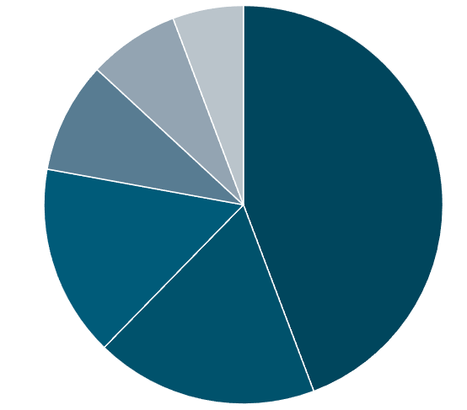
Quantitative Findings
In your opinion, what parts of the session worked well and why? (n=133)
Organisation and range of subject areas
  Access/Foundation information and progression supports
7%
9%
  Welcoming atmosphere, variety, breaks, comfort, refreshments
11%
  Clear information, interactive sessions with strong Q&A
54%
19%
  Campus experience (tours, lecturers, students)
22%
TU Dublin content (modules, placements, sample classes)

Slide 15
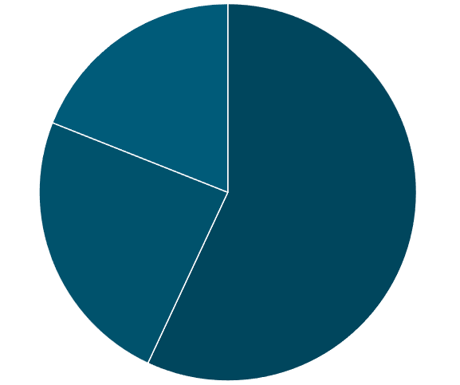
Quantitative Findings
Did the session have any other useful outcomes for you that you would like to share? (n=89)
TU Dublin-specific benefits (course insights, student supports, campus familiarity, CAO preference)
19%
Gained key information (financial supports, migrant options, career pathways, take-home materials)
45%
15%
Increased confidence and sense of accessibility to university

Slide 16
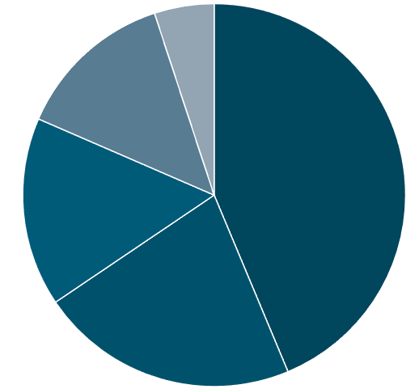
Quantitative Findings
Would recommend the Taste of TU Dublin to a friend?
NOTE: 100% (31/31) said Yes!
Welcoming environment
Breaking barriers & inspiration (Addressed questions on finance, applications, courses, and support for migrants)
6%
Progression pathways (helped clarify next steps in education)
16%
Insight & experience (positive exposure to courses, campuses, and welcoming staff)
52%
19%
26%
Informative (provided clear and comprehensive guidance on university entry)

Slide 17
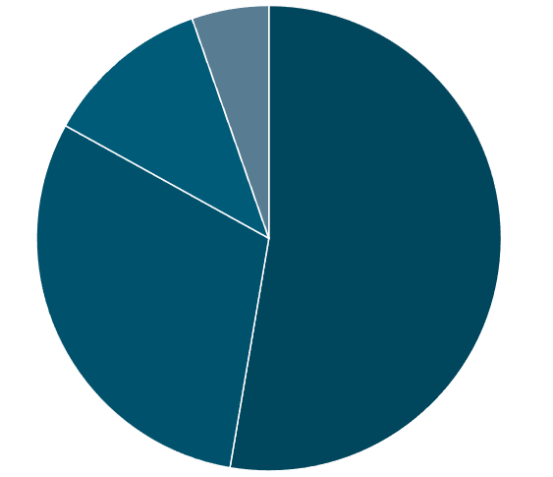
Quantitative Findings
Barriers to attending Taste of TU Dublin (n=32)
Clearer, more accessible information needed
Need for reassurance and encouragement
6%
13%
Practical barriers (timing, childcare, transport/parking, advertising)
59%
34%
Personal factors (motivation, fear of judgement, age concerns)

Slide 18
Quote
“It’s extremely useful for anyone who is interested in going to college. The session will give all the information they need to know, and answers to all the questions regarding the college, courses, fees, eligibility, requirements etc. So, they are prepared for the processes”

Slide 19
Recommendations
Continue & improve on Taste of TU Dublin
Enhance collaboration with community partners
Offer follow-up engagement opportunities
Monitor/measure long-term impact

Slide 20
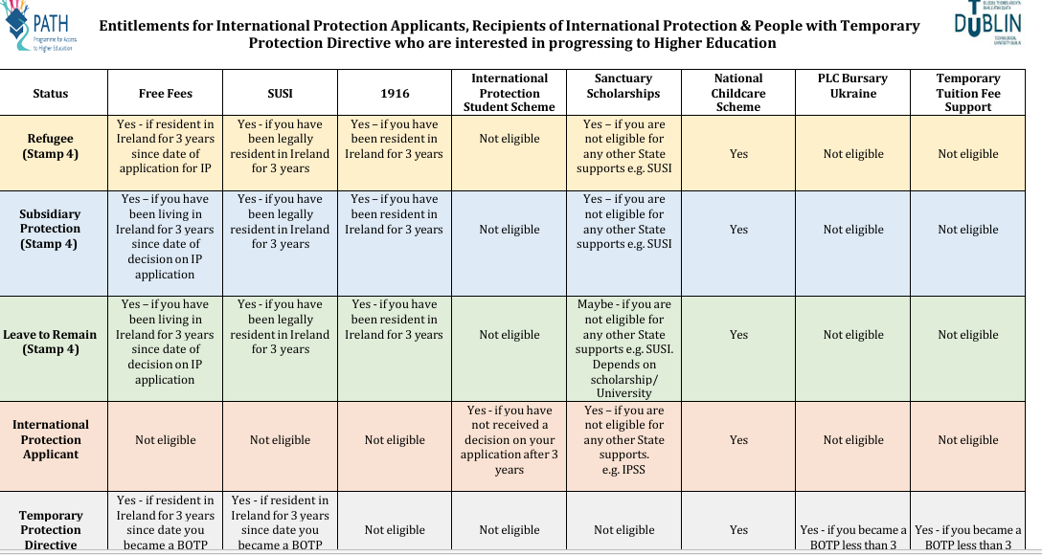
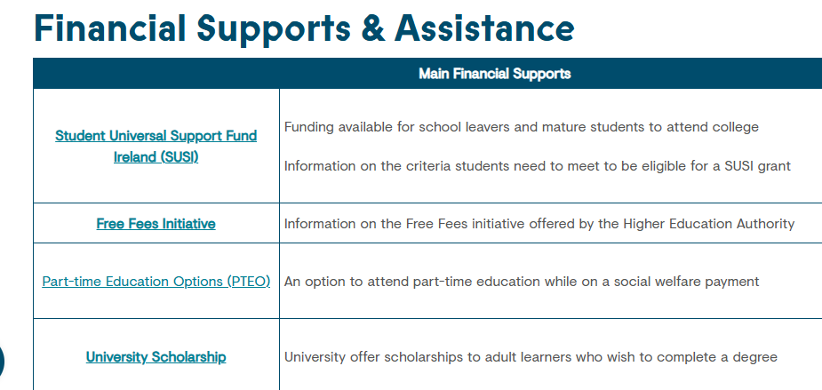
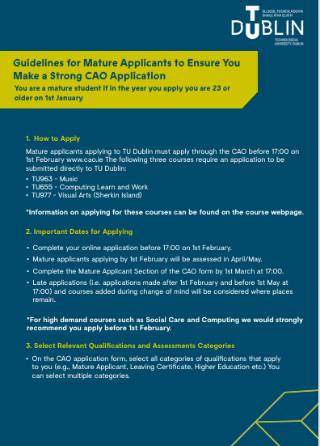
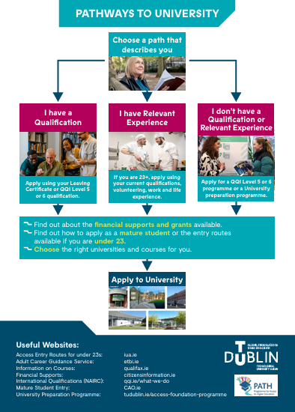

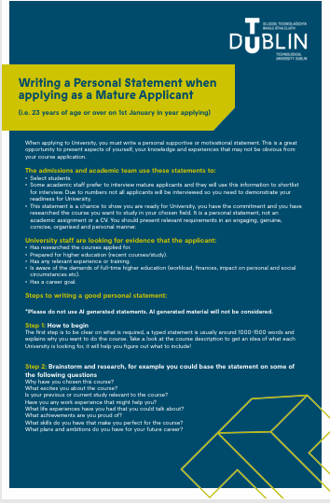

Slide 21
Preparation Days for Mature Students
These sessions take place in three of TU Dublin’s campuses. They provide a valuable opportunity for mature students to meet staff, learn about the campus environment, and connect with fellow students before the term begins.
The aim is to help mature learners feel more confident, informed, and supported as they begin university.

Slide 22
Number of Mature Students attending Preparation Days
Academic Year | Attendees
2023-24 | 33
2024-25 | 103
2025-26 | 117
Total | 263

Slide 23
Quotes
“It was great to meet the heads of some key areas. Being introduced to some of the opportunities and programs outside the classes really felt welcoming. I am far less worried about restarting life”

Slide 24
To conclude……
Informing
Providing people with the right information in an interesting & interactive way at the right time supports people with making a decision to progress.
Advising
Tailoring information to individuals’ circumstances to ensure they feel confident in taking the next step with a clear understanding of what to expect.
Preparing
By bringing people onto campus, introducing them to university staff, discussing the support available, and highlighting financial options, individuals are better prepared for university.

Slide 25


Thank You!
Questions?
Karen.Carter@TUDublin.ie

