Slide 1
Supporting Students, Sustaining Ourselves: A Self‑Care Approach for Third‑Space Practitioners
Anna Galvin, Disability Support Services &
Andrea Crockett, Student Support and Development Team,
Student Affairs Division

Slide 2
Introduction
Context
Importance of Self-Care
Inspiration
Team Self-Care in Practice

Slide 3
Context
“Third space” refers to roles situated between academic and administrative domains. In Ireland examples include learning technologists, student support and engagement teams, disability support services, counselling teams, academic skills supports etc.
Third space professionals must mediate between competing priorities:
  Academic expectations
  Institutional policy
  Student needs
  Boundaries
Notes:
Whitchurch | The concept of third space as an enabler in complex higher education environments | London Review of Education
Inside the third space: a podcast exploring the hybrid roles of higher education professionals

Slide 4
Context
All the while;
The Irish Higher Education system is undergoing expansion, and mergers for those working in Technological Universities
Challenges balancing student needs with limited resources.
There is increasing emphasis on and accountability for “student success”;
Placing further administrative and reporting burdens on third space staff.
Notes:
HEA: Review of the Irish National Framework for Student Success in Higher Education

Slide 5
Context
Rise in both the level and complexity of mental health issues among university students in Ireland
The student population is becoming more diverse, with higher numbers of students with disabilities and complex support needs
Increasing demand on student support services
Empathy and kindness needed to fulfill role and support students, however, subsequent risk of compassion fatigue
Notes:
Counsellors’ experiences of providing counselling to students in university‐level institutions in Ireland: An evolving phenomenon - Harrison - 2021 - Counselling and Psychotherapy Research - Wiley Online Library
Disabled Students Engaged with Support Services in Higher Education in Ireland 2023/24
https://eprints.bbk.ac.uk/id/eprint/47038/1/FINALES%20Supporting%20Staff%20Wellbeing%20in%20HE%20Report.pdf

Slide 6
Importance of Self-Care
The World Health Organisation (WHO) defines workplace wellbeing as a holistic state where employees experience physical, mental, and social health.
Wellbeing in the workplace is not merely the absence of illness or injury but a positive state where workers can thrive, feel supported and perform effectively.
Supporting staff well-being improves job satisfaction, motivation, and productivity, and reduces work-place stress and burnout.
Self-care at work is essential, not optional, for sustaining health and well-being.
Team connectedness and social support is a key contributor to workplace wellbeing.
Notes:
HEA Strategy for Student and Staff Health and Wellbeing
WHO: Workplace health
2023 Work in America Survey: Workplaces as engines of psychological health and well-being
A sense of belonging is crucial for employees. How employers can foster connection and social support

Slide 7

What inspired us to put a team self-care hour in place?
Active* Consent - Consent promotion resources, trainings & more​
“Compassion Without Compromise – Self-Care Strategies for Managing Exposure to Vicarious Trauma"
Self-care assessment to reflect on how you practice self-care (physically, psychologically, spiritually, and professionally).
Student Support and Development Manager implemented team self-care hour.
'50 ways to take a break'​ handout.

Slide 8
What have we put in place?
Initially implemented within the Student Support and Development Team
Initiative shared with and established within the Disability Support Service Team
Allocated session once a month
Blocked off in the diary – ideally planned ahead for full semester
Rotating schedule – each session is team member lead
Takes place on anchor day, in person
Accessible and free

Slide 9
What have we put in place?
Examples:
Mario Kart
Uno
30 Seconds
Ted Talk
Pool Competition
Self-Guided Meditation
Mindfulness session
Table Quiz
Paint & Sip (non-alcoholic!)

Slide 10
What have we put in place?
Student Affairs Division External Supervision Policy
Integral piece of self-care for Student Affairs support staff whose work may not be professionalised.
External supervision, available to full-time and part-time staff.
Cost is reimbursed via the Student Affairs Division.
Allows for further debriefing for staff members who may have a heavy and/or large caseload (while maintaining student anonymity) in turn helping to create a safer working environment for staff.

Slide 11
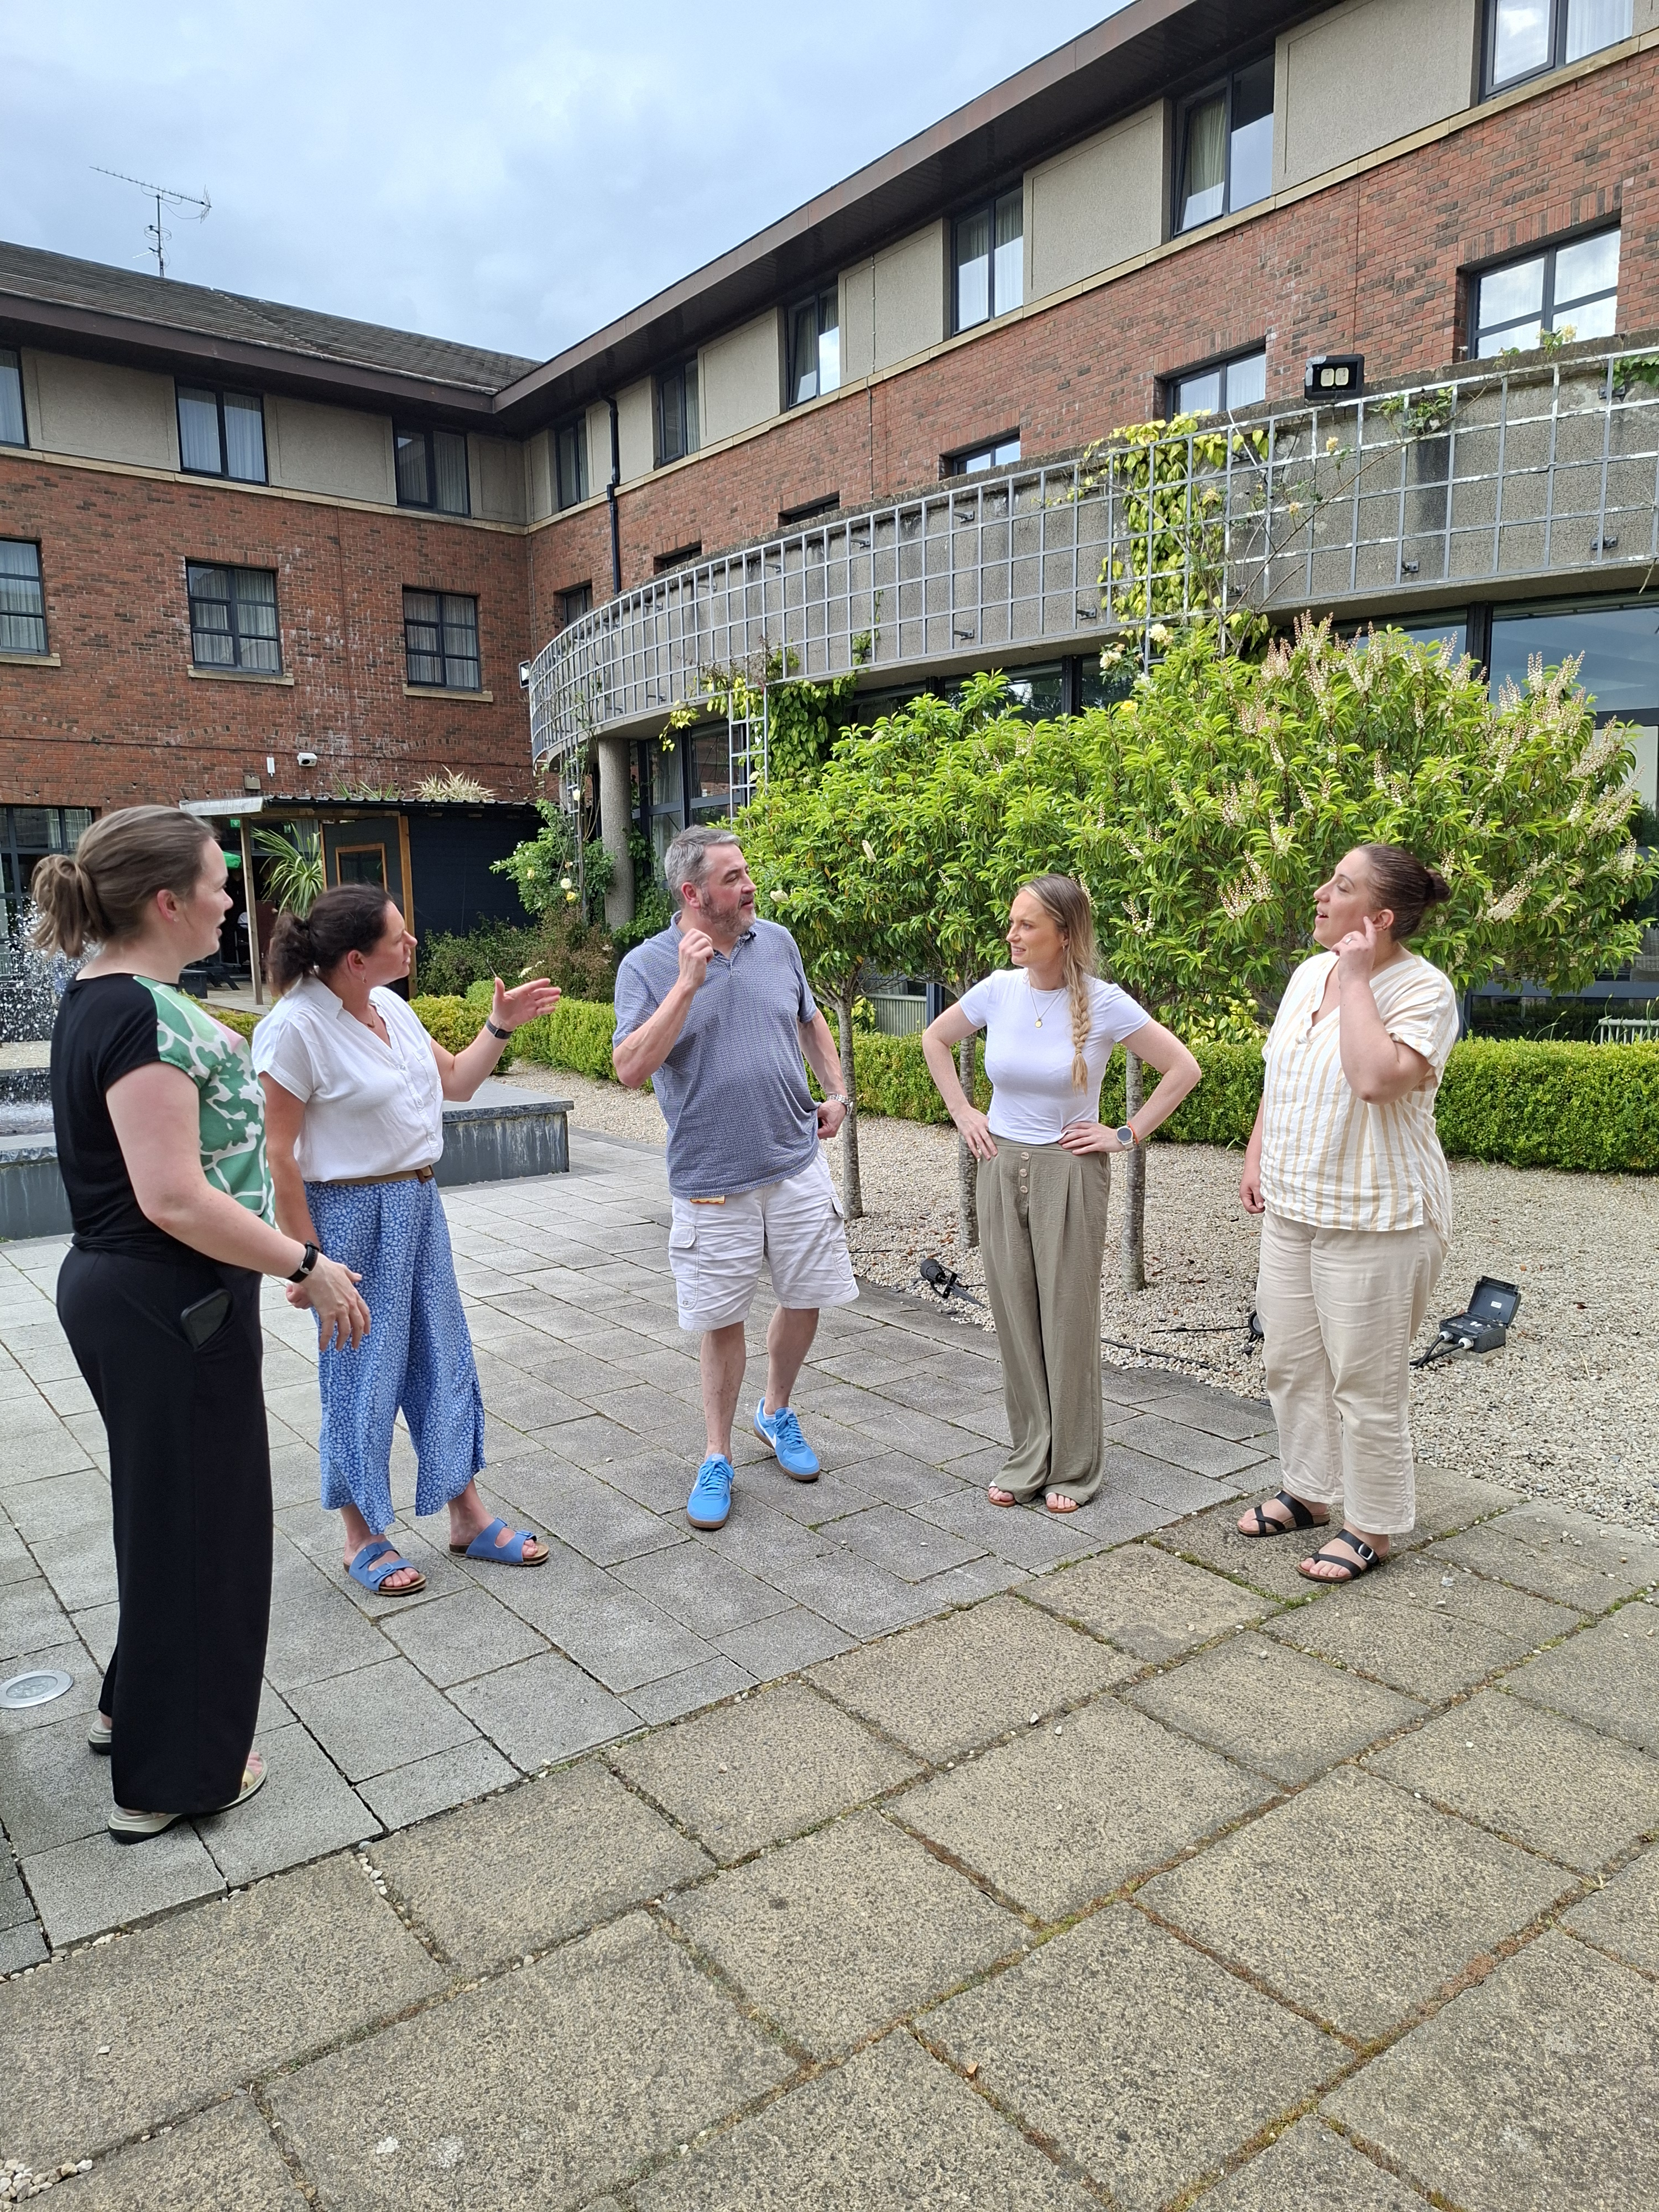
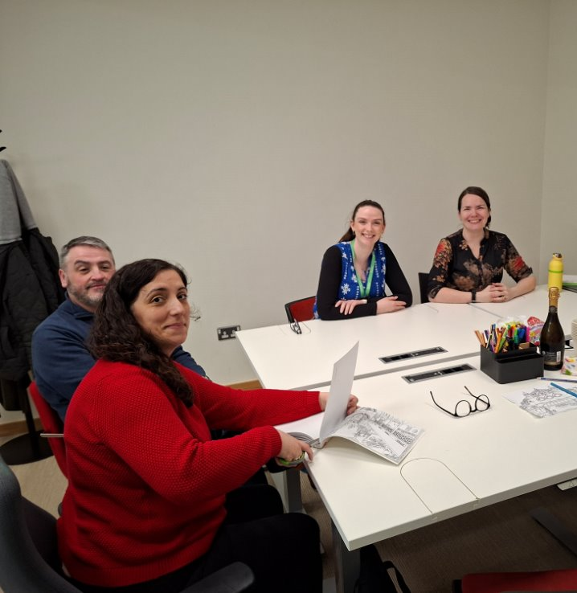
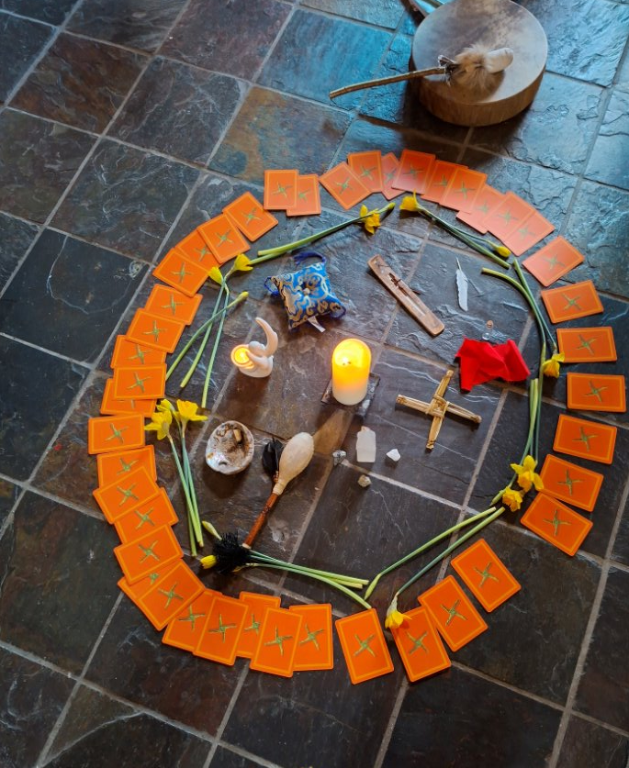
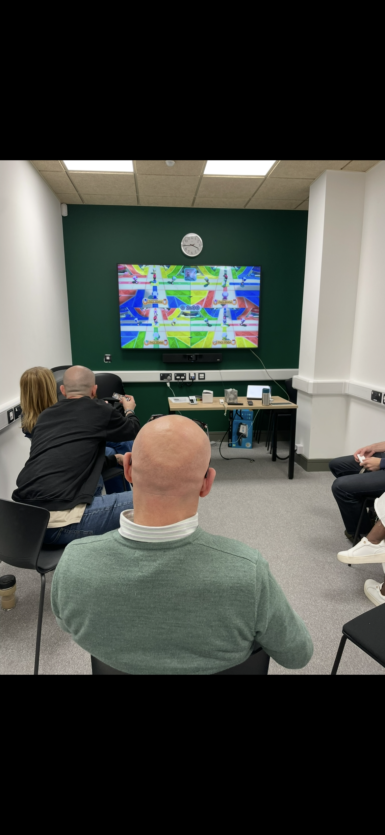

Slide 12
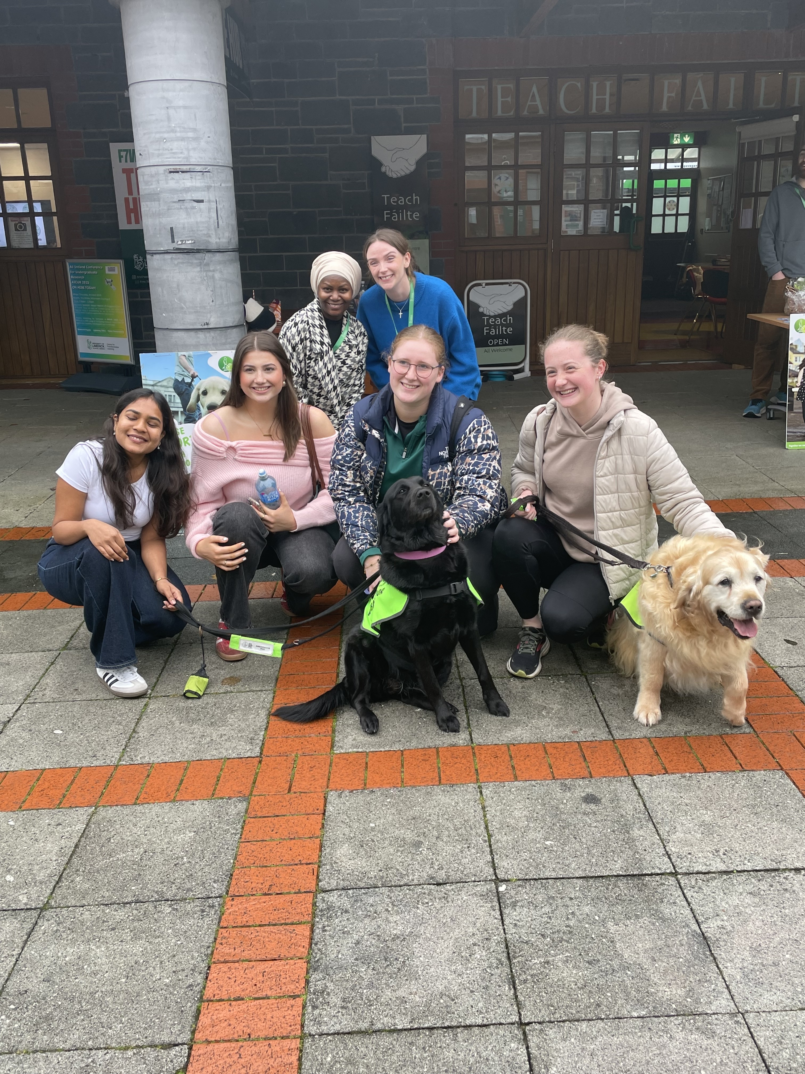
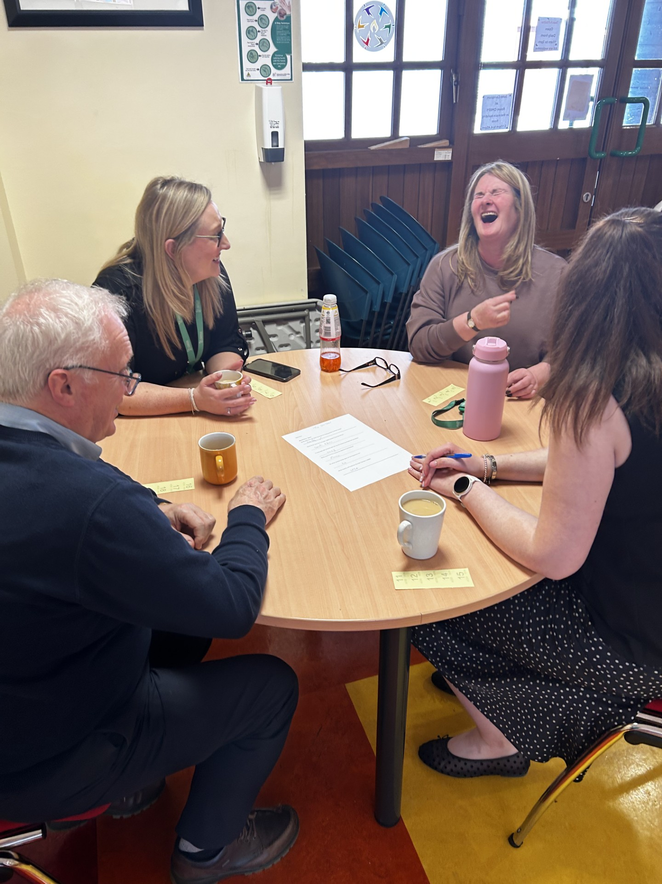
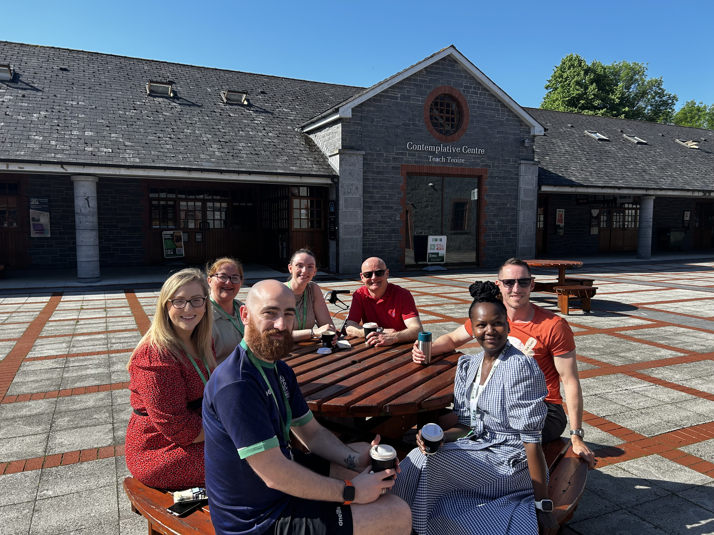

Slide 13
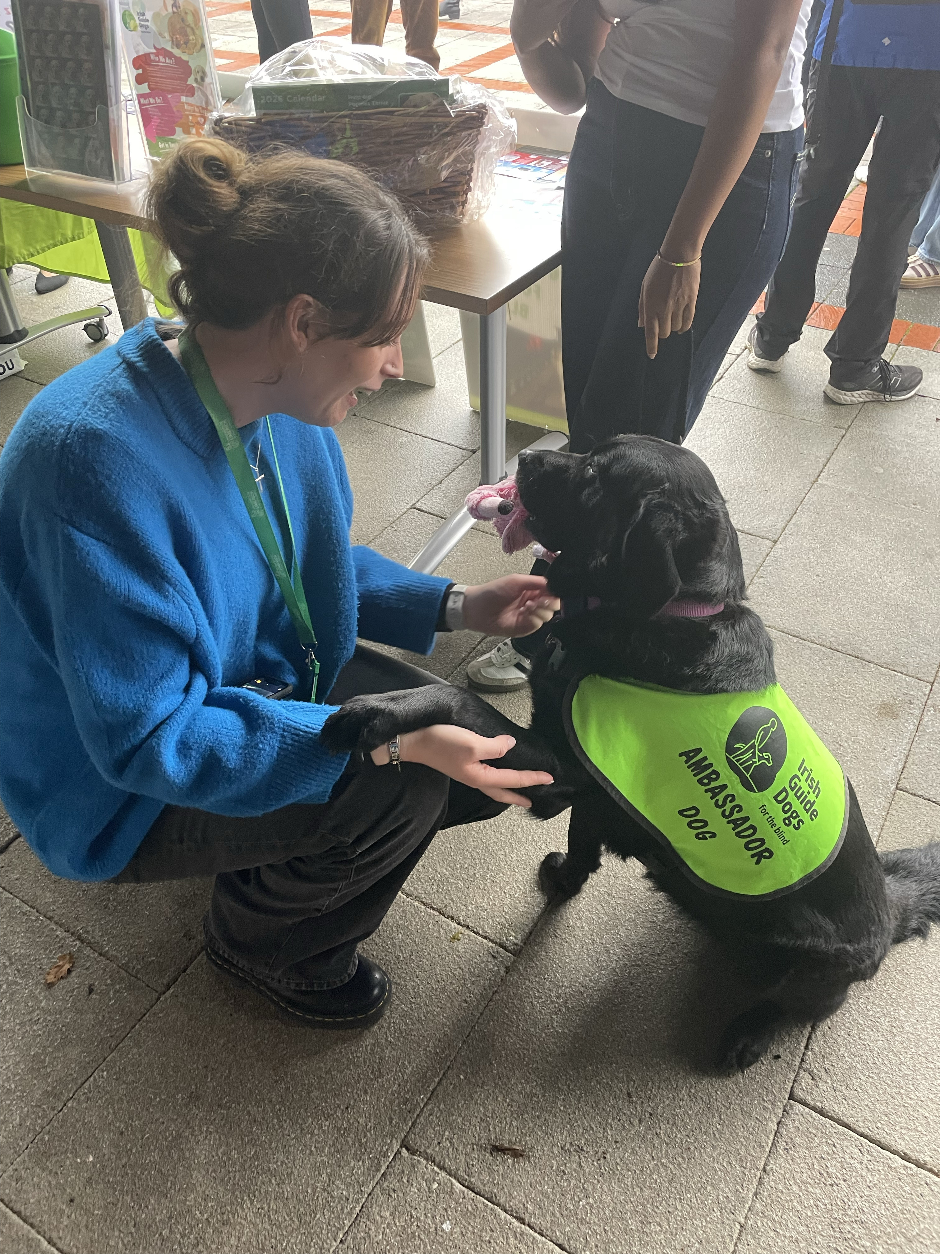
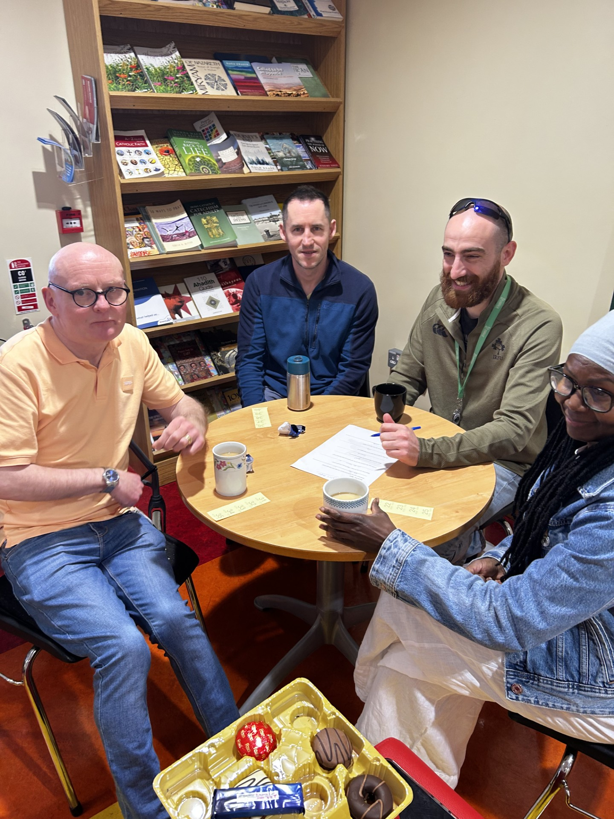
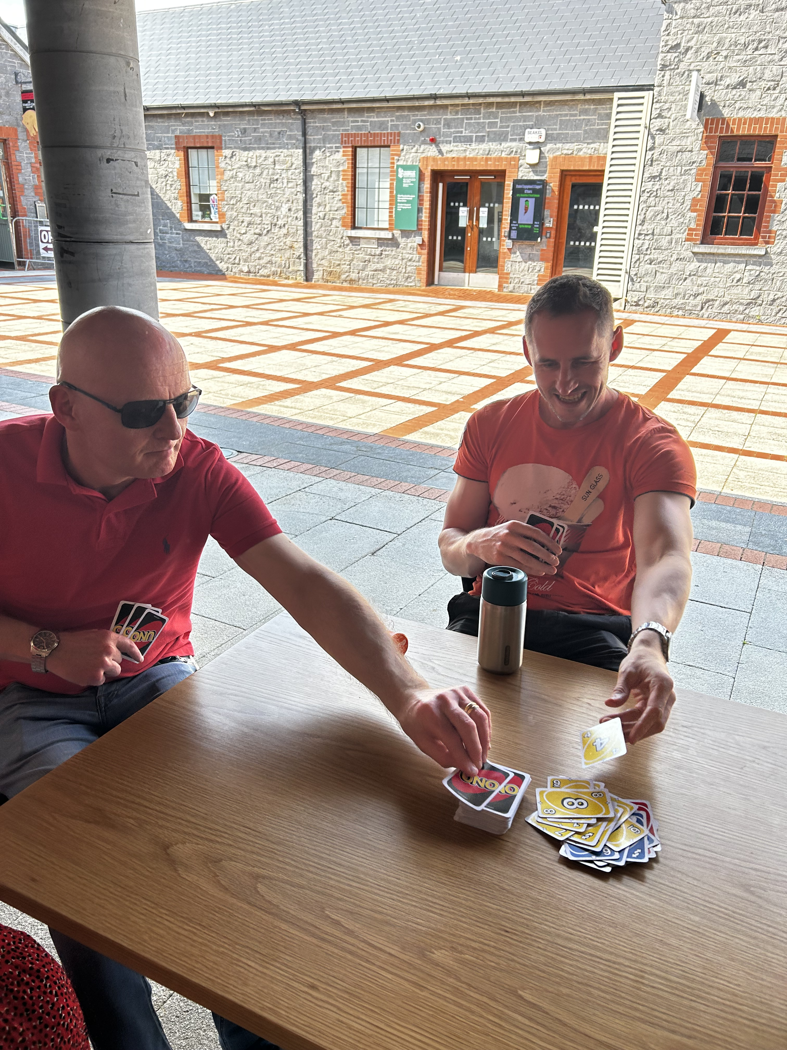
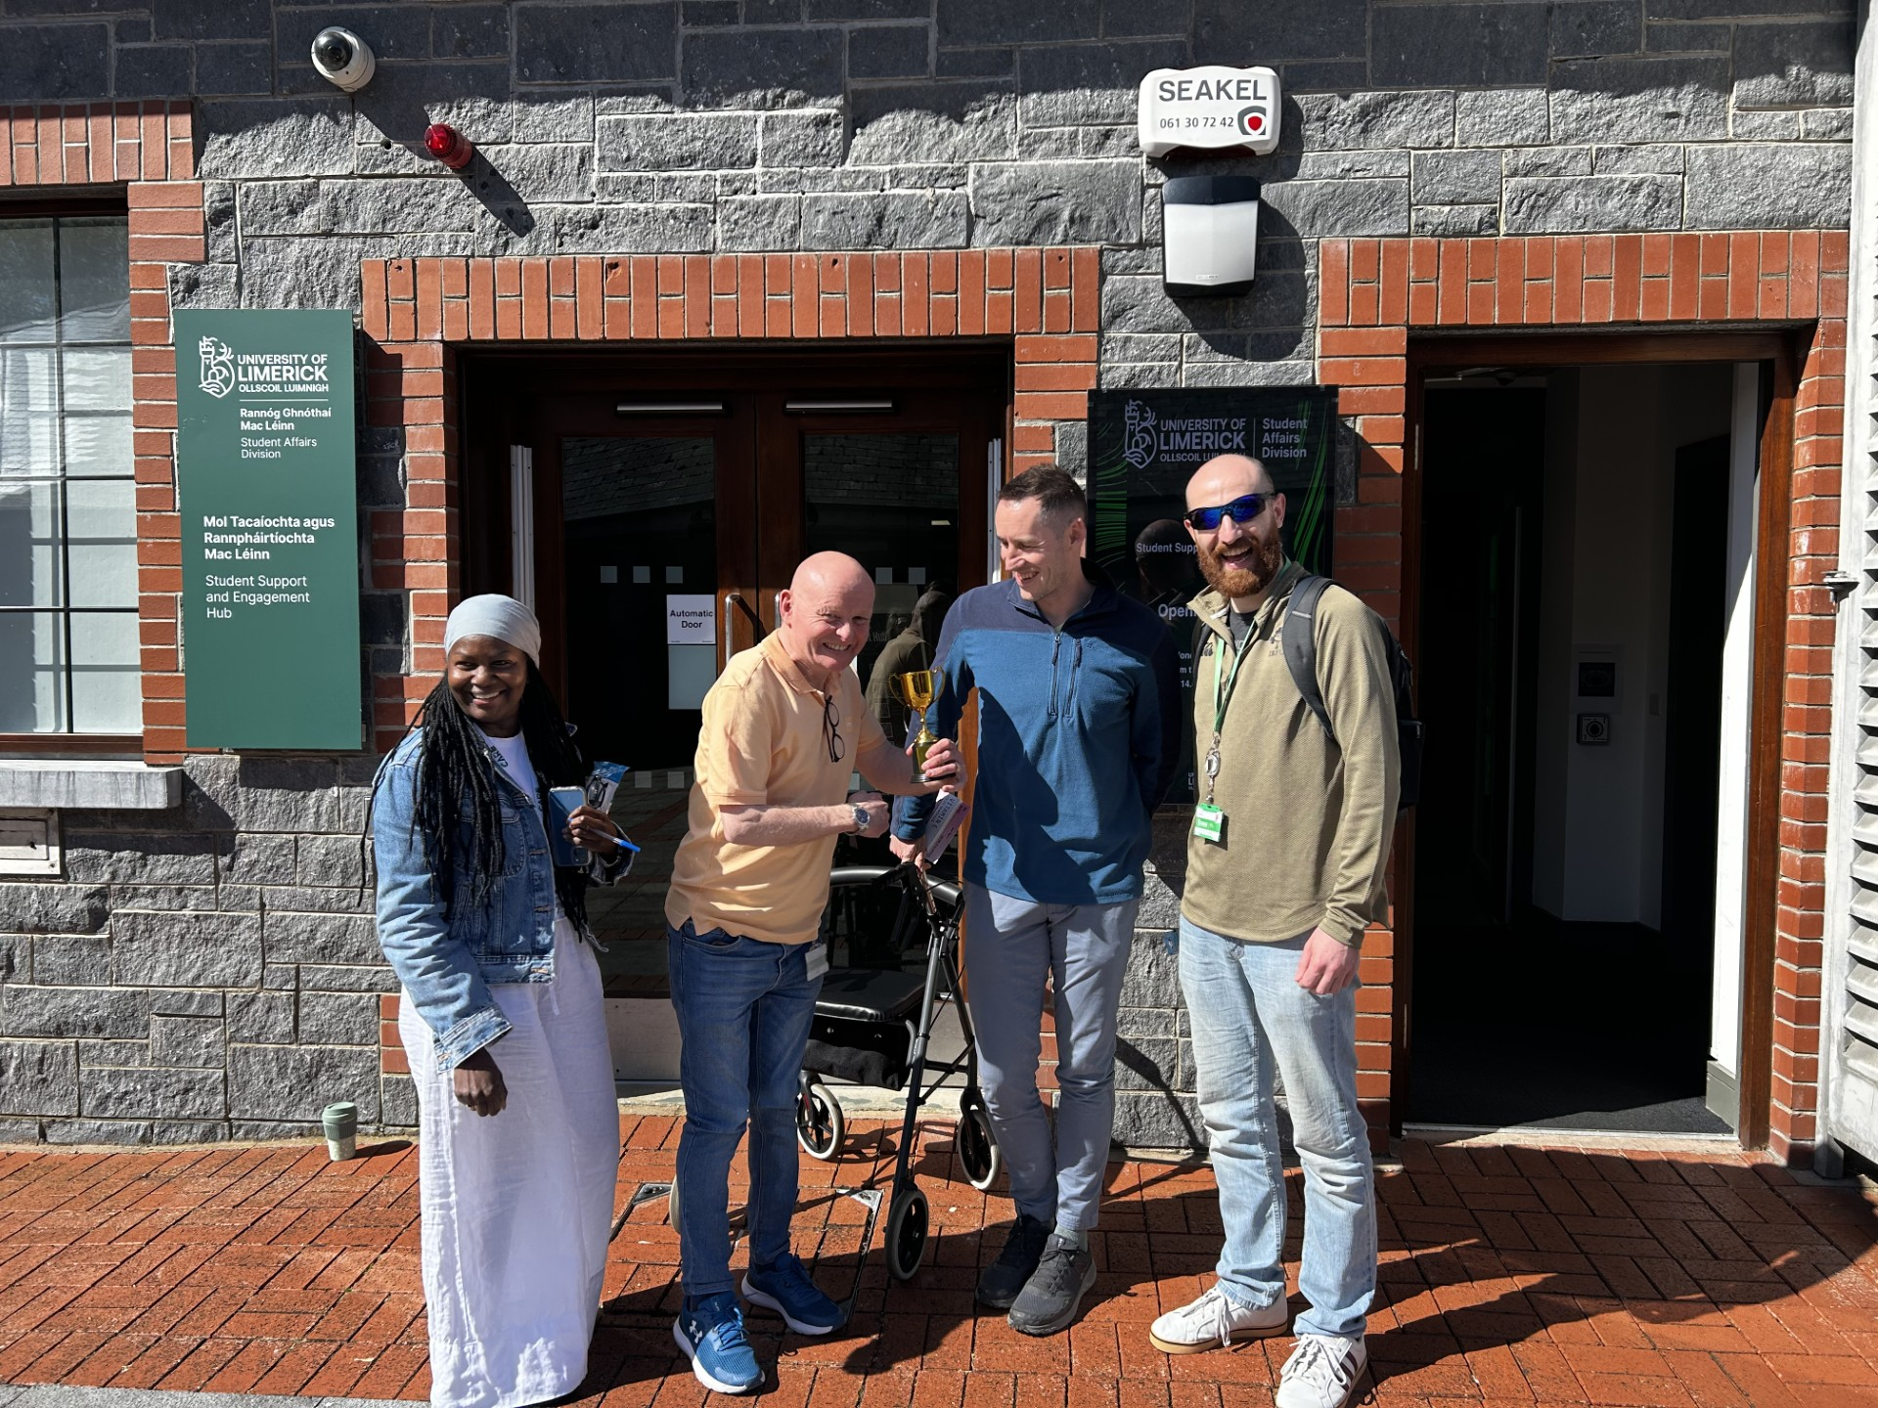
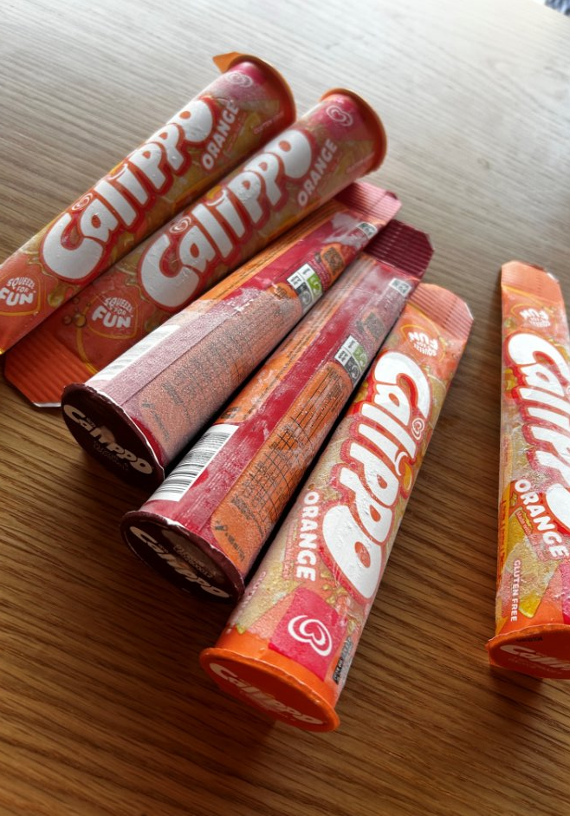

Slide 14
Quotes
Having the opportunity to engage in a team activity once per month to relax and step away from the day-to-day is a fantastic initiative. As each staff member gets the opportunity to organise a wellbeing activity, we all get to share in something that is meaningful to a colleague - we learn from each other's self-care practices and interests. It has been fun, relaxing, and has even had a hint of friendly competition.
The hour was a fun way to interact with the team and get to know each other better. There was some great, unique ideas which kept us all guessing. It's good just to do normal stuff with your colleagues and to see a different side of them!
I really value how we come together as a team to share positive, light-hearted moments. The humour we bring into our activities makes such a difference, it helps us relax, connect, and genuinely enjoy spending time together.
I also really appreciate how thoughtful and inclusive we are when choosing activities. Making sure everyone’s needs are considered creates a strong sense of belonging and helps strengthen our connections as a team.
It is great to see how we have embedded wellbeing as a shared priority and made it a natural part of how we work, normalising the importance of self-care. The laughter during our sessions is truly uplifting, and it is something I always look forward to each time.

Slide 15
Quotes
This one hour a month has been so enjoyable, restorative, and grounding. I wouldn't have thought it would make such a difference but it's been a tangible reminder to apply the advice and care we give to others to ourselves and colleagues. I feel it has strengthened team connections and given a space to be with colleagues in a supportive way. It has brought moments of levity to what can at times be an intense and demanding role.
Not knowing what your colleague has planned for the wellbeing hour is all part of the fun, it could be something relaxed and chilled or a really interactive or hilarious activity. It's a lovely way to learn more about your colleagues hobbies or interests and who they are outside of the work environment. Belly laughs and laughing till you cry while playing UNO or 30 seconds have been standout moments for me. The wellbeing hour has often nourished my soul, recharged my battery, and helped me to better cope in the more stressful moments of my job.
It's good just to do normal stuff with your colleagues and to see a different side of them!

Slide 16

Contact Us:
Disability Support Services:
disabilityservices@ul.ie
Student Support and Development Team:
seso@ul.ie

Slide 17
Thank you!

