Slide 1
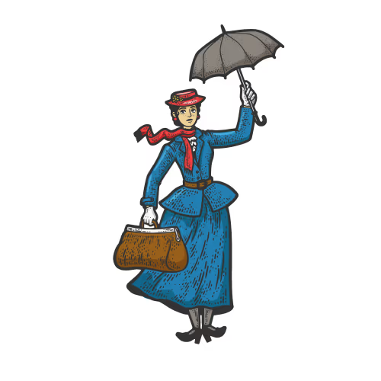

The Mary Poppins Principle: Practising Magic, Designing Calm - Reframing Leadership for Sustainable Student Support
Dr Niamh Nestor and John Wyatt, UCD Student Advisory Service
SAI Summer Seminar 2026
Notes:
It’s late on a Friday before a bank holiday… and the phone rings.
And before I answer, I already know a few things.
I know it’s serious. I know it involves a student.
And I know I’m about to make decisions very quickly, with incomplete information.
And in that moment, we hold multiple things at once: the student, their family, my team, the institution, and the potential consequences.
That pressure - the mix of urgency, responsibility and uncertainty, will be familiar to many of you.

Slide 2
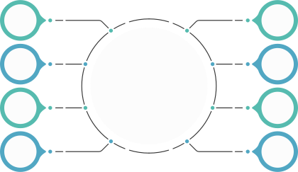
Professional intuition
Experience-informed judgement in the absence of formal protocols.
Goodwill & responsiveness
Colleagues picking up the phone, especially out of hours.
Relational capital
Knowing who to call, and them being willing to answer.
Values-driven decision-making
Deep care, compassion and commitment to student wellbeing.
What’s in the bag?
Institutional memory
“What did we do last time?” (precedent)
Reputational awareness
Sensitivity to optics, risk and institutional impact.
Soft power and influence
Negotiating across boundaries without formal authority.
Collective capability
Drawing on the skills and judgement of others in real time.
Dr Niamh Nestor and John Wyatt, UCD Student Advisory Service | SAI Summer Seminar, 18 June 2026.
Notes:
In those moments, we reach into what I think of as Mary Poppins' bag.
We produce what looks like ‘magic’, but it’s not magic.
It’s a set of capabilities that are largely invisible.
Things like:
- professional judgement.
- knowing who to call and them answering.
- drawing on past experience.
- making values-driven decisions under pressure.
This is highly skilled work.
But it’s also largely invisible and implicit, and that's where our challenge begins. —and that’s where the challenge begins.

Slide 3

Risks to consider
  High dependency on individuals, relationships and goodwill.
  Inconsistent pathways for escalation and decision-making.
  Uneven experience for students and staff, depending on networks.
  Significant emotional labour and pressure on responders, leading to risk of burnout.
  Risk of fragility in the response when key people are unavailable.
  Reliance on tacit knowledge that is not captured or shared.
Dr Niamh Nestor and John Wyatt, UCD Student Advisory Service | SAI Summer Seminar, 18 June 2026.
Notes:
While this works on most occasions, it comes at a cost.
It creates high dependency on individuals, inconsistent experiences, significant emotional labour, and high risk.
And over time, it starts to feel a bit like Sisyphus - constantly responding, but never really changing the system underneath.
The question then become: How sustainable is this as demand increases?

Slide 4
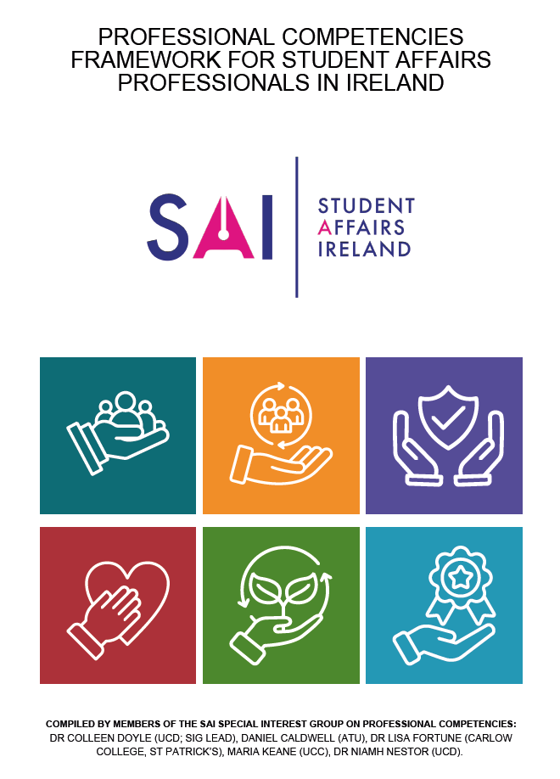
SAI Professional Competencies Framework
Leadership
A key aspect of leadership is the creation of psychologically safe environments where learning, reflection and growth are supported. (p. 29) (our emphasis)
Practising Self-care
Practising self-care is essential in student affairs work due to the emotionally demanding nature of the role, which can include exposure to student distress, complex decision-making, boundary management, and sustained interpersonal engagement. Without appropriate self-care, there is an increased risk of burnout, compassion fatigue, and reduced effectiveness in supporting students. (p. 35)
(our emphasis)
Dr Niamh Nestor and John Wyatt, UCD Student Advisory Service | SAI Summer Seminar, 18 June 2026.
Notes:
At a certain point, we realise that this isn’t a people problem. It’s a systems problem. And as leaders in student affairs, responsible for, among other things, our team's wellbeing, we need to recognise and make clear that what we’re calling ‘magic’ is actually expertise that hasn’t been codified. It's relationships that haven’t been structured and decisions that haven’t been systematised.
Systems thinking helps us step back and ask: Where is demand coming from, how does it escalate, and where can we intervene earlier?
And strategic leadership is about acting on that. Strategic leadership is needed here to not only respond well but to shape the conditions around that response.
So then our question became: What would it look like to intervene before the Friday afternoon phonecall?

Slide 5
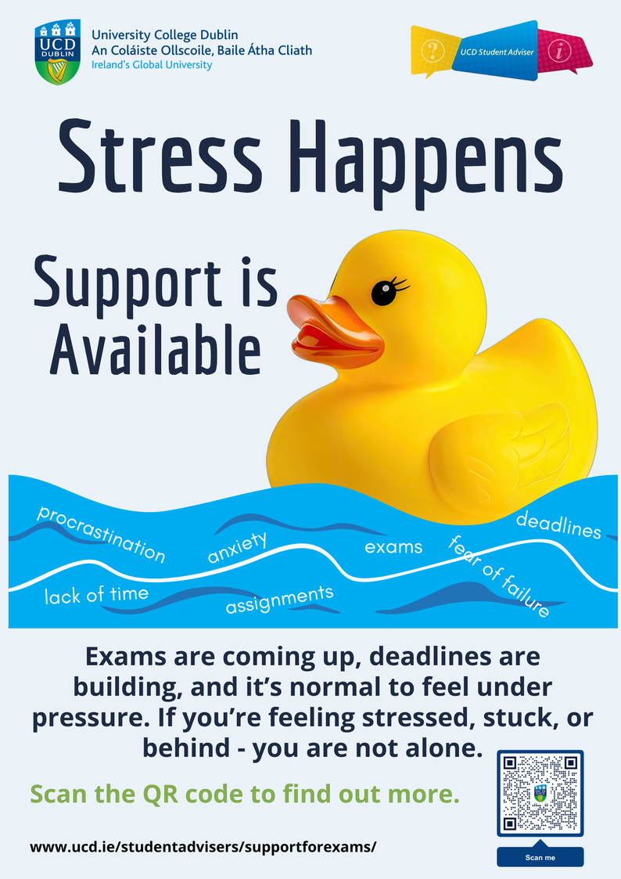
What do the data tell us?
Approx. 33% of students annually consider withdrawing from HE (ISSE; N=40,000+) ⟶ c. 12,500 UCD students.
Why?
  ISSE 2024/25: “Didn’t like programme” (17%) / “Personal” (11%).
  UCD data: “Personal” (55%) / “Didn’t like course” (23%).
How are we responding?
  Use of early-alert systems (LEAP).
  Peer-support programmes alongside this.
    Mind Your Mate: Upskilling students to support peers.
    Focushub: Informal body-doubling study sessions that support focus and accountability.
    CampUs Collective: Student-led projects that foster connection, belonging and leadership development.
    Awareness-raising of support services.
Dr Niamh Nestor and John Wyatt, UCD Student Advisory Service | SAI Summer Seminar, 18 June 2026.
Notes:
The Irish Survey of Student Engagement (n=40,000+) has consistently found that more than one-third of students annually consider withdrawing from higher education. In 2024/25, UCD students most commonly cited “Didn’t like programme” (17%) and “Personal” (11%) as reasons for considering withdrawal. However, analysis of UCD’s withdrawal data from the same period shows a different pattern, with “Personal” (36%) and “Didn’t like course” (19.4%) emerging as primary drivers of actual withdrawal. This contrast suggests that while programme-related dissatisfaction may prompt initial consideration of leaving, personal factors are more likely to lead to withdrawal, underscoring the importance of initiatives that strengthen belonging, wellbeing and engagement in supporting progression and success.
We can predict that there will be a number of crisis cases every year that require a multi-unit response.
Initiatives to address student disengagement are already underway in UCD. The Student Advisory (SA) Team leads university-wide initiatives such as LEAP, which uses Brightspace data to identify students at risk of disengagement and enables early intervention by SAs, thereby supporting improved engagement and wellbeing. However, internal survey data on engagement with SAs indicate that additional factors continue to impact students’ ability to engage beyond those captured through early-alert systems. Peer Mentee feedback highlights the positive impact of peer-support on students’ sense of belonging. Consequently, the SA Team has been piloting initiatives designed to proactively enhance belonging and develop peer-support skills, including:
Mind Your Mate (workshops equipping students to support peers experiencing mental health challenges) FocusHub (informal "body-doubling" study sessions that support focus and accountability)
CampUs Collective (student-led projects that foster connection, belonging and leadership development)

Slide 6

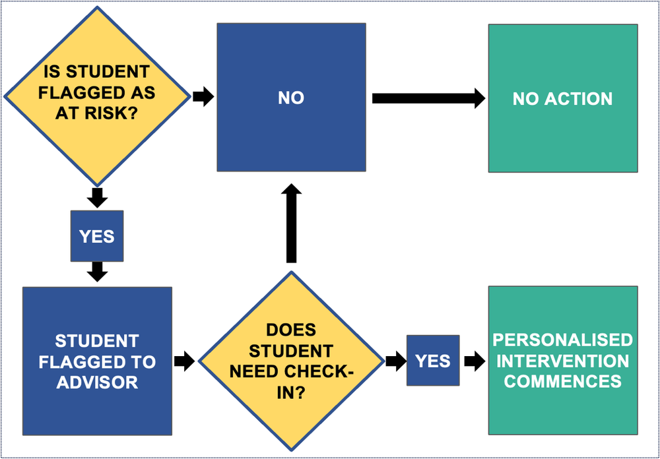
UCD LEAP: How can the data help us?
LEAP Aim
Help students transition to UCD by linking analytics with support
Our Approach
Develop weekly programme-level VLE data report for Advisers
Our Assumptions
1. Disengagement is reflected in the VLE and assessment
2. Early identification & support mitigates wellbeing challenges
Impact
LEAP is not a silver bullet, but it ensures that:
  Fewer students end up in crisis situations
  Our student affairs leaders who manage crises have more data early on to better inform & prepare crisis responses
Dr Niamh Nestor and John Wyatt, UCD Student Advisory Service | SAI Summer Seminar, 18 June 2026.
Notes:
One example of how we’ve started to do that is through LEAP.
LEAP allows us to identify patterns of disengagement early, before they escalate into crisis.
What we’re seeing is that many students who reach crisis point have already shown signs of disengagement.
So this gives us a chance to intervene earlier,
and it also gives staff better context when they are responding.
It’s not a silver bullet.
But it shifts us meaningfully upstream, from reactive to proactive.

Slide 7

Practising magic, designing calm
  From implicit practice to intentional system-building.
  Real-time response still required.
  Turning practice into systems change so as to ensure that magic isn’t the only thing holding the system together.
Dr Niamh Nestor and John Wyatt, UCD Student Advisory Service | SAI Summer Seminar, 18 June 2026.
Notes:
We will always need the magic.
There will always be moments that require judgement, care and real-time response.
But leadership isn’t about carrying the bag.
It’s about designing systems where fewer situations reach that point - where responses are more consistent, and where staff are supported, not stretched.
The goal isn’t to lose the magic.
It’s to make sure it’s not the only thing holding everything together.

Slide 8
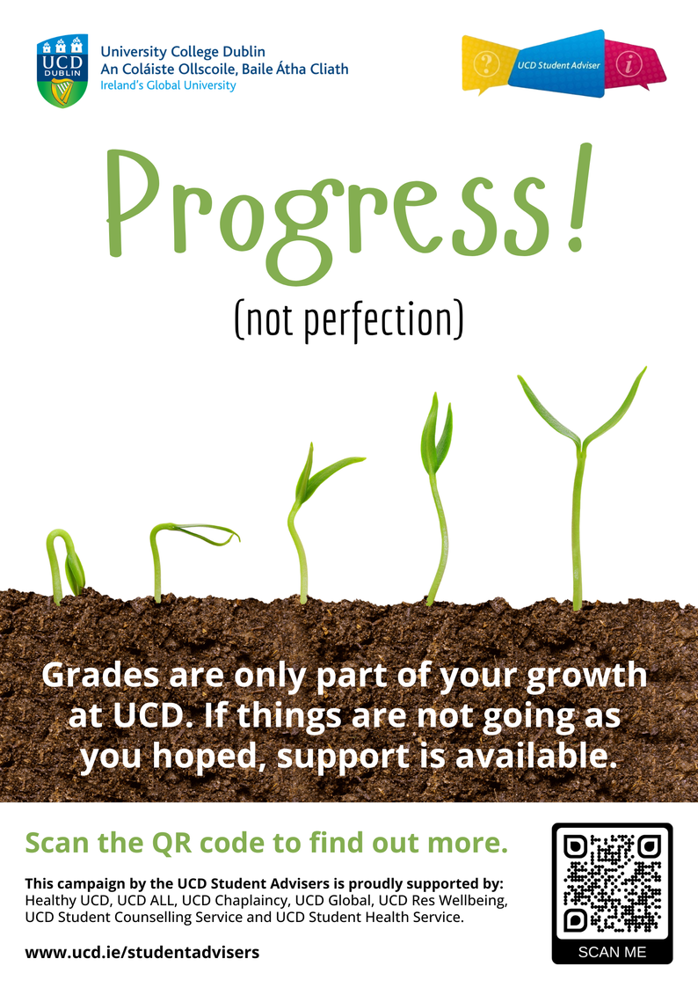
Thank you!
Contact
Niamh: niamh.nestor@ucd.ie
John: john.wyatt@ucd.ie
Helpful links:
UCD Student Advisory Service website: https://www.ucd.ie/studentadvisers/
Our student guides: https://www.ucd.ie/studentadvisers/studentguides/
Initiatives and Projects:
Mind Your Mate: https://www.ucd.ie/studentadvisers/studentguides/mindyourmate/
FocusHub: https://www.ucd.ie/studentadvisers/studentguides/focushub/
CampUs Collective: https://www.ucd.ie/studentadvisers/belong/
Recent awareness-raising campaigns:
Our ‘Progress, Not Perfection’ exam results campaign: https://www.ucd.ie/studentadvisers/progressnotperfection/
Our ‘Stress Happens, Support is Available’ pre-exams campaign: https://www.ucd.ie/studentadvisers/supportforexams/
Dr Niamh Nestor and John Wyatt, UCD Student Advisory Service | SAI Summer Seminar, 18 June 2026.
Notes:
One example of how we’ve started to do that is through LEAP.
LEAP allows us to identify patterns of disengagement early, before they escalate into crisis.
What we’re seeing is that many students who reach crisis point have already shown signs of disengagement.
So this gives us a chance to intervene earlier,
and it also gives staff better context when they are responding.
It’s not a silver bullet.
But it shifts us meaningfully upstream, from reactive to proactive.

