Slide 1
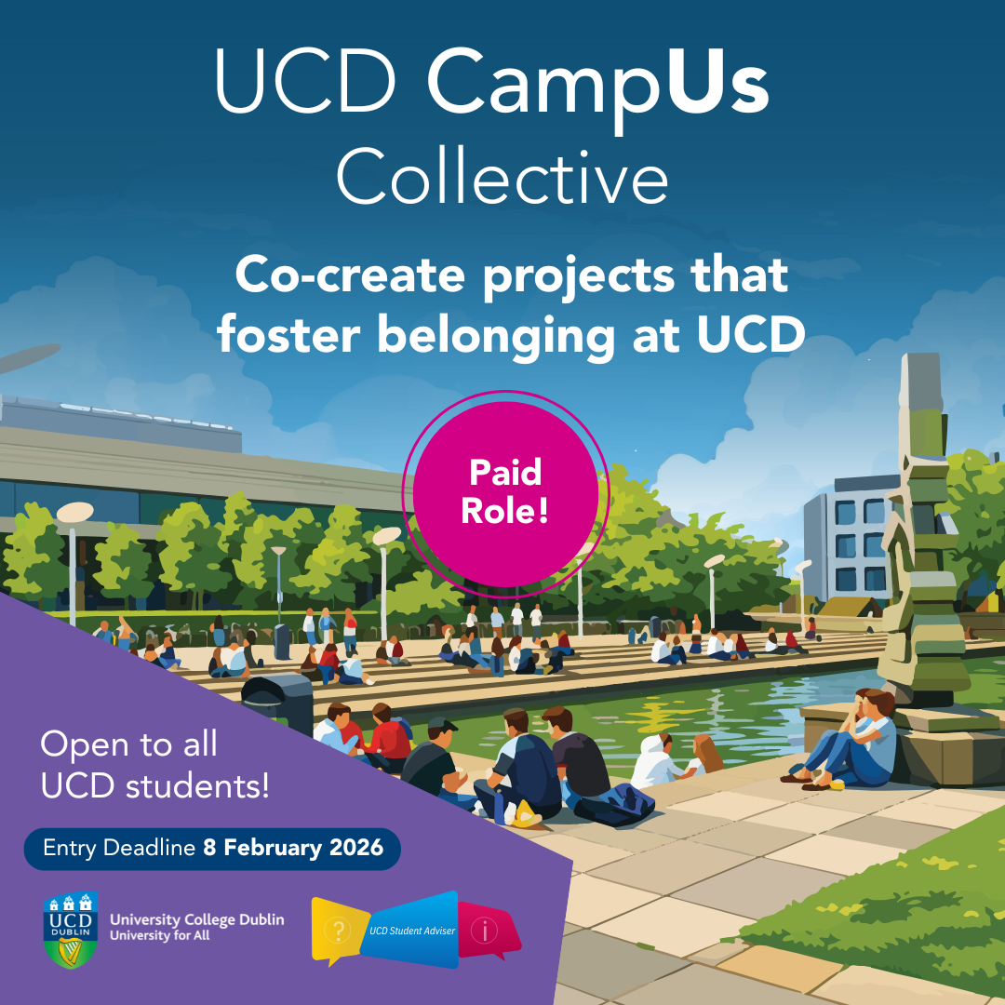

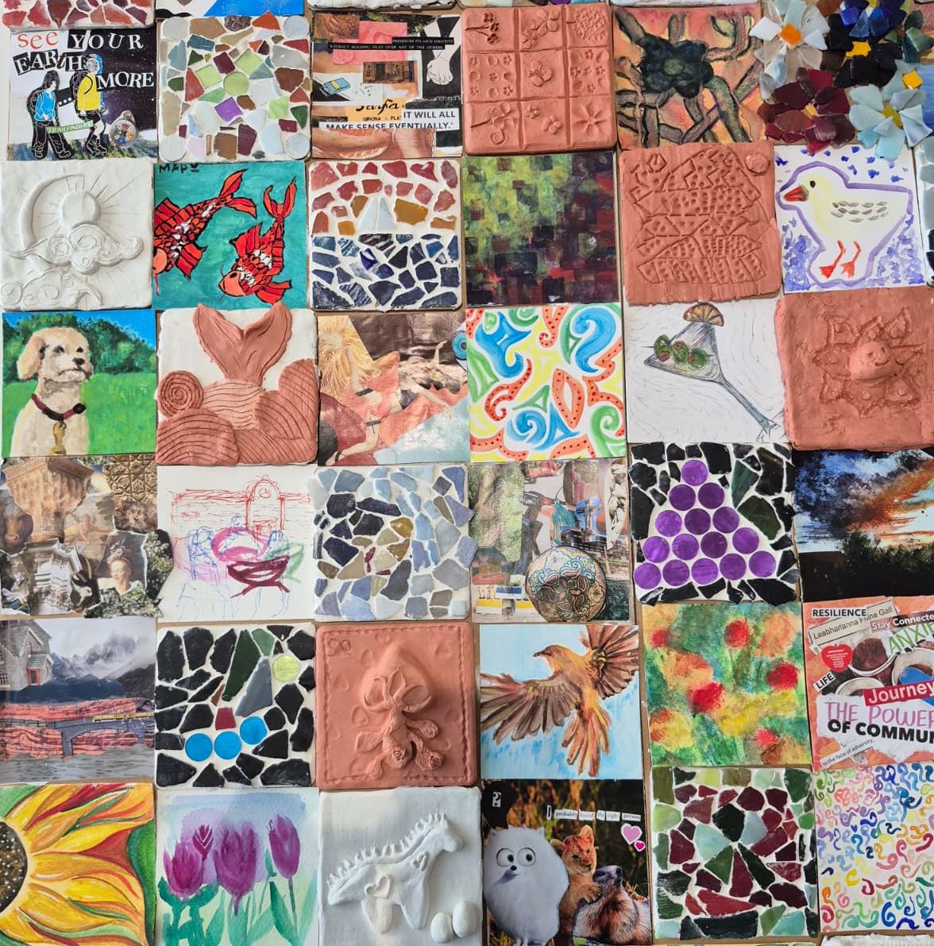
UCD CampUs Collective:
Co-creation in Action
SAI Summer Seminar 2026
Emma Somers and Dr Niamh Nestor
UCD Student Advisory Service
Notes:
For students
Altruistic -- Aligned with their values of connection and inclusion
Practical − learning by doing; Develop leadership, teamwork, and project management skills
Paid role -- Each student was paid €350 for their contribution
Benefits for UCD
Peer-led pilots
Data and insights
Aligned with strategy

Slide 2

SAI Professional Competencies
Advising, Supporting and Empowering Students
Understanding the role of student affairs in enhancing the student experience.
Focus on equitable opportunities for participation.
Connection to opportunities.
Contextual Knowledge of the Irish Higher Education Landscape
Understanding student engagement, belonging, progression and success.
Articulate the contribution of student affairs to student wellbeing, belonging and success.

Slide 3
UCD CampUs Collective 2025/26
Small-scale projects to strengthen connection, foster inclusion and create a sense of belonging.
Led by Student Advisory Service with funding (€20,000) from HEA / ALL.
Core: Collaborative, student-led, Universal Design.
For students: Altruistic, practical, paid.
For UCD: Strategic alignment, peer-led pilots, experiential data and insights.
UCD CampUs Collective: Co-creation in Action | Emma Somers and Niamh Nestor (UCD) | SAI June 2026
Notes:
Students developed small-scale projects that would strengthen connection, foster inclusion and create a sense of belonging.
Led by Student Advisers Team with funding (€20,000) from HEA / Access and Lifelong Learning via University for All Staff Partnership Programme
Key design principles: collaborative, student-led, Universal Design
Benefits for students: altruistic, practical, paid
Benefits for UCD: strategic alignment, peer-led pilots, experiential data and insights

Slide 4
Rollout (six months)
December
January
February
March/April
May
First meeting of working group, staff and paid students
Applications open, promo campaign, online information session
Onboarding and workshop sessions; teams forged
Teams deliver projects, staff mentors,
Belonging Week
Group and individual reflection on their projects and impact

Slide 5
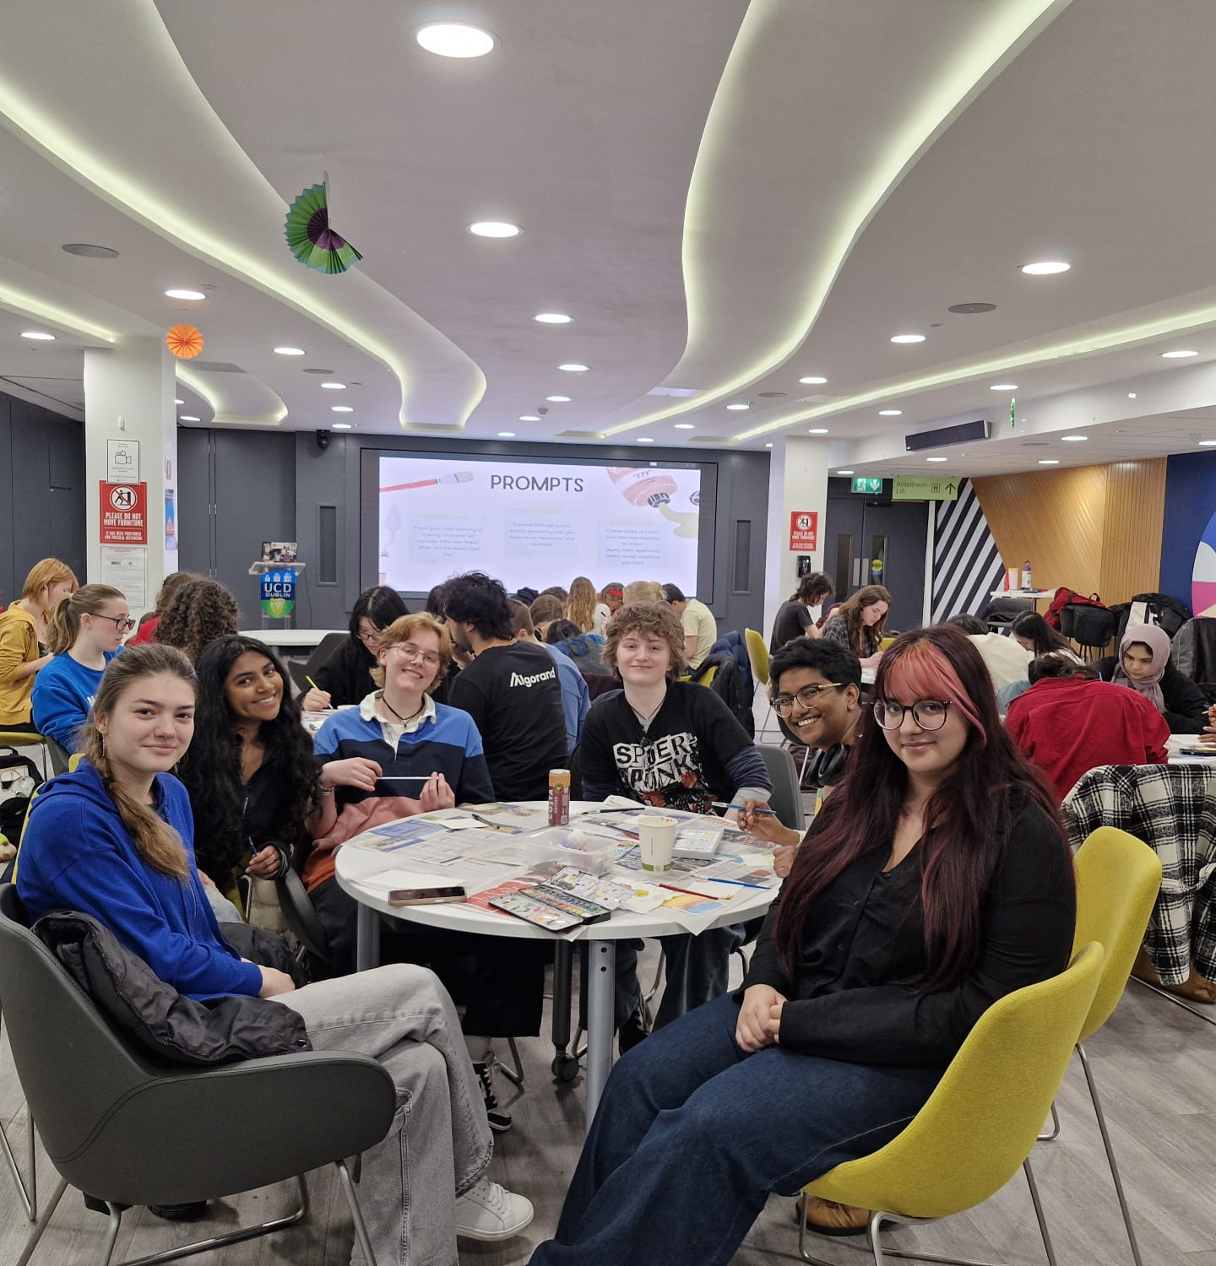
The projects
Creative Mode: Series of hands-on workshops, culminating in an exhibition reflecting student life.
Calling All Commuters: A survey and campus stand to check in with our commuter students.
Cumann Connections: A space to hear from students who want to connect one to one.
Social Lounge: “Pop-up” spaces where students can gather informally without expense.
Parents/Guardians Group: Research to better understand students who have parenting responsibilities.

Slide 6

In numbers
1,500+
380
24
5
1
8
unique visits to the website
students applied
participants completed programme
student teams
Belonging Week
events
1,000+
students
engaged
Notes:
More than 1,500 students out of the 35,000 emailed clicked through to the website ➔ 4.2% CTR (industry average in Ireland is 1.5-3%). A quarter of those students (380) applied.
24 out of 28 students completed the programme. Those 24 students engaged more than 1,000 of their peers through stands, a survey and specially curated events. We’re so proud of them.
Each group varied in size and approach, and therefore in the nature and level of support needed. But as always with these projects, it needed more hours than we could give it. Incredible support from staff on our working group by way of mentoring.

Slide 7
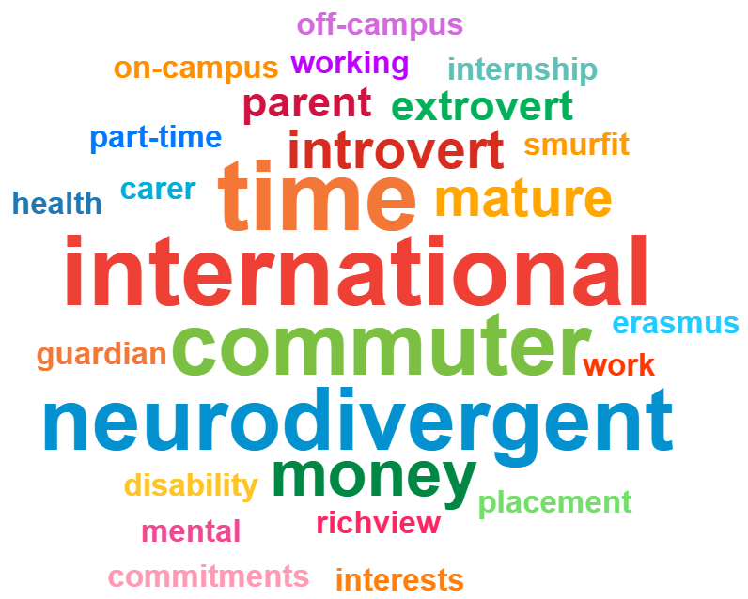
Initial takeaways
Students care about belonging
Resourcing is vital for these initiatives
Barriers to engagement are many and complex
Notes:
Students care about belonging – huge response from intl, postgrad and commuters
Resourcing is vital for these initiatives – time as well as money
Barriers to engagement are many and complex – we saw this in the variance in attendance from one event to the next;

Slide 8
Contact:
Emma: emma.somers@ucd.ie
Niamh: niamh.nestor@ucd.ie
Links:
Project website: https://www.ucd.ie/studentadvisers/belong/
Team website: https://www.ucd.ie/studentadvisers/
Thank you! Questions?
Notes:
More than 1,500 students out of the 35,000 emailed clicked through to the website ➔ 4.2% CTR (industry average in Ireland is 1.5-3%). A quarter of those students (380) applied.
24 out of 28 students completed the programme. Those 24 students engaged more than 1,000 of their peers through stands, a survey and specially curated events. We’re so proud of them.
Each group varied in size and approach, and therefore in the nature and level of support needed. But as always with these projects, it needed more hours than we could give it. Incredible support from staff on our working group by way of mentoring.

